Slide 1
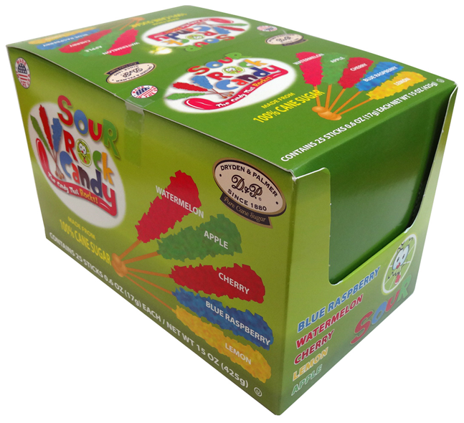
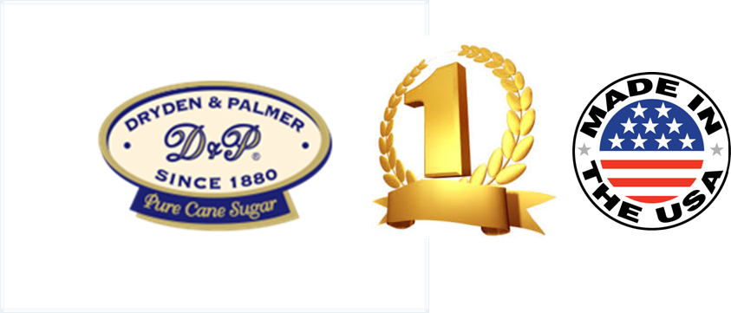
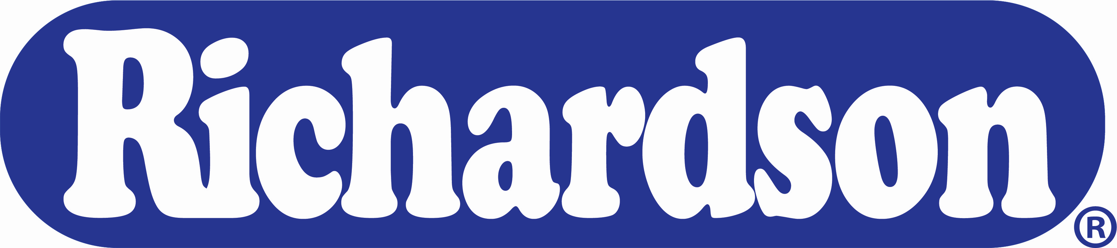
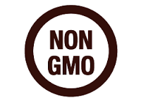

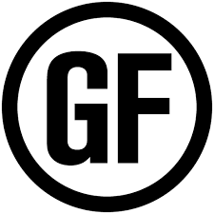

A LEGACY OF CHIRISTMAS CELEBRATIONS!
Why Richardson’s Christmas Candies ?
We are the only company that produce Christmas Rock Candy and Bogdon’s candy sticks:
Rock Candy with Christmas Flavors and Finials
Bogdon’s Holiday’s liquor flavors
So next time when your customers look for fun, colorful and yummy way to celebrate Christmas, you can rest assured that Richardson has you covered!
Why Richardson?
A legacy of American Celebrations’ favorites
Proudly made in USA & NY
Dryden & Palmer are the #1 Rock Candy since 1880!
Our products can be found in all states across America, as well as in most countries worldwide.
Ingredients:
SourBlue Raspberry: Cane Sugar, Citric, Malic & Tartaric Acid, Hydrogenated Vegetable Oil,Artificial Flavor, Blue 1, Yellow 5
SourWatermelon: Cane Sugar,Citric, Malic & Tartaric Acid, Hydrogenated Vegetable Oil,Artificial Flavor, Titanium Dioxide, Yellow 5, Blue 1 SourLemon: Cane Sugar, Citric, Malic & Tartaric Acid, Hydrogenated Vegetable Oil,Yellow 5, Natural Flavor, Xanthan Gum, Citric Acid, Sodium Benzoate SourRedApple: Cane Sugar, Citric, Malic & Tartaric Acid, Hydrogenated Vegetable Oil, Natural & Artificial Flavor, Titanium Dioxide, Yellow 5, Blue 1 SourCherry: Cane Sugar,Citric, Malic & Tartaric Acid,
Product Information:
Case Pack : 6/25ct.
GTIN : 50011167437207
UPC :
SourBlue Raspberry 0 11167437127
SourWatermelon 0 11167437165
SourLemon 0 1116743713 4
SourCherry 0 1116743702 8
SourRed Apple 0 1116743705 9
Dimensions : Case:16.81 x 15.41 x 6.38”Cube : Case:.96Gross
Weight: Case:8.67Pallet
Will be updated
Richardson Brands Co.
101 Erie Boulevard Canajoharie, NY 13317
(800) 839-8938

Slide 2
Boost this Halloween Experience!
Why Richardson’s Christmas Candies ?
We are the only company that produce Christmas Rock Candy and Bogdon’s candy sticks:
Rock Candy with Halloween Flavors and Finials
Bogdon’s Holiday’s liquor flavors
So next time when your customers look for fun, colorful and yummy way to celebrate Halloween, you can rest assured that Richardson has you covered!
Why Richardson?
A legacy of American Celebrations’ favorites
Proudly made in USA & NY
Dryden & Palmer are the #1 Rock Candy since 1880!
Our products can be found in all states across America, as well as in most countries worldwide.
Ingredients:
SourBlue Raspberry: Cane Sugar, Citric, Malic & Tartaric Acid, Hydrogenated Vegetable Oil,Artificial Flavor, Blue 1, Yellow 5
SourWatermelon: Cane Sugar,Citric, Malic & Tartaric Acid, Hydrogenated Vegetable Oil,Artificial Flavor, Titanium Dioxide, Yellow 5, Blue 1 SourLemon: Cane Sugar, Citric, Malic & Tartaric Acid, Hydrogenated Vegetable Oil,Yellow 5, Natural Flavor, Xanthan Gum, Citric Acid, Sodium Benzoate SourRedApple: Cane Sugar, Citric, Malic & Tartaric Acid, Hydrogenated Vegetable Oil, Natural & Artificial Flavor, Titanium Dioxide, Yellow 5, Blue 1 SourCherry: Cane Sugar,Citric, Malic & Tartaric Acid,
Product Information:
Case Pack : 6/25ct.
GTIN : 50011167437207
UPC :
SourBlue Raspberry 0 11167437127
SourWatermelon 0 11167437165
SourLemon 0 1116743713 4
SourCherry 0 1116743702 8
SourRed Apple 0 1116743705 9
Dimensions : Case:16.81 x 15.41 x 6.38”Cube : Case:.96Gross
Weight: Case:8.67Pallet
Will be updated
Richardson Brands Co.
101 Erie Boulevard Canajoharie, NY 13317
(800) 839-8938

