Slide 1
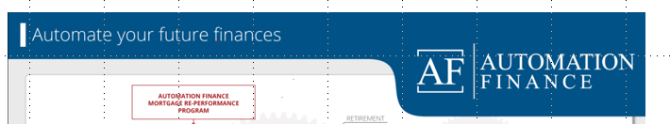
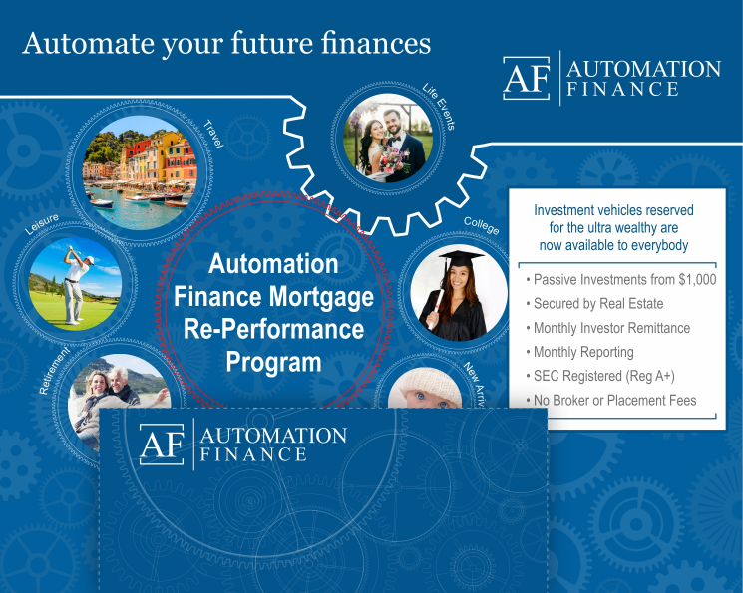


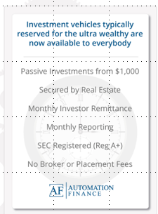
1. Please Use this lockup for the title. Please make the “automate your future finances” 20% bigger
2. Please make each picture 5% bigger (by adding back cropped area) so there is just a small gap between edge of each picture and the line inside e each cog
3. This center cog needs to be a unified image that attracts the eye. It’s the key element that drives everything else. It’s the magic that makes everything else happen. I will upload hi-res image for the center picture with the red cog
4. This doesn’t work at all. There is noting special about this picture or this cog. It should be the same as the others
Mortgage
Re-Performance Program
5. The font is too big and the while background is too stark. We need to look high-class and expensive
5. The cogs teeth should mesh so they fit together

Slide 2
