Slide 1
THRIVE
MCI & ASSOCIATES
PRESENTATION

Slide 2



OUR SERVICE
Independent Financial Practice
INSURANCE
ACC
ESTATE & SUCCESSION PALNNING
ADVICE
We offer advice on all insurance products. Ranging from house & car, to life, health and pet insurance.
We have the ability to provide lending with strategy attached. Getting you in and out of your mortgage as quick as possible.
Ensuring that all the t’s are crossed and i’s dotted is often overlooked. It generally appears and stays on the to do list.
Products and options can be confusing, we pride ourselves in ensuring our clients have all the answers so we are able to help them make educated decisions.
THRIVE

Slide 3
W
OFF
WARRANT OF FINANCIAL FITNESS
+
ACC
+
+
INSURANCE
ESTATE & SUCCESSION
ADVICE
SERVICE OFFER
THRIVE
www.thrive.kiwi

Slide 4
BESPOKE ADVICE
FAMILY SUPPORT STRUCTURES
A vital piece of the puzzle that is often missed when assessing someone’s risk.
PERSONAL ASSET/DEBT LEVELS
85%
Get it right the first time, with an in depth analysis of your financial situation.

CURRENT PRODUCT ANALYSIS
We’ve found that 85% of clients that we meet with, have outdated and incorrect risk structures in place.
FUTURE GOALS
Do you know where you could be? Let us help guide you there.
PERSONAL RISK TOLERENCE
We’re all unique. That’s what makes life great, but that proves why a cookie cutter approach doesn’t work.

Slide 5

BENEFIT | INSURANCE
DISCOUNTS | THAT WORK
25%
5%
EFFICIENTCY PASS BACK
Due to efficiency in our acquisition cost of client, we are often able to pass back savings that we are able to obtain on new policies back to our clients.
THRIVE RATE
CORPORATE RATE
THRIVE

Slide 6

BENEFIT | ESTATE & SUCCESSION PLAN
+
WILLS
Making sure this box is ticked is what we do with all of our clients.
EPA
Often an overlooked document, but absolutely necessary for anyone who owns an income protection policy.
+
DOCUMENTS| THAT WORK
BUY/SELL AGREEMENTS
The most vital piece of the puzzle when protecting a business. Incorrect ownership or levels of cover can have devastating effects.
HOLISTIC APPOACH
+
SUCCESSION PLAN
Often the most difficult task for a business owner to complete, identifying the risk and strengths of a business is part of what we uncover in our process.
+
Benefit
Using a holistic approach when assessing a business risk always leads us to uncover area’s within the business that needs serious attention. Often these situations will provide professionals like yourselves opportunities to generate additional revenue by offering further advice.
THRIVE

Slide 7

BENEFIT | ACC
+
ANALYSE EXISTING
Assessing information direct from ACC to establish the client’s current structure.
IDENTIFY OPPORTUNITIES
Determine area’s of overspending where saving could be made without increasing risk for the client.
+
REDUCE COST
IMPROVE BENFITS
RECOMMEND CHANGES
Present findings to the client and recommend steps to remedy the current situation.
+
IMPLEMENT
Process and discuss recommendations with the client’s accountant, also making changes to any insurance policies that might be required.
+
REDUCED LIABILITY
Liability is reduced for Accountants as the loss of the fatality benefit is often not considered and could have catastrophic impact on the client.
+
ACC Benefit
We are able to assist firms like yourself with an ACC review offer on their clients. ACC might seem straight forward for many, but the reality is that many get it wrong. As we consider the clients complete risk situation, we are able to offer a complete solution for the client.
THRIVE

Slide 8


NO TIME
How about using our online meeting room?
ONLINE ADVICE
Last year we introduced an online meeting room into our business. This meeting room is a safe and secure place for us to meet with our clients. They are able to record our meetings, sign documents and share screens. We can even meet with Mum & Dad if they’re in two different places that day. Works great for families with young kids and people with no time.
70%
Faster
80%
Prefer
100%
Satisfaction
THRIVE

Slide 9

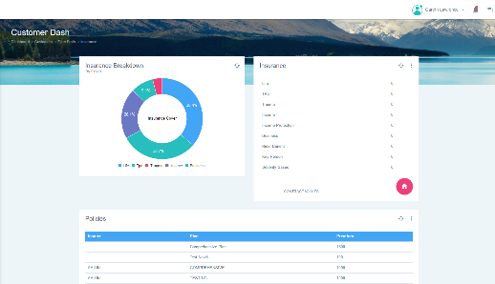
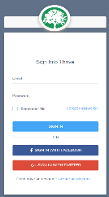
SUPPORT
We believe in partnering, not just transacting.
LIVE CHAT
Talk to an adviser by clicking one button. Access to information and advice instantly.
+
CLAIMS
Submit, manage and track any claims.
+
MONITOR
Monitor the growth of you Assets & Income. Manage your insurance policy and place your wills in your own document vault for safe keeping.
+
CLIENT
PORTAL
ONLINE
Free access to your own personalized client portal.
THRIVE

Slide 10

THRIVE TIME LINE
A short history of who we are.
December 2013
Complete independence as a financial practice. Rebrand to Thrive from traditional ties.

Slide 11


2015
BUSINESS EXPANSION
This was a busy year, we doubled our staff compliment to three…and expanded our business reach to the Hawes Bay
RELOCATION
Thrive relocated to Feilding to better service the wider regions. Also, Feilding was a pretty cool place. We hired our very first staff member, now we were aiming for the big leagues.
2014

Slide 12
2016
EXPLOSION
So I had to put on my big boy pants, because things were getting serious. We took on another 4 team members, moved into our new offices on the square in Feilding, and then decided it was a great idea to expand our business to Christchurch. This move added our 5th team member to the team….for that year!
Jan 2017
BUSINESS & SERVICE
You guessed it! The year started with another addition of a staff member…what can I say, “We love people!” The goal of the year was, and still is, to try and innovate an industry stuck in tradition. Client experience was an area that need serious attention.

Slide 13
TODAY
So here we are today: We continue our quest to change the industry through innovation. We
have been able to make some great improvements to our client experience, through the addition
of our online portal. We are also extremely excited about the opportunity to make you part of our story…

Slide 14


Slide 15
Companies Problems
Staff churn
  Medical benefits are the 3rd most valued benefit increasing retention
Cost of Employee Benefit Schemes
  FBT and Medical Premiums
Machine Down time
  The real cost of your employee being Sick
HR Management of benefits
Commercial in confidence

Slide 16
Employee’s Problems
Cost of Primary Healthcare
  Most of the time we are avoiding the Dr
Managing of cashflow
  Budgeting almost never includes the Dr Bill
Self managed illnesses
  Normaly leads to longer time off work
Commercial in confidence

Slide 17
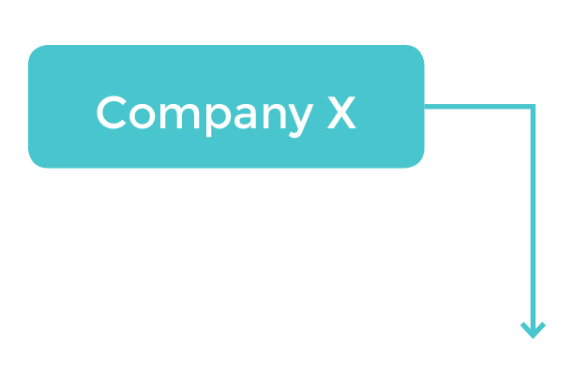
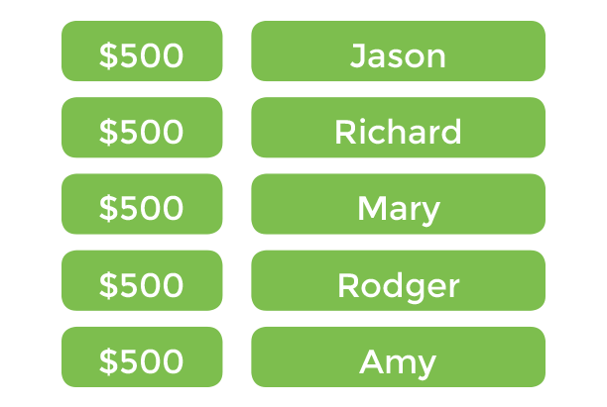
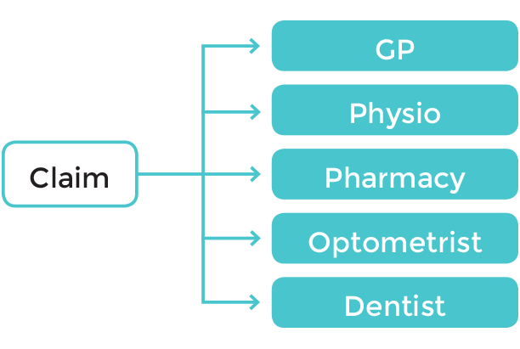

How Medifund Works
$Benefit/employee e.g. $500
Commercial in confidence

Slide 18
Why Medifund?
Cost effective
  Actual cost $5per member per month
Additional layer of communication with your staff
  A discrete way to value health
Empowerment to your staff
  By trusting them with company asset
Ease of use
  Safe and secure using the best of tech and innovation
Commercial in confidence

Slide 19

WE would like to be
in your CORNER…
ADDRESS
8 Manchester Square, Feilding.
PHONE
06 323 4555, 021 120 4884
WEBSITE
www.thrive.kiwi

