Slide 1

Business Reporting Application
Revision to Menus/Criteria Screens
Updated Oct 7
RM Intel
Proprietary and Confidential – Oct 2017

Slide 2
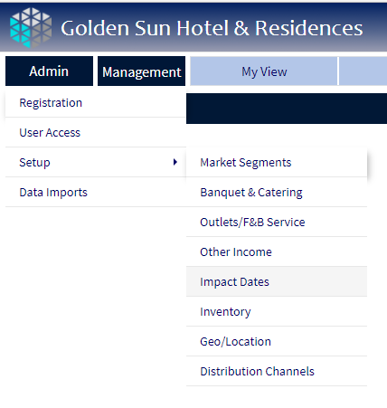
Application Menus: There are 4 main functional tabs (dark blue) with menus.. We have 3 challenges.
Need: Property Search Screen
Need : Report Criteria Screen (or pop up)
Replace current design with format closer to existing menu style
Example Menu format
RM Intel

Slide 3
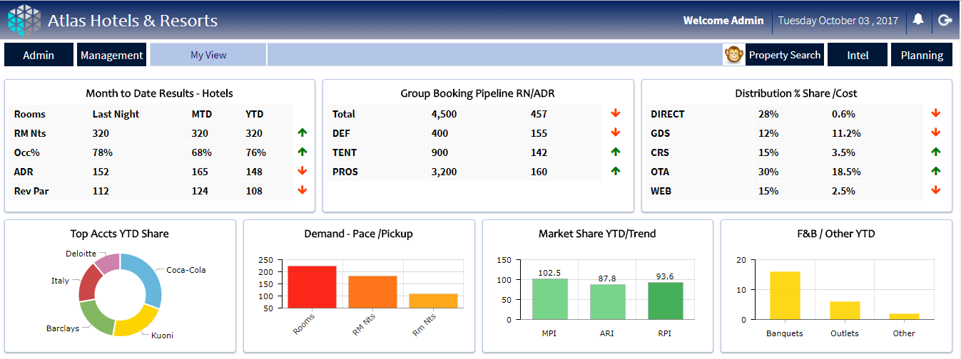
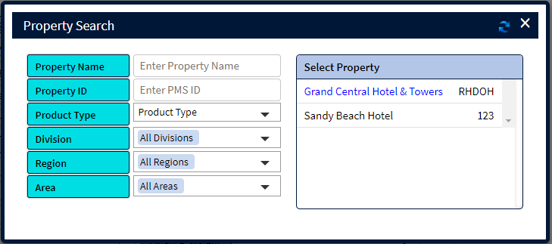
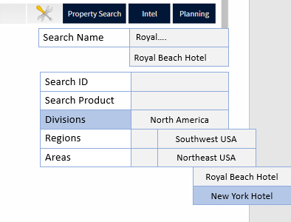
Property Search – currently a pop up – needing redesign – ie drop down menu from tab, sketch as shown
current
desired
RM Intel

Slide 4
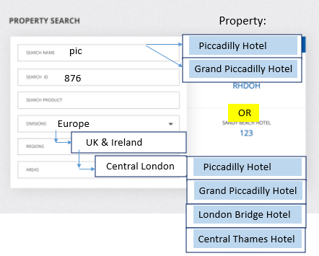
Property Search – requirements notes: must flow from menus and be concise
There are 3 different sections in the property search.
Search Name and ID are input strings which return all properties matching the search – suggest this is on the right side as seen here..
The product is a picklist of fixed items with properties attached to each. The list returned can be very long..
The Geo Section (divisions/Regions/area) is LINKED.. In a hierarchy, so we need some kind of hover over to display the associated next tier. For example.. I may have 5 divisions.. And highlight/select Europe.. This will automatically generate the regions under Europe if I move th mouse to regions.. The list of matching hotels will be automatically populating on the right.. This list can be very long (imagine 50-100 items returned on the search list .. Or more) need to consider this in the design.. Can’t be too small to read however..

Slide 5
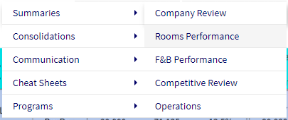
Management Tab Menus – Three level menu structure.. Need assistance with UI presentation here.. Menu level 1-2 as is, Level 3 is represented in the tabs on the first row..
Once a specific report is selected, the second tab row drops down, allowing specific report parameters to be set. Need help with UI on this..
In this example: user selects from the ‘Management’ main tab:
‘Consolidations’ .. Then ‘Rooms Performance’.
This opens the view to a selection of reports – named on horizontal tabs.. Linked to ‘rooms performance’
User then selects one of the 4 available reports and gets a second row of tabs with functions/criteria related to the specific report selected.. In this case: ‘Revenue Summary’
What would be the best way to present UI for this?
RM Intel

Slide 6
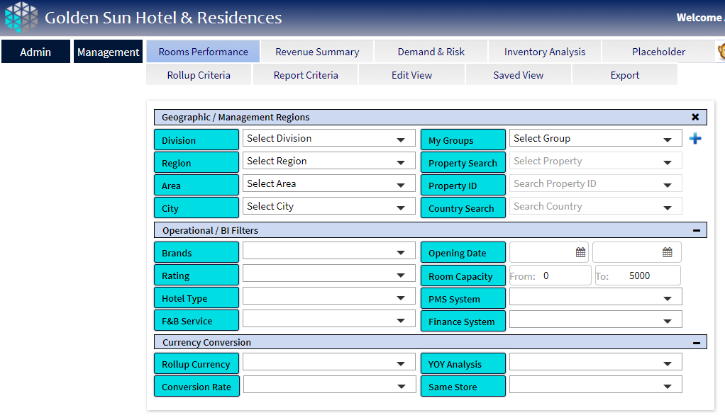
Rollup Criteria – rewrite on this view.. How can we redesign a report criteria screen to be more concise, modern looking, and not take up the whole page? Right now it is heavy and cumbersome..partly due to the heavy colours which should be lightened to the blue shading of the menus.. Note: all the functionality needed is present.. As the criteria screen impacts all the reports it does not need to be on the second row of every report.. Can it be placed in one location or as an icon?
‘lighten up’ redesign UI on criteria options…
RM Intel

Slide 7
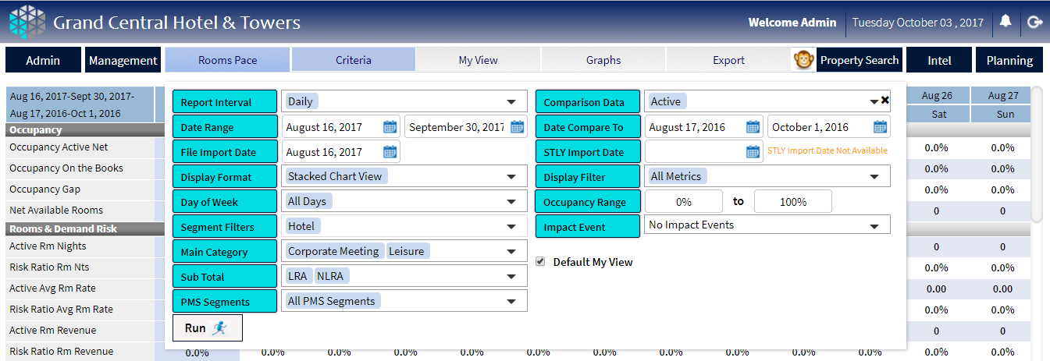
9. Accessing Reports and Criteria.. When a report is selected the top tab bar shows the name of the report, and associated functionality. The criteria screen shows upon clicking the tab but needs redesign.. It looks confusing to sit on top of the report (darken report background?) should slide show /hide, functionality is fixed but UI can be improved
RM Intel

