Slide 1
SpotCoin Logo Requirements
27 September 2017

Slide 2
Required Reading
spotcoin overview 2017 - loc.pdf - This document was created by Andrew and will explain the overall technical snapshot of SpotCoin to better assist your knowledge base for branding ideas.
pdf_spotcoin_2017_final.pdf - This document is essentially the same exact thing as spotcoin overview 2017 - loc.pdf but was tailored for future investors. Note: It was not finished nor is it entirely accurate from a specifics standpoint but I do like how it flows. Ideally I would like to re-create this document in a more concise manner as a handout to future partners, interested partners, investors, etc.
Technical Overview - Spring 2017.pdf - This is a more in-depth snapshot of our processes. This is just for your situational awareness and could help paint a clearer picture.

Slide 3
Definitions & Info
The blockchain is a decentralised electronic ledger with duplicate copies on thousands of computers around the world. It cannot be altered retrospectively, allowing asset ownership and transfer to be recorded without external verification. (Reference: http://www.wired.co.uk/article/unlock-the-blockchain)
IoT as "a global infrastructure for the information society, enabling advanced services by interconnecting (physical and virtual) things based on existing and evolving interoperable information and communication technologies"[3] and for these purposes a "thing" is "an object of the physical world (physical things) or the information world (virtual things), which is capable of being identified and integrated into communication networks (https://en.wikipedia.org/wiki/Internet_of_things)
What is a 'Spot Market’ - The spot is a market for financial instruments such as commodities and securities which are traded immediately or on the spot. In spot markets, spot trades are made with spot prices. Unlike the futures market, orders made in the spot market are settled instantly. Spot markets can be organized markets or exchanges or over-the-counter (OTC) markets.
Ripple is a real-time gross settlement system (RTGS), currency exchange and remittance network by Ripple. Also called the Ripple TransactionProtocol (RTXP) or Ripple protocol, it is built upon a distributed open source Internet protocol, consensus ledger and native currency called XRP (ripples). - https://en.wikipedia.org/wiki/ISC_license – Ripple Uses ISC License
https://en.wikipedia.org/wiki/Dash_(cryptocurrency)
https://en.wikipedia.org/wiki/Nxt
https://en.wikipedia.org/wiki/Blockchain

Slide 4
Identified Competition
Although SpotCoin doesn’t have any direct nitche competition due to our very focused mission, the following pages can help you better understand the marketplace.
https://www.etoro.com/
https://nxt.org/
http://bitfury.com/
https://goldenfleece.co/
https://www.encrypgen.com/
https://polybius.io/
https://www.blockchain.com/
https://www.kraken.com
https://cex.io/

Slide 5
Logo
The current logo does not paint a clear picture of SpotCoin’s core. I believe it focuses too much on the BitCoin Logo and isnt a clean representation of the company. We want to focus on:
Security
Transparency
Value-add
Proven Leadership
Integrity
Expedited Transactions

Slide 6
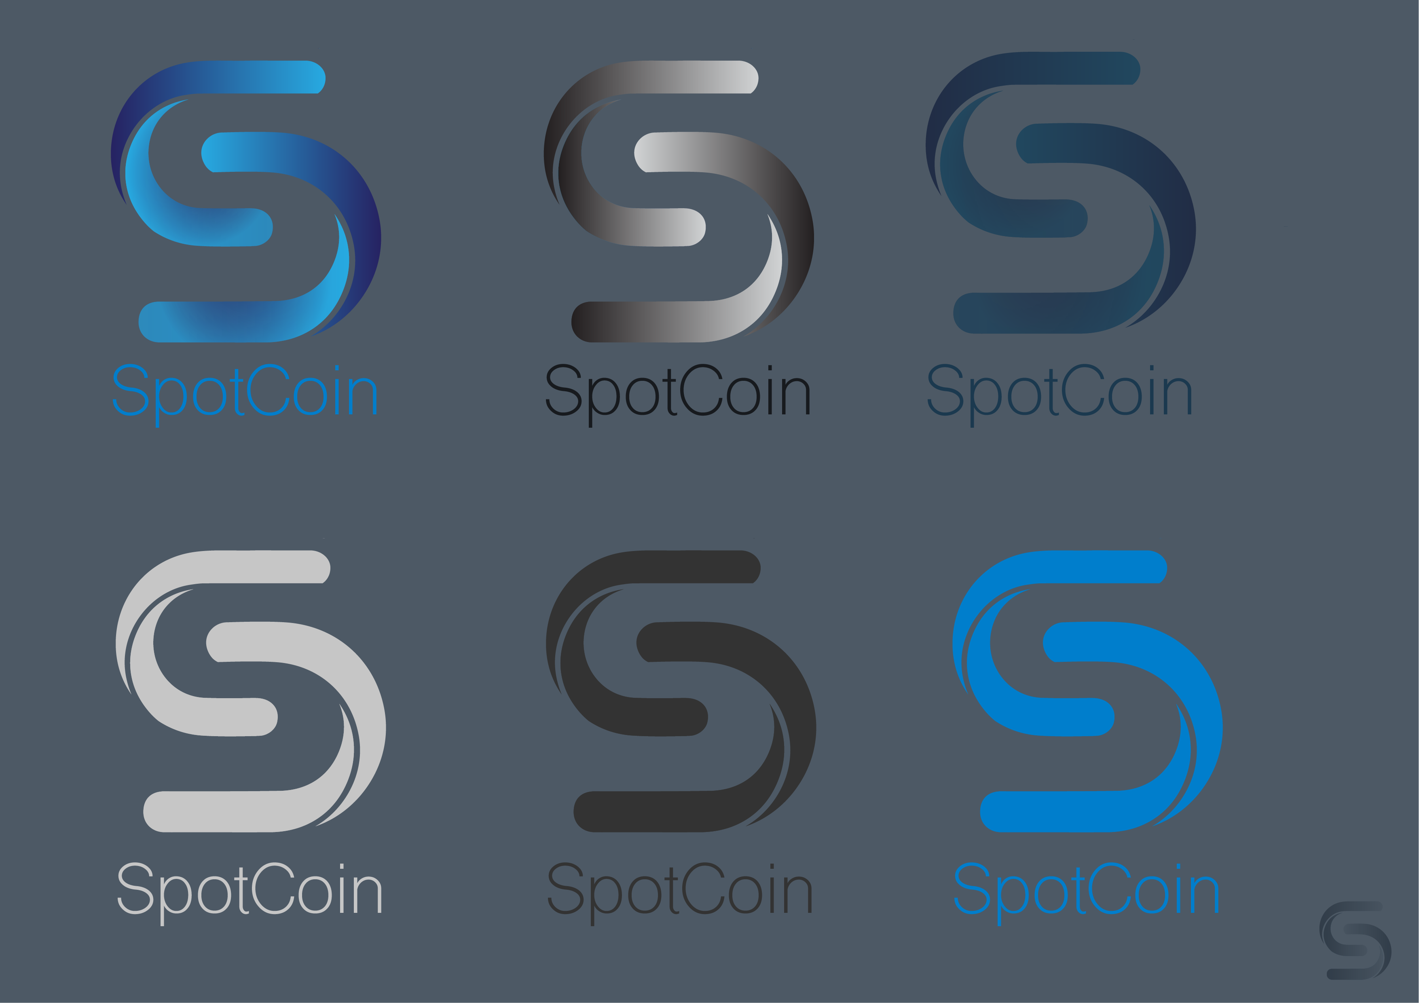
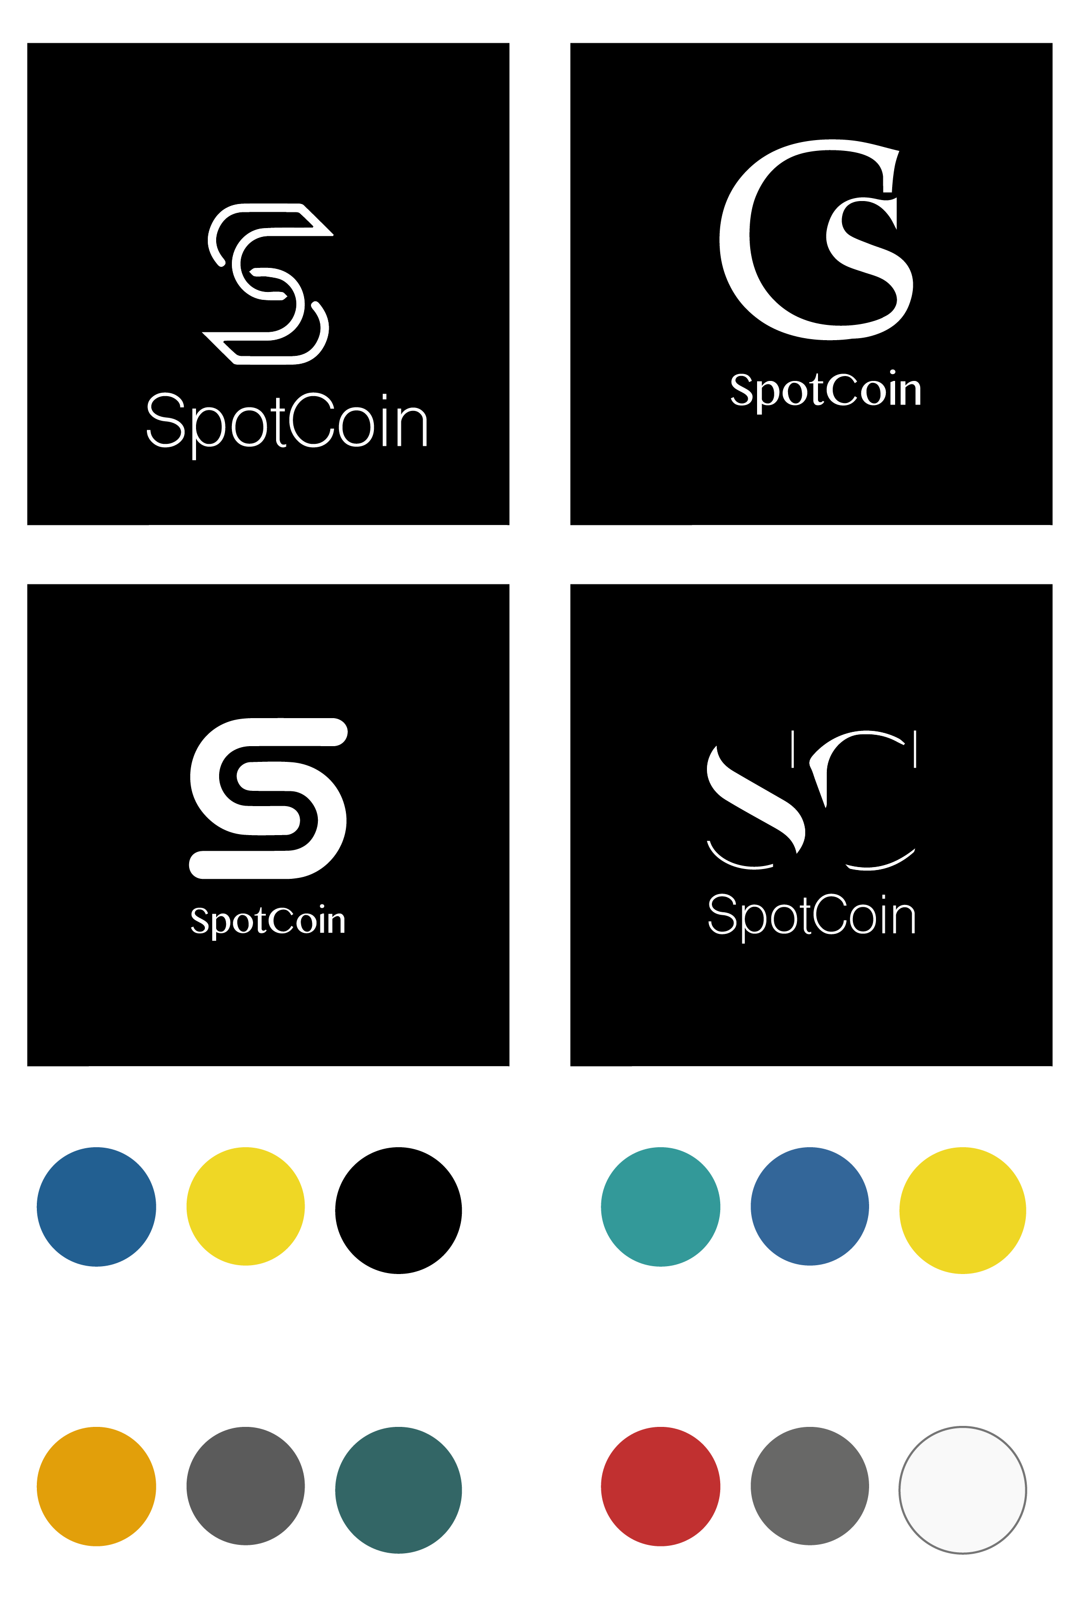

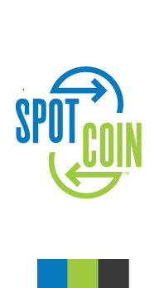
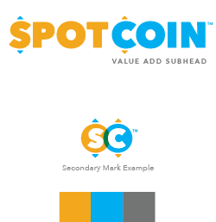
Previous Examples

