Slide 1

Insights: Always On Influencer Marketing

Slide 2
The most credible form of advertising comes straight from the people we know and trust.
Nielsen’s ‘Global Trust in Advertising Report’ interviewed respondents in 60 countries.
83% said they trusted the recommendations of friends and family.
Notes:
This is useful - as our journey leading to our current USP and offering is key as we have based this on what we know clients and brands want

Slide 3
What we mean by ‘friends’ now includes social influencers we have never met.
Purchase decisions are being influenced, everyday, by the creators we follow on social media.
The content they create that features brands and products is earned media.
And it is THE most valuable asset in the digital marketing mix!
SO, HOW CAN YOU GENERATE MORE EARNED MEDIA?
THAT’S WHERE INSTRUMENTAL’S
INSIGHTS COME IN
Notes:
This is useful - as our journey leading to our current USP and offering is key as we have based this on what we know clients and brands want

Slide 4
Influencers and consumers are connected in a constant content cycle.
Influencer builds global audience through relatability & shared passions
These consumers then follow the influencer to see future authentic content and trusted recommendations
Influencer creates content featuring products the audience is interested in.
Consumers engage with content, discover and share with friends and family.

Slide 5
The challenge for brands is how to get involved in the cycle.
Which means finding a way to influence the influencers.
Influencer builds global audience through relatability & shared passions
Brands need to reach out to influencers at exactly the right time to maximise the chances of them creating content featuring your product.
Consumers follow influencer to see future authentic content and trusted recommendations
Influencer creates content featuring products (earned media)
Consumers engage with content, discover and share with friends and family

Slide 6
It’s all about timing!
With over 7 million active influencers, knowing who to contact & when is critical?
Notes:
This is useful - as our journey leading to our current USP and offering is key as we have based this on what we know clients and brands want

Slide 7
You NEED to know:
When an influencer has mentioned your brand
When they have mentioned a similar product
When they have mentioned a direct competitor
AS SOON AS IT HAPPENS!!
WHICH IS IMPOSSIBLE TO DO MANUALLY.
WHICH IS A PROBLEM!
Notes:
This is useful - as our journey leading to our current USP and offering is key as we have based this on what we know clients and brands want

Slide 8
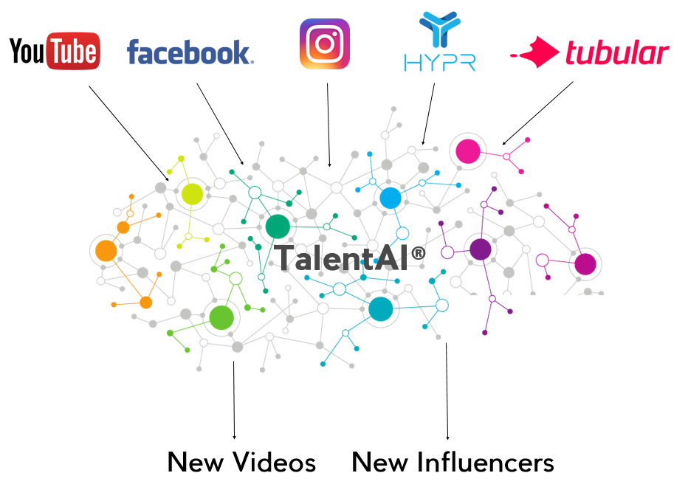

INSIGHTS, POWERED BY TALENTAI, SOLVES THAT PROBLEM
DATA: We capture API data from YouTube, Instagram & Facebook to discover every new piece of influential content uploaded every day and audience data from Hypr and Tubular to profile the creators and their audience.
INSIGHTS: Our TalentAI tool then processes that information to match the content to your brand, product or category to find the talent and content that is engaging your customers TODAY.
ACTIONS: A single, weekly report then powers your in-house teams with the priority talent to contact with offers, product or partnership opportunities.
RESULTS: Clients are converting an average of 30% of the leads generated by Insights into earned media which drives sales on going.
Notes:
This makes more sense now - is more focussed and most importantly the connect paragraph sums up the benefit of the offering for the client
I think one of the biggest questions from clients was always around not feeling overwhelmed by all the data and understanding what they could do with it
The offering feels like it works for both brands and agencies

Slide 9
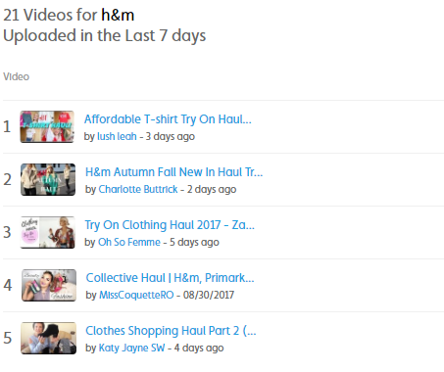
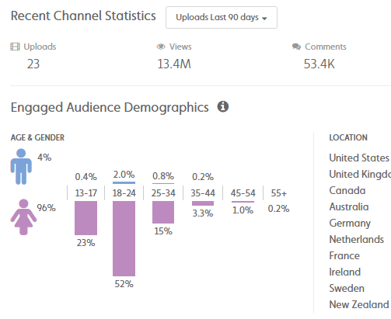
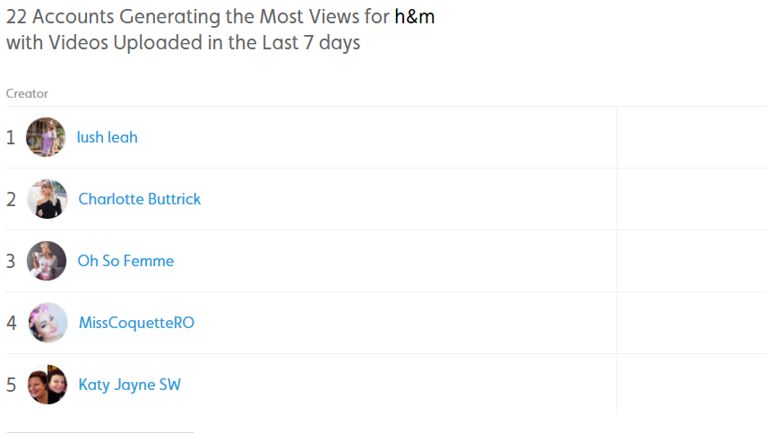
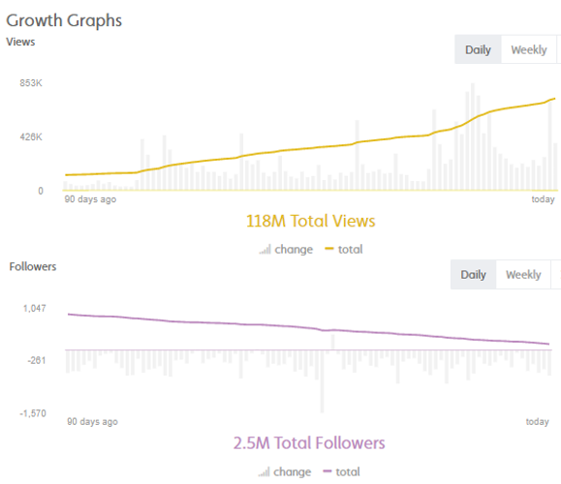
Members get a weekly report, with everything you need to win more earned media with influencers.

Slide 10
Insights that ensure your content cycle overlaps with the influencers to drive earned media and sales.
Influencer builds global audience through relatability & shared passions
TalentAI captures new videos created in sector
Brand gains real time insights into influencers active NOW engaging consumers
Consumers find and follow influencer to see future authentic content and trusted recommendations
INFLUENCER
CONTENT CYCLE
Influencer creates content featuring products (earned media)
BRAND CONTENT CYCLE
Consumer engages with content, discovers and shares with friends and family
Brand connects with influencer to share new products or services

Slide 11
Everythings5pounds.com
Case study

Slide 12
Joining Process
1
2
3
4
Select keyword/s or overall sector you would like to receive reports on.
Add target audience demographics information to finesse search.
Select minimum influencer reach if applicable.
Generate first report and tweak until happy. Then receive weekly and start connecting!

Slide 13
Insights membership from only £250 per week
Base Plan
£400 per week
3 month initial term
1 months notice
Includes:
Weekly content tracker
Weekly influencer tracker
Premium Plan
£250 per week
12 month term
1 months notice
Includes:
Weekly content tracker
Weekly influencer tracker
Monthly overview (including earned media value)
Rising stars tracker
Influencer network tracking
Discounts on additional services
Notes:
Relist what comes as a summary for option 1 and option 2
name the options something

Slide 14
Members benefit from discounts on additional influencer marketing services
Talent Deep Dives: Get detail audience data on influencers you are interested in paid or long term partnerships with.
Influencer Tracking: Build a bespoke database of the influencers you want to track on an ongoing basis to have daily data on the size and shape of their audience and engagement.
Outreach Program: Outsource the process of connecting with the influencers at scale to our experienced team. We’ve managed campaigns contacting thousands every month!
Full Campaign Management: Launching a new product, service, or just want to drive sales. Our team has over 30 years of experience delivering industry leading paid content campaigns around the globe!

Slide 15





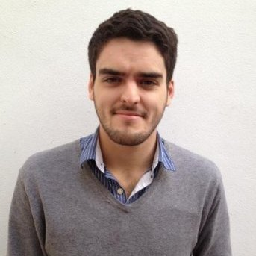







“Instrumental nailed the process for us perfectly - discovering amazing comedy influencers that were so good they could have been in the show.’'
ALEXANDRA BONDI, VIACOM
‘’Instrumental helped us find influencers who were completely off our radar and deliver incredible returns on our budget. The first content partnership hit 3x our monthly view target in just 2 weeks.”.
WILL SWEET, USER ACQUISITION LEAD AT CODE KINGDOMS
“The organization, process and communication in particular has been great…I’m happy to say you guys have managed us brilliantly!”
LEO BIRCH, STRATEGIST AT BBC WORLDWIDE

Slide 16
Warner Music and venture builders Blenheim Chalcot invest in Instrumental following successful tech demo
Instrumental: Leaders In Finding Online Talent
Tech discovers Calum Scott’s Dancing On My Own cover which goes on to become the biggest selling single by a UK artist in 2016
Warner Music Entertainment President, Conrad Withey, founds Instrumental
Instrumental extends tech capability through data partnerships & launches brand solution for influencer discovery
Pepsi launch their first 100% influencer led campaign, exclusively with Instrumental leading the talent selection and management
The Times features Instrumental & TalentAI re how it is changing the face of talent discovery in book publishing
Instrumental
2015
2016
2017
Instrumental begins to develop machine learning capabilities and TalentAI platform launches with Live Nation and Pan MacMillan signing up
Warner’s major labels around the world begin working with Instrumental to find the next music stars
Instrumental celebrates first #1 best seller in book charts with Saffron Barker
Instrumental’s brand division delivers campaigns across the globe for brands including: British Airways, BBC, Vodafone, Jack Wills, Channel 5, P&G and Wella
Instrumental develops tech to discover music talent by tracking API data from YouTube
Instrumental Insights and Outreach products launched off TalentAI capabilities

