Slide 1

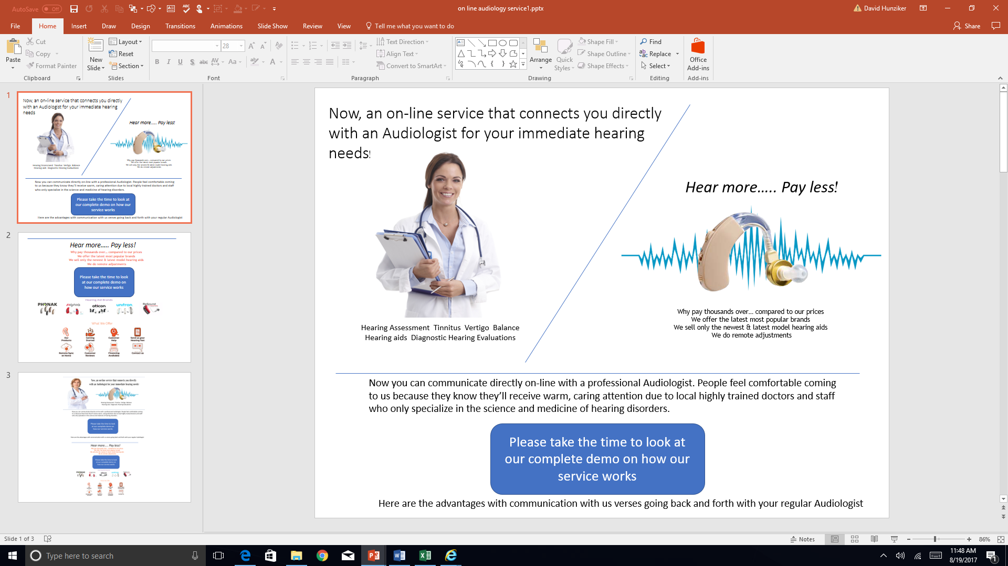
STRATEGY NEW HEARING WEB SITE
SEPTEMBER 11TH
UNDERSTANDING
CHALLENGES
METHODOLOGY
MARKETING & BRANDING
CONCEPT
SCREEN IMAGES

Slide 2
UNDERSTANDING
Dr. Jennifer Elfert and her husband Jeffery want move into marketing two new (hearing) territories.
Both services on-line
  Discounted hearing aids
  Audiologist packages
Separate from their present retail operations
Trading outside of the State of New Jersey

Slide 3
CHALLENGES
Discounted hearing aid
  Competitive pricing
  Needs instructional messaging
Audiologist packages
  A new concept
  Untested

Slide 4
WEB SITE METHDOLOGY
Focus on “showing people how the process works”.
Walk them through every step and make it clear that a hearing test is needed.
In both concepts create short videos for “How it Works” and “Online Audiologist” pages.
Build messaging around differentiators:
Professional medical service
Low-cost hearing aids with high-touch support
Audiologist appointments online (video chat)
Use the About Us page not as a standard company write-up, but more as a means of conveying your mission and purpose.
Don’t try to cram too much information onto the website. That’s something BUYHEAR does and it really destroys the sales funnel. Instead, use a blog to continually educate people.

Slide 5
Marketing and branding
Most importantly, start with branding, and realize that creating the website is only the beginning. Ongoing digital marketing is an absolute must in ecommerce
Search engine optimization/google ad words are key
As important are:
Facebook
Secondary Facebook advertising
Blogs on web site
Testimonials

Slide 6

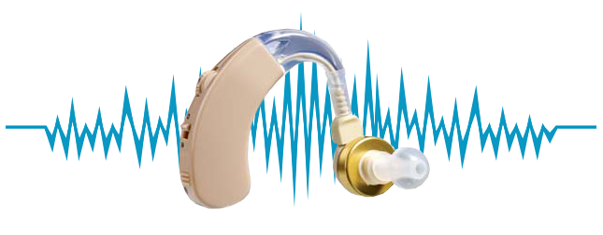
Now, an on-line service that connects you directly
with an Audiologist for your immediate hearing needs!
Hear more….. Pay less!
Why pay thousands over… compared to our prices
We offer the latest most popular brands
We sell only the newest & latest model hearing aids
We do remote adjustments
Hearing Assessment Tinnitus Vertigo Balance
Hearing aids Diagnostic Hearing Evaluations
Now you can communicate directly on-line with a professional Audiologist. People feel comfortable coming to us because they know they’ll receive warm, caring attention due to local highly trained doctors and staff who only specialize in the science and medicine of hearing disorders.
Please take the time to look at our complete demo on how our service works
Here are the advantages with communication with us verses going back and forth with your regular Audiologist

Slide 7
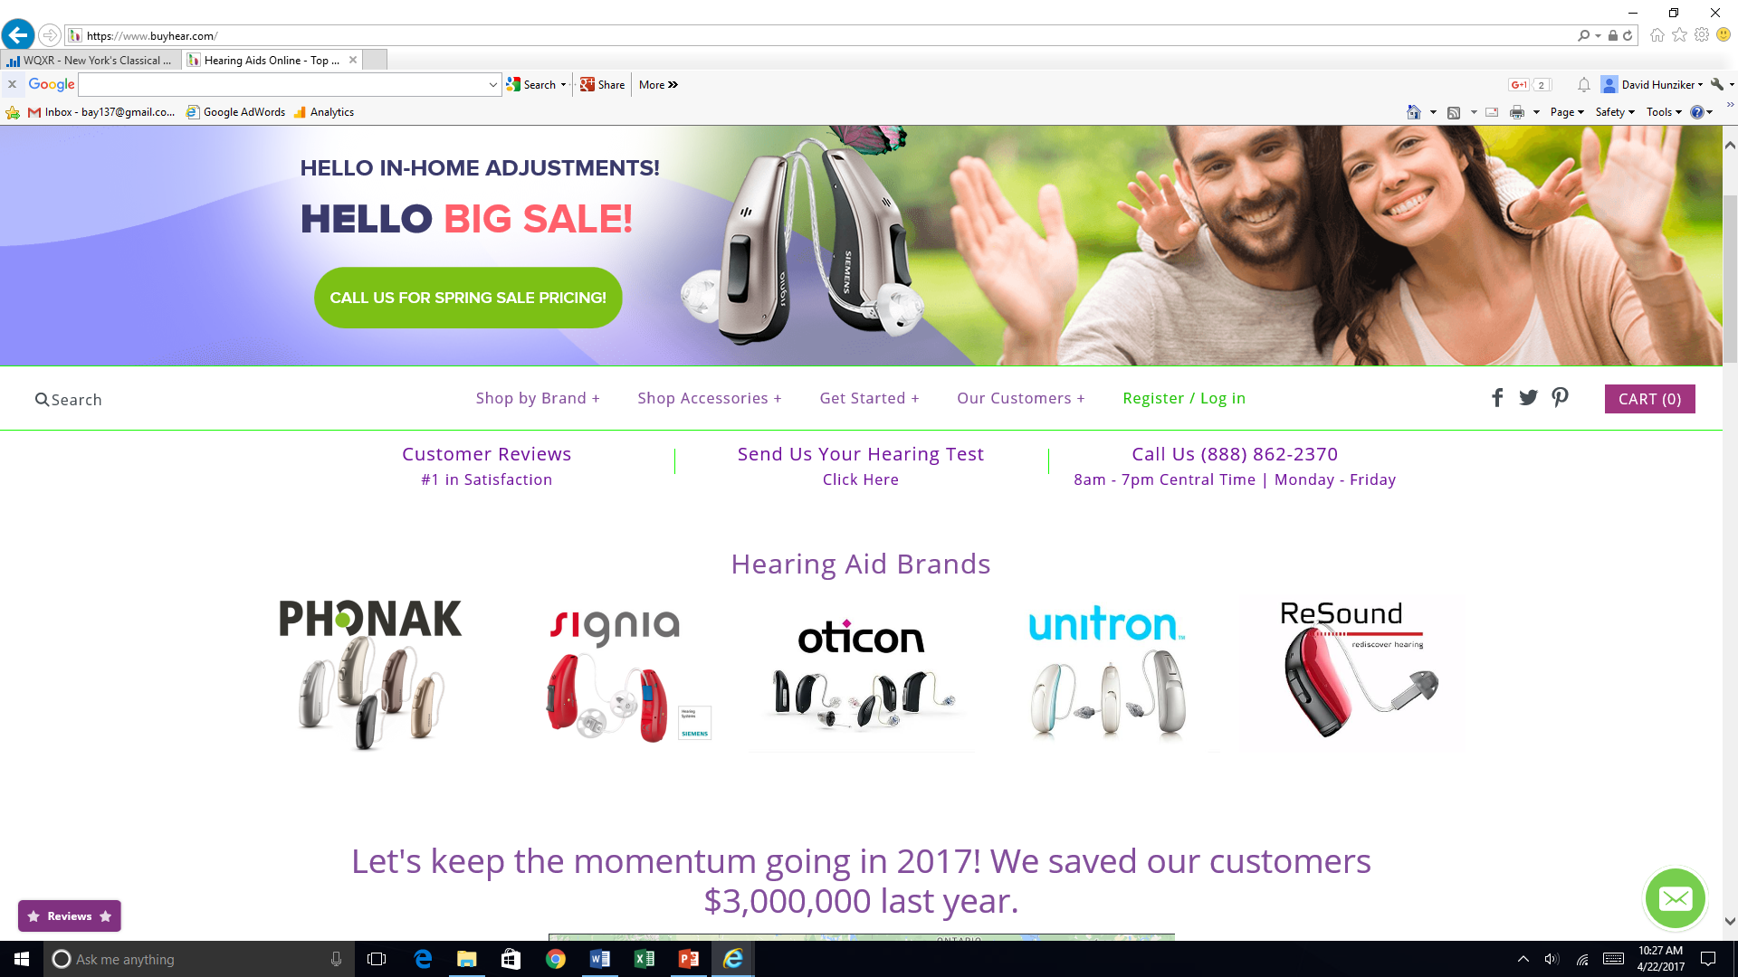
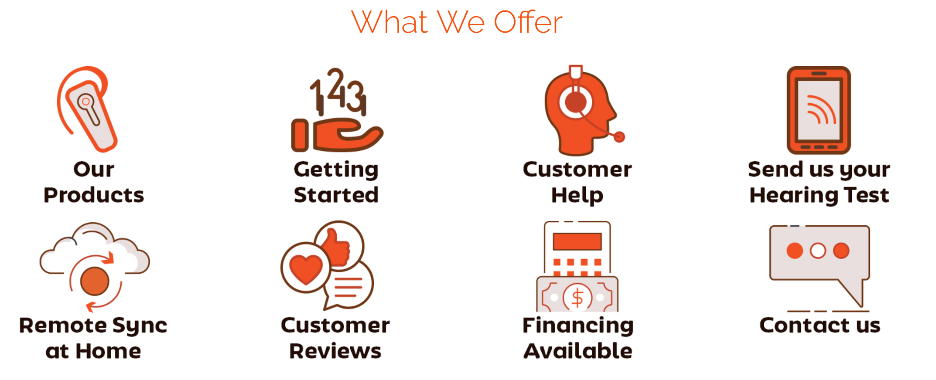
Hear more….. Pay less!
Why pay thousands over… compared to our prices
We offer the latest most popular brands
We sell only the newest & latest model hearing aids
We do remote adjustments
Please take the time to look at our complete demo on how our service works

Slide 8
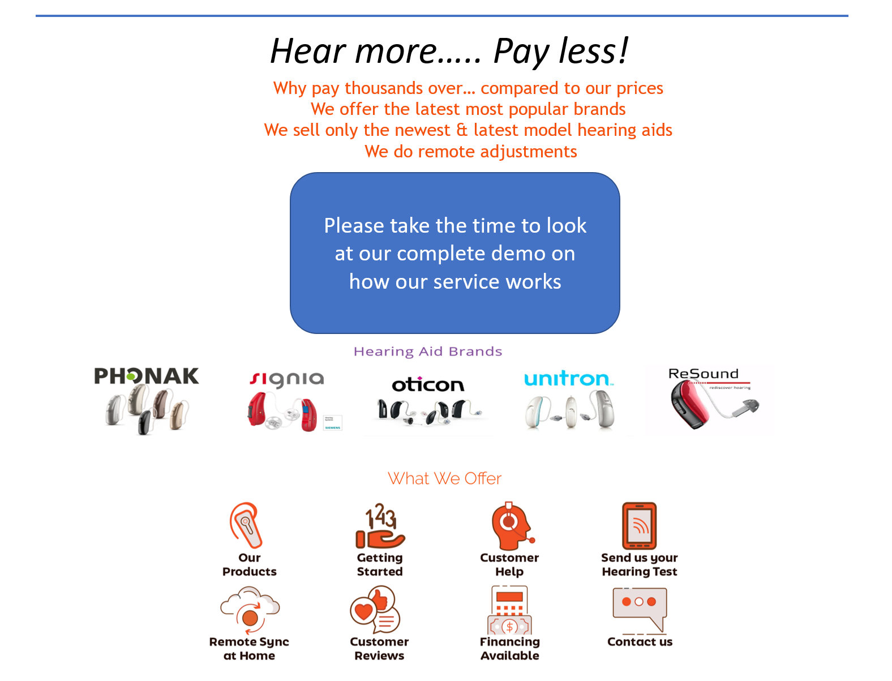
Don’t try to cram too much information onto the website. That’s something BUYHEAR does and it really destroys the sales funnel. Instead, use a blog to continually educate people
A New on - line Service Web site dealing directly with
the Audiologist and her team. It could be sold in packages
by the month. This web site would also sell discount hearing aids .
A Direct response web site selling discount hearing aids on line. The prospect has to get an ear exam and then transfer the information to our client, or the client talks to prospect by phone for instructions. See link on demo, how to explain to prospect on the web site

Slide 9
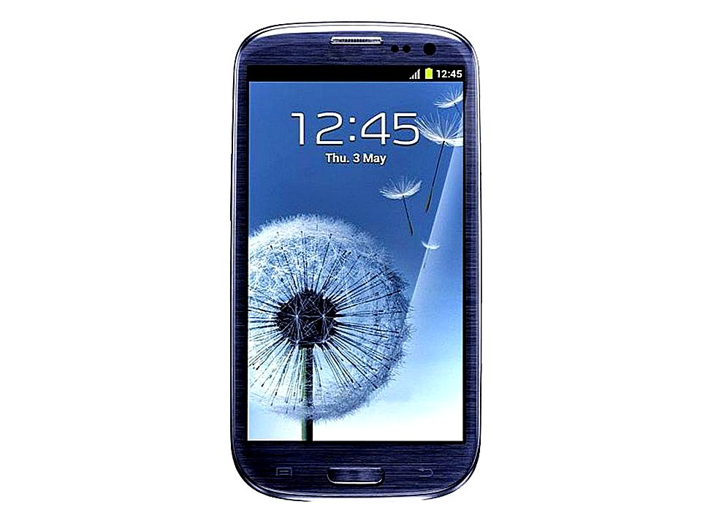
NEW FULL SCREEN IMAGE
RESIZE FOR CELL PHONE
3

