Slide 1
Southern Behavioral Healthcare Website

Slide 2
Logo SBHC Home Page Hours or Appt times, Phone #, Patient Portal
Home About Us Services* Conditions We Treat* New Patients Contact Us
Vision & Mission*
Our Providers
Health Insurance Plans
Office Policies
Prescription Refills
Online Payment?
HIPPA
FAQ
Hours of Operation
-Closed on major Holidays and weekends
After Hours #s, Emergency
Locations, Directions
What to Bring
Forms
*see following slides

Slide 3
Vision & Mission
Vision
Mission
To be the leading provider of outpatient psychiatric care in Atlanta Metro South, working together to promote (the) mental wellness of our community.
To provide mental health services to children, adults, and the developmentally disabled population that is culturally sensitive regardless of age, race, gender, orientation, religion, or creed;
To work hand in hand with clients to overcome mental health challenges and improve their quality of life;
To partner with families and caregivers in achieving desired treatment goals for the client;
To provide compassionate care within an environment that fosters healing and recovery;
To bring hope and strengthen faith.
We aim to offer service that patients recommend to family and friends, that other providers prefer, and is relevant in the community we serve.

Slide 4
Services (Current)
Diagnostic evaluation and treatment
Psychopharmacology
Bariatric pre-surgical consultation (and other surgeries)
Disability and work-related reports (Include?)
Early childhood Assessments
Substance abuse assessments
Developmental disabilities

Slide 5
Services (Prospective)
Telepsychiatry
Group Therapy (Anger, Pregnancy*, Autism, Grief*, Obesity*)
Family Therapy
“Back-up psychiatry” for out of towners, confidential off record
Parenting class
Medication clinics
TMS
* coming soon!

Slide 6
Conditions We Treat
Mood Disorders: Depression, Bipolar, Seasonal Affective Disorder, Cyclothymic Disorder, Premenstrual Dysphoric Disorder, Disruptive Mood Dysregulation Disorder
Anxiety Disorders: Generalized Anxiety, Panic, PTSD, OCD
Common Disorders of Childhood: ADHD, Oppositional Defiant Disorder
Sleep Issues
Psychotic Disorders: Schizophrenia, Brief Psychotic Episodes
And More: Addiction, Eating Disorders

Slide 7
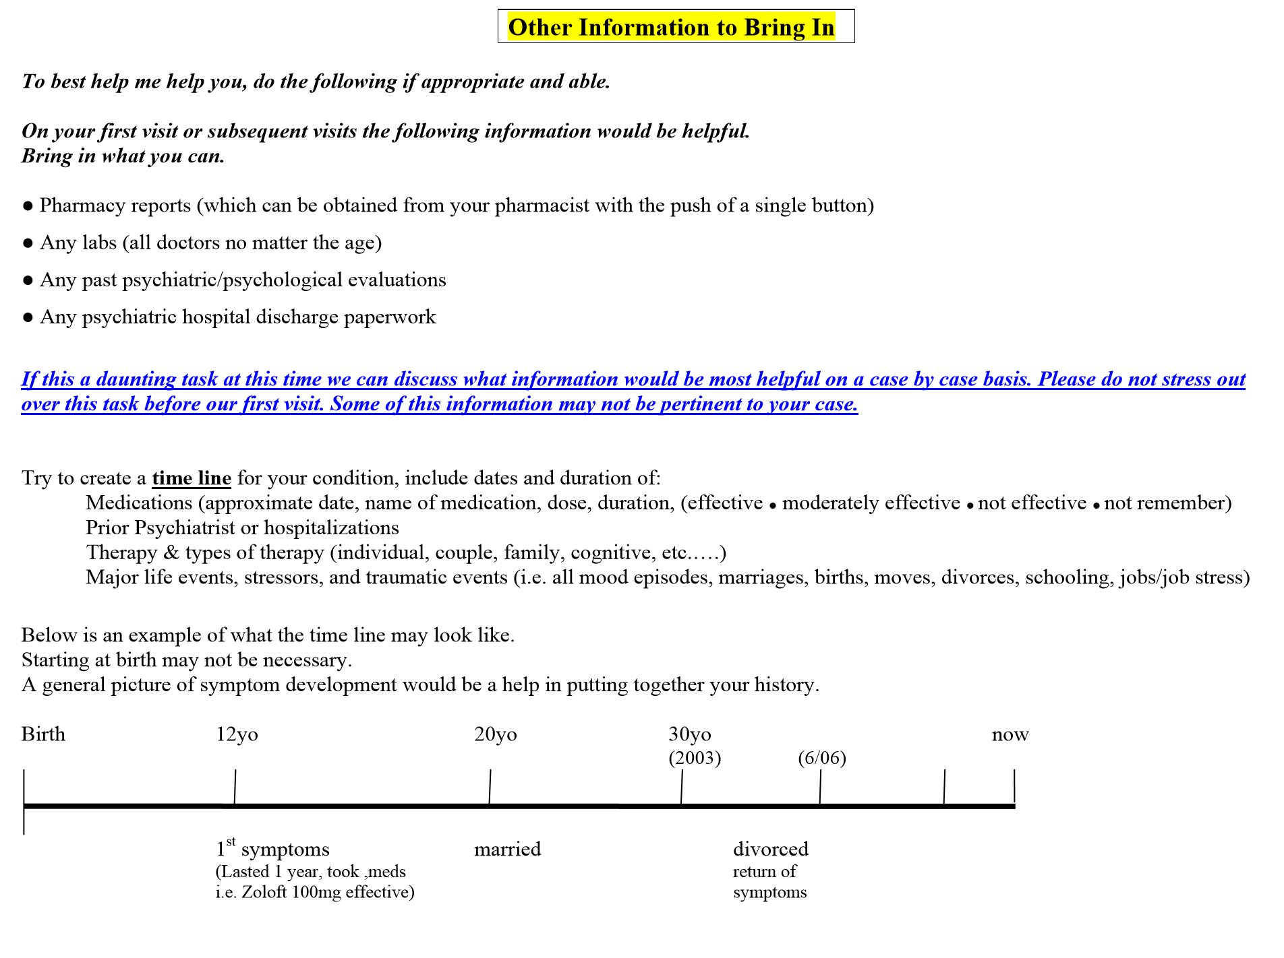
New Patient Forms
New patient packet for download which includes:
  Consent to release information
  Privacy policy
  Treatment agreement
  Self report
  HIPPA
  Other information to bring to 1st or any appt. http://www.josephbergermd.com/start.html
  Rights and Responsibilities (Grady)
  Anonymous screenings, not a form
Notes:
The other information to bring in should not be copied as this is a screenshot and should be revised.

Slide 8
Extra Information:
Logo
Appointment times (ie from 8-5)
Cancellation policy
Telephone call policy
Local area hospitals or services
Refill policy
Payment policy, acceptable forms of payment
Accepted insurances
Bio, philosophy
Links to social media ie Linked In?
Medical disclaimer and liability statements
FAQ
Event calendar
News and community links

Slide 9
FAQs- borrowed from Young Minds Psychiatry website as an example
OFFICE VISIT:
Q. What do I need to bring with me to my first visit?
A- Insurance card, patient forms found on our Form's page.
Q- How long do I have to wait to be seen?
A- We try to have very little wait time for your convenience.
Q- What typs of insurance do you accept?
A- We accept a large variety of insurance plans. Please click here to view our accepted insurance list.
SIGNS THAT YOU MAY NEED TO SCHEDULE A VISIT.
Q- Why is my child not doing well in school?
A- Your child may need some testing.
Q- I feel sad, tired and I do not have energy. Is that normal?
A- No, If you have these feeling for a long period of time, you may be suffering from depression or other mood disorders.
Q- I am have trouble with my child. Do you do therapy for children?
A- Yes, our psychiatrist is specialized in child, and adolescent psychiatry.
Q- My teen got distant all of a sudden. Do I need to schedule a doctor's appointment for her/him?
A- YES, your child’s sudden changes are red flags that he/ she maybe going through some difficulties.
Q- I get very worried for no apparent reason. Is there something that I can do?
A- This may be a sign of anxiety, you may need therapy and medication to treat it.
Q- How do you know if you need to see a psychiatrist, therapist, counselor or psychotherapist?
A- If you're interested or curious, just go. People go to therapy for a host of reasons -- anything from getting support, to getting help for major mental illness, to working through a particular issue(s), to just getting an outsider's perspective on the issue(s), to thinking about questions of meaning, etc.
The information on this website is for information but not intended to be a diagnoses or a treatment.Proper diagnoses and treatment require entering into a psychiatrist-patient relationship and the specialized care that would follow.
Notes:
Screen shot from a website and should be revised before use.

Slide 10
Optional Subscription for Online Screenings to be on the Website
www.mentalhealthscreening.org
Notes:
No need to include yet.

Slide 11
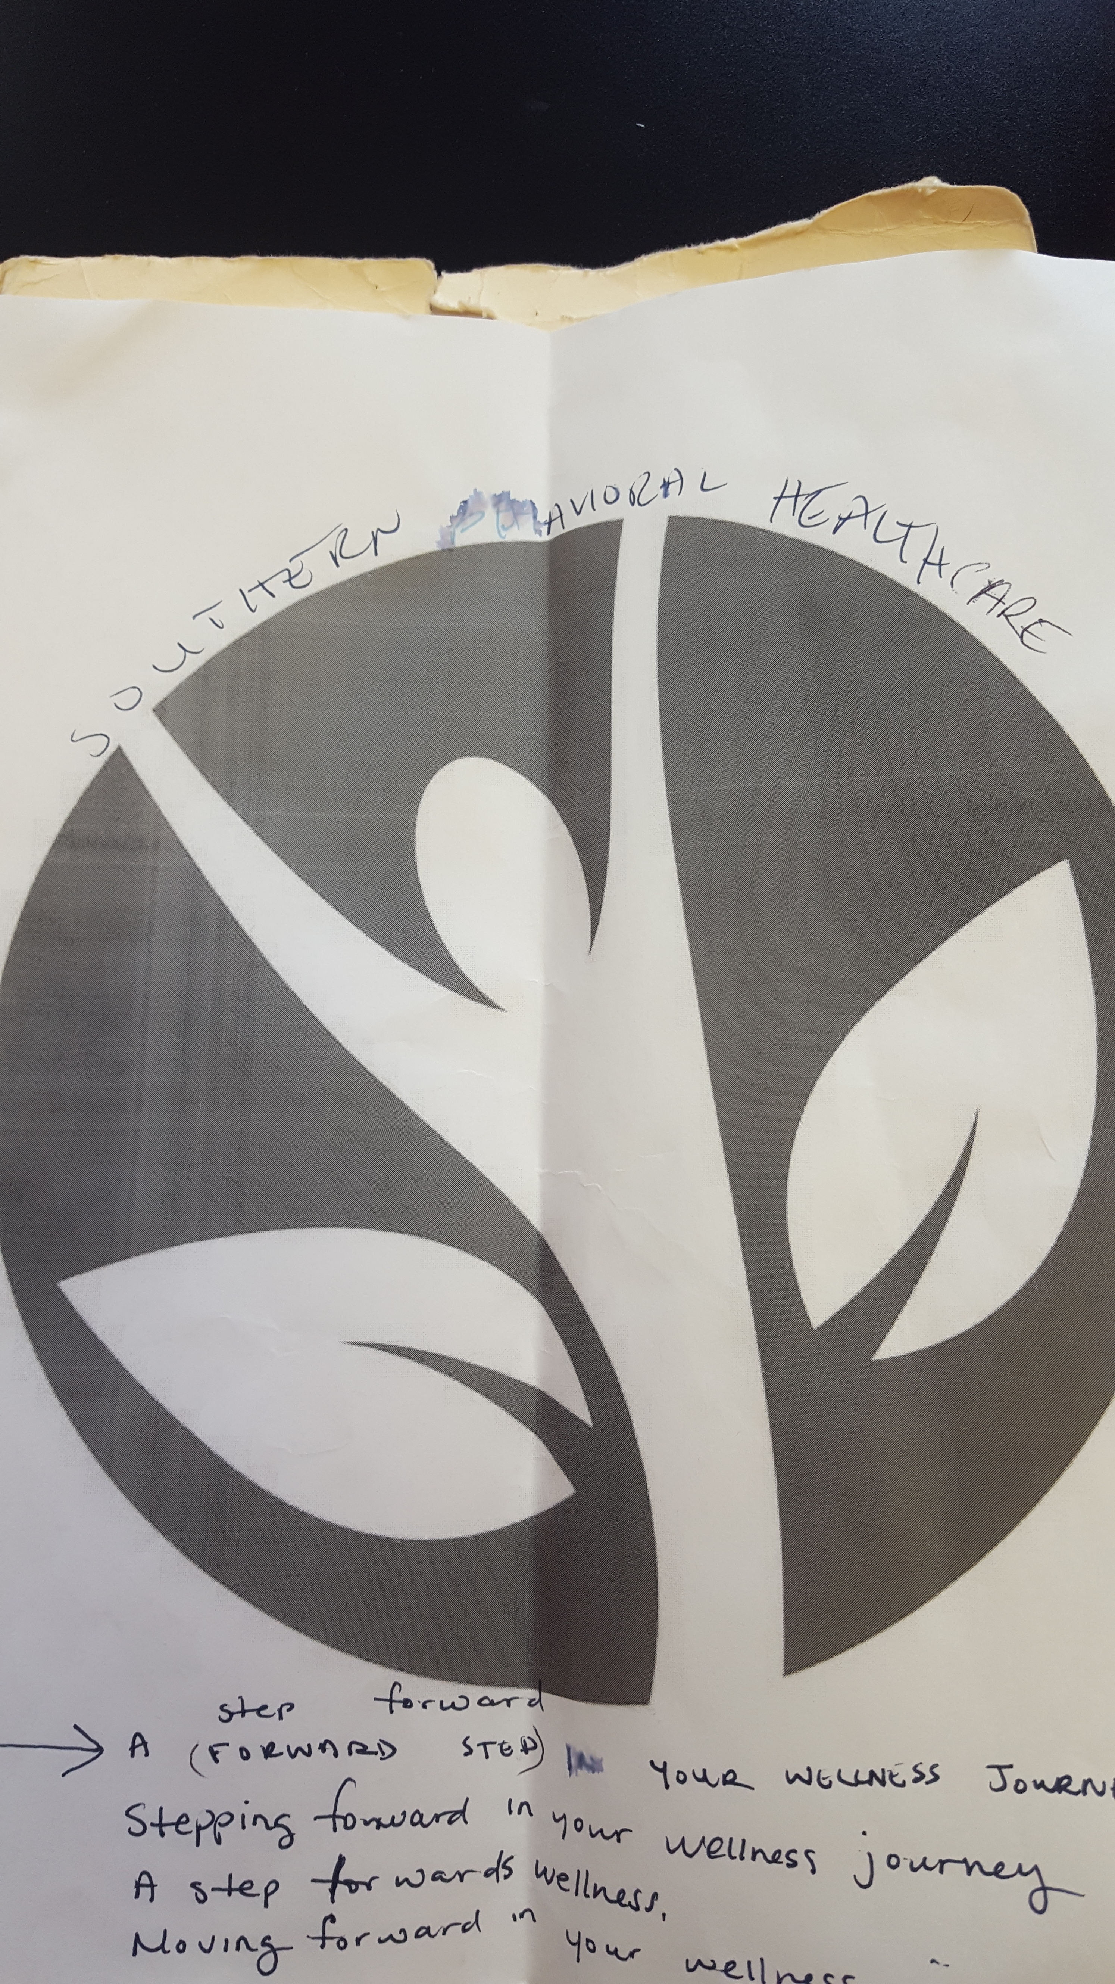
We plan to design a logo similar to this but really liked this one off Google.

