Slide 1
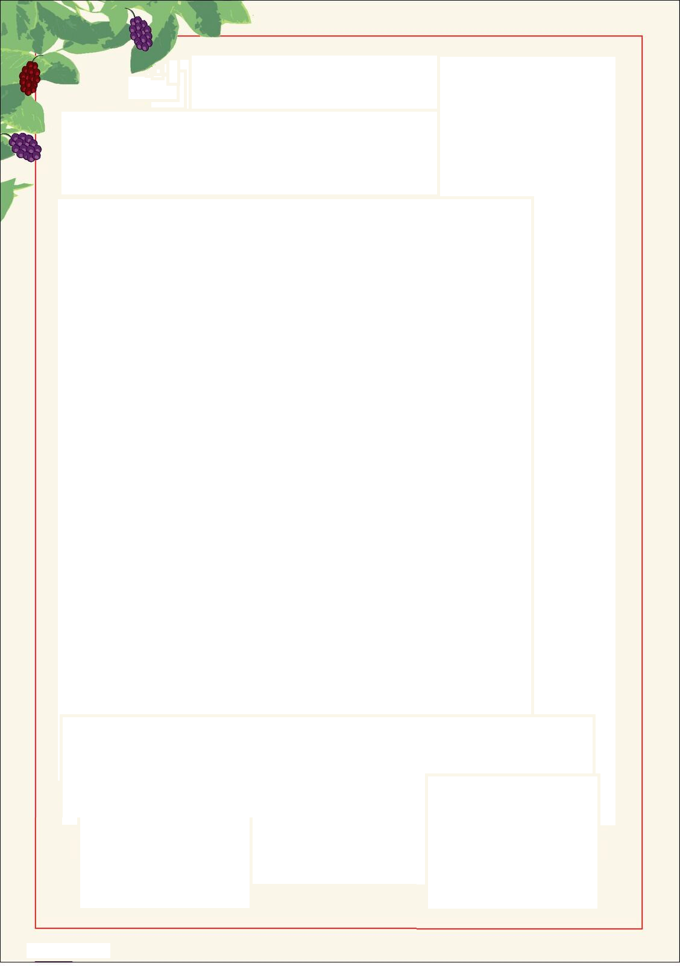

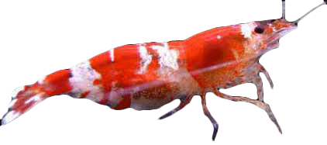
SHRIMP
MULBERRY
Mulberry Leaf Based Dietary Supplement
for all Ornamental Shrimp
Mulberry Leaves are a Natural Source of
Vitamin A, B, C, and K
Calcium, Iron, and Potassium
Dietary Fibre
Beneficial phytonutrients
Best of all shrimp LOVE it!!!
Net Weight: Four x 3g tubes

Slide 2
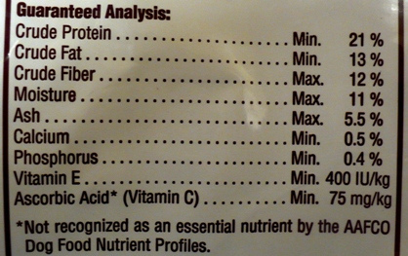
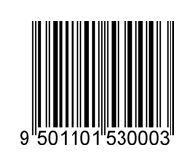
Shrimp Love Mulberry is designed to be used as part of a varied diet for your shrimp. It comes in a convenient applicator to easily control and provide the exact amount of food you want to feed.
Feeding Instructions: Use as part of a varied diet for your shrimp. Feed once a day, the amount will vary with the number of shrimp present. Avoid over feeding and remove any uneaten food to avoid water quality issues.
Storage: Keep frozen for long term storage. Remove one applicator at time. After an applicator is removed from the freezer and thawed discard any remaining food after one month. Store the applicator in the refrigerator between feedings.
Produced in Australia by:
Shrimp Love Mulberry
PO Box 1011
Clayton South, VIC 3169
www.shrimplovemulberry.com
info@shrimplovemulberry.com
Expiry Date (Frozen Storage):

