Slide 1


Slide 2


Slide 3




Slide 4
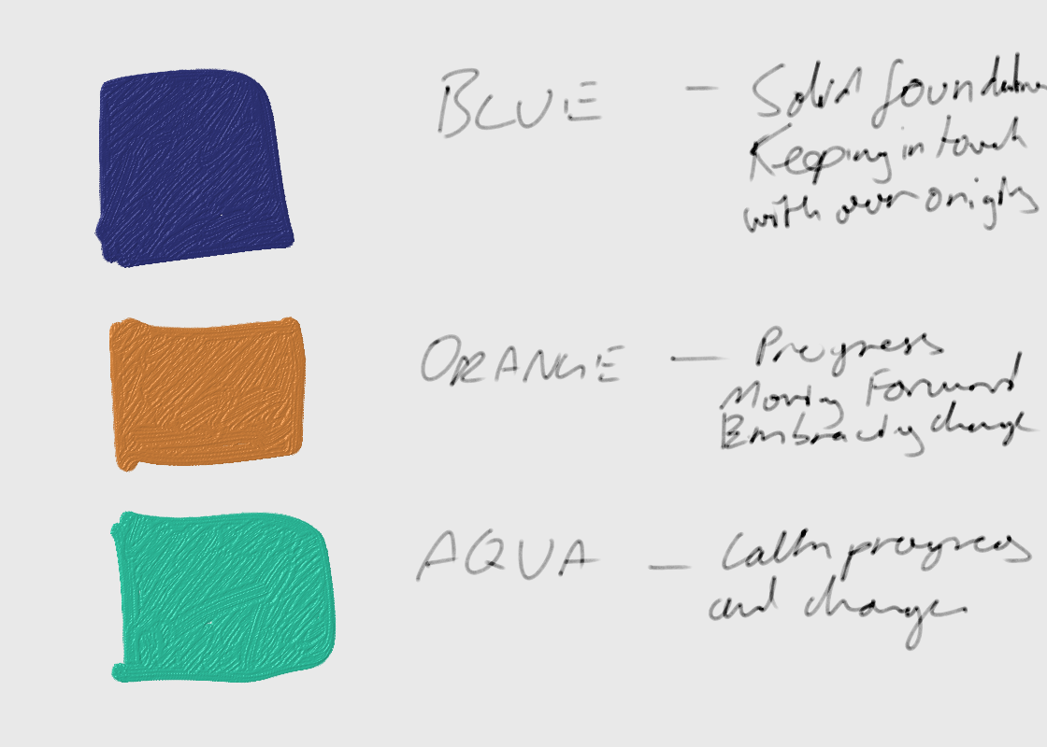
CSO Colour Branding We a wide spectrum of colours to represent its diversity and its commitment to the future. CSO looks to leverage off this by looking for colours / colour palette to represent our and our customer journey Blue – Representing our solid foundations and keeping to our origins Orange – Representing progress and embracing of change Turquoise – representing a calm and seamless transition to a new way of working and a new way of thinking

Slide 5


Slide 6



Slide 7


