Slide 1
Agilify Transformation
JIT
Lean
Agile
Outcomes
Transparency
Accountability
Notes:
No magic to our process
Based upon agile tenants
Agile is an execution method to get results with feedback, continuous improvement, measurable progress
We facilitate the process, just like a personal trainer would work with his/her client to get desired results

Slide 2
Transformation for Business
Agile is an umbrella term for an execution framework within which teams can address complex adaptive problems, while delivering results of the highest possible value.
The framework is based upon incremental delivery and continuous improvement with teams working toward a common goal.
Agilify uses agile tenants to
Achieve Outcomes
Create Transparency
Build Accountability

Slide 3
The Agilify Process
Executive Planning
Success
Routine
Reps
Plan
Problem
Backlog
Priority
Team/Tools
Interval
Sprints
Feedback
Finish
Measure
Priority

Slide 4

Personal Trainer Approach
Help you do something you could do yourself
Provide a plan and routine to follow
Provide motivation for consistent effort
Help you measure your outcomes
Notes:
Personal trainer analogy—problem areas, goals, exercise plan (with components)

Slide 5
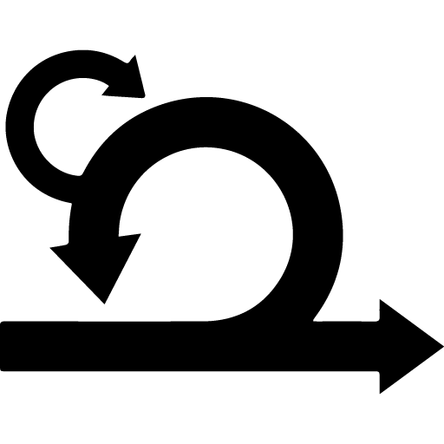
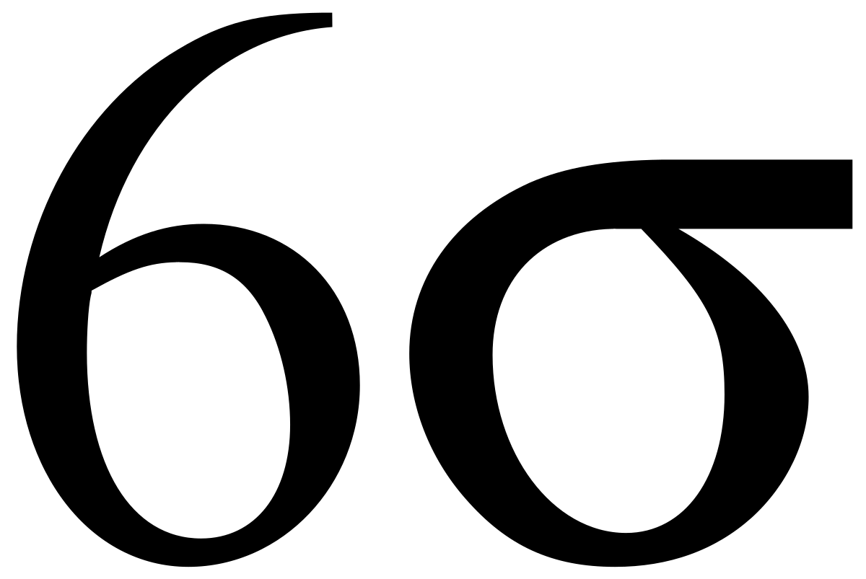
Relevant Graphics for inspiration
AGILE Process
LEAN Six Sigma
Notes:
Personal trainer analogy—problem areas, goals, exercise plan (with components)

