Slide 1

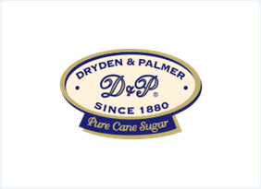

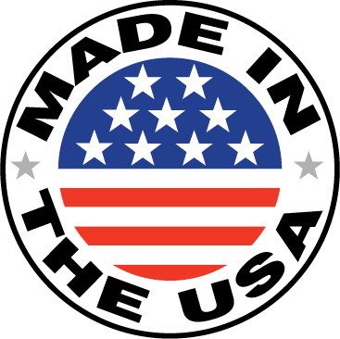
Go BIG. Go GIANT !

Slide 2
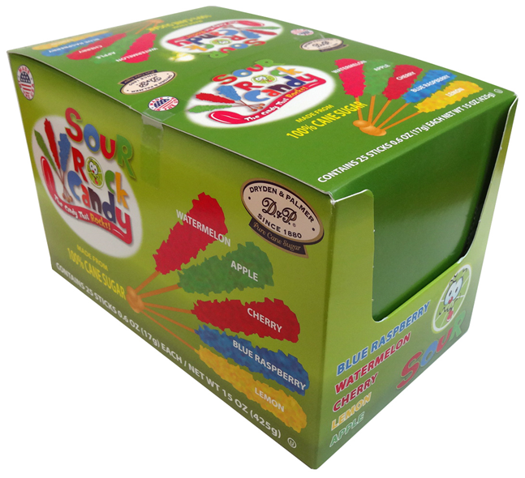
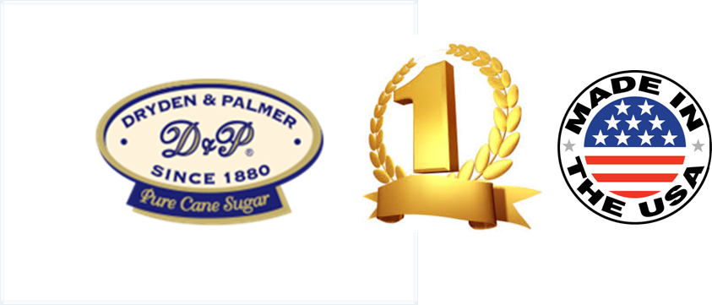
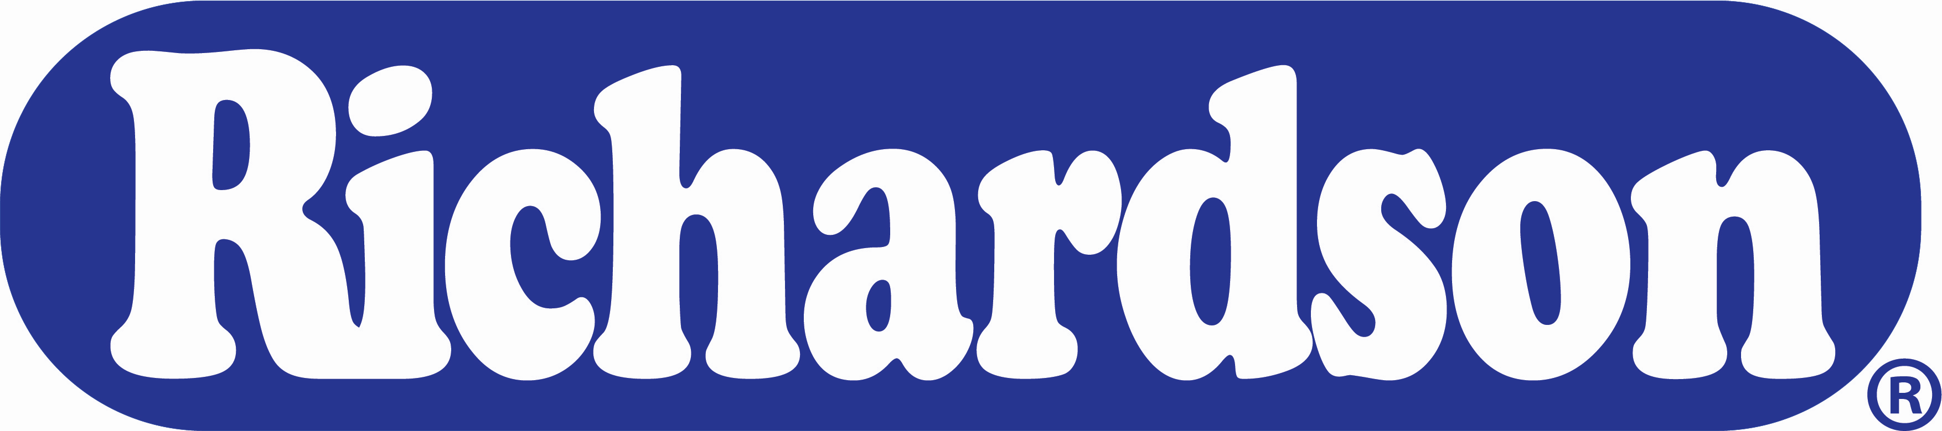




Go BIG. Go GIANT!
Why Dryden & Palmer?
Dryden & Palmer are the #1 Rock Candy since 1880! Dryden & Palmer products are proudly made in the USA and can be found in all states across America, as well as in most countries worldwide.
Our Rock Candy grown Artisan style for a fun, festive and decorative experience!
And we are the only company that produce GIANT Rock Candy!
Why GIANT Rock Candy ?
Big and oversized candy is always a great way to attract consumers and address their on-going demand for unique and fun treats and experiences. So next time when your customers look for the cool and fun candies, you can rest assured that Dryden & Palmer GIANT Rock Candy has you covered!
Ingredients:
SourBlue Raspberry: Cane Sugar, Citric, Malic & Tartaric Acid, Hydrogenated Vegetable Oil,Artificial Flavor, Blue 1, Yellow 5
SourWatermelon: Cane Sugar,Citric, Malic & Tartaric Acid, Hydrogenated Vegetable Oil,Artificial Flavor, Titanium Dioxide, Yellow 5, Blue 1 SourLemon: Cane Sugar, Citric, Malic & Tartaric Acid, Hydrogenated Vegetable Oil,Yellow 5, Natural Flavor, Xanthan Gum, Citric Acid, Sodium Benzoate SourRedApple: Cane Sugar, Citric, Malic & Tartaric Acid, Hydrogenated Vegetable Oil, Natural & Artificial Flavor, Titanium Dioxide, Yellow 5, Blue 1 SourCherry: Cane Sugar,Citric, Malic & Tartaric Acid,
Product Information:
Case Pack : 6/25ct.
GTIN : 50011167437207
UPC :
SourBlue Raspberry 0 11167437127
SourWatermelon 0 11167437165
SourLemon 0 1116743713 4
SourCherry 0 1116743702 8
SourRed Apple 0 1116743705 9
Dimensions : Case:16.81 x 15.41 x 6.38”Cube : Case:.96Gross
Weight: Case:8.67Pallet
Will be updated
Richardson Brands Co.
101 Erie Boulevard Canajoharie, NY 13317
(800) 839-8938

