Slide 1

Crowd Funding Project
Logo and Design Brief

Slide 2
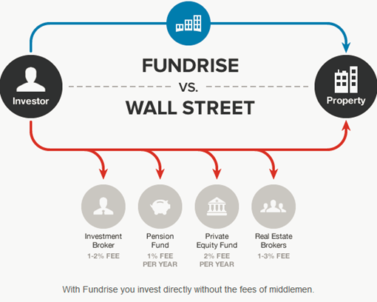
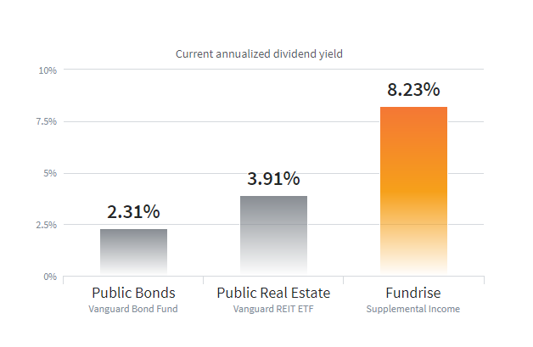



What is the Automation Finance Fund?
What are we?
Automation Finance is an asset management company that provides smaller investors access to investments usually reserved exclusively institutions.
We operate an asset-backed investment system that creates passive income for our investors.
We pay 12% return on your capital (secured by hard assets)
How do we do it?
Relentless Pursuit of Value: Thorough due diligence to uncover value
Skip the middlemen: We save up to 8% by eliminating broker fees, pension fund fees and the cost of running a sales organization. That’s millions of dollars of we can pass on to you
We deal direct and you keep the savings.
Automation Finance is a mortgage fund that invests in performing and non-performing mortgages. We have generated 12% return for our investors every year since we started in 2014
We are regulated by the SEC and our trustee is US Bank
Automation Finance
+
+
+
= ~8%
Save up to 8% by dealing direct
12.0%
Automation

Slide 3








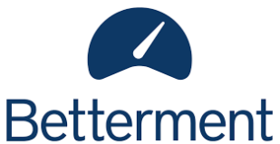
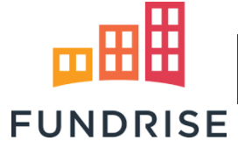




What is the Automation Finance Fund?
How Does it Work
We accept investments from small and large investors of as little as $1,000
We pool the funds and buy troubled mortgages from large banks and institutions. The borrower may be paying late, paying infrequently or not paying at all.
We re-negotiate the terms of the borrowers mortgage to make it affordable for them. In some cases we have to foreclose and sell the house.
We have liquidated more than 1,200 loans (5% through Foreclosure). That’s several hundred families we have helped to keep their home.
We pay you 12% return on your capital (secured by the loans in the fund).
Project Description
We are launching our first crowdfunding program and need a corporate identity that is warm, open, trustworthy and appealing….without seeming frivolous or lightweight. This is a serious business. We need to look like we have been around for a long time and will be around forever
Deliverable
Logo and color palate that is warm, serious and approachable
Inspiration: SoFi, Wealthfront, Betterment
The old school: One day we will be a peer…
Low Costs through technology
Pooled Capital

Slide 4
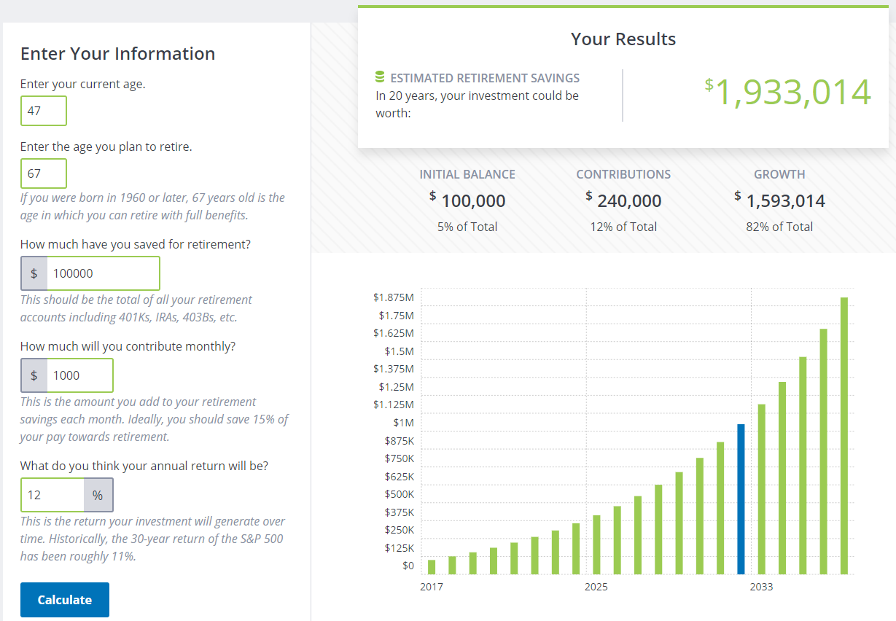
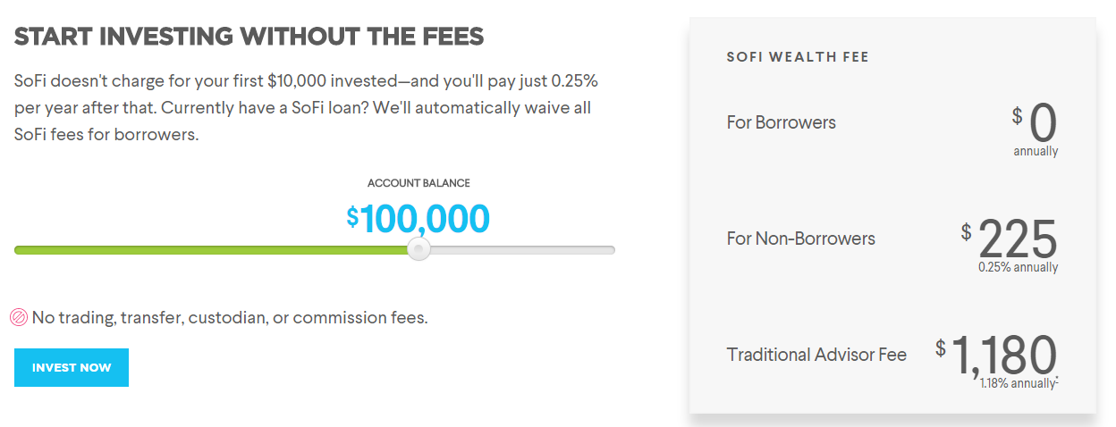
AF For Retirement: Turn $100,000 into $1.9 million in 20 years
Invest $100,000 today
Re-invest the monthly interest payments of $1,000
How does it work?
You invest a lump sum of $100,000
AF pays 12% interest on your principal each month
The interest is re-invested in the fund
No distributions are made and the principal grows over time
You save $25,000 in fees or $1180 per year (1.18% - Sofi)
Retire in 20 years with a $1.9m pension pot and $200,000 of annual income pre-tax

Slide 5
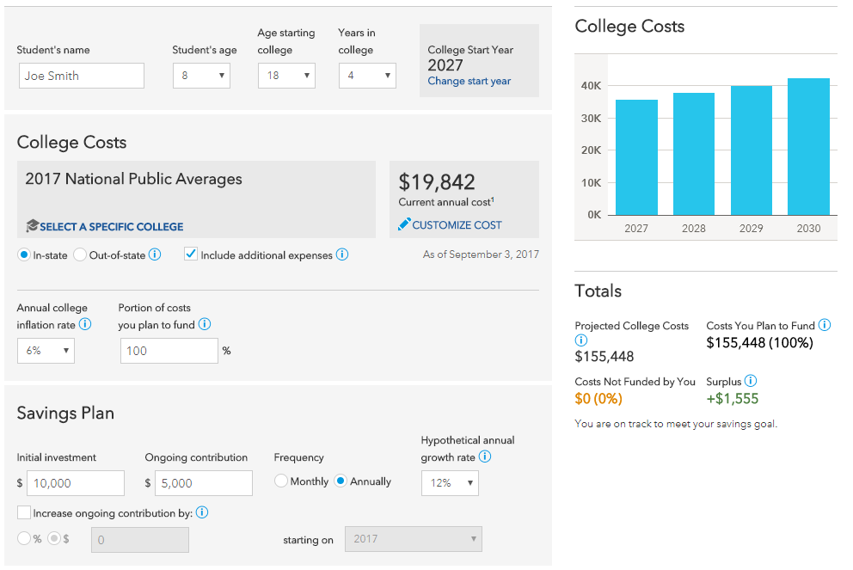
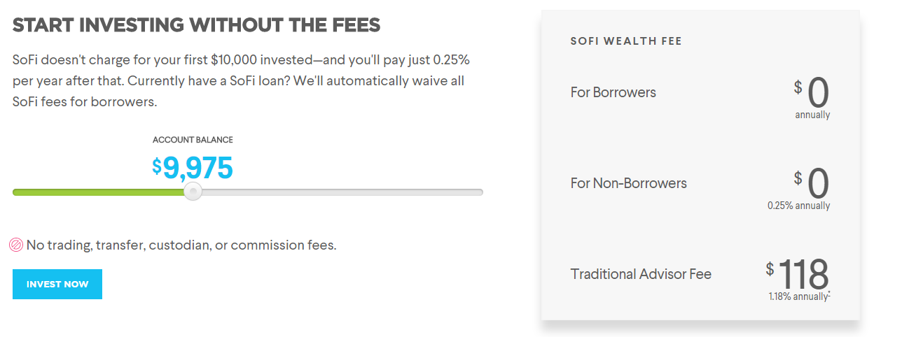
AF For College: Start today $10,000 for your 8 year-old, add $5,000 per year and Fund 100%
Invest $10,000 on child’s 8th birthday: top up $5,000 each year
Re-invest the monthly interest payments of $100
How does it work?
You invest a lump sum of $10,000 and $5,000 each year for 10 years
AF pays 12% interest on your principal each month
The interest is re-invested in the fund
No distributions are made and the principal grows over time
You save up to $122 in fees each year (1.18% - Sofi)
Fund 100% of child’s college fund by the day they start in 2027
https://www.americanfunds.com/individual/planning/tools/ext/college-savings-calculator

Slide 6
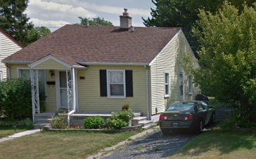
How does it work?
Raising Funds
Automation Finance pools funds from investors under Section A of the SEC code. Management has put up $1m of the funds in the Fund
Those funds are held by US Bank in trust for the investors in the Fund
Investing Funds
AF as the fund manager finds pools of mortgages to buy, conducts due diligence and agrees a transaction with a Bank of other seller. We buy the loans a discount to face value.
US Bank sends the purchase funds to the seller and takes ownership of the loans. AF is hired as the asset manager.
How AF Adds Value
Our team works through the loan servicer to modify their loan so they can afford their payment. In effect, we are sharing some of the discount to face value with the borrower.
Once the loan is performing for 12 months, it can be sold at a higher price. In the intervening period, AF collects a monthly payment that is greater than the 12% paid to the investor.
Returning Funds
The loan servicer remits the monthly borrower payments directly to the Trustee (US Bank) who holds them and makes the 12% interest payments. AF doesn’t touch any of the fund
As the end of the investment period, the Trustee returns the capital to the investor
.
Borrower Situation: Delinquent on Payments 60 Months
Asset | First Lien Mortgage – Accelerated Payoff
Type | Loan Modification
Location | Royal Oak, Michigan
Asset Valuation | $135,000
NPL Purchase Price | $72,028
Purchase Date | 1/5/2016
Recoveries | UPB: $151,500 Monthly Payment $860.20
Sale Date | June 2017
Investment Performance: Typical Example
Comment | Elderly borrower unaware of loan and had not paid in 5 years. Deceased husband managed finances. Borrower had good income and wanted to pay off asap. Reduced term and increased payment to help reach her goal.
Hold Period | 18 Months (2 months post RPL status)
Returns | Sold $105,106: ROI 1.29x and IRR 28%
Automation Holdings LLC

Slide 7
Every month, we help around 30 borrowers to avoid foreclosure….
90% Satisfied
100% Better than Expected
Borrower Quotes….June/July
“As Josh told me … he wanted to help us keep our house and move forward” V. Harnden
“Kind, Understanding, Genuine … did not talk down to me like others” M. Schweikard
100% Agree
“Spoke maybe 20 times, 15 emails, never missed a call, even at 7pm” M. Allan
“Josh was wonderful, its the loan I did not like...that’s not on your company” Anon
“…worked with me much better than previous owners of our loan” T &L. Brown
“Josh was very polite and patient” R. Morales
“Very determined to help my situation so it worked for both parties” S. McMinn
“Josh was very helpful” T. Kamill
June: 21 Surveys 6.21.17
July: 10 Surveys 7.21.17
“…terrific, honest follow up skills too” D. French
Borrowers are Happy To Sign Attractive Modifications and Make Monthly Payments by ACH

Slide 8
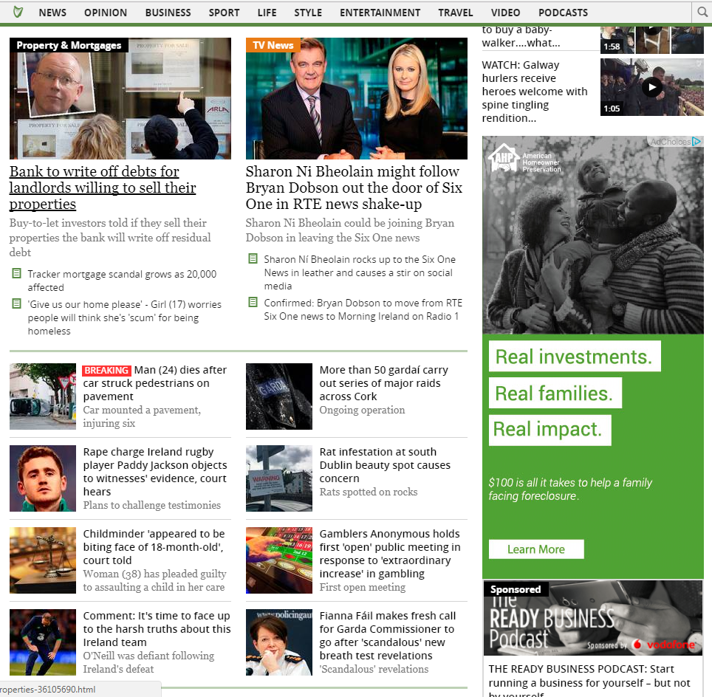
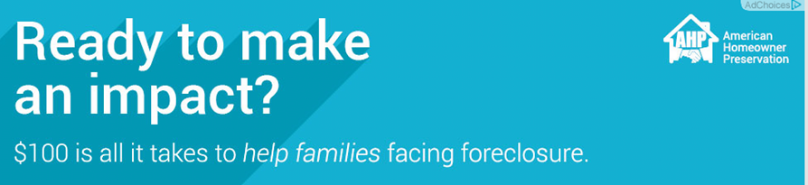
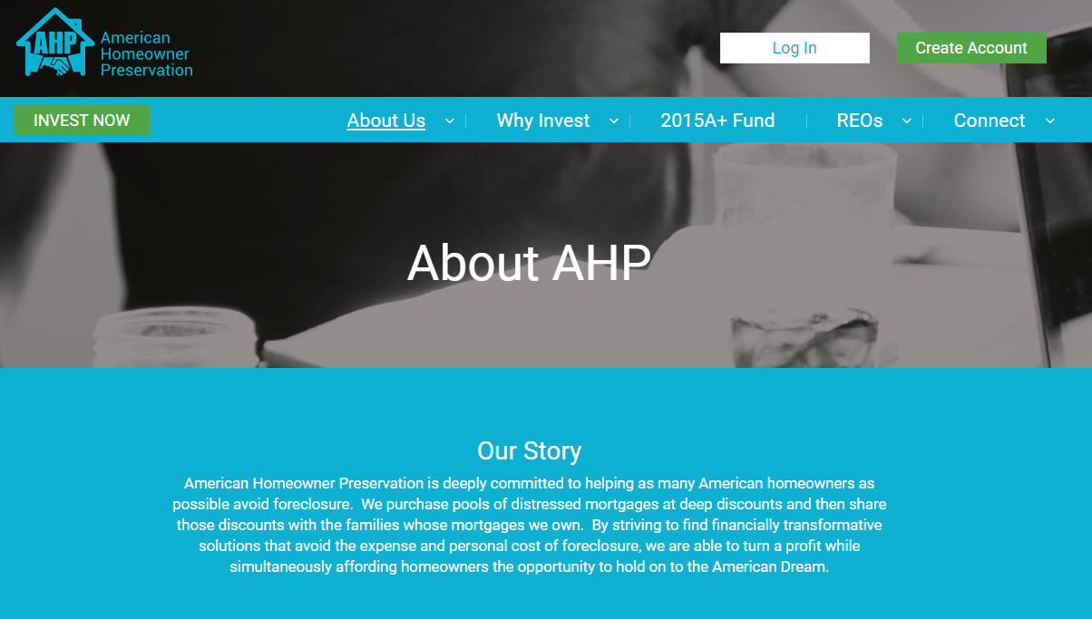
We will use the logo for advertising like this….(AHP is a similar business to ours)
Cookie Driven in Media
Banner Ads
Website

