Slide 1
CO-ACH-IEVE™ Growth Conversations
A People and Team Development System for Leaders and Managers

Slide 2
One of the widest capability gaps in any organization is talent. Specifically, as it relates to the following:
The on-going leadership challenge to sufficiently engage employees to execute consistently
The inability to identify and develop future leaders in organizations
Do any of the above capability gaps exist in your organization? If so, you’re NOT alone! Here’s the reality:
A mere 30% of the US workforce is actively engaged, while up to 70% of organizations report failing to successfully execute on their strategies (there’s a strong connection here!)
40% of top leadership is headed to retirement in the years ahead, and organizations do not possess a strong enough leadership pipeline to fill these vacant seats
FINALLY, THERE’S A WAY FORWARD THAT WORKS.
Have every leader and manager in your organization attend the CO-ACH-IEVE™ Growth Coaching Experience.
The CO-ACH-IEVE™ process and principles create high performance cultures where strong execution, enhanced employee engagement and leadership pipelines are full.

Slide 3
WHAT IS CO-ACH-IEVE™?
CO-ACH-IEVE™ provides leaders and managers with a repeatable process, framework and system for coaching people to potential. CO-ACH-IEVE Growth Coaching:
Creates trusting relationships
Unlocks dormant potential in people, teams and organizations
Establishes commitment to specific goals and execution
Fuels the leadership development pipeline

Slide 4
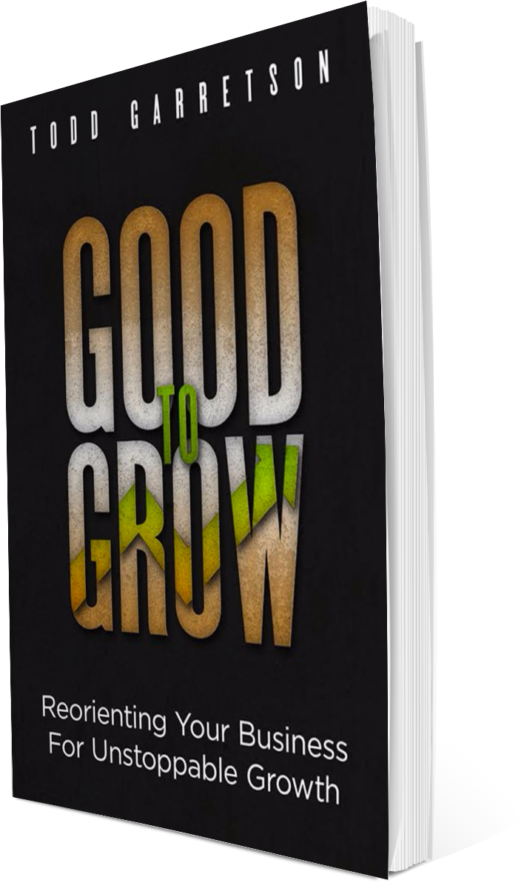
CO-ACH-IEVE™ PROGRAM HIGHLIGHTS
We create permanent behavioral change as a result of consistent application, accountability, and supportive coaching
We feature self-discovery learning and best practice sharing through group interaction
A few of the learning keys that participants will be engaged-in during the 7 week experience include:
Working with Different Communication Styles
Handling Different Coaching Reactions
How to Apply Six Coaching Fundamentals
Asking the Powerful Coaching Questions
The Power of Peer Coaching
Notes:
Not the person in the spotlight, but putting the spotlight on your coachee
Chances are when you thought of your great coach, they were great spotlight listeners – they made you feel as if you were the only person in the room
Guide on the side, not a sage on the stage
Coaching is a process of paying full attention to someone
When people are truly listened to and focused on, they light up

Slide 5
WHO SHOULD ATTEND?
Suggested Audiences
Newly appointed managers or high potential leaders
Managers in organizations with direct reports
Anyone responsible for developing people or teams
Organizations with a desire to enhance employee productivity and overall engagement
Organizations with a goal to improve execution of strategy

Slide 6
WHAT’S INCLUDED?
Level 1
ENTIRE LEVEL 1 PACKAGE PLUS:
Level 2
Half-Day Interactive Workshop and Participant Workbook
Level 3
6 Practice and Follow-up Sessions (60-90 minutes each)
Individual CO-ACH-IEVE™ Coaching Template Tool Kit (multi-format)
A copy of Good To Grow: Reorienting Your Business for Unstoppable Growth
Lifetime Access and Membership to CO-ACH-IEVE™ Peer Coaching Leadership Group
4 Additional Sessions to Implement the CO-ACH-IEVE™ process for building high performing teams and units
Team CO-ACH-IEVE™ and Leadership Development Template Tool Kit (multi-format)
ENTIRE LEVEL 2 PACKAGE PLUS:
CO-ACH-IEVE™ Engagement Index Assessment for Individuals, Teams, and Organization (Pre-Training Measurement + 3, Quarterly Check-ups to Assess ROI)
*Organizations must commit a minimum of 15 participants for any CO-ACH-IEVE™ level*

Slide 7
GOOD TO GROW
While growth is a top-of-mind priority for businesses across all industries, leaders are plagued with a lack of confidence and uncertainty in choosing, organizing, and executing the right strategies. If this describes you or your organization, rest assured—you're not alone! Over 80% of organizations share the same frustrations. Finally, there is a way to get unstuck. Join strategy advisor Todd Garretson as he unlocks two decades’ worth of first-hand experience working with family-held and publicly-traded organizations. Through a series of thoughtful growth clippings and inspirational insights, Good to Grow has the power to help you finally explode through the toughest plateaus en route to your full potential. With mini-surprises and unexpected nuggets on every page, your next big idea is waiting to be discovered. So, what are you waiting for? Ready, set, grow!

Slide 8
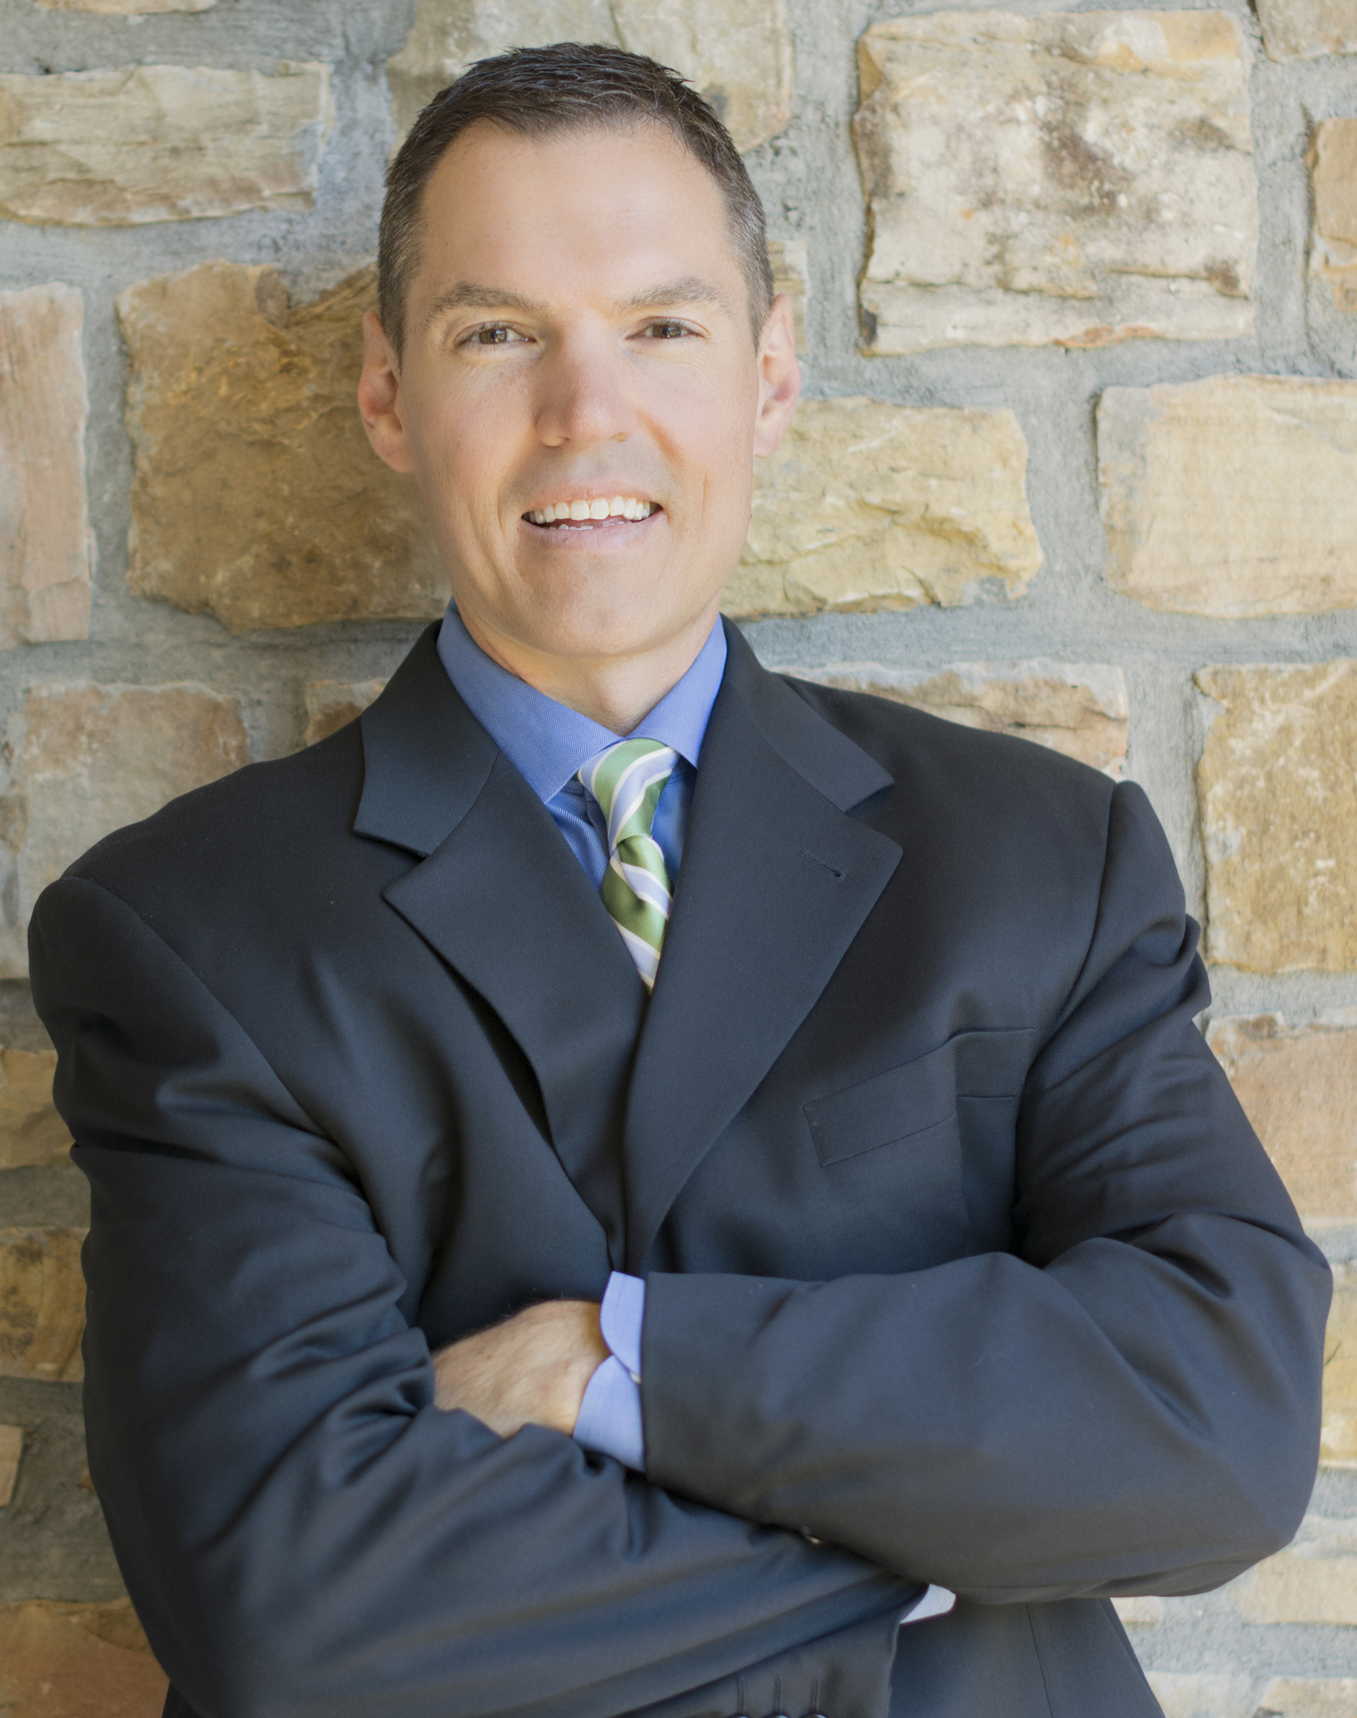
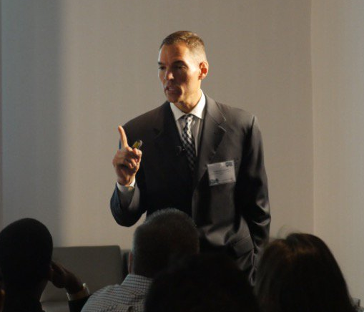
TODD GARRETSON
Founder and Chief Growth Strategist Todd Garretson has a passion for helping organizations unlock dormant growth potential in people, teams and organizations. The work he does helps his clients’ businesses explode through growth plateaus and barriers enroute to their full potential!
Todd spent the first decade of his career building, expanding and eventually, selling a family manufacturing business. He spent over six years in a number of corporate leadership roles, leading strategy and market share growth initiatives for Hunter Douglas and Newell Rubbermaid.
Having grown up in a mid-size family manufacturing business alongside his father and brother, Todd brings a wealth of knowledge, expertise and background to help business owners and executive teams navigate unique growth challenges.
A growth strategist at heart, Todd specializes in building high-performance organizations as well as helping owners and executives with strategic growth development. You can find Todd at the intersection of the architect and the builder - with the unique skill to both envision it and make it come to life.
Residing in Atlanta, GA with his wife, Lauri, and their four children, weekends and free time are spent with family, coaching youth sports, and sharing his passion for fitness and nutrition.
Todd is available for speaking engagements to all size audiences, guest writing and various board and advisory assignments.
www.toddgarretson.com | todd@circlemakers.co

Slide 9
TESTIMONIALS
"Prior to hiring CircleMakers, my biggest fear was that a 'consultant' would cost us lots of money with little return. It couldn't have been further from the truth. Not only was CircleMakers quickly immersed into the details of our business, but was highly skilled in helping us develop the right growth strategy and guiding us through the execution phases - which is where we struggled the most." President, Large-size Sysco Company "I never expected a consultant to come in and in a short time, understand our business so well. He listens and meshes so well with my team, and his process for enhancing growth and performance has propelled the business to the next level." President, Medium-size Home Product Brand
“Wow"! What a wonderful presentation you gave. The material you presented was incredibly insightful, your comments on business building were off-the-charts inspirational, and the distinction you made between culture and strategy was incredibly memorable.”
VP, Leading Healthcare Company

Slide 10


CircleMakers is a strategy advisory firm that helps organizations drive stronger performance and growth. Through a portfolio of unique development experiences, we help organizations unlock dormant potential in people, teams and organizations.
From family-owned businesses, private equity portfolio companies, to publicly-held businesses, organizations range in size from $1 million to over $1 billion.
In addition to custom strategy consulting, CircleMakers.Co is an on-line destination and multi-media strategy resource for growth oriented executives, business owners, CEOs and professionals. Our mission is to equip owners with tools, inspiration, best practices, and practical resources that can be accessed and applied against their business challenges.
www.circlemakers.co

