Slide 1

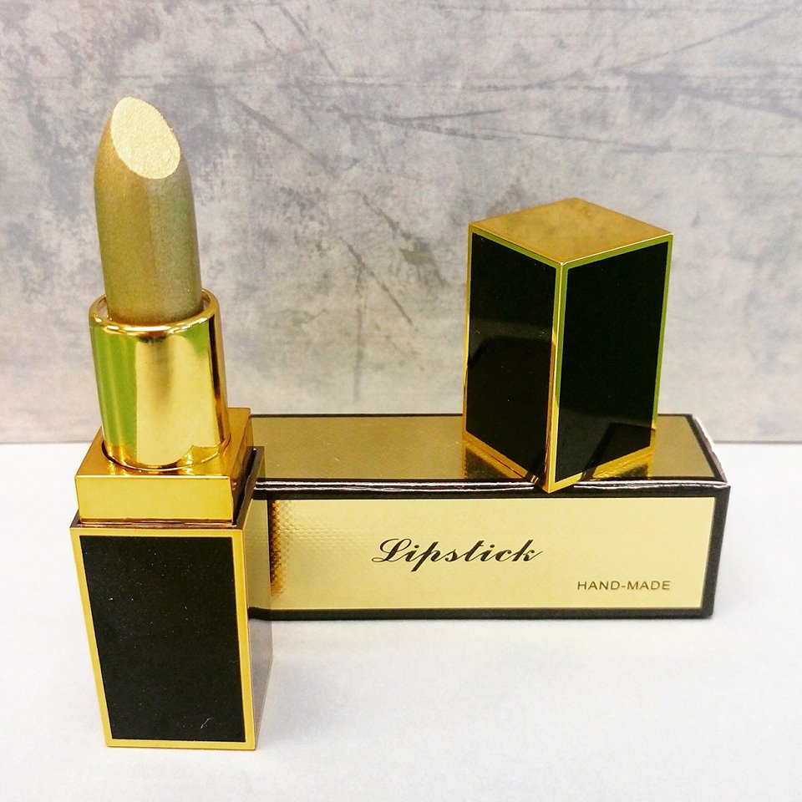
CHARLIE'S COSMETICS
A slogan proposition

Slide 2
CHARLIE'S COSMETICS
Jewel your lips

Slide 3
CHARLIE'S COSMETICS
The make-up jewel

Slide 4
CHARLIE'S COSMETICS
Lips that stick attention

Slide 5
CHARLIE'S COSMETICS
Lips so slick, gazes stick

Slide 6
CHARLIE'S COSMETICS
Enchant yourself

Slide 7
CHARLIE'S COSMETICS
Glamour up

Slide 8
CHARLIE'S COSMETICS
Thank you!

