Slide 2

Case Study

Slide 3
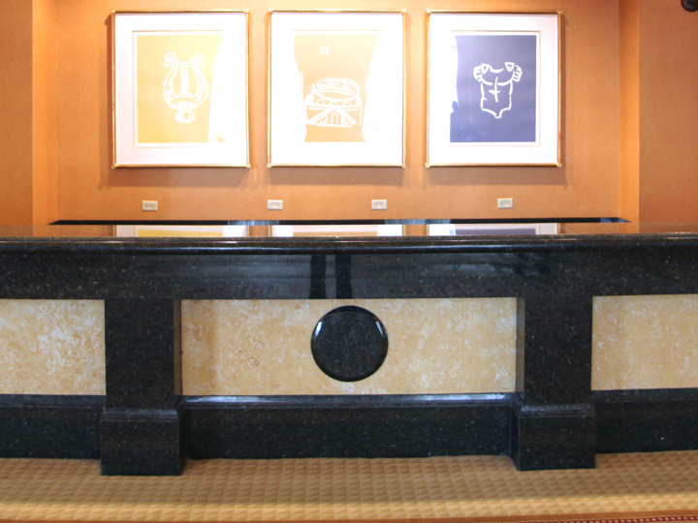

Katrina is the hotel manager.

Slide 4

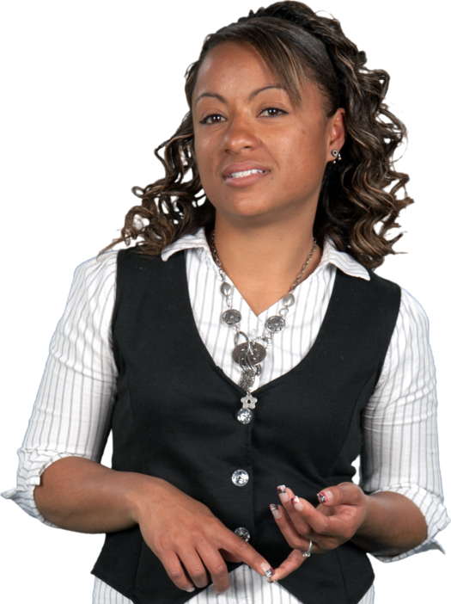
Sally is her second shift supervisor. Sally has worked for Katrina for five years.
Sally is domineering and abrasive. She always wants results. She has constant trouble connecting with her people, but she does get the job done.

Slide 5

Sally doesn’t deal well with Joe, also a supervisor.
She says, ‘Joe is talkative and scatterbrained’.

Slide 6
Sally has told Katrina how much Joe ‘bugs’ her.
Today, Sally says to Katrina: “I have done everything I can do, I can’t put up with Joe for even one more minute.”

Slide 7
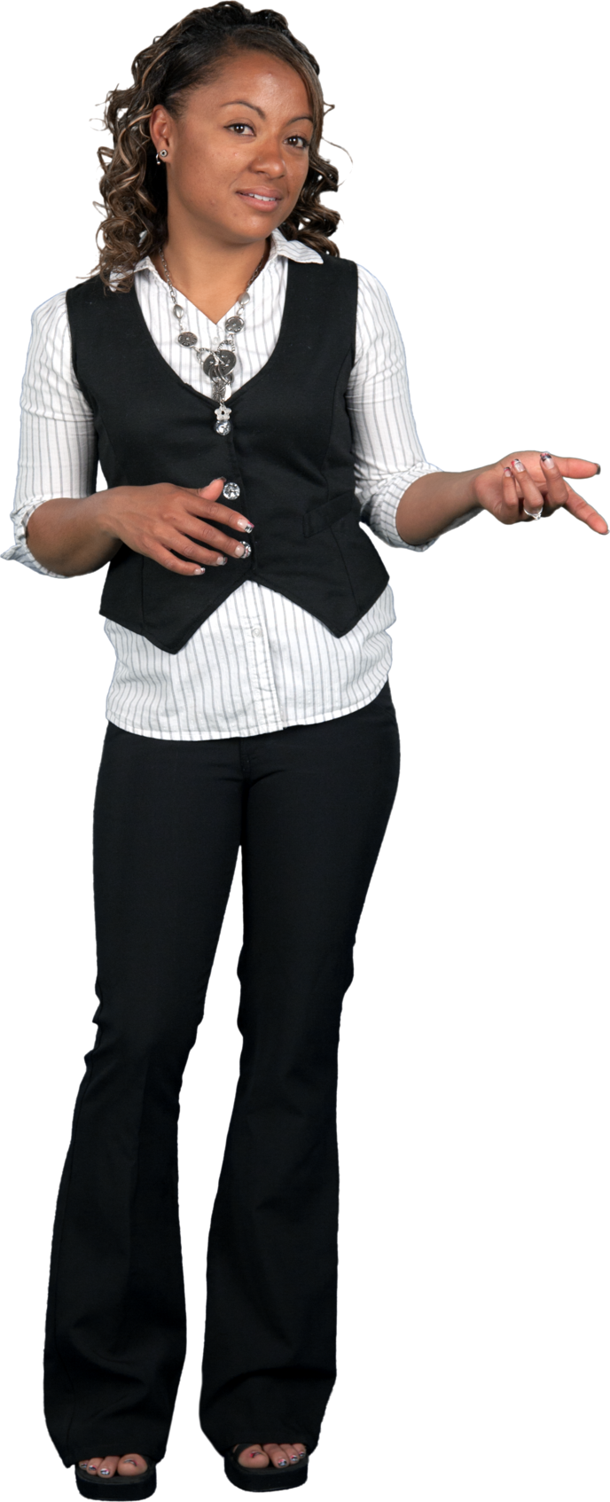

What is the best question Katrina can ask Sally?

