Slide 1
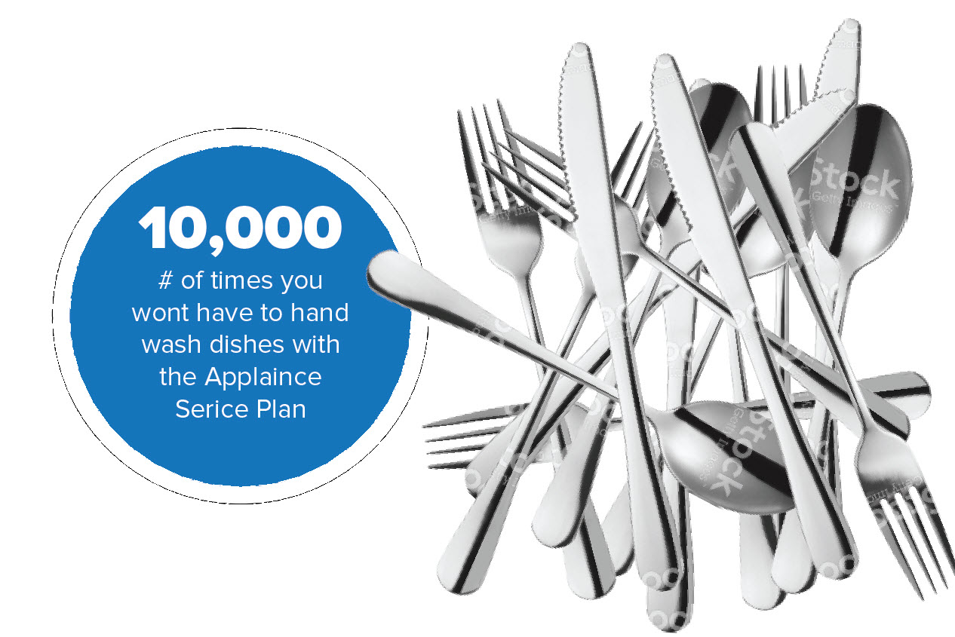
13,000 – The number of times you won’t have to hand wash your dishes in the next 5 years. Don’t forget the Appliance Service Pan.
Concept Application
Initial concept was mentioned as a sticker, so this would have to adhere to the front of the lower rack. Alternatively it could be a “standee” of sorts that stands among the posts of the lower rack.

Slide 2
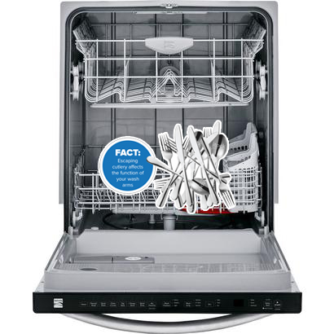
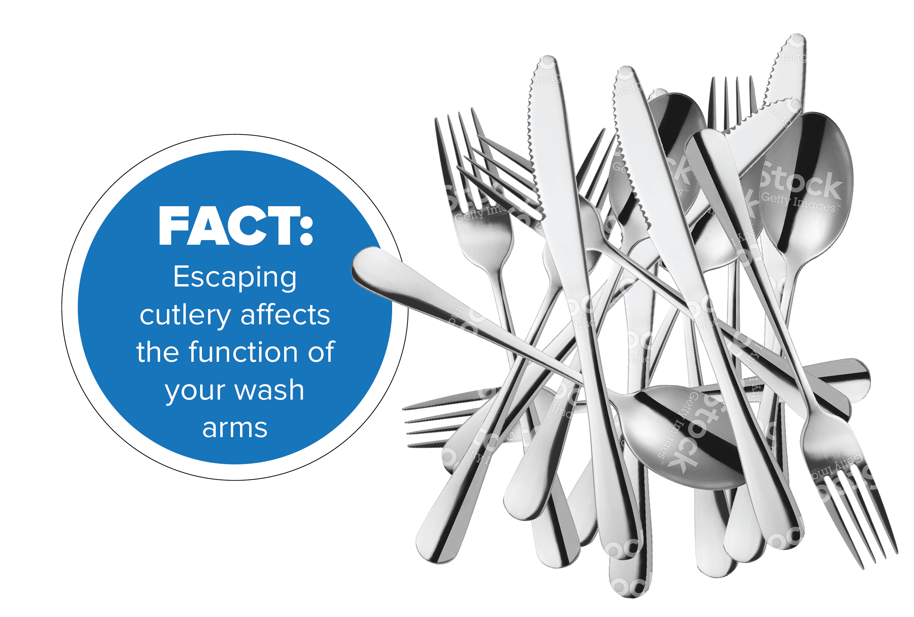

Slide 3
Inside the dishwasher, we would have a sticker image of cutlery (knifes, forks, spoons, etc) all bunched together. This sticker would go on the dishwasher rack.
Heat and hot water plus electronics
Breakdown Fear - “FACT: ”.
Technology Fear - Water, Heat, Hi-Tech Electronics, Spinning Blades - What could go wrong? You won’t have to worry if you protect me with the Appliance Protection Plan.
Wear and Tear - The average family does 3,000 loads of laundry a year. That’s a lot of work. Make sure you protect me with the Appliance Service Plan.
13,000 – The number of times you won’t have to hand wash your dishes in the next 5 years. Don’t forget the Appliance Service Pan.
13,000 – The number of times you won’t have to hand wash your dished in the next 5 years.

Slide 4
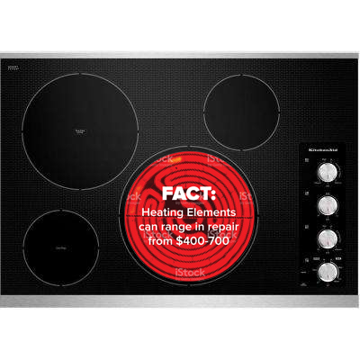


Slide 5
On the exterior of the oven, directly on top of the heating element, we are thinking we would have an image, circular, of a heating element (so basically a sticker of a heating element on top of an actual heating element). It can be black, grey or maybe even “heated” so “warm colours”. The text on the sticker would read
Breakdown Fear - “FACT: Heating Elements can range in repair from $400-700”.
Technology Fear - Water, Heat and Electronics. What could go wrong? You won’t have to worry if you protect me with the Appliance Protection Plan.
Wear and Tear - The average family cooks about 1,0000 meals a year . That’s a lot of work. Make sure you protect me with the Appliance Service Plan.
Peace of Mind/ Less Work – Dinner for a family of 4 costs $80.

Slide 6
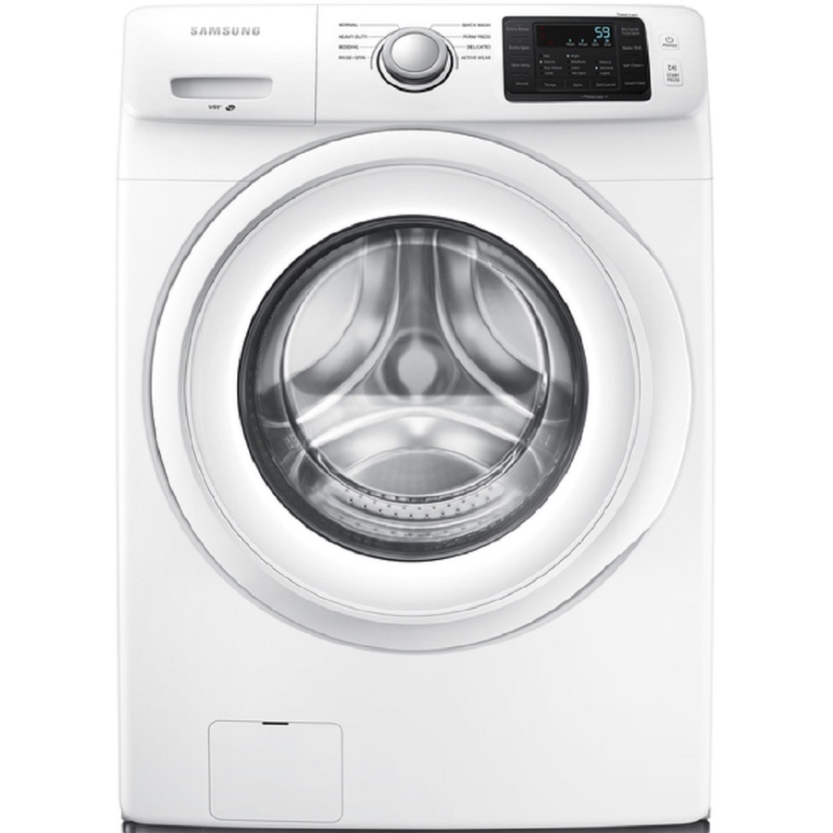

Water, Heat and Electronics. What could go wrong?
You wont have to worry if you protect me with the Appliance Protection Plan.
Water + Heat + Electronics.
What could go wrong?

Slide 7
Water, Heat and Electronics. What could go wrong?
You wont have to worry if you protect me with the Appliance Protection Plan.
18,000
The average family des 10 loads of laundry a week.
Over 5 years 5 years that’s a big number.

Slide 8
On the exterior of a front load washing machine, we picture an image that covers half the circle of a Front load door. This image will be a stack of clothes being washed or a “pile” of clothes (likely non-transparent image, but would like to see both options if possible. The text on top of the image would read
Breakdown Fear - “FACT: Large loads put stress on your drum assembly”.
Technology Fear - Water, Heat and Electronics. What could go wrong? You wont have to worry if you protect me with the Appliance Protection Plan.
Wear and Tear - The average family does 4,000 loads of laundry a year. That’s a lot of work. Make sure you protect me with the Appliance Service Plan.
18,000
The average family dos 10 loads of laundry a week. In 5 years that’s a big number.

Slide 9
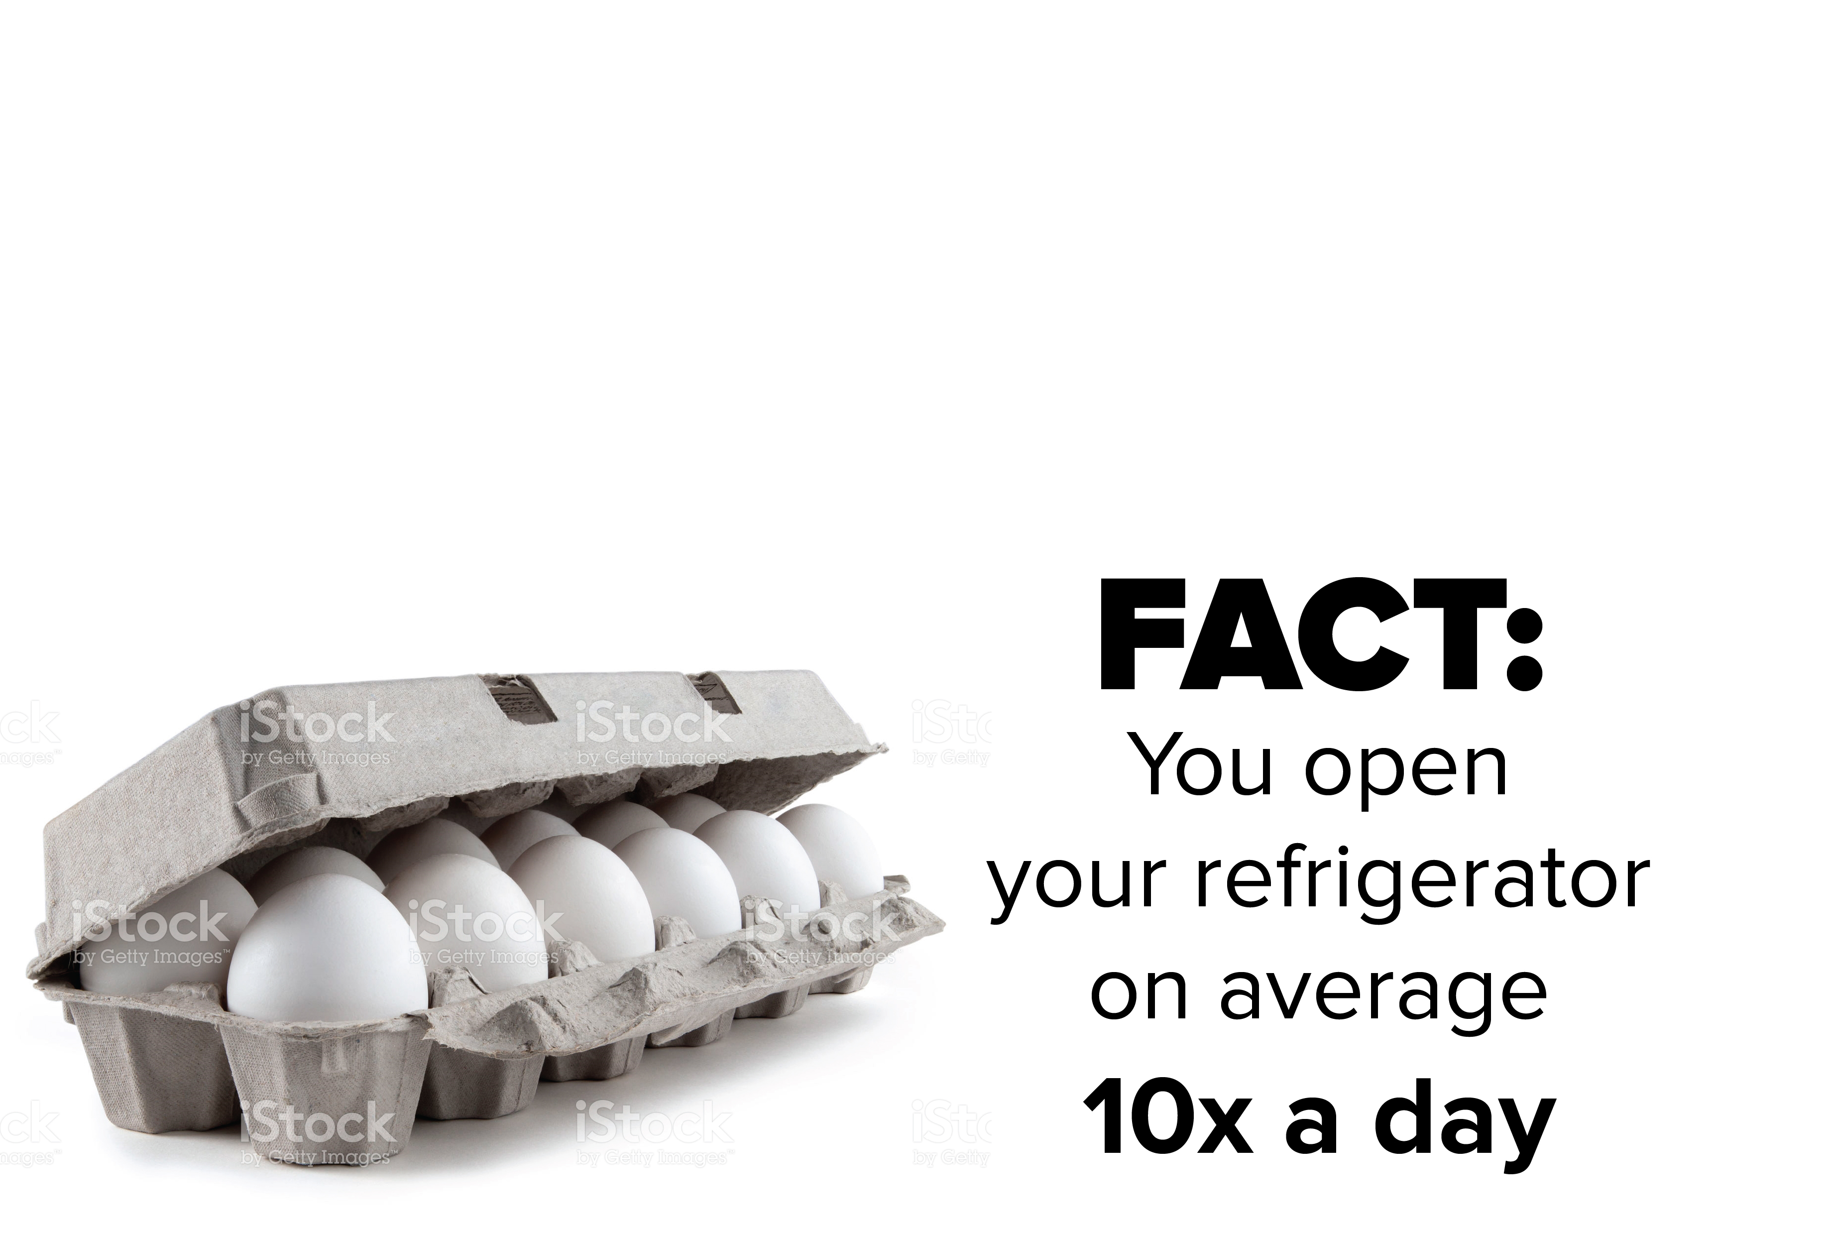
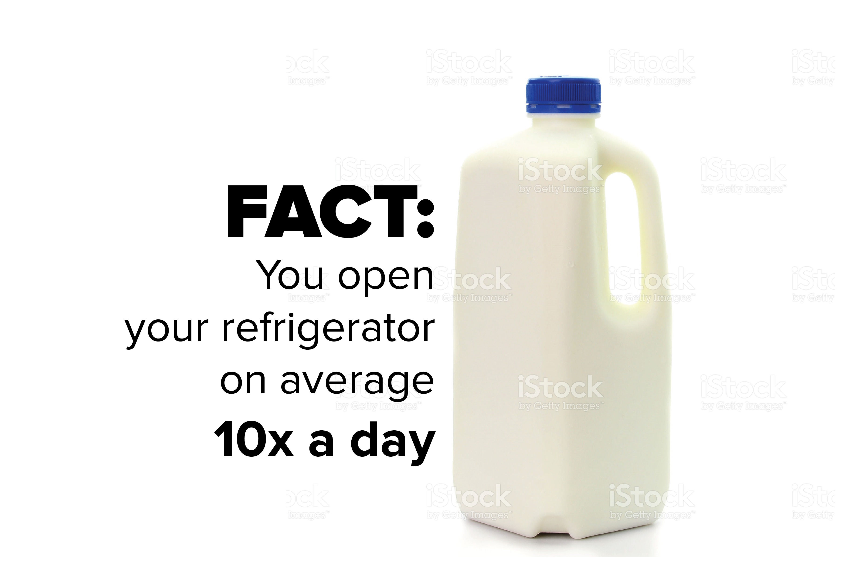

Slide 10
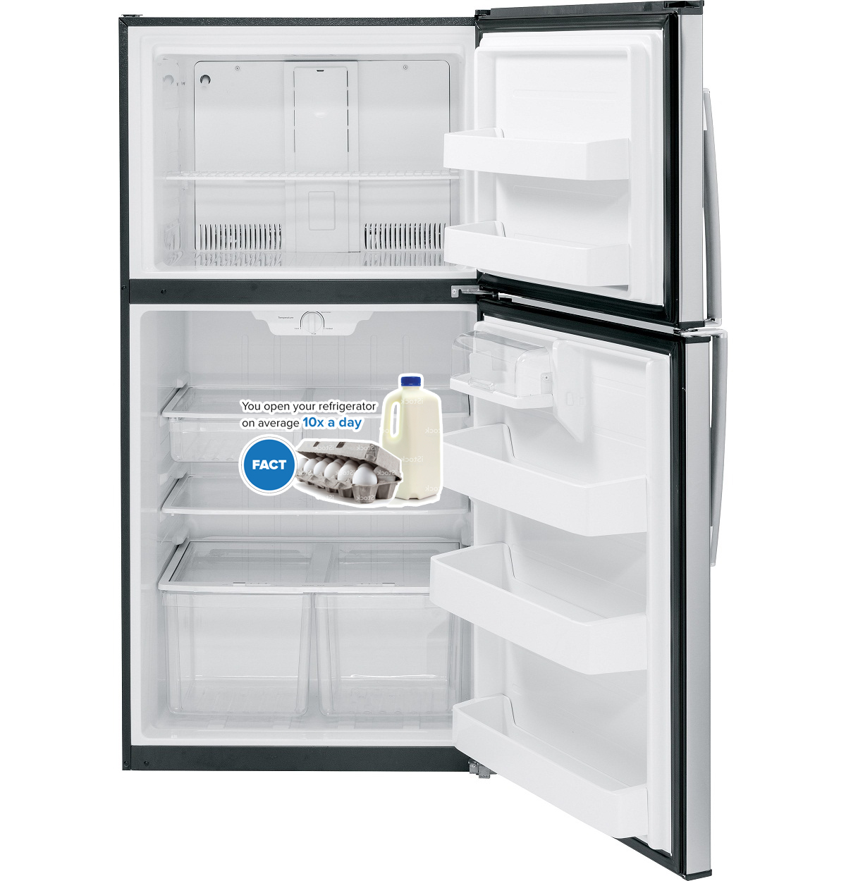
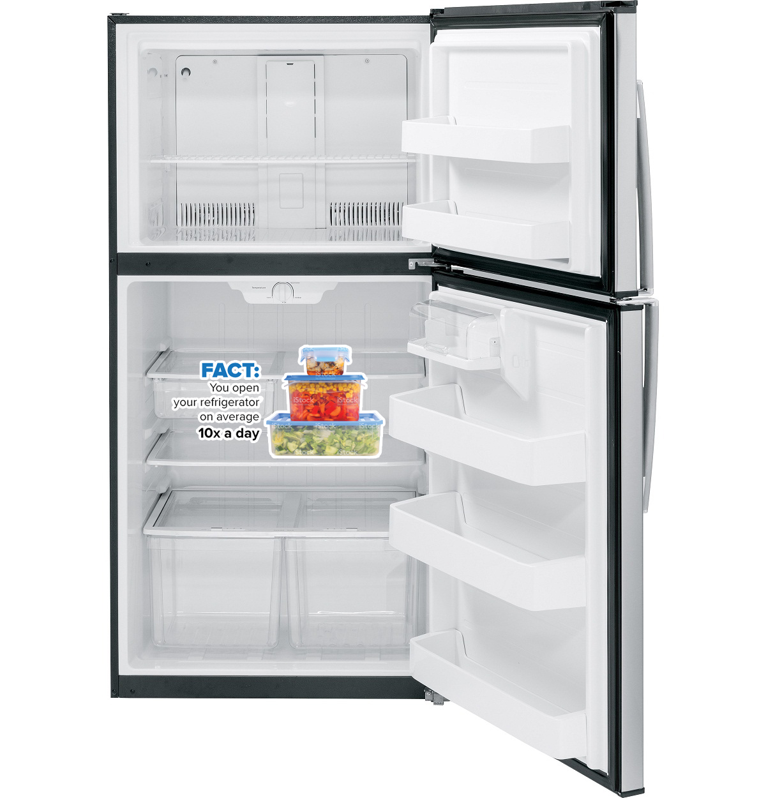

Slide 11
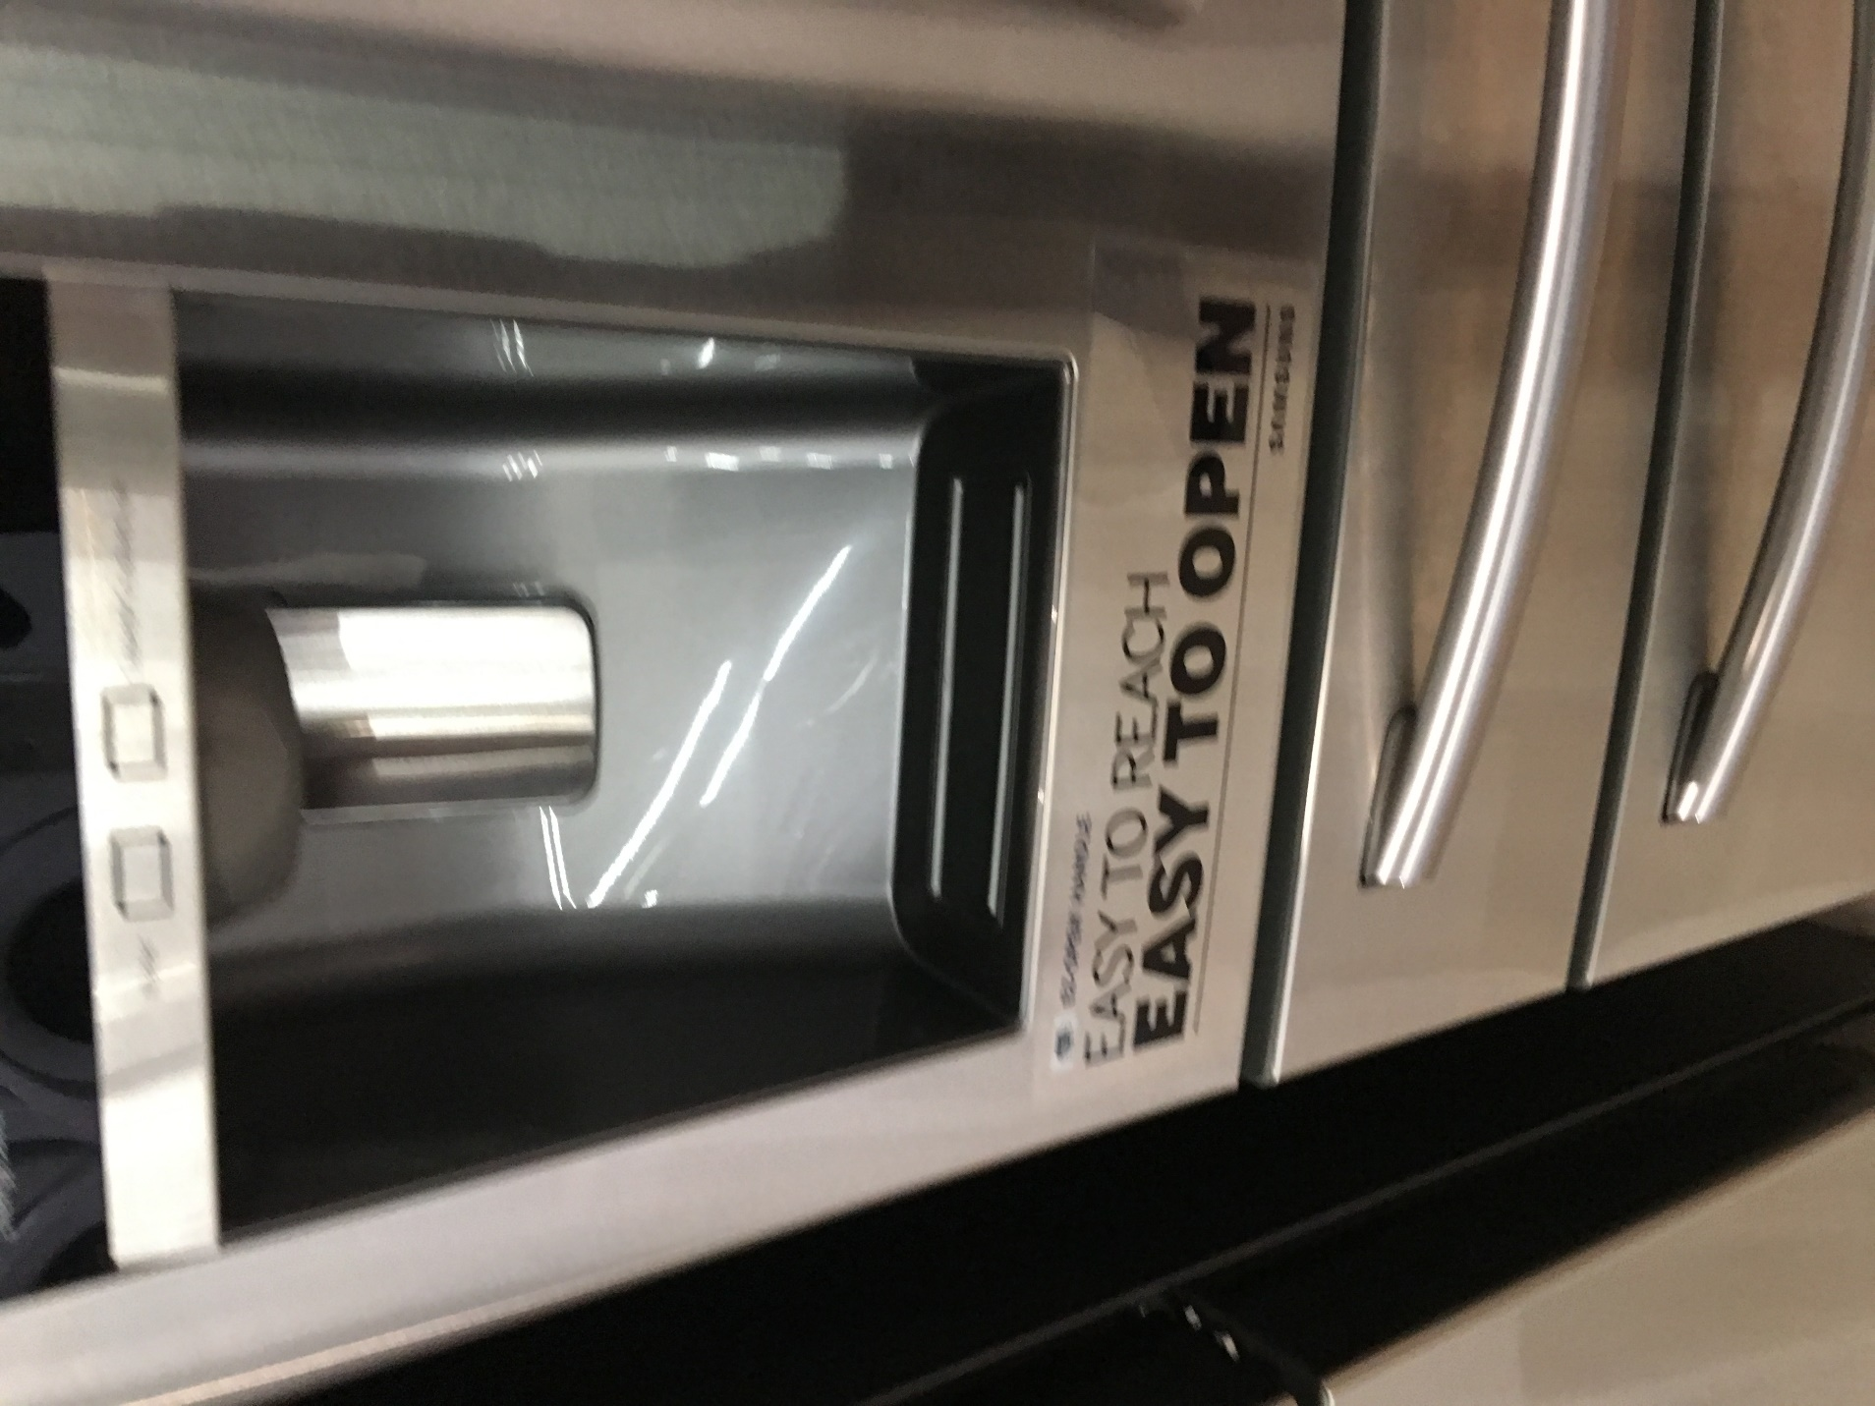

Slide 12
Breakdown Fear
Ice Maker
Breakdown Fear - “FACT: Large loads put stress on your drum assembly”.
Technology Fear - Water, Heating, Cooling and Hi-Tech Electronics. What could go wrong? You won’t have to worry if you protect me with the Appliance Protection Plan.
Wear and Tear/Usage – Your family will open your fridge 10,000 time a year. That’s a lot of work. Protect me with the Appliance Service Plan.
10,000 The number of times your family will open this fridge every year. That’s a lot of work. Protect me with the Appliance protection plan.
First Idea: Fridges WITH ice makers should have a sticker POS that would go on/inside the internal ice machine. Image could be cubes of ice stuck together or Ice stacked (along those lines, could be transparent or none transparent). The text on top of the image should read “FACT: The ice machine is the #1 breakdown in refrigerators”
Second Idea: Fridges WITHOUT ice makers will have a sticker that is an image of food (i.e. fruit pile, veggie pile, milk and eggs… lets see some variety) in either the glass shelves inside a refrigerator OR “inside” the plastic drawers. The text on top of this background image should read “FACT: You open your refrigerator on average 10x a day” Keep your food fresh with the Appliance Service Plan.

Slide 13

Design plate that can be placed in a dishwasher that has key messaging on it. Include the P3 logo
13,000
The number of times you won’t have to hand wash your dishes in the next 5 years. Don’t forget the Appliance Service Pan.

Slide 14
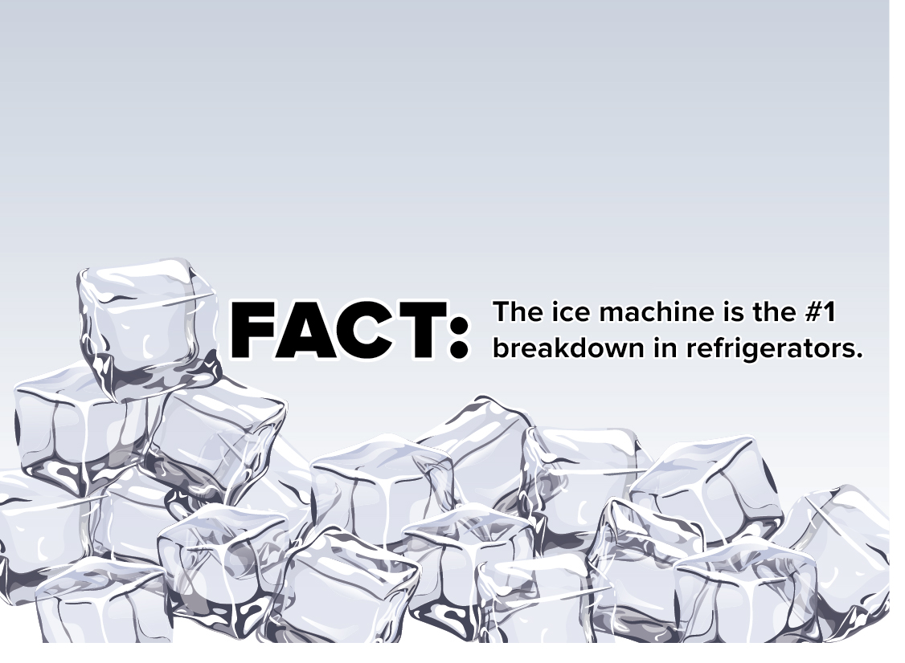
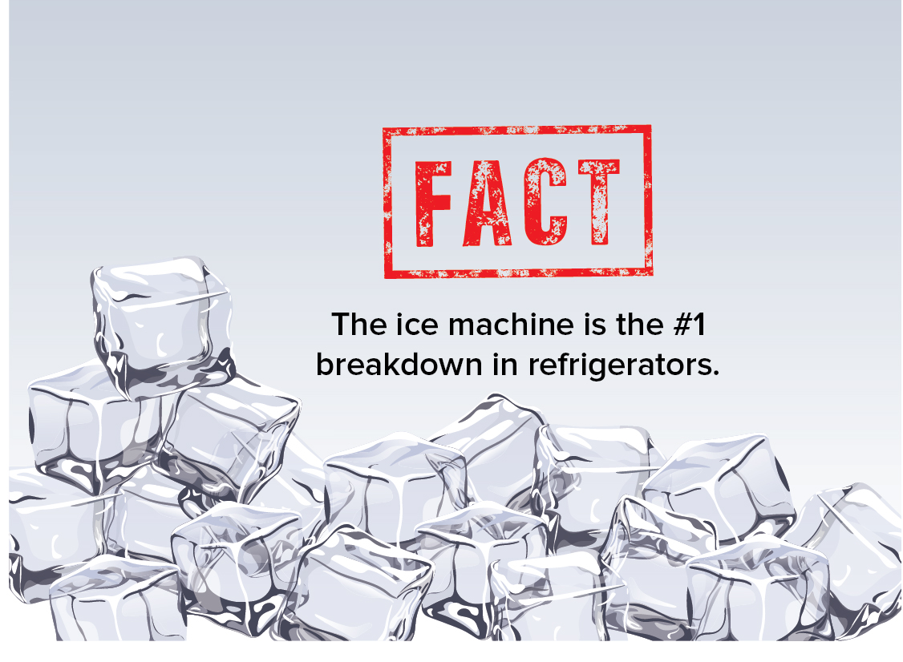

Slide 15
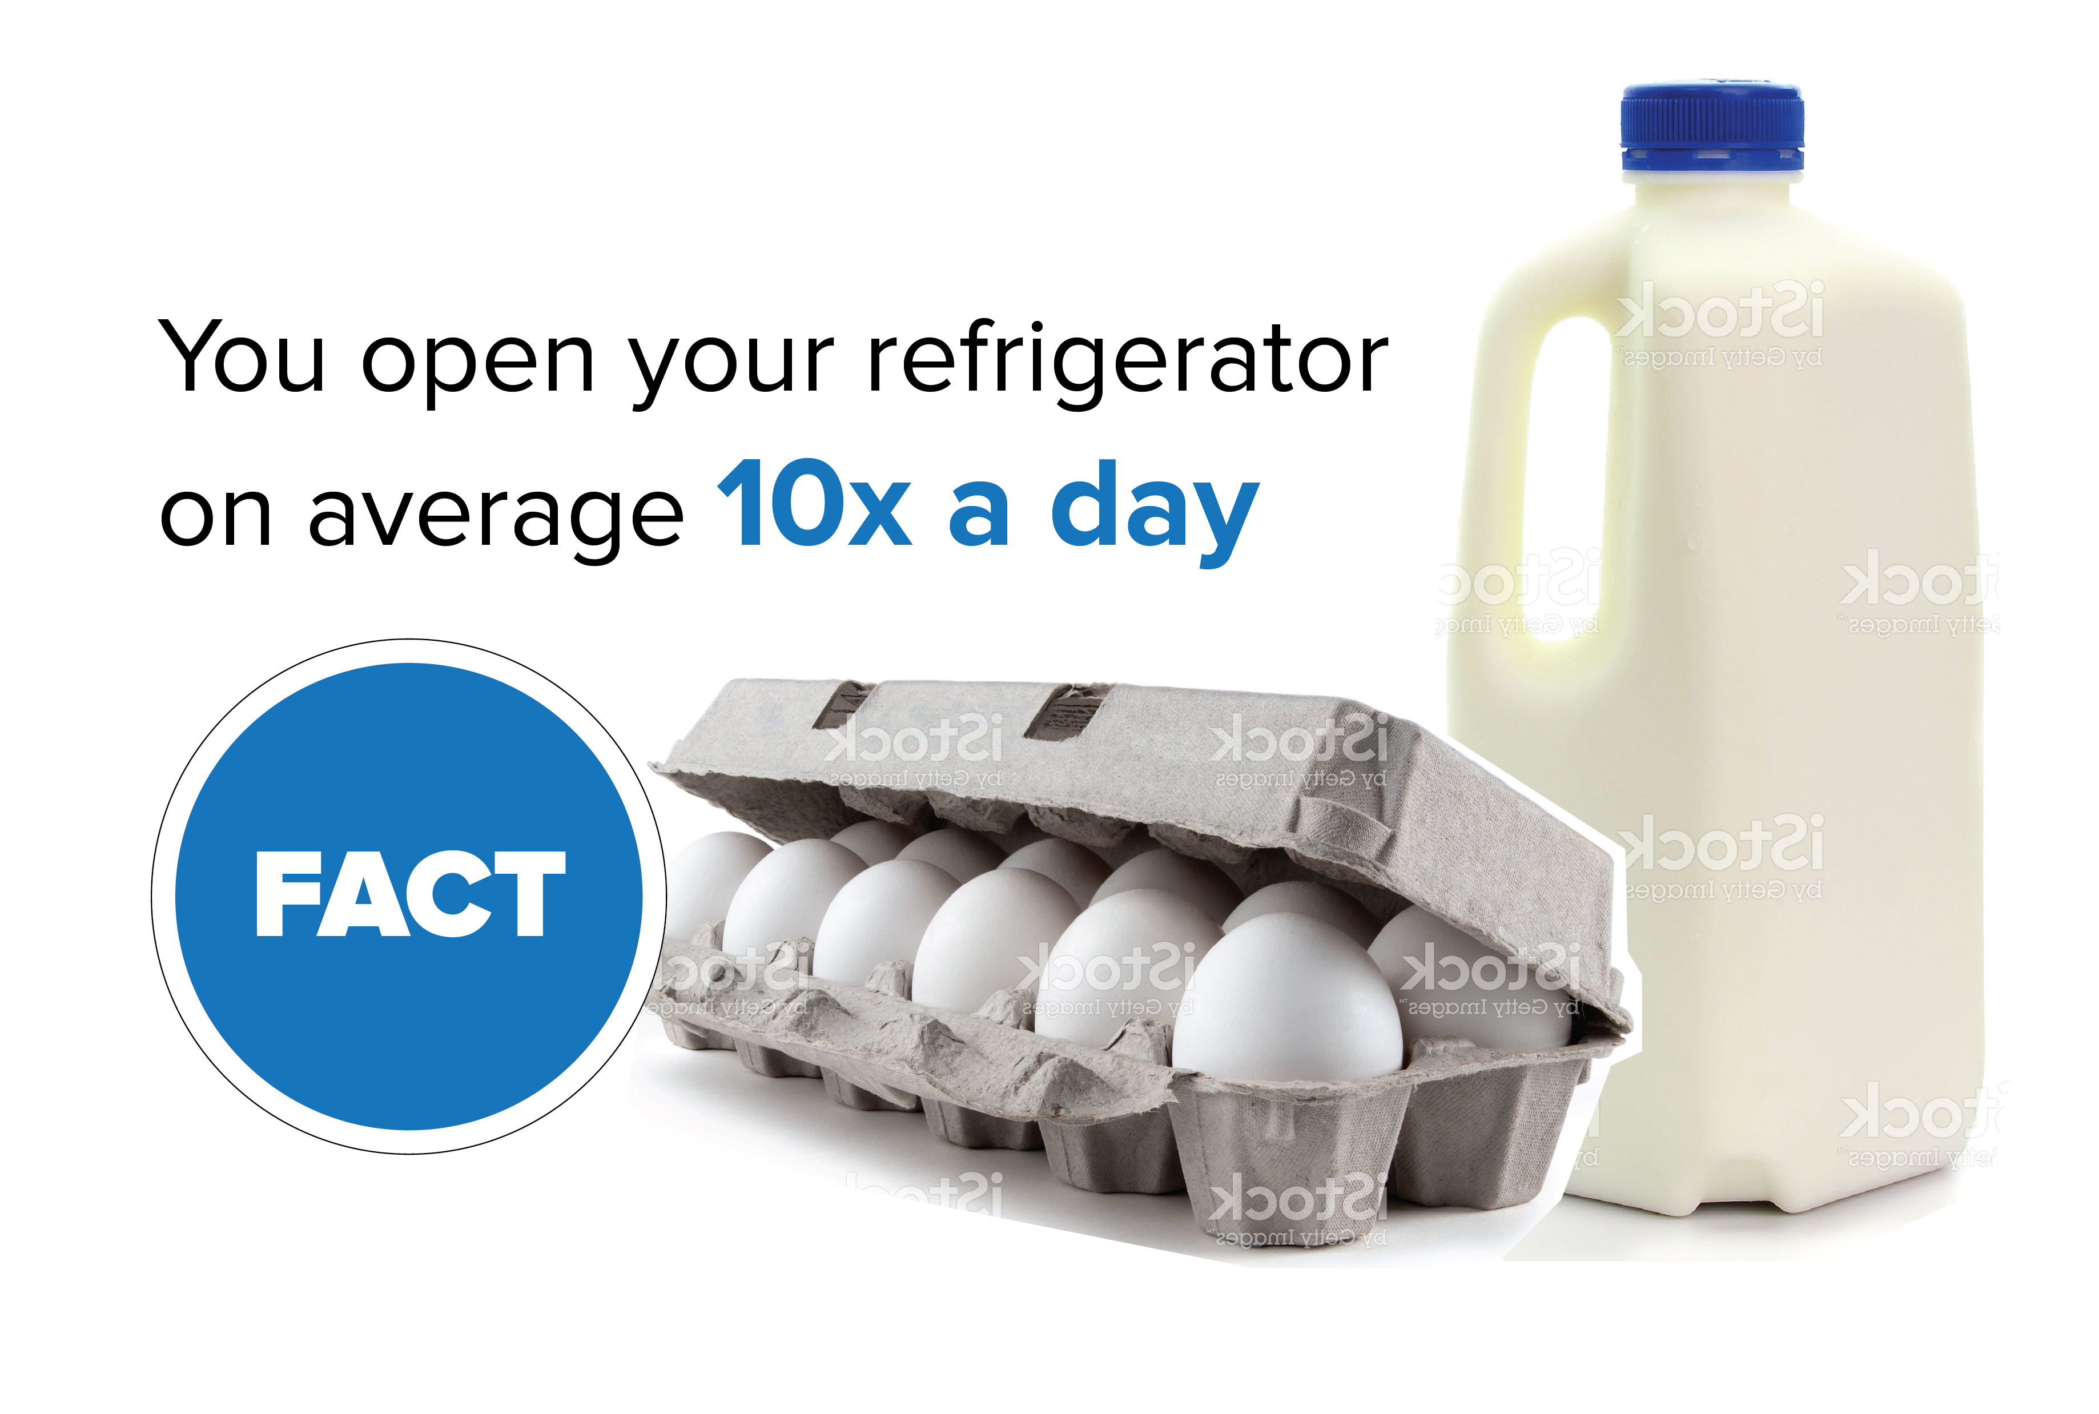
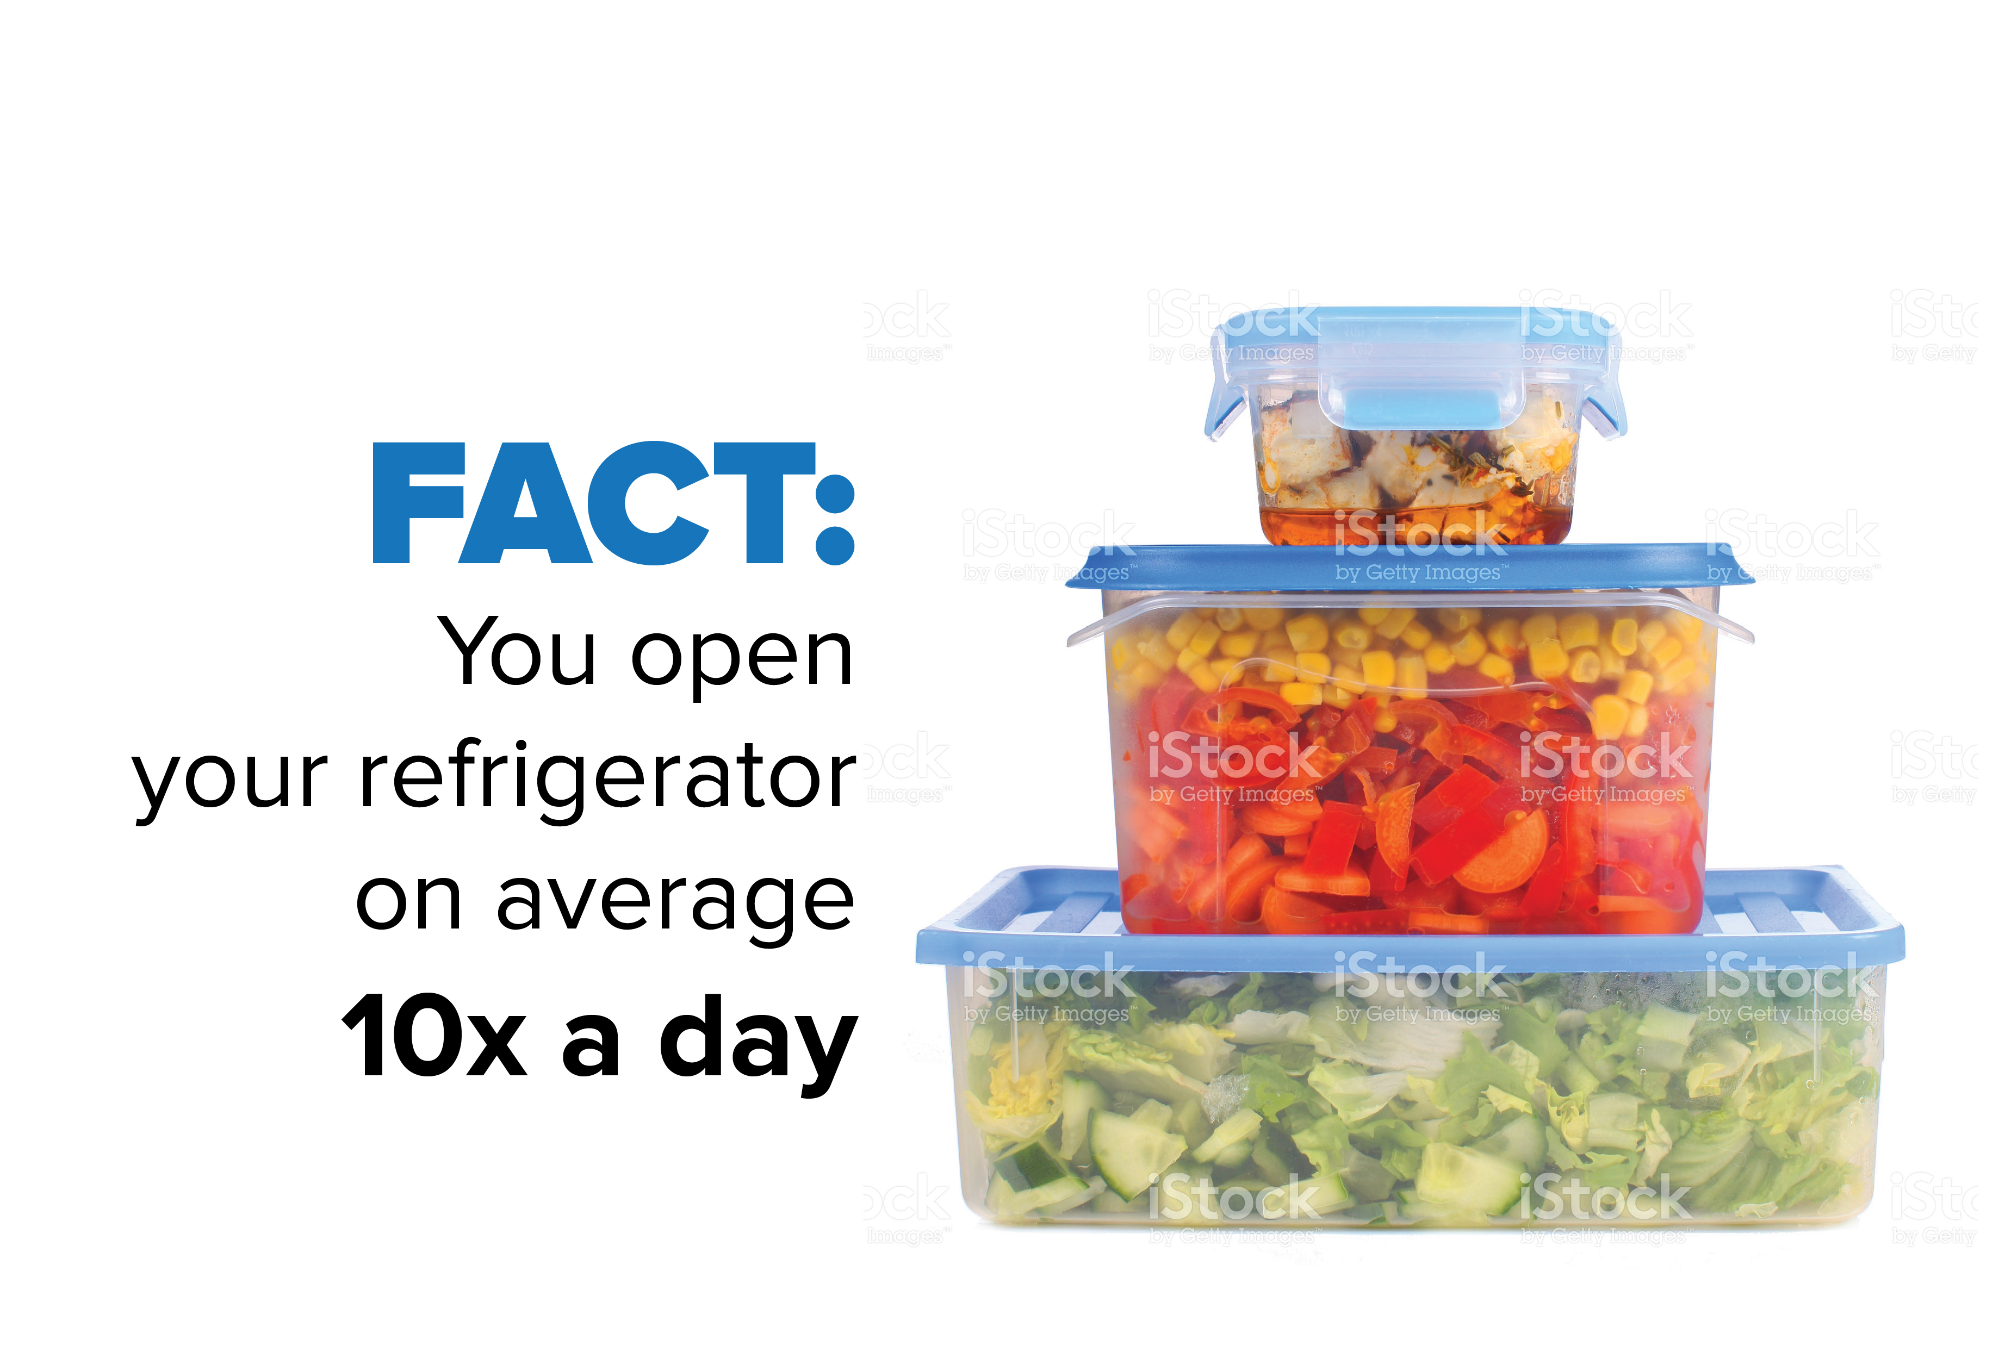

Slide 16


Slide 17


Slide 18
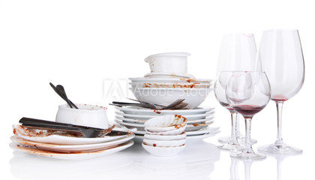

Slide 19


Slide 20


