Slide 1

This logo is sort of what we were thinking of - but we want it to look cooler!

Slide 2







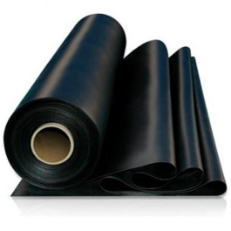

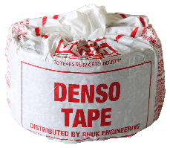

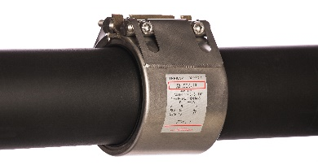

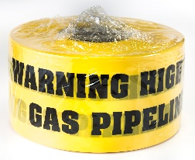
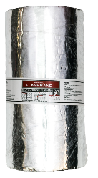

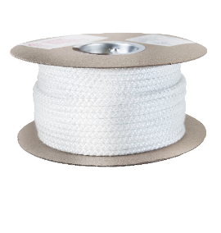
This is what our new website is going to look like:
GASKETS & SEALS
PLUMBING , DRAINAGE & INDUSTRIAL SUPPLIES
METAL GASKETS
RUBBER GASKETS
FIBRE GASKETS
DRESSING SETS
PLUMBING SUPPLIES
GASKET MATERIALS
CHEMICAL PRODUCTS
DENSO PRODUCTS
GLAND PACKINGS
DRAINAGE SUPPLIES
SEALS & ‘O’RINGS
WARNING TAPES
ROOFING TAPE
SEALING PRODUCTS
FIBREGLASS ROPES

Slide 3
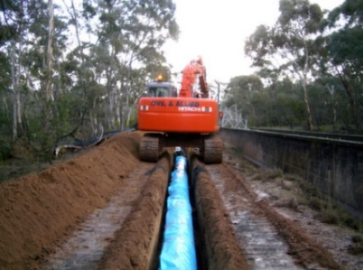

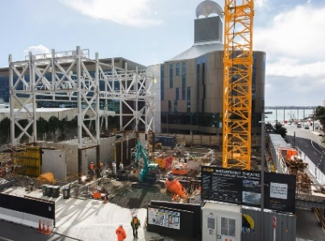
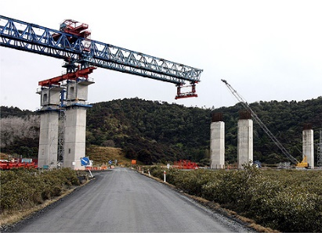
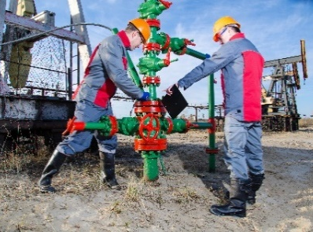
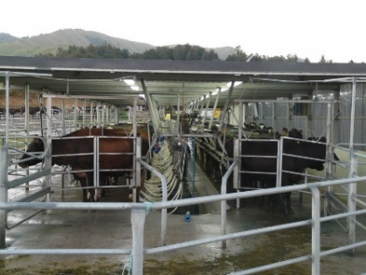
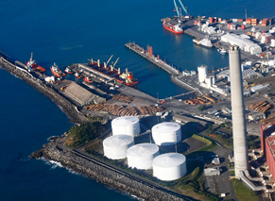
OUR CUSTOMERS ARE IN THESE INDUSTRIES:
ENERGY
DRAINAGE
PLUMBING
CONSTRUCTION
INFRASTRUCTURE
DRILLING
AGRICULTURE
MARINE

