Slide 1
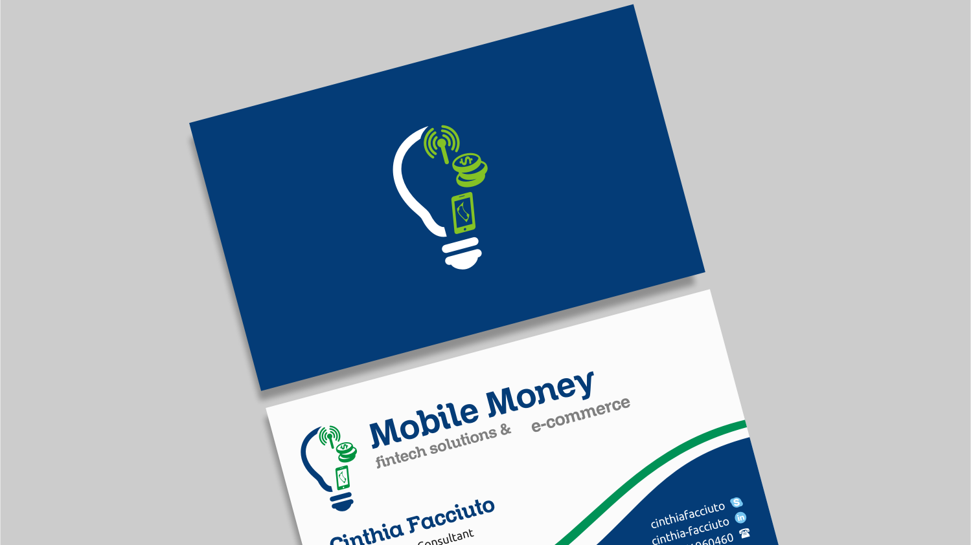
Logo
Mobile Money Fintech Solutions ecommerce
Consulting
Fintech Solutions&e-commerce
Logo

