Slide 1
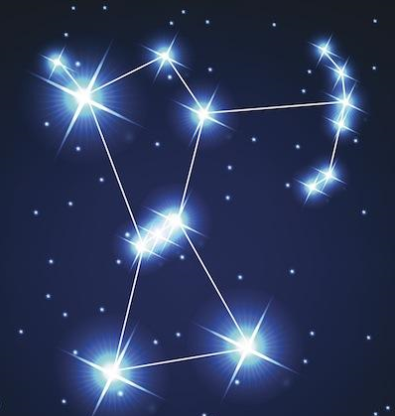

Orion Brazilian Jiu-Jitsu

