Slide 1

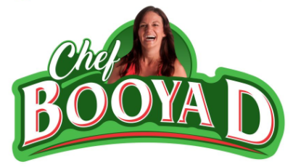
1. Circle start and ends here by making the circle less curved
2. Light green Underline
1. Circle start and ends here by making the circle less curved
3. Completely separate the D and have lighter green show here.
4. Clean up this line, it isn’t a clean line
6. Have same space between the D and red line and the B and red line on both logos --------→
5. Remove lighter green spot here
3. Completely separate the D and have lighter green show here.
4. Clean up this line, it isn’t a clean line

