Slide 1
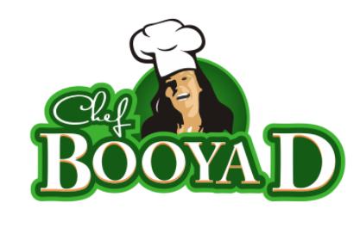
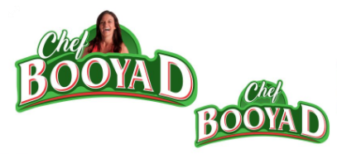
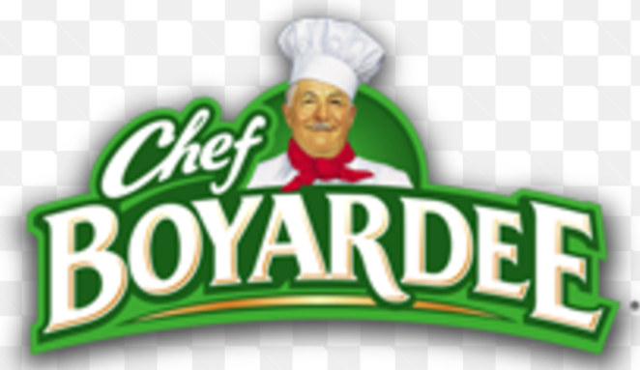
Change Chef font. Difficult to read when it’s a small logo
Use image of me (not cartoon like) with no hat
Make half circle a little wider
Separate the D more
Notice there is no lighter green outline on the top of the font on the original (see below)? It outlines the outside letters on the trop then follows the half circle around the top to the last few letters. I like that look better
Separate the D more
or try: Booya “D”
Add space between Chef and Booya or remove the lighter green font outline here

