Slide 1
Icon suite

Slide 2
Brief
Please create 3 identities - Fundraising / Experience Management / Marketing
Please create 6 icons - Personalisation / Emotion / Ease / Tribe / Impact / Listen & Act
Please create mini infographic using icons Voice --> Listen --> Act (in a circle connecting)
Below are current brand assets. You may use these or create a new direction.

Slide 3
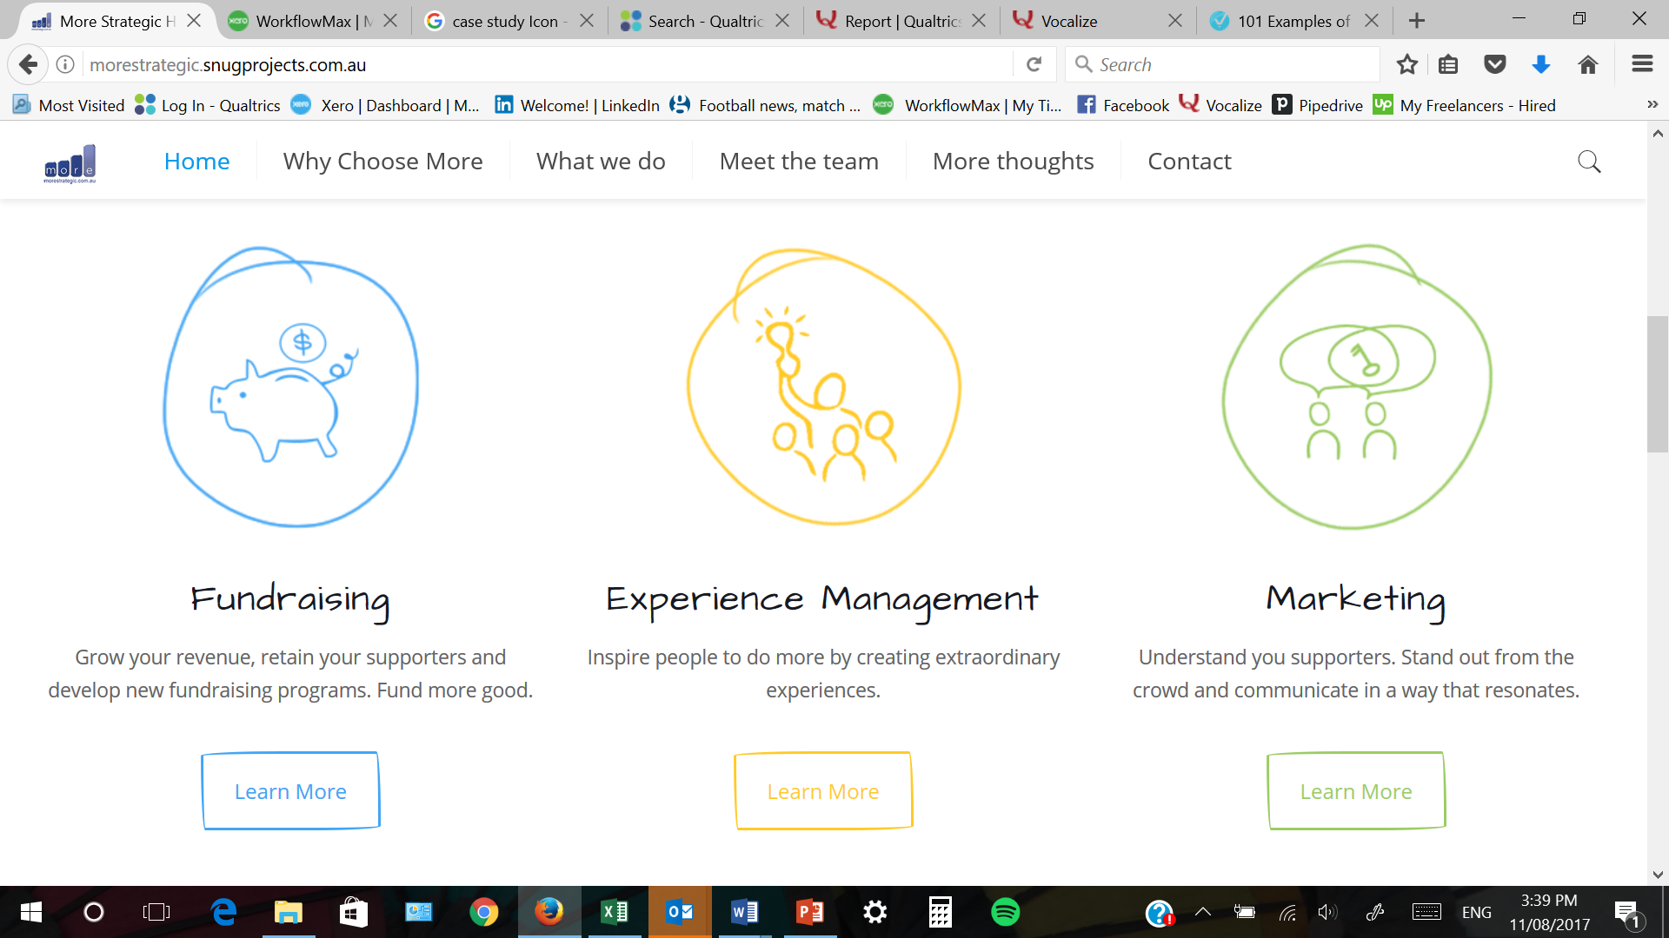

Website redesign – Icons will be needed for web & marketing collateral

Slide 4






Icon options
Circles
Bold strong colours
Strong thicker lines
Level of detail = simple
Flat (not rounded shiny edges)
Single colour
Cheaply Replicable

Slide 5
Fonts
Helvetica
Comic Sans

Slide 6
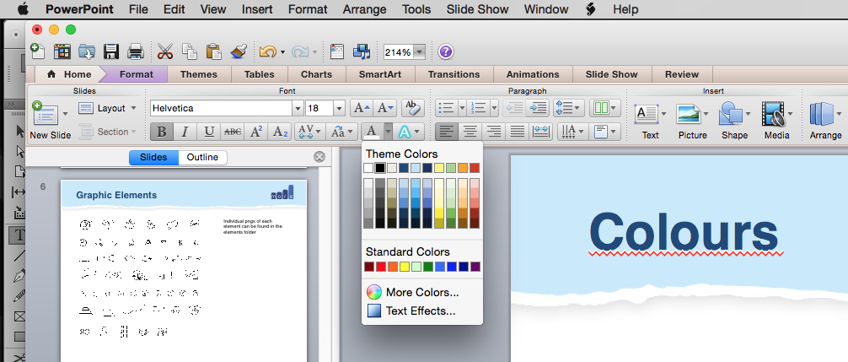
Colours
Brand Colours
Complementary Colours
C100 M89 Y16 K14
R53 G67 B115
PANTONE 661 C
C22 M0 Y0 K0
R204 G232 B250
C86 M100 Y0 K0
R79 G102 B166
PANTONE 660 C
C30 M0 Y47 K0
R192 G217 B162
You may use complementary
Colours or shades of these colours
Additional complementary
colours may be added.
0 M20 Y K0
R240 G212 B228
If you hit the drop down in your theme colours. You’ll find them there.
C0 M0 Y20 K0
R255 G247 B157
C0 M34 Y94 K0
R233 G176 B58
C0 M80 Y80 K0
R192 G80 B41

Slide 7









Post Its
These are all transparent pngs can be used on any background and are great when combined with a graphic element to create a slide sub heading page.
I’ve also created 3 different types of Yellow post its as they’ll be used MORE often.

Slide 8





Paper Rips
5 different types of paper rips are available

Slide 9




























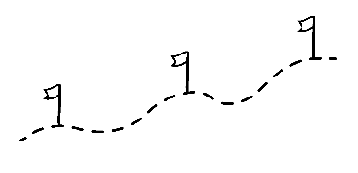





















Graphic Elements
This is the current range but we would like to revisit to create our
own icon range in brand colours. Design elements for ppt will be required
Later

