Slide 1

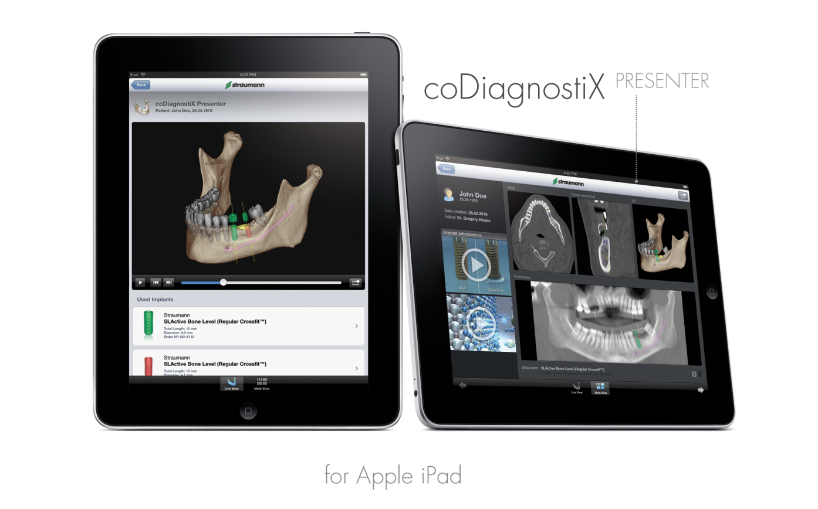

CARES caseXchange™: Impressions
Click to Begin
* For some licenses, case fee my apply
New
coDX 8

Slide 2

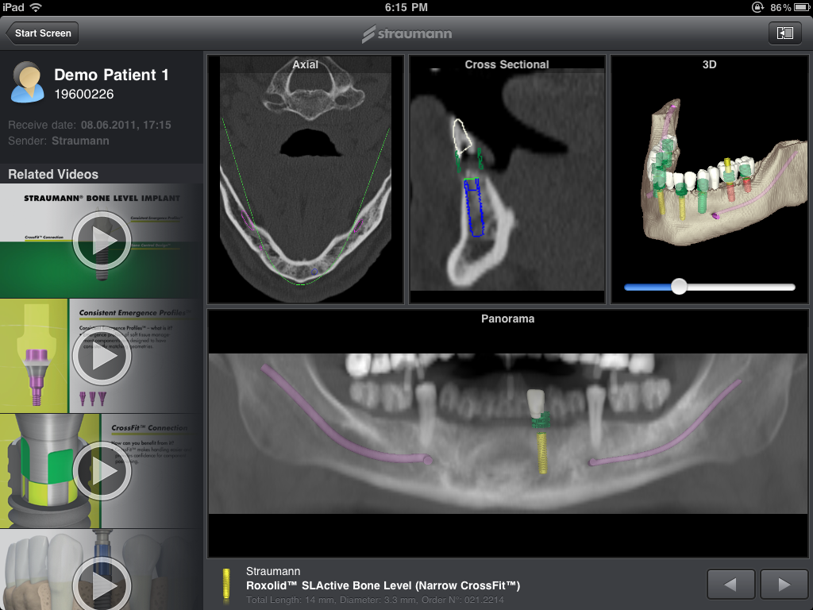

Slide 3
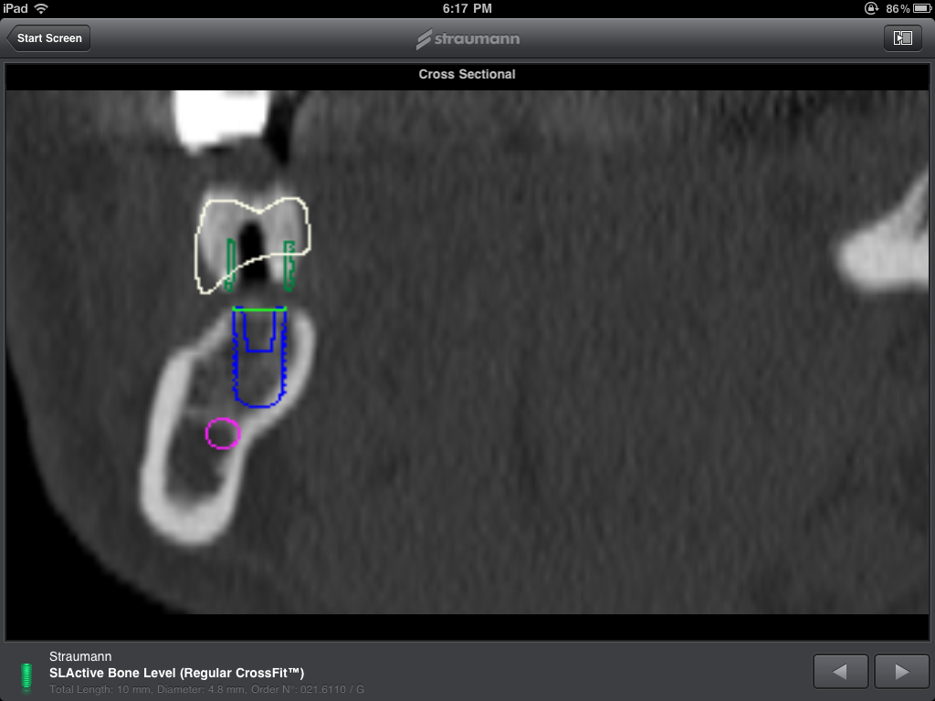

Slide 4
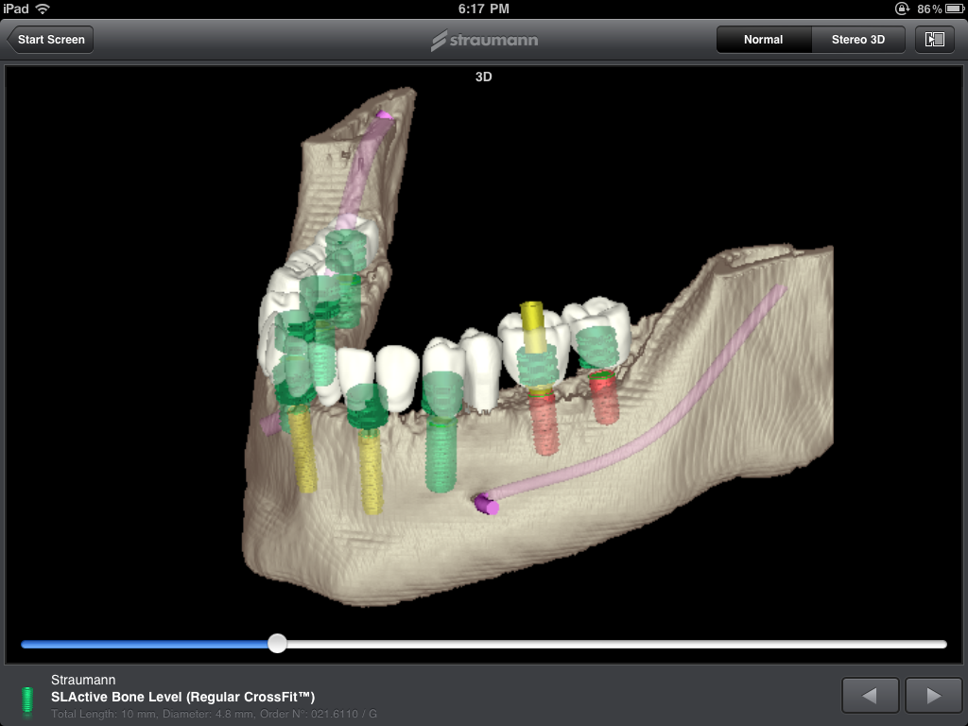

Slide 5
