Slide 1
VIDEO MUSIC PLANET
LOGO Development Vision

Slide 2
LOGO FEATURES
The logo should consist of the following:
Logo Title: Video Music Plant
Logo Initials: VMP
Logo Art: Cartoon Character – Ape or Chimpanzee wearing headphones and glasses
The complete logo should incorporate all three of the above features: Title, Initials, and Character. Logo design must be original. Each of the three elements should be able to stand alone.

Slide 3

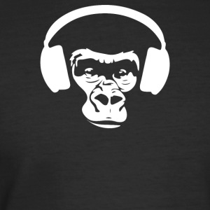
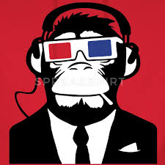
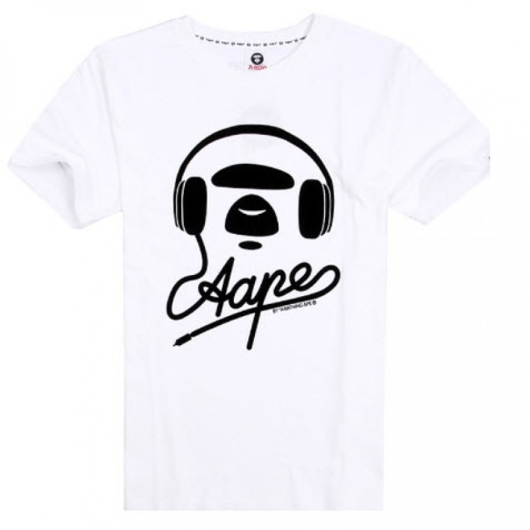


Logo Character Samples (Ape or Chimp with Headphones/Glasses)

Slide 4






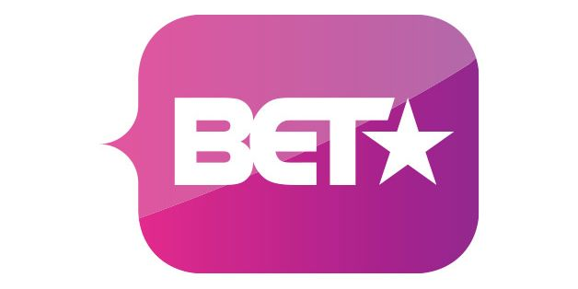



Logo Initial Samples

Slide 5
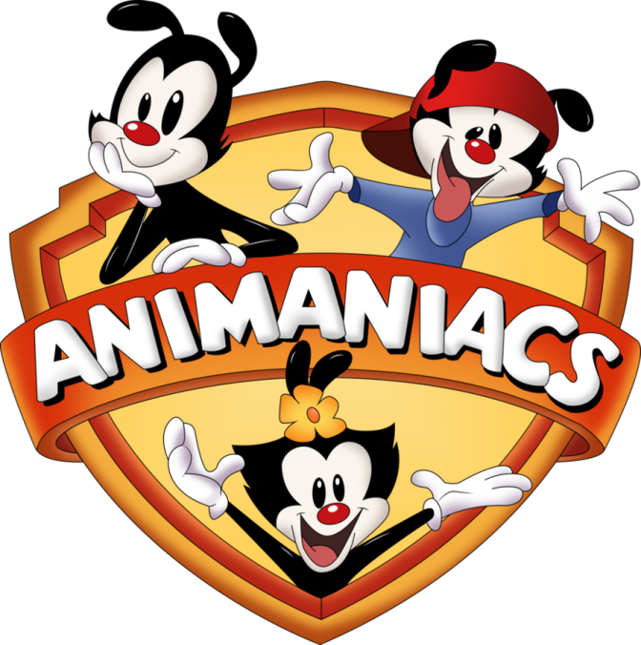


General Cartoon Logos

