Slide 1
BENCHMARK
Factory
Value proposition

Slide 2

If I would be given a chance to start all over I would choose Network Marketing.
Bill Gates

Slide 3

OUR 3 OFFERS
The first French Agency dedicated to B2B Network Marketing
ANALYSIS
STRATEGY
NETWORK
FACTORY
CONTENT
FACTORY
IMPLEMENTATION
LEADS
FACTORY
Network Generation
Events
Wine Club
Dedicated Business Clubs
Executive Business Dinners
Business Exhibitions
…
Leads Generation
Digital Campaigns
Insight sales & leads qualification
Lead nurturing
Marketing automation
…
Content Generation
White papers
Use cases
Barometers
Infographics
…
LEADS
RESULTS
Our Databases: more than 100,000 qualified contacts

Slide 4
LOSAM AGENCY
Your marketing plan/objective for strategic market sector (2,500 employees and more)
Identify your potential clients and priority targets
Create dedicated messaging for your targets and for French Market
Improve your leader position and your brand visibility on B2B market
Federate your French ecosytem and your partners
Touch your targets through a network marketing strategy
Launch Business Clubs to engage your Clients
Develop new business opportunities
Increase leads generation and your sales pipe

Slide 5




OUR PROPOSAL FOR
A basis for our discussions
#1 Marketing Diagnosis
#2 Digital Campaigns
#3 “summit”
#3 Business Club
To identify yours assets (databases, white paper, use cases …)
To define your priority targets
To create your Marketing roadmap
3 main targets:
IT (CIO, CISO, CTO)
Marketing (CMO, CDO)
Design (Advertising Agencies, Design Offices, Research departments…)
Objectives:
Test our messages on different targets and to create a French Barometer “Storage, sharing, and collaboration tools in enterprises”
Generate new leads and users in companies
Event in Paris with a Keynote ( VP) + 2/3 clients testimonies during a plenary session
3 Workshops for each targets (IT, Market, Design) with collaborative demonstrations
Ecosystem partners village to demonstrate the global role of in France
Improve your brand and your imminence on French Market
Generate new qualified leads
Involve your ecosystem and your partners in this disposal
Strategic Board: 1 breakfast with 5/6 representative CxOs (Ambassadors)
An online private community
4 diners : with client testimony in the Ritz Paris:
Retain customers and create a sense of belonging to your brand
Invite your prospects to these events to create a trusting relationship with them

Slide 6

CALENDAR OVERVIEW
A basis for our discussions
Business
Users Club
Format: afterwork – client testimony – wine tasting – 20/30 attendees
Retain customers and create a sense of belonging to your brand
Invite your prospects to these events to create a trusting relationship with them
Business Club #1
Business Club #2
Business Club #3
Business Club #4
40
Leads
40
Leads
40
Leads
40
Leads
Dedicated DataBase Creation - Clients & Prospects
Linkedin private community animated
May17
Jun17
Jul17
Aug17
Sep17
Oct17
Nov17
Dec17
Jan18
Feb18
Mar18
Apr18
May18
Event Organization
Marketing Diagnosis
Digital Campaigns X3
Promote your assets (X2)
Create a French Barometer (X1)
Enrich contacts databases
Identify users
Develop new business opportunities
Event
Improve your brand and your imminence on French Market
Involve your ecosystem and your partners in this disposal
Generate new qualified leads
400
leads
250
leads

Slide 7
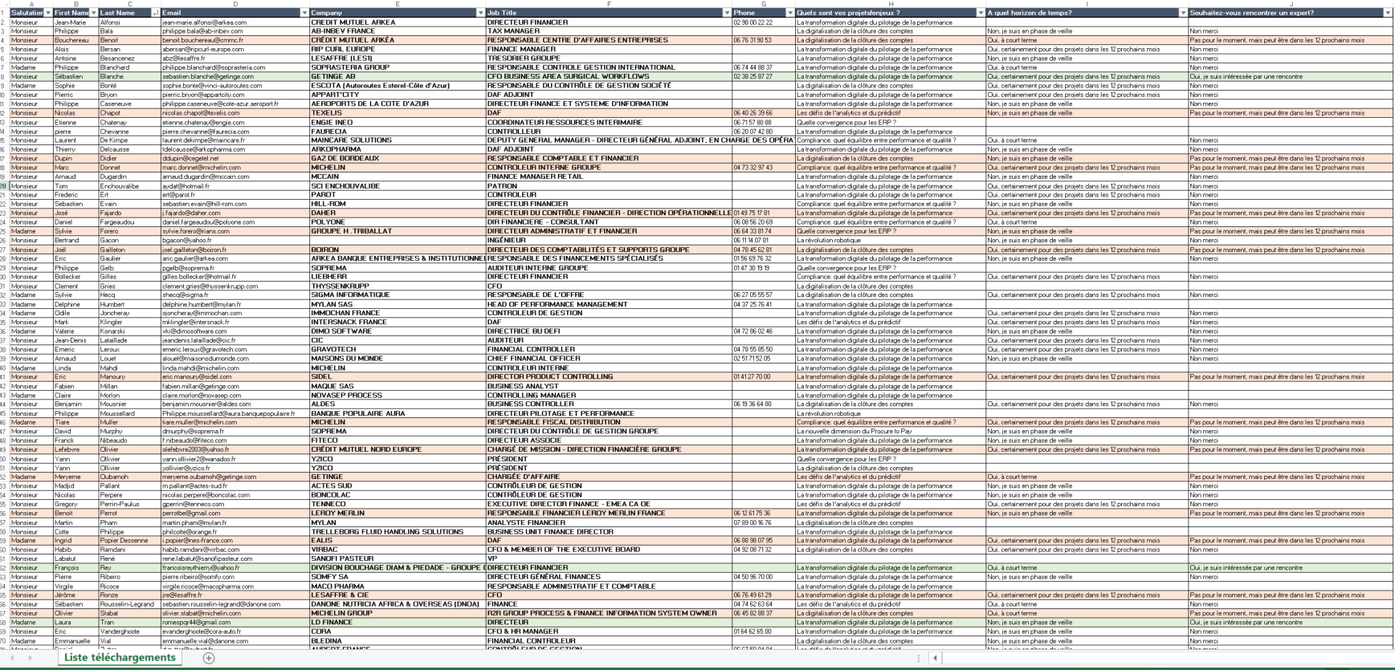
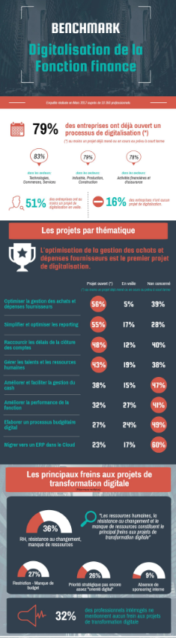
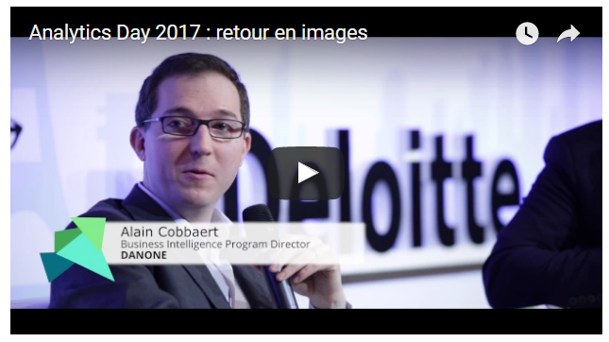

DELIVERABLES (2/2)
A Leads Generation results focused
Digital Campaing & Events
We share with you detailed contacts:
Attendees registered for the event
Contact having participate to a barometer
Contact having downloaded contents
These contacts will enrich your databases and your sales contacts network (.xls file)
We help you in leads qualification:
Projet maturity forms
Priority targets identification
Booking appointements with « hot » prospects
Visibility & Brand Imminense:
Infographics
Videos
Printed content

Slide 8
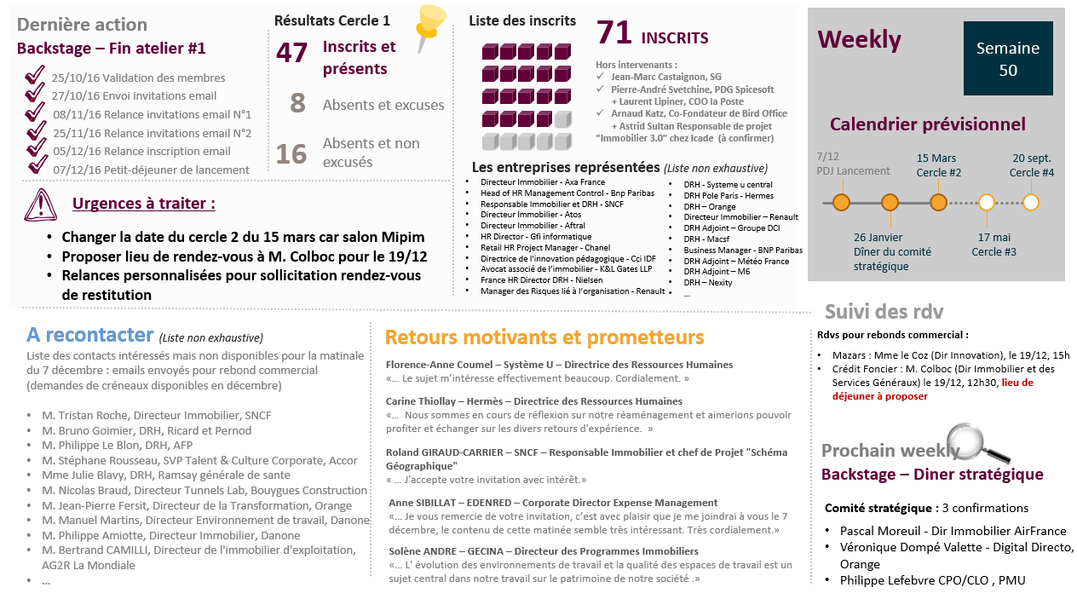
DELIVERABLES (1/2)
A Leads Generation results focused
Business Users Club
Online private community animated
We share with you detailed contacts of all attendees of the Business Club (between 30/40 contacts registered, and 20/30 presents per Club)
These contacts will enrich your databases and your sales contacts network through (.xls file)
We identify qualified prospects interested in the Business Club but not availables, and we support you in booking appointments with them
All our actions are shared every week through a detailed weekly report
We identify all needs expressed during the Club to help your sales in lead qualification
ATTENDEES LIST
PROSPECTS LIST
NEEDS DETECTION

Slide 9
MARKETING OUTSOURCING (1/2)
1 day per week
Senior Marketing Manager
+ back office support
We assist you from marketing strategy definition to operational implementation
Marketing and Sales strategy definition
Partnerships follow-up: CDAF, Deloitte, Option Finance …
Account based marketing strategy creation
Databases creation based on the defined Marketing strategy
Content creation: White papers, use cases, kakemonos…
Competitor monitoring,
Leads & opportunities follow-up
Management and coordination of Marketing disposals
Strategy
Implementation
Follow-up

Slide 10
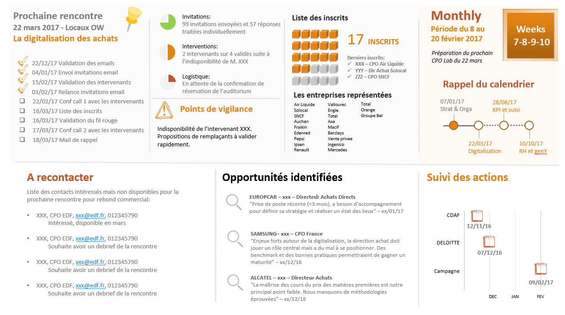
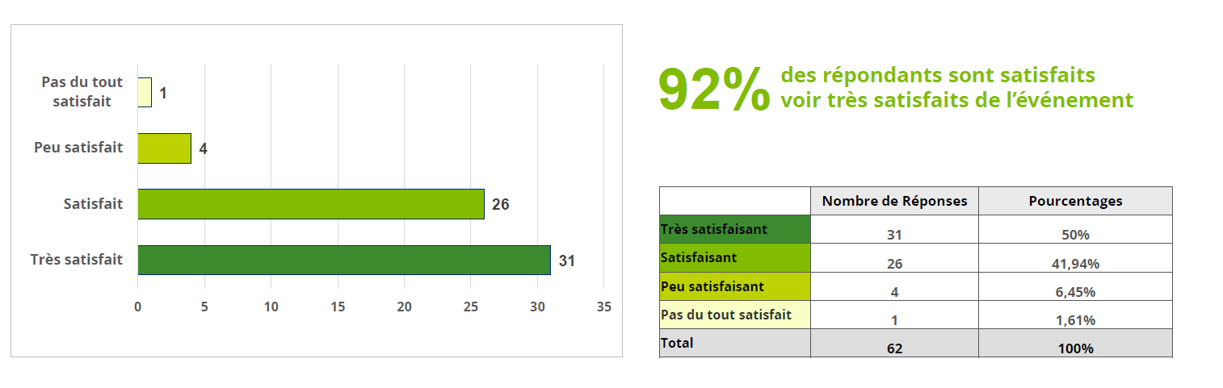
MARKETING OUTSOURCING (2/2)
1 day per week
Senior Marketing Manager
+ back office support
Monthly reports, Marketing actions ROI analysis…
We assist you, after all your marketing actions, to analyze return on investment:
Attendees quality analyze
Satisfaction barometer creation on demand
Leads & Opportunities follow-up
Thanks to a dedicated resource, we assist you in all your marketing disposals:
Operational marketing actions: content creations, marketing supports, follow-up and coordination
Marketing recommendations: competitor monitoring, market events analysis…
Marketing outsourcing with our Agency offers you 20 % discount on all disposals – marketing outsourcing includes project management through your dedicated resource.

Slide 11

BUSINESS CLUBS
The Agency takes charge of creating and leading exclusive think tanks of best practices involving CxO or “Heads of”, or users community, or Alumni…
You will be able to identify new business opportunies and listen to the market's expectations to develop innovative offers.
Test
BUSINESS
CLUBS
CONCEPT
FORMAT
“Barcamp” lead of targets round table where everyone shares their own challenges, knowledges and experiences about a defined subject.
Frequency: 4 events per year (One per quarter)
Deliverables: attendees detailed contacts, lead qualifications, opportunities follow-up, appointment bookings …
25 people maximum per session to ensure an open debate format.
Exclusivity: in our white label service framework, the Agency organizes all this lead generation program exclusively
for

Slide 12
FOCUS ON 6 SERVICES
Dedicated to in order to improve French Sales Development
02
BUSINESS CLUBS
The Agency takes charge of creating and leading exclusive think tanks of best practices involving CxO or “Heads of”, or users community, or Alumni…
03
EXECUTIVE BUSINESS DINNERS
Networking and Benchmarking dinners between decision-makers who choose 2 subjects of concern beforehand, on which they wish to feed their reflections by experience feedback between peers. All dinners take place in a Parisian luxury hotel…
04
WHITE PAPERS & BAROMETERS
Creation of white papers or barometers “from scratch” or translation and adaptation of existing documents for the French market.
Market studies, editorial staff, customers interviews, design, printing, promotion.
04
DIGITAL CAMPAIGNS
Launch of Digital campaign, based on existing assets or benchmark creation to identify new leads and short-term projects.
Digital campaigns could be launched in white label or through our website
www.benchmark-factory.com
06
01
LEADS QUALIFICATION
Leads qualification by phoning and emailing actions following a Business Club or a Digital Campaign, to facilitate your sales actions and prioritize identified projects.
MARKETING OUTSOURCING
We assist you from marketing strategy definition to operational implementation.
We dedicate a senior marketing manager to direct all your marketing plans and follow all actions.
.

Slide 13
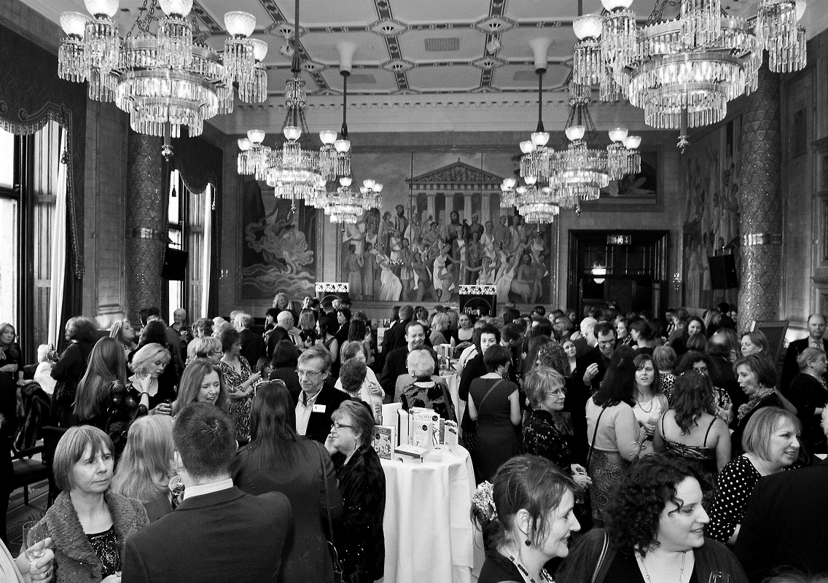
EXECUTIVE BUSINESS DINNERS
Networking and Benchmarking dinners between decision-makers who choose 2 subjects of concern beforehand, on which they wish to feed their reflections by experience feedback between peers. All dinners take place in a Parisian luxury hotel…
You will be able to increase your visibility and to identify new high level qualified contacts.
EXECUTIVE
DINNERS
CONCEPT
FORMAT
VIP dinners for your clients and your priority targets
4 dinners per year in a Parisian Palace
11 people per table:
10 top executive decision-makers
1 sponsor
Each attendee selects 2 subjects of interest and moves from one table to another during the dinner, to debate on theses challenges
Agenda:
1 - Roundtable with decision-makers to identify their challenges
2 - Debates and experiences sharing
3 - Best practices identified synthesys by the sponsor
4 - Clients move to another table and new decision-makers come to your table
Sponsor leads one table (= one subject) and debates with 20 decision-makers during dinner
All detailed contacts are shared after the dinner (around 150 qualified contacts).

Slide 14

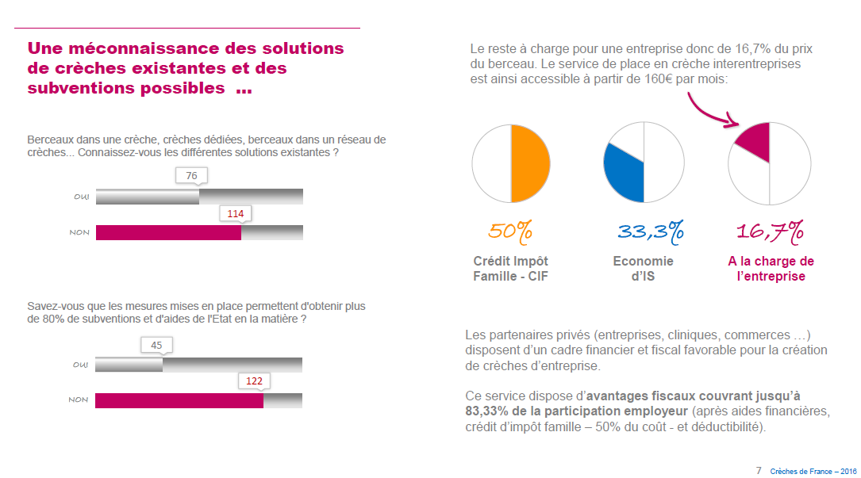
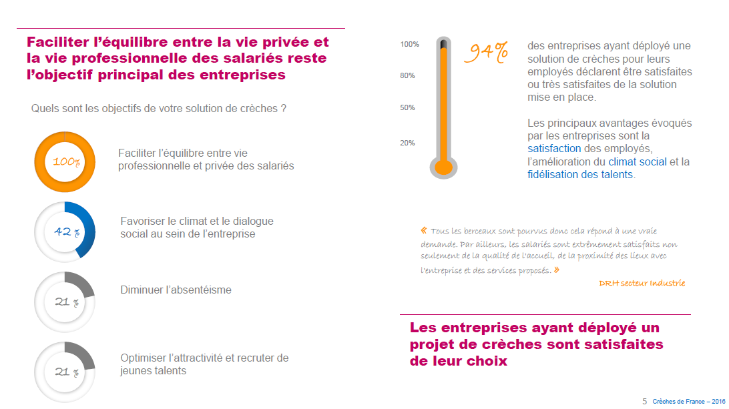
WHITE PAPERS & BAROMETERS
Creation of white papers or barometer “from scratch” or translation and adaptation of existing documents for the French market.
The Agency takes charge of creating market studies, editorial staff, customers interviews, designs, printings, promotions.
You will be able to promote your brand through a high quality asset and to identify new qualified leads.
WHITE
PAPERS
OBJECTIVES
EXAMPLES
Create a high value content
Collaborative white papers
Promote your brand
Barometers, use cases, infographics
Identify new leads
Launch Digital Campaign

Slide 15

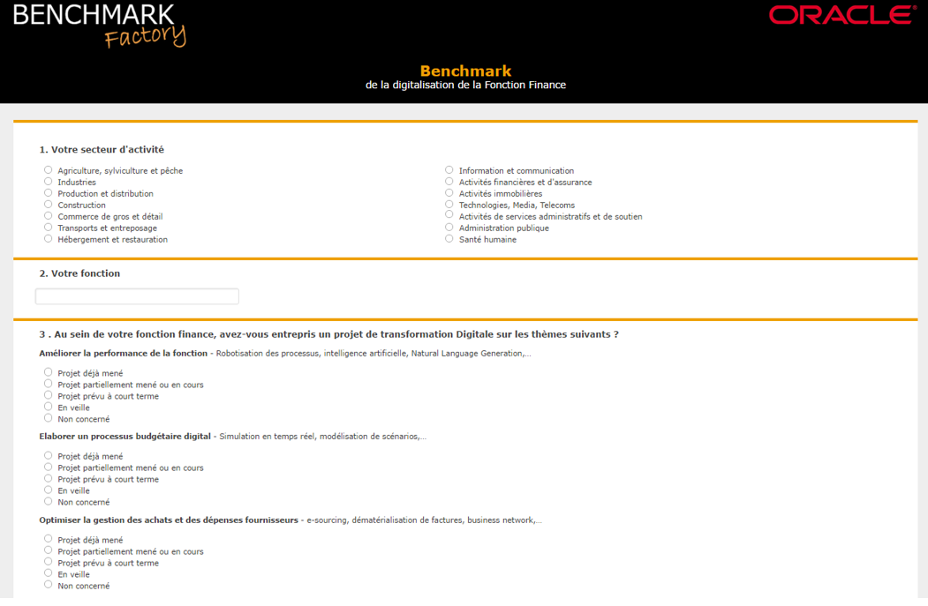
DIGITAL CAMPAINS
Launching of digital campaign, based on existing assets or on benchmark creations to identify new leads and short-term projects.
Digital campaigns could be launched in white label or through our website www.benchmark-factory.com
You will be able to reach a large qualified target, collect CRM Data and identify new clients projects.
DIGITAL
CAMPAINS
OBJECTIVES
EXAMPLES
Promote or create a content
Reach a large qualified target
Increase your visibility
Engage your clients & prospects

Slide 16
LEADS QUALIFICATION
Leads qualification by phoning and emailing actions, following a Business Club or a Digital Campaign, to facilitate your sales actions and prioritize identified projects.
You will be able to accelerate your sales process thanks to our leads qualification and to focus your actions on priority opportunities.
LEADS
QUALIFICATION
OBJECTIVES
DELIVERABLES
Insure a fast first contact with the “hot” leads to guarantee the best reactivity and quick projects identification
A synthesis for every identified relevant project:
Short project description
Project timing
Project Budget
Key stakeholders and detailed contacts
Insight sales
Leads qualification
Lead nurturing
Prioritize leads coming from marketing disposal and define your sales pipe
Assist your sales and help them focus on high value actions

Slide 17
BUDGET
A Leads Generation results focused
XX€ for 3
LEAD CAMPAIGNS
XXK€ for the
SUMMIT
XXK€ for 4
BUSINESS CLUBS
3 Digital Leads Campaigns
1
Event in Paris
users Club
Databases creation & Content adjustments
Forms and infographics creation
Emailings Campaigns, leads follow-up…
Databases creation and follow-up
Logistical organization and expenses
Invitations, reminders, leads follow-up…
Invitations and follow-up
Logistical organization and expenses
reminders, Linkedin group, leads follow-up…
XXK€ the Full one year Package including a marketing Manager dedicated 6 days per month

Slide 18
OUR BOTTOM LINE
Specialized, custom-made, measurable
ANALYSIS
Dedicated
to B2B
White
Label
Measurable
Results
STRATEGY
ESSENTIAL
IMPORTANT
IN OUR DNA
IMPLEMENTATION
LEADS
Our team is composed by former consultants specialized in B2B Marketing and a former Marketing Director of a Big Four company.
Our disposals are created especially for our clients and we offer custom-made services.
Only your brand is visible.
We commit to delivering measurable results: generated leads, new relationships, satisfaction barometer, identified opportunities…
RESULTS

Slide 19









OUR CLIENTS
Specialized, custom-made, measurable

