Slide 1

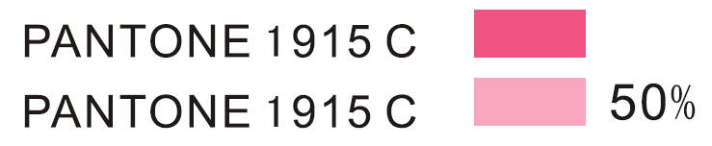

BRAND LOGO
Pantone:

Slide 2
ABOUT bloop
bloop = make up – (the fuss) + Fun x Your Imagination
bloop is makeup made easy
A new generation of make-up using innovative packaging and technological advancement in product quality and texture to help women combat the highly competitive world of today.

Slide 3
PROJECT BRIEF
To create an outer box for a set of nail polish (6pcs of nail polishes in a set).
Packaging requirement.
Packaging has to be as compact as possible.
Will need 2 window opening (front and back) to showcase the color of the nail polishes inside.
Looking for a unique and fun design.
Will need to allocate areas to input :-
Distribution details
Ingredients
Country of origin
Barcode & Product code

Slide 4
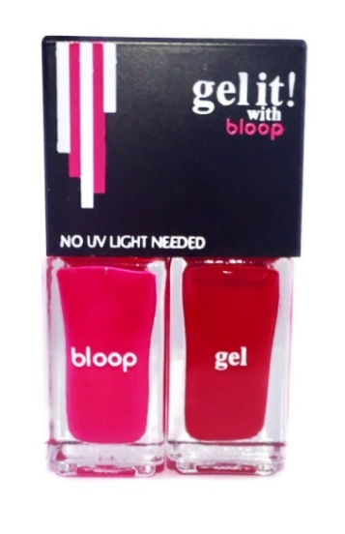
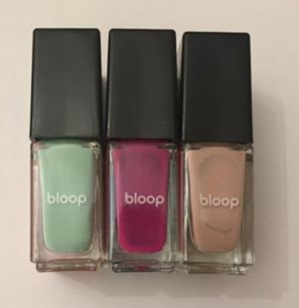
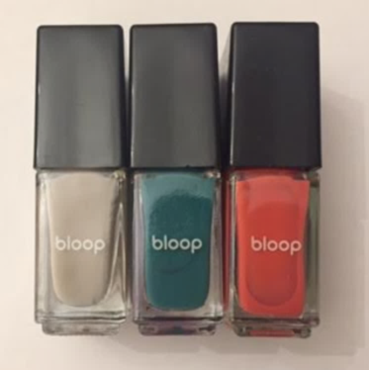
PACKAGING DETAILS
A window opening to
Showcase the colors.
FRONT and BACK of the box.
PRODUCT SIZE
For reference
BOX SIZE
D: 3.7cm
H: 2.8 cm
H: 5.9 cm
H: 3.1 cm
H: 6.0 cm
W: 5.7cm
H: 0.7cm

Slide 5
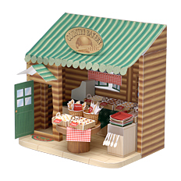
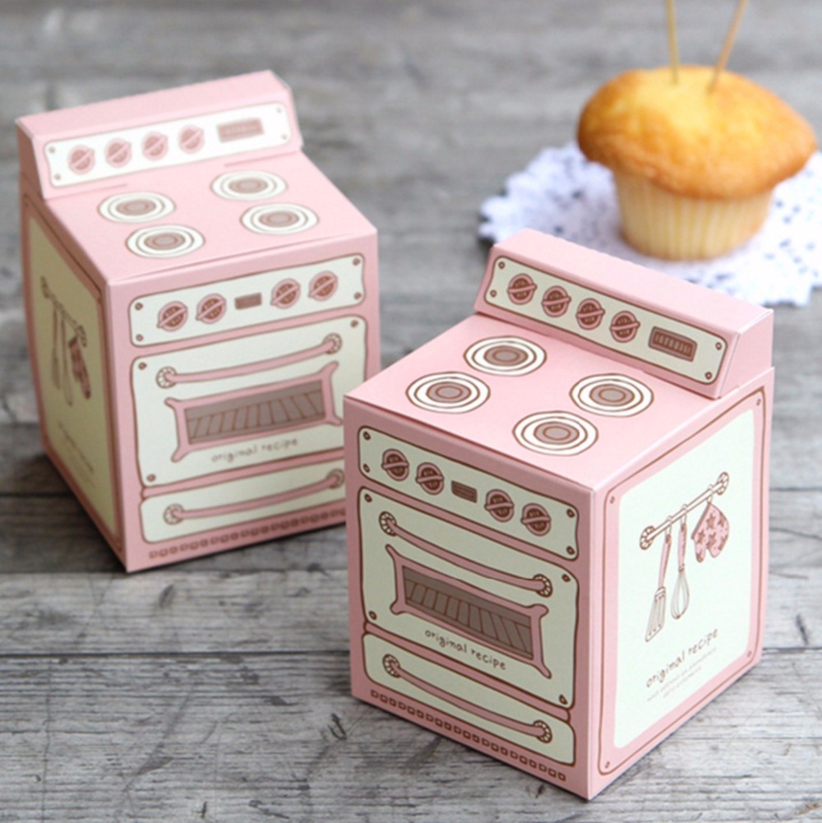
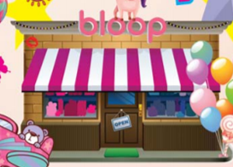
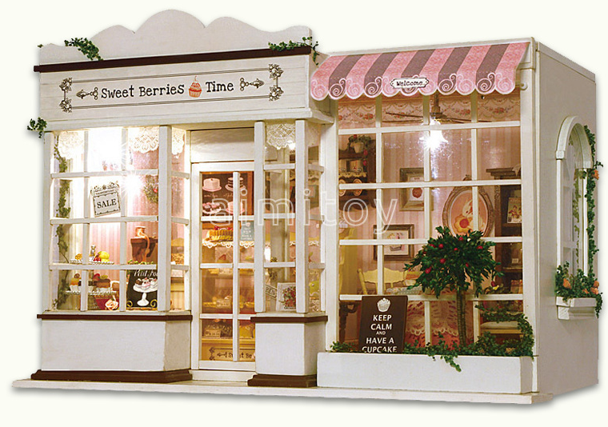
concept ideas however we are open to other ideas.
A packaging that can be converted into a 3D beauty shop without much production cost on packaging.
Free-hand drawn in a form of Beauty shop / cafe instead of oven
Able to lift up this part to make it 3D

