Slide 1
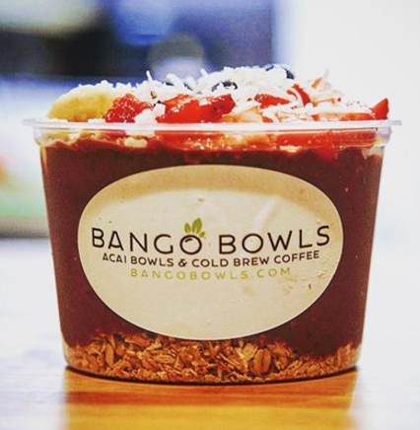
Honey and coconut shavings -
“The Bango Bowl Breakdown”
Our signature acai blend consists of pure acai, strawberries, bananas, blueberries and a dash of soy milk. We serve cold to create an creamy sorbet consistency.
Fresh fruit (Strawberries/Banana/Blueberries) -
Organic Granola -
Acai Blend
Organic Granola -
Customize your bowl with choices of granola, fruits, seeds and more

