Slide 1
Sports for Schools: brand guidelines

Slide 2
Review of 2014
Guiding Principles & some
To do our bit to encourage kids to live a healthy life
To inspire, challenge, and excite
To encourage “i can’t” to become “I CAN”
To be socially and environmentally responsible
To create worthwhile and well rewarded careers
To do the right thing

Slide 3

Our 5 brand values
EXCITE
The key, central value around which the other four are built. We want children to discover for themselves the great feeling from physical exercise – whether at an event or elsewhere. If we had to sum Sports for Schools up in just one word, this would be it.

Slide 4

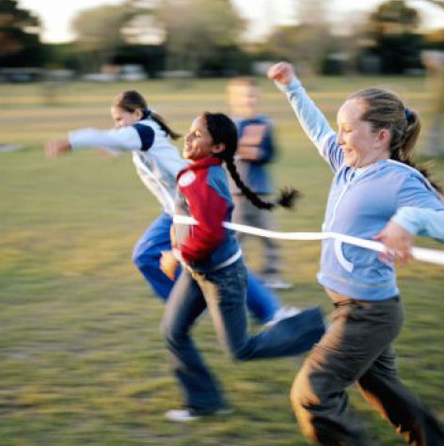

Our 5 brand values
ACHIEVE
We want everyone who connects with Sports for Schools to get a sense of achievement. We want people to discover that anything is possible to those that try – and the result is a wonderful sense of achievement. For some this will be from just completing a fitness circuit, for others it will come from seeing those children discover new physical abilities. However it happens, touching Sports for Schools will deliver a great result for that person – they will have achieved something.

Slide 5




Our 5 brand values
TEAM
Excitement isn’t the same when you have no one to share it with. The sense of being in a crowd trying your hardest, making your muscles work, and then the great feeling of recovering from the activity are all part of being in a team. Creating a new personal benchmark each and every time you do the fitness circuits, during the event or weeks afterwards, competing with your friends to better yourself.

Slide 6

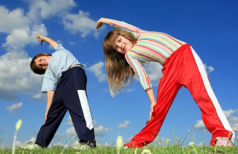

Our 5 brand values
ALERT
The net result of all the excitement, achievement, working as a team is a sense of being sharp: both physically and mentally sharp. We don’t molly-coddle participants; because letting them work hard, pushing their physical boundaries is perhaps the best way for them to feel sharp at the end of the event – and later on when they test their physical fitness in the future.

Slide 7

Our 5 brand values
WOW
The very best brands all create a sense of ‘wow’ by going to great lengths to make them happy. This is what WE want to achieve. Whether it’s because someone has received great service, discovered an extraordinary athlete, discovered something in themselves or we’ve done a great job of correcting a mistake. Negative situations will happen from time to time, but there is always a way to turn them around – and beyond that, to turn dissatisfied customers into brand ‘ambassadors’. If there’s an apology to be made, make it straight away. Be genuinely sorry. And use your discretion to satisfy the customer – even if the cause for complaint was out of your control. No customer is louder in their praise than the one who expected the worst and received the very best. This is word-of-mouth marketing at its very best.

Slide 8
C | M | Y | K | Red | Green | Blue | HEX
10 | 100 | 90 | 0 | 230 | 0 | 25 | #E60019 | #d70b24
60 | 0 | 100 | 0 | 102 | 255 | 0 | #66FF00 | #6eb92b
95 | 15 | 0 | 0 | 13 | 217 | 255 | #0DD9FF | #0094db
0 | 0 | 0 | 90 | 25 | 25 | 25 | #191919 | #3e3a39
0 | 80 | 90 | 0 | 255 | 51 | 25 | #FF3319 | #ea541f
0 | 60 | 90 | 0 | 255 | 102 | 25 | #FF6619 | #ef831e
80 | 0 | 100 | 20 | 41 | 204 | 0 | #29CC00 | #009233
70 | 0 | 100 | 10 | 69 | 230 | 0 | #45E900 | #3fa531
100 | 40 | 0 | 0 | 0 | 153 | 255 | #0099FF | #0074c1
80 | 0 | 0 | 0 | 51 | 255 | 255 | #33FFFF | #00afec

