Slide 1
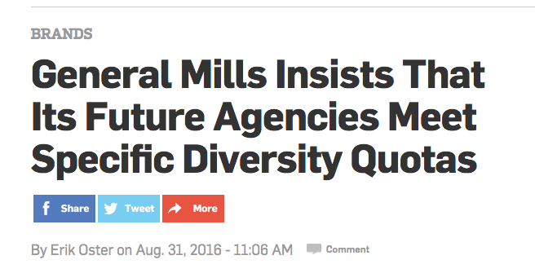
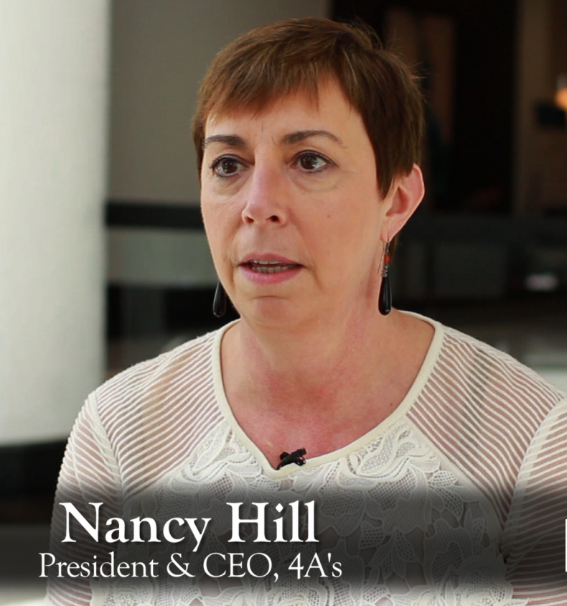
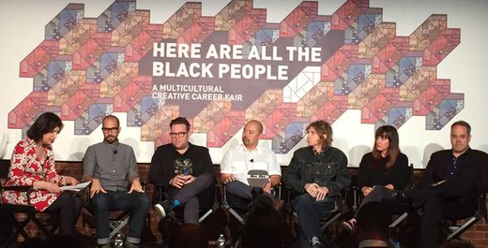
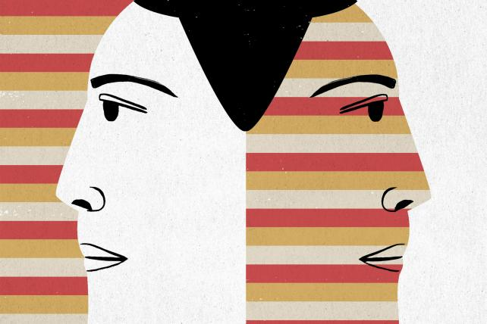

12% LLC
Narrowing the racial diversity gap
A powerful new approach to increasing the African-American employment rate in the communications industry
Despite efforts to increase participation, African-American rates of employment in the communications industry have actually declined over the past decade
African-American Proportion of Workforce*
Overall Workforce
2005
Overall Workforce
2016
Communications Industry
Communications Industry
11%
7%
12%
5%
  While the communications agency hiring rate of people of Hispanic or Asian origin has reached parity with their overall workforce participation rates, African-American participation has actually dropped by nearly a third.
  Communications agencies have identified this gap as a critical issue but are falling further behind on AA hiring.
  *REFERENCE TO COME
Clients have now begun to directly exert pressure on the industry
“In order to push yourself to have a more diverse work force you have to be intentional about it — and nothing will drive intent faster than a client’s dollar”
Why are communications agencies failing to increase the AA hiring rate?
An industry too inwardly focused to realize that it can be offputting
Assuming barriers to hiring all people of color are the same and are not unique to each group
Dramatic disconnection from the most critical candidate pool that can provide an immediate and lasting impact

Slide 2
The 12% Mission
Drive parity in opportunity and representation for the most promising young African-American minds while creating a cultural and competitive advantage for progressive communications organizations
Process
Community Connection
12% works closely with the African-American communities within relevant college programs with a strong focus on HBCUs
Identification & Vetting
Candidates are identified through community connection and formally assessed for relevant agency technology skills, emotional, cultural and academic prowess.
Multi-Focal Training
Coaching provided to crystallize candidate’s personal brand and voice, to improve the communication of value and reduce time spent ‘trying to figure out.’ Coaching also focuses on personal presentation and professional etiquette training to facilitate corporate integration.
Training program specific to advertising industry, to include all major disciplines.
Onboarding Support
New hires will be provided innovative e-development platform with personal mentor, to ensure successful onboarding.
Community Building
Each 12% candidate signs an agreement to initiate a mentoring relationship with a young African American professional hired after them within their organization.
About 12% LLC
12% is a B Corp (for-profit social enterprise) created by two principles with direct and complimentary experiences in tackling related challenges.
Jo Leonard has created a highly successful coaching practice focused on helping soon to graduate, or recently graduated, college students find purpose-driven careers. She is also the founder and Executive Director of the RJL Foundation which provides guidance and assistance for young adults who are “aging out” of the welfare system with over half of the foundation’s fellows being African-American.
Paul O’Neill spent his career in the advertising business culminating in running leading agencies at both WPP and IPG. He has personally dealt with the barriers and frustrations in identifying and attracting talent from the African-American business community despite significant corporate efforts. He has also witnessed the significant advantages gained when truly diversified teams are assembled and nurtured.

