Slide 1


Title Goes Here
January, 2017
Presented to John Doe
Presented by LPC

Slide 2

2013 Overview/Goals Achieved
Increase Tenant Satisfaction – Goal achieved 95%
  Tenant Surveys: Overall 21 % increase over 2012
  Retention/Touch Program Benchmarked in 2013
  Work order response time < 1hr.
  Pro-actives increase to 55% achieved 49.3%
  Survey Monkey - Established Protocol
  Tenant Meetings & Property Inspections
Expense Containment- Goal Achieved 94%
  Reduced expenses by 5% achieved 9% savings from rebids on selected controllable expenses
  Reduce Energy Consumption an additional 5% over 2012 levels achieved 13.2% consumption savings
  Capital Tracking tool - Complete
  Energy Star –14 out of 18 Buildings
Team Development - Goal achieved: 100%
  Implementation of Engineering Development Program
  Completed Managerial Development through BOMA
  Completed Lunch and Learn Series
  Emergency Preparedness Manual
LPC/EOP
Team Meeting – 3.26.14

Slide 3
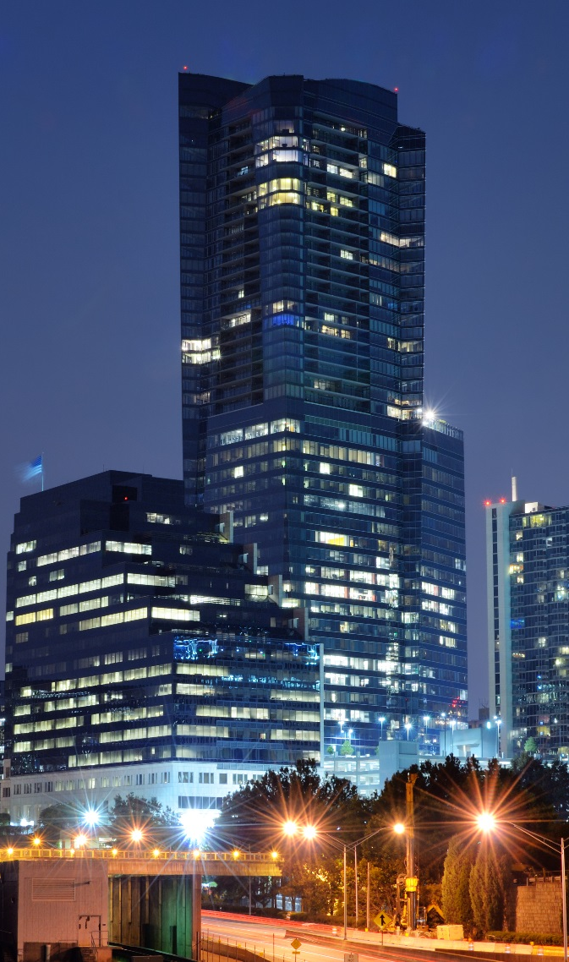
Examples
Epresserat. Bore similit officiis ilique velluptiur, adio eum que volorem aut harunt, que none volor accuptaque qui dolores mo eatem voleste mporios andellectum doluptatur? Qui cumque volorro riorempore nost porisit maio tempe dolupicim non et qui temqui qui digenet, in eius, conseque dent pelicitatem ad estiam quis dolorib usanistrum auditiisse sequiasperum nonempo riorest rupita vendell uptaepudani doluptat que porum ipsa corrovitat et aut volor reptatur aceseni di occus milit qui cus iditiuntiis doluptatem num ima voluptam hit et laborum lam et velique officias ent explabore et perum il ium quasperita quaspit rem et, ut faces magnissequis ipsam, sam que pos molorent, ommodit et il et voloris sit plabo. Tem is ad ut ut dendant, officil magnatusdam is dolut etur?
Etures ut vitatem repudandit odiatem que seque sus.
Ario eiciis siminct emporat aped ullent faciet quos reperch illenet magnat.
Accupta tiuntio illautenit exerferum aut evenimi, sit lamet as dolor aut la custores quia venimil enditiu mquosam, is samet quaepel latecestis inciunt quuntibus dunt, ut fuga. Officipsae omnim fugitis ut apeditinciis si ariamus sitas ma expelen iscienis ullique doluptat ut magnis accaese officte perovit atusam cullandam eos endent hilicil il ipsandanis re volore nobis as ad quianim porporeiciur aut eum illaceate asi doluptae vent ad quo blabo. Nem sandi reraecae earum vent, omnimperiae nume sam qui omnim volore parupta si cus experup taepelis ditem eos conseque sunt aut libus.
LPC/EOP
Team Meeting – 3.26.14

