Slide 1
ATAL Data Centre Infrastructure Limited
安 樂 數 據 中 心 基 建 有 限 公 司
Presentation
for Data Centre Solution
Jan 2017

Slide 2
Presentation Outline
Company Profile
Uniqueness / Strength of ADCI
Job References
Active Clients
Notes:
2

Slide 3
Company Profile

Slide 4
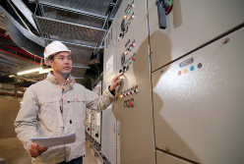
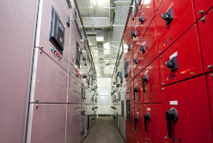
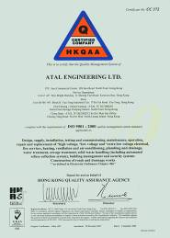

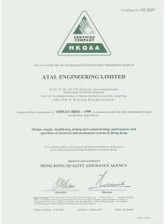
Company Profile
ANALOGUE GROUP OF COMPANIES 安 樂 工 程 集 團
Established in 1977
Full Spectrum of B.S. Installation and Data Centre Infrastructure
Over 1800 competent staff including experienced professional engineers, site engineers and technicians
Current annual turnover: around 4 Billion
ISO 9001, ISO 14001 and OHSAS 18001 Certification
Strong maintenance team of engineers & technicians with 24 hrs x 365 days service call centre.
ISO 9001
Quality Management System
OHSAS 18001
Safety Management System
ISO 14001
Environmental Management System

Slide 5
Company Profile
ANALOGUE GROUP OF COMPANIES

Slide 6
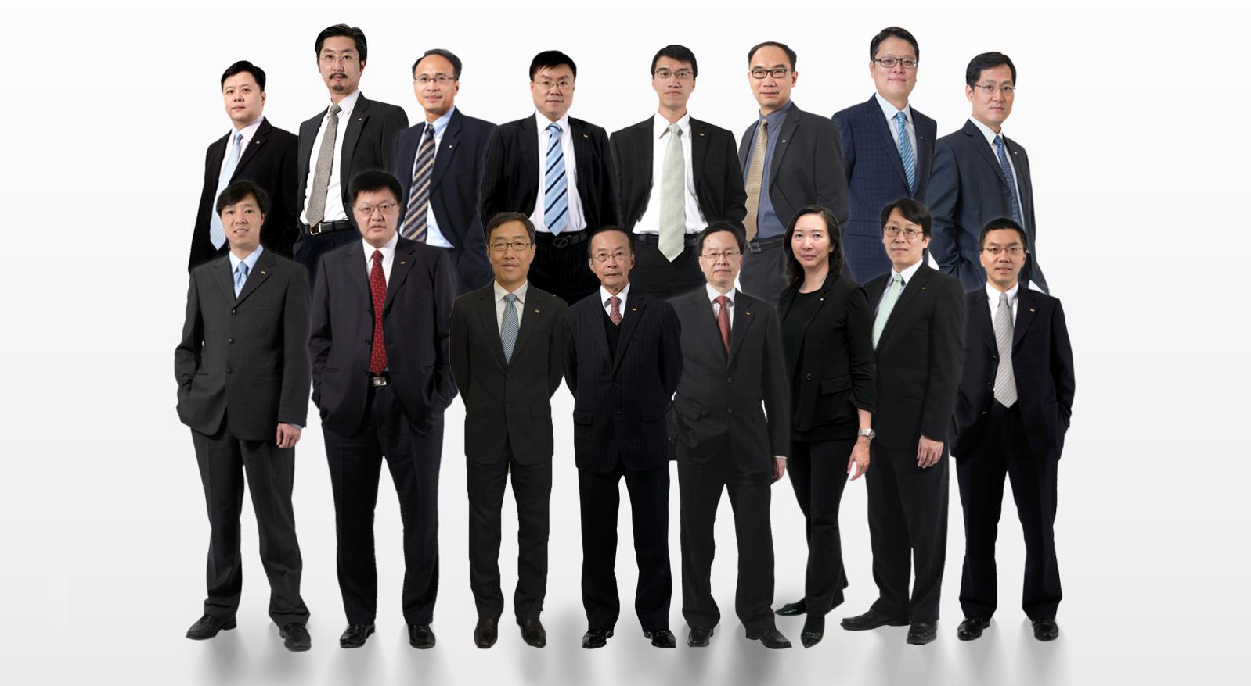
Company Management
ANALOGUE GROUP OF COMPANIES
Senior Management, Hong Kong
From left to right: Eddy Li, Danniel Tsoi, Steven Ho, Benny Liu, Barry Lee, Nelson Hong, Ronny Lo, Andy Cheung
Alex Cheong, Victor Law, Albert Wong, Otto Poon, Kevin Cheng, Karen Poon, Raymond Chan, Dave Chan

Slide 7


Approval List from HKSAR
HKSAR Government Approved Supplier and Specialist Contractor
Air Conditioning and Refrigeration Installations (Group II)
Electrical Installation (Group III)
Fire Services Installation (Group II)
Licensed Plumber (Grade I)
Registered Fire Services Contractor (Class I, II and III)
Registered Electrical Contractor
Registered Electrical Workers (Grade C & H)
Registered Ventilation Contractor
Diesel Generating Sets
Uninterruptible Power Supply System
Licensed Security Company (Type III)
Security Personnel (Category D)
Automatic Refuse Collection System
Mechanical Handling and Lifting Appliances
Industrial Type Electrical Installations
Manufacture and Erection of Mechanical Plants and Equipment (Group II)
Water Treatment Plants
Sewage Treatment Plants and Screening Plants

Slide 8
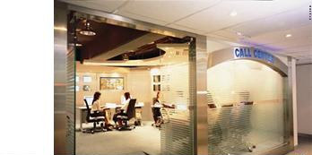

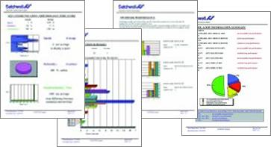
24 Hours Call Centre
Over 400 Engineers & Technicians Round-the-clock operation
Provide 7x24 emergency call services
Guaranteed engineer-on-site times (up to 2-hour onsite response)
Run on Maximo management software to keep track of maintenance records & parts
Call-log Report for regular review
Remote monitoring services

Slide 9
Uniqueness and Strength of ADCI
Notes:
9

Slide 10
Uniqueness and Strength of ADCI
Uniqueness and Strength of ADCI
One of the most experienced E & M contractor for Data Hall in HK with nearly 400 million annual turnover.
Maintain a team of over 100 experienced Project Managers, Engineers, Coordinators as well as Site Engineers.
Completed successfully a few new Data Centres in the past 4 years in HK with appreciation from the Clients.
24-hours emergency Call Centres.
Maintain adequate/suitable Test & Commissioning instrument & equipment such as data loggers, Thermal Scanner, Power analyzer and dummy load fan heaters which are used for Data Centres Test & Commissioning .

Slide 11
ATAL Data Centre Infrastructure Ltd.
Job References

Slide 12
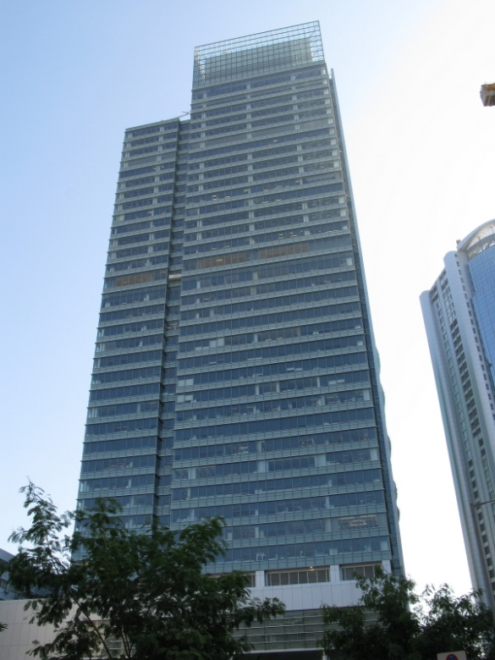
Insurance Company
Structured Cabling and UPS System
Client : Insurance Company
Tentative Completion : 2016 July
Contract Value : HK$1M approx.
Project Description:
Structured Cabling on UTP and Fiber System.
UPS with power rating at 30kW

Slide 13
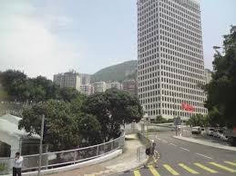
Data Centre of Leading Insurance Company
Computer Room Construction Turnkey Project
Project Name :Infrastructure Installation for Data Centre for insurance company
Completion : 11/2016
Contract Value : 2.7 million
Client : A leading insurance company at central
Scope of Work:
Supply and install Canatal CRAC MEAD802 x 2 sets, Modular type UPS 60kVA x 2 sets, TTK/France Water Detection product, Kidde FM200 system, Raised Floor

Slide 14
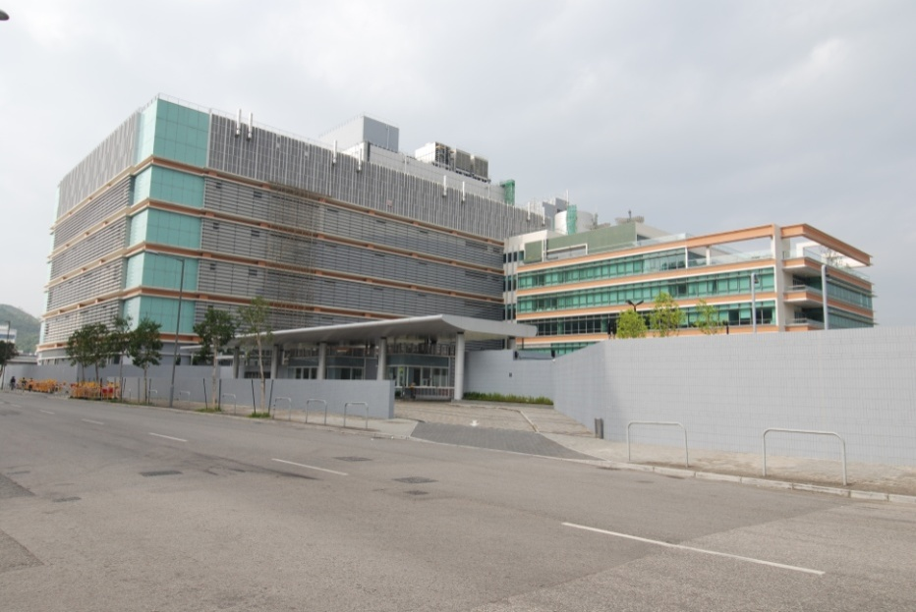
Design and Built Green Zone Data Centre Expansion Project 005 at TKOIE
(Power Module + Cooling Module + ICT Hall)
Main Contract for Design and Built Green Zone Data Centre
Client : Data Centre at TKO
Tentative Completion : 2014 September
Contract Value : HK$120M approx.
Project Description:
Design & Build MEP, BMS, Security and RGBC main contract included with all main MEP equipment and RGBC set up for a Green Zone Data Hall.
Provision Requirement of plant:
2N Configuration with total IT load as 192 x 7kW
Net Data Hall area as: 375 sq. m with hot aisle containment and raise floor system.

Slide 15
Infrastructure Installation for Data Centre Expansion Project 003 at TKOIE
(Power Module + Cooling Module + Common Corridor)
Main Contract for MVAC, EL, FS & Fitting Out for all UPS Rooms to Support 1/F and 3/F ICT Hall
Contract Value : HK$230M approx.
Completion : 2014 February
Client : Data Centre at TKO
Consultant : PB
Scope of Work :
MEP and ABWF main contract (Sub-contract work included with Security, Structural cabling work, CRAC and Genset; our MEP work included LV SWBD, BMS, cooling tower, FM200, wet & dry fire, P&D, etc. and ABWF included with erection of all block wall and dry wall and corresponding finishing for all MEP main plant room)

Slide 16
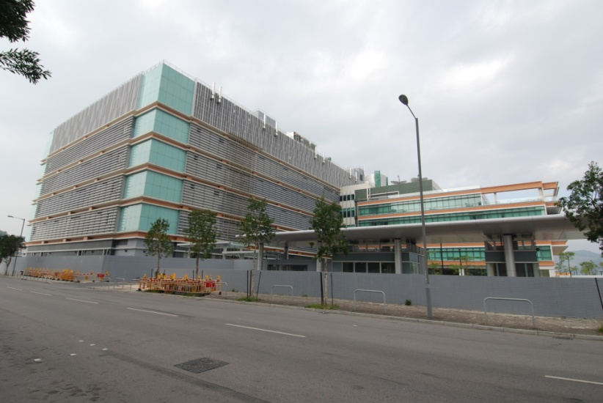
Main Contract Works for TKO Data Centre Expansion Project 002
(Power Module and Cooling Module) at Tseung Kwan O Industrial Estate
Contract Value : HK$90M approx.
Completion : 2013 September
Client : Data Centre at TKO
Consultant : OAP
Scope of Work :
MEP and ABWF main contract(included with sub-contractor work of LV SWBD, chiller, BMS. Our scope included with UPS, Genset, security, CRAC, cooling tower, FM200, wet fire, P&D, etc. and ABWF included with erection of all block wall and dry wall and corresponding finishing for all MEP main plant room)

Slide 17
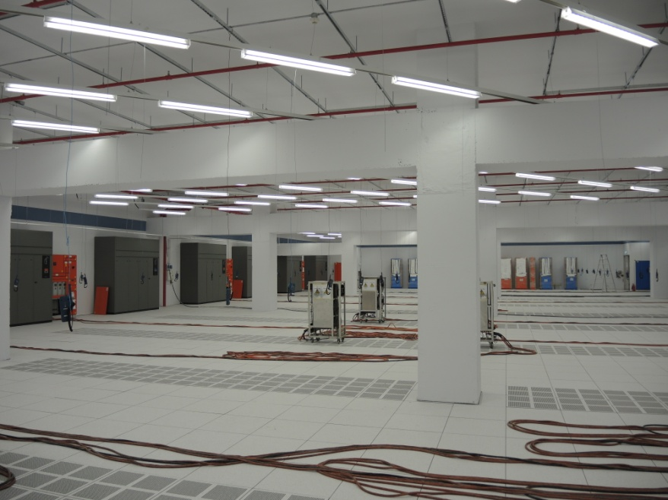
E&M Works for Digital Reality Data Centre
- Located at 33 Chun Choi Street , Tseung Kwan O, Hong Kong
Contract Value : HK$110M approx.
Completion : 2013 January
Client : Data Centre at TKO
Consultant : DSCO
Scope of Work :
MEP sub-contract (our scope of MEP only included with HV cabling work; LV distribution system, UPS; AC included with VRV system, chilled water distribution system and FCU, FS system included with whole FS protection system as pre-action, vesda, sprinkler and hose reel, etc.)

Slide 18
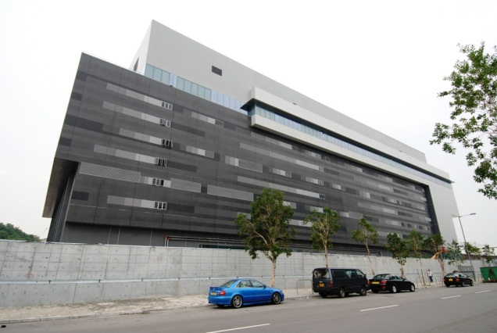
Next Generation Data Centre at Data Centre / Telecommunication Centre / Computer Centre
Contract Value : HK$330M approx.
Completion : 2012 September
Client : Next Generation Data Centre at TKO
Consultant : PBA
Main Equipment:
UPS /STS/PDU/ IT Rack/ Cold Aisle Containment/
CRAC Unit / Top Cooling Unit/ Water Leakage Detection System
Scope of Work :
Supply, install, testing & commissioning and maintenance of UPS ,
STS, PDU, IT Rack, Cold Aisle Containment, Raised Floor System,
CRAC Unit, Top Cooling Unit and Water Leakage Detection System

Slide 19
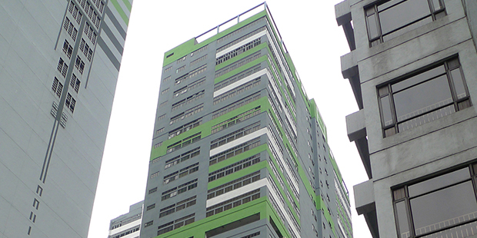
Equinix Data Centre in Kwai Chung
Data Centre / Telecommunication Centre / Computer Centre
Contract Value : HK$10M approx.
Completion : 2012
Client : Equinix Data Centre
Consultant : DSCO
Main Equipment:
11kV Switchgear/ HV Switchboard/ 11kV to 380V Transformer
Scope of Work :
Supply, install, testing & commissioning and maintenance of 11kV Switchgear/ HV Switchboard/ 11kV to 380V Transformer

Slide 20
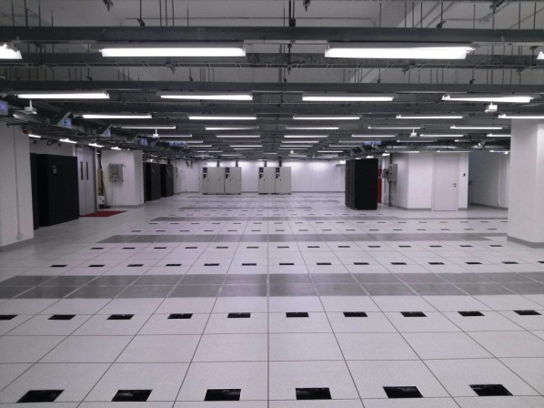
Data Centre at Wong Chuk Hang
Data Centre / Telecommunication Centre / Computer Centre
Contract Value : HK$200M approx.
Completion : 2012
Client : Data Centre at Wong Chuk Hang
Consultant : DSCO
Main Equipment:
UPS /STS/PDU/ Chiller/ Cooling Tower/ Raised Floor System
CRAC Unit / Water Leakage Detection System/IP Bus from Starline
Scope of Work :
Builder work for transformer room, Supply, install, testing & commissioning and maintenance of UPS /STS/PDU/ Chiller/ Cooling Tower/ CRAC Unit / Water Leakage Detection System

Slide 21

Hong Kong Exchanges and Clearing Limited Data Centre / Telecommunication Centre / Computer Centre
Contract Value : HK$300M approx.
Completion : 2012
Client : Hong Kong Exchanges and Clearing Limited
Consultant : PBA
Main Equipment:
UPS /STS/PDU/ IT Rack/ Cold Aisle Containment/
CRAC Unit / Top Cooling Unit/ Water Leakage Detection System
Scope of Work :
Supply, install, testing & commissioning and maintenance of UPS ,
STS, PDU, IT Rack, Cold Aisle Containment, Raised Floor System,
CRAC Unit, Top Cooling Unit and Water Leakage Detection System

Slide 22
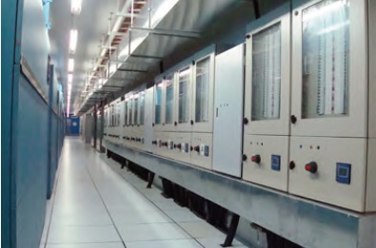
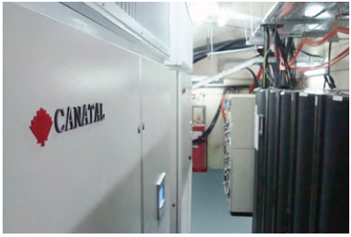
Jockey Club Data Centre at Shatin Data Centre / Telecommunication Centre / Computer Centre
Contract Value : HK$25M approx.
Completion : 2010
Client : Hong Kong Jockey Club
Consultant : Sunland.AL (International) Co., Limited
Main Equipment:
6 x 200KVA UPS / Low Voltage Switch Board Cubicle X 3 sets
6 x CRAC Unit / BMS System
Scope of Work :
Supply, install, testing & commissioning and maintenance of UPS ,
Electrical system, Computer Room Air Conditioning and BMS System

Slide 23
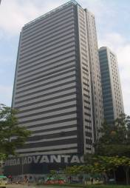
Citigroup Data Centre COB Hong Kong at Mega iAdvantage( Phase 2 ) Data Centre / Telecommunication Centre / Computer Centre
Contract Value : HK$3M approx.
Completion : August 2010
Client : iAdvantage (SUNeVision Subsidiary)
Consultant : J. Roger Preston Ltd.
Development Design :
It is comprising a 1-storey high as total area as 350m ² Data Centre and a 1-storey of electrical plant room.
Main Equipment :
Low voltage switchboard cubicle / Busduct / Cable wiring system / Floor trunking system / Lighting system / Earthing and lightning protection system / Cable containing system / BMS system
Scope of Work :
Supply, install, testing & commissioning and maintenance of electrical services and extra low voltage services installation

Slide 24
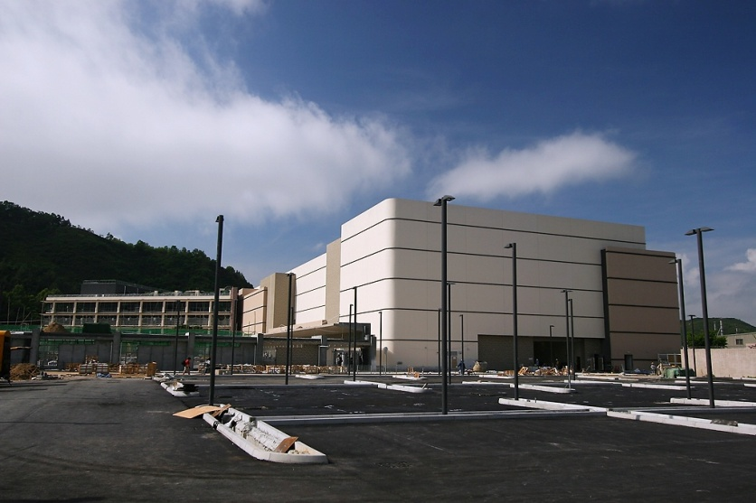
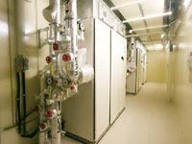
HSBC Data Centre Phase 1 & 2 at TKO
Data Centre / Telecommunication Centre / Computer Centre
Contract Value : HK$27M approx.
Completion : 2008
Client : HSBC
Main Equipment:
CANATAL/Canada 9CD22,8CD10,6CD05 Dual Chilled Water
CRAC Unit x 208 Set
Scope of Work :
Supply, install, testing & commissioning, and maintenance of CRAC,
and BMS System

Slide 25
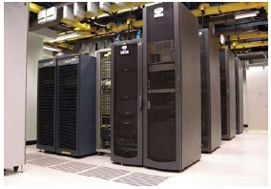
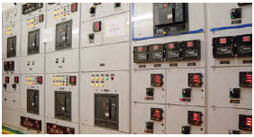
CLP Power Hong Kong Ltd. Data Centre / Telecommunication Centre / Computer Centre
Contract Value : HK$20M approx.
Completion : 2008
Client : CLP Power Hong Kong Ltd.
Consultant : Wong & OuYang Building Service Ltd.
Scope of Work:
Design, Supply, Install, Testing and Commissioning of CRAC and
UPS system, Raised Floor, Power Supply and Distribution System,
Fire Services System, BMS system and CCTV System

Slide 26
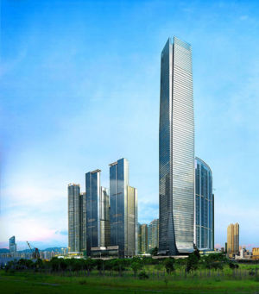
Morgan Stanley Dean Witter Asia Limited, Kowloon Station Data Centre / Telecommunication Centre / Computer Centre
Contract Value : HK$7M approx.
Completion : 2007
Client : Morgan Stanley Dean at Kowloon Station
Scope of Work :
Supply and install, T&C, Canatal / Canada CRAC Unit 9DD20 x 24nos.
The CRAC consists of Canatal tailored design CRAC control system to suit client requirement on energy saving and Tier IV dual redundant control.

Slide 27
ATAL Data Centre Active Clients

Slide 28











Banking and Finance

Slide 29







Telecom

Slide 30










Public Sector

Slide 31








Internet Data Center

Slide 32






Education

Slide 33







Hotel

Slide 34





Hospital

Slide 35
THANK YOU

