Slide 1


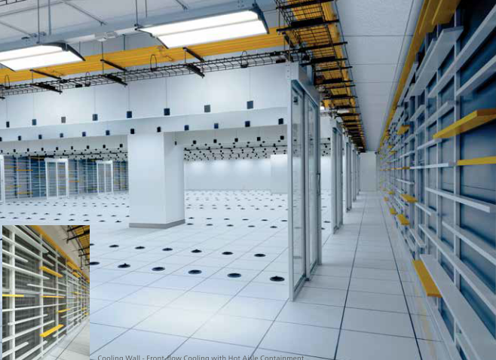

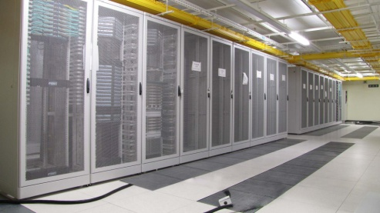
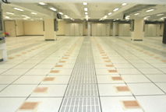
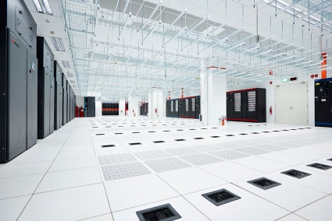
In fashion and Green Data Centre Solution
Make your Data Centre Trendy & Green
Hong Kong Office
13/F, Island Place Tower, No. 510 King's Road, North Point, Hong Kong Tel : (852) 2561 8278 Fax : (852) 2565 7638 Email : ataldci@ataldci.com.hk

Slide 2


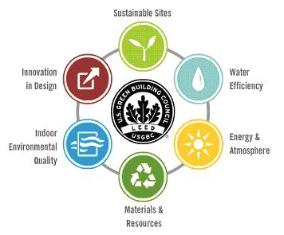

Leadership in Energy and Environmental Design
“Whole-Life” Approach
Planning • Design
Construction • Commissioning • Completion
Operation • Maintenance • Management
Tailor-made intelligent and Green
Fully experience Engineering team
Smart Value for your building
One Stop Solution
Design Intent
Performance Review
Realize model
Site Implementation
T&C and Performance Verification
Operation and PM Service
Operation Performance review
24-hour round-the-clock support
Our solution integrate a full range of systems, including:
Air Conditioning
Builder’s work
Electric system
Testing &
commissioning
Fire system
Preventive
Maintenance
& support

Slide 3
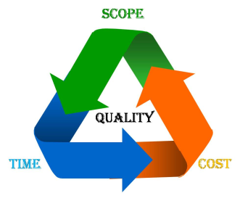
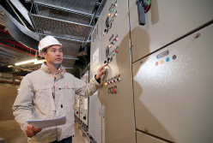
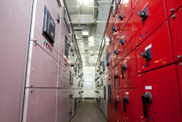
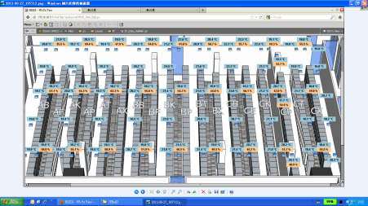
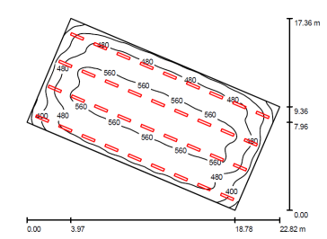
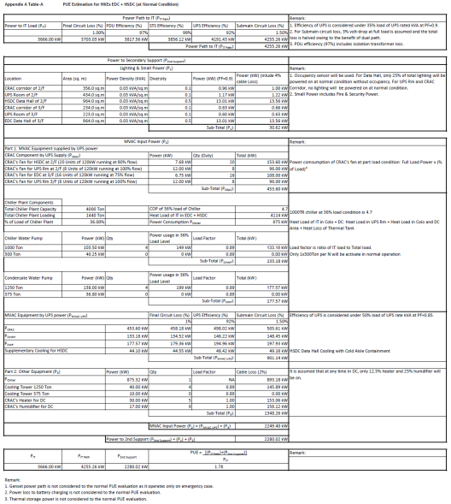
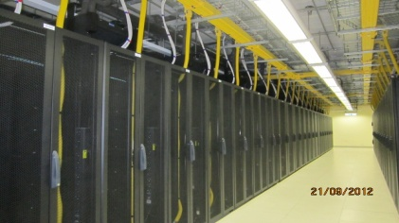
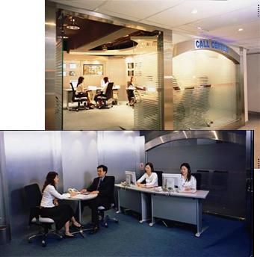
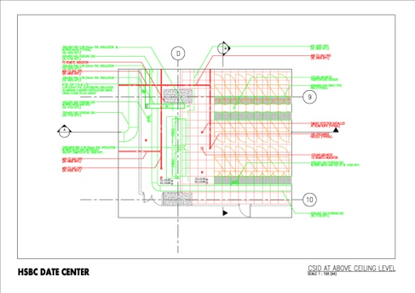
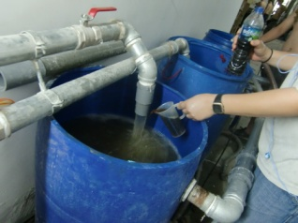
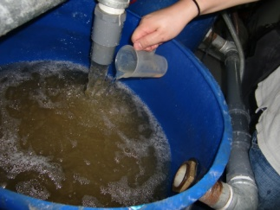
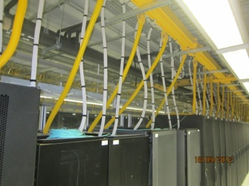
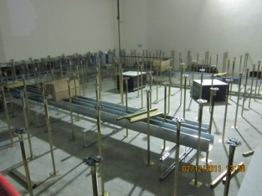
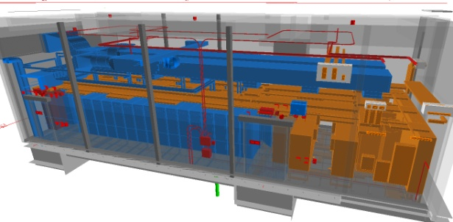
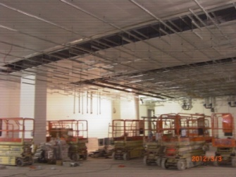
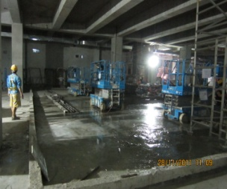
One Stop Solution
Lighting Calculation
Review the performance about plant operation
Design Intent proposal
Realize Model & Site Implementation
T&C and Performance Verification
Operation and Preventative Maintenance Services
Design & Performance Review
PUE Calculation
Project Implementation
CSD Preparation
Site Installation
BIM model Implementation

Slide 4

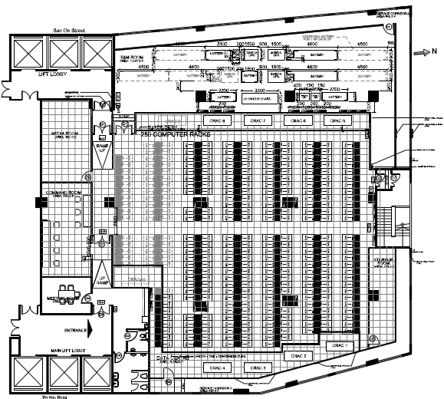


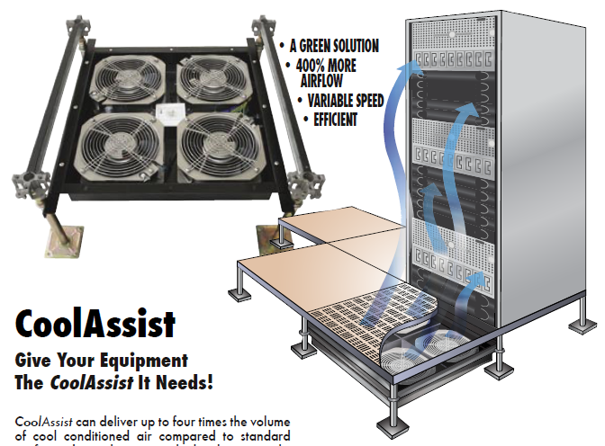
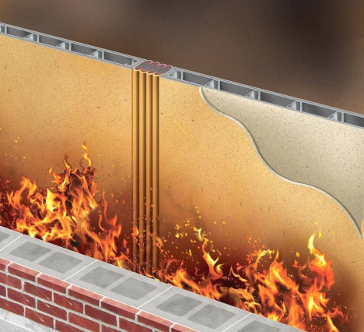
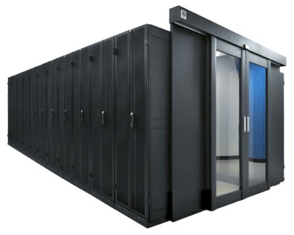

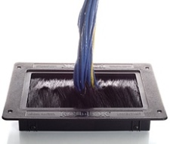
Design Evaluation
Intelligent Design & Drawing
Intelligent LED Lighting System
High integrity Fire Insulation Wall & Door
Testing &
commissioning
Rise Floor with containment System improve the hot spot and cooling enegy

Slide 5
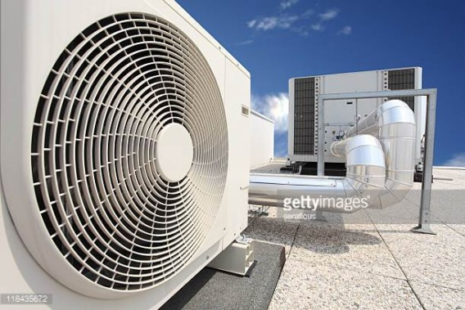

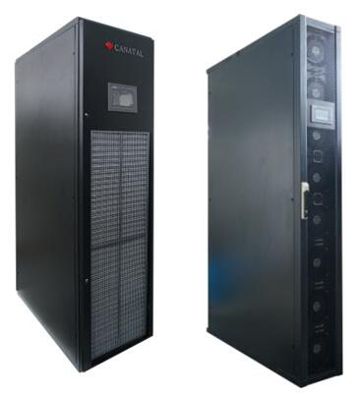
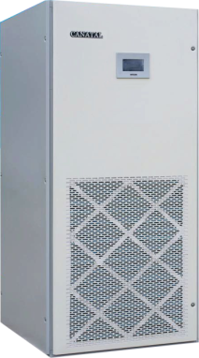
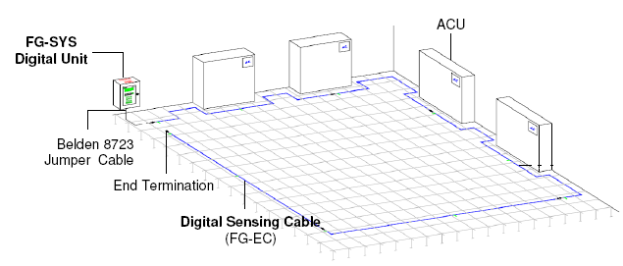
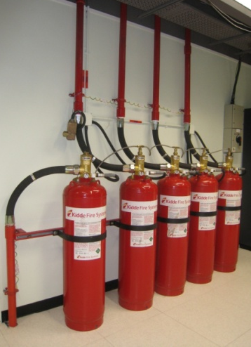


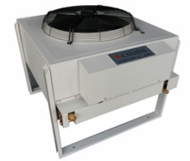
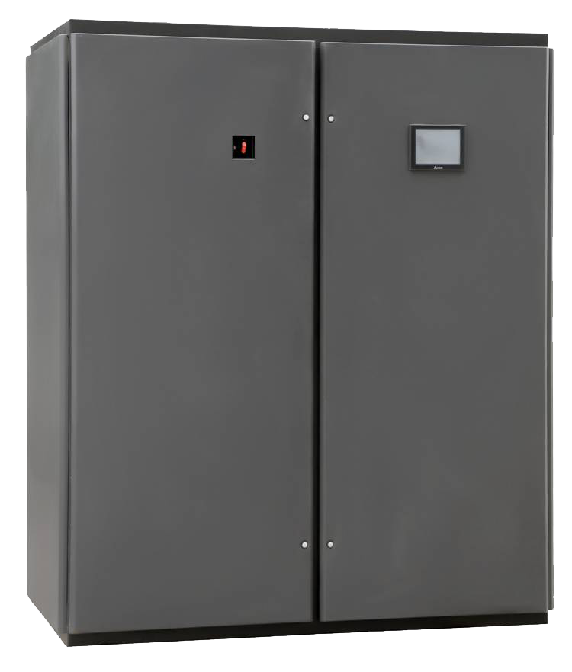
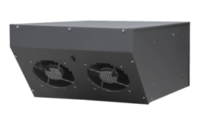
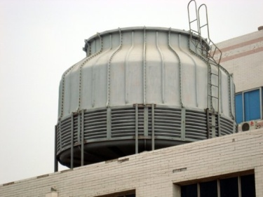
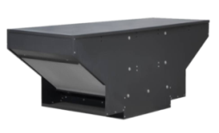
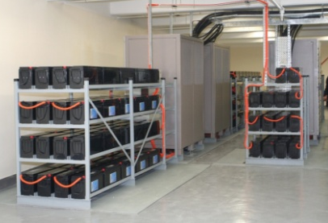
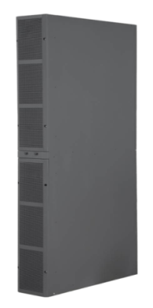
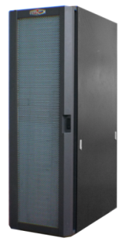
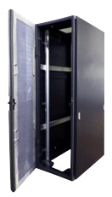
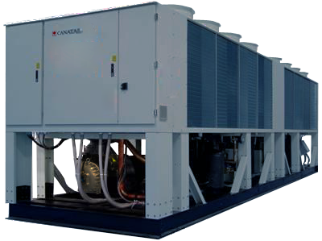
Product Optimization
CANATAL
MVAC Solution

Slide 6
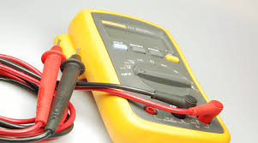
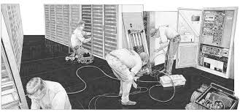
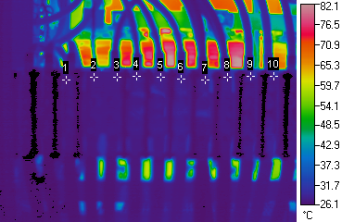
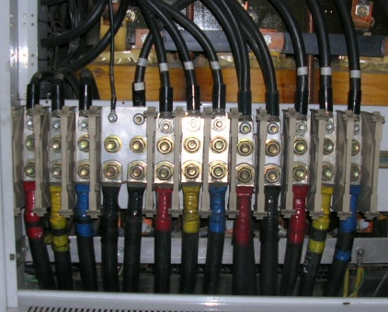
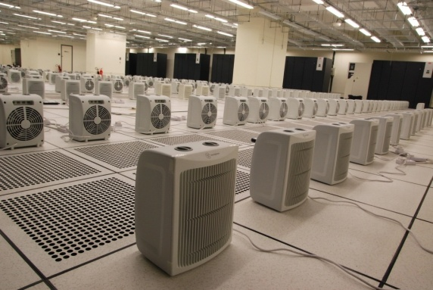
T&C and Maintenance Service
Thermo Scan for Electrical System to ensure the integrity of electrical system
integrated Performance Verification Testing (iPVTTM)
Maintenance Service
Preventive maintenance
7x24 e-call service
WR2 Periodic Inspections
A/C and chilled water system maintenance
Genset solution and maintenance
Water detection System service
Fire Service maintenance and upgrade
infrared Scanning
Data Centre floor Cleaning
Value Added Service
Energy efficiency assessment
Periodic iPVT
Develop the Standard Operating Procedures (SOPs)
Heat load test

Slide 7


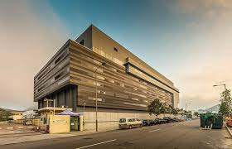
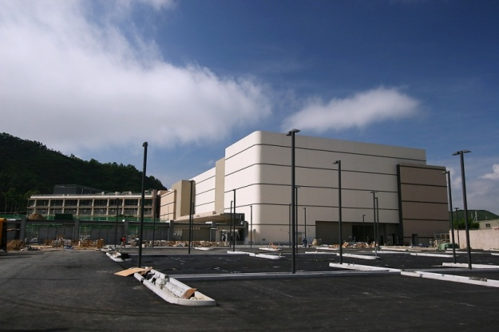

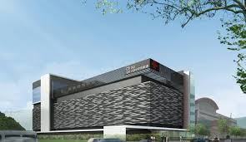
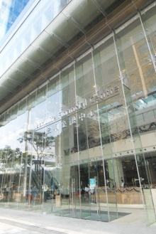




Successful cases

