Slide 1
Examples of networks

Slide 2
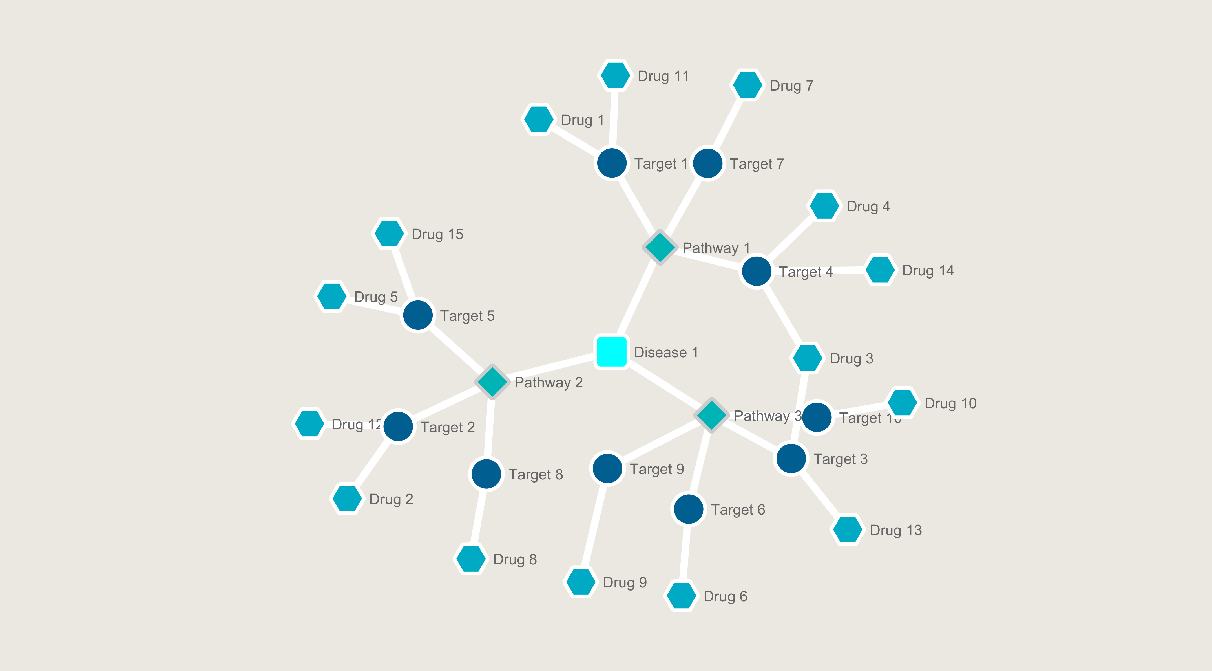

Slide 3
