Slide 1
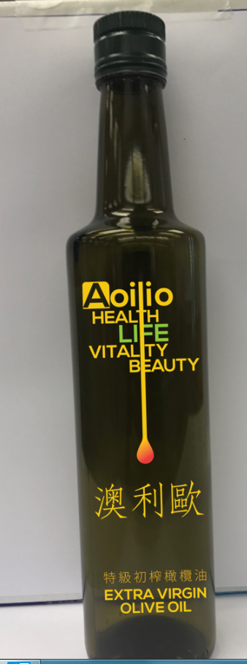
Need to group “health, life vitality and beauty” in the same look and feel
Can’t distinguish the brand and mission, feel confused
Overall Performance:
Not good
No design at all
It should look like an oil droplet
Select a different font in “San Serif”, increase the font weight

Slide 2

4 missions should be in the same colour and size
Design them using the same look and feel
It should look like an oil droplet
Select a different font in “San Serif”, increase the font weight

Slide 3

Capital Letter for the word “LIFE”
Re-adjust the color tone,
The whole design looks dull

