Slide 1
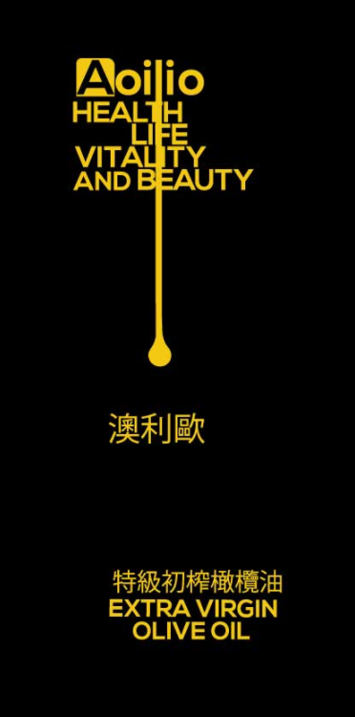
Making “Aoilio” logo more eye catching
Need smaller font for the 4 missions
Align ‘T’, ‘F’, ‘I’ and ‘E’
Remove ‘AND’
Use different color in the same tone for the mission
The logo should look more elegant and professional. The layout is now too simple and not pleasant.
In addition to this version, can you please put your copy onto a bottle, business card and soap so that I can see if it looks okay.
Does not look like an ‘oil droplet’, please use more illustration and gradient color
Use a different font
Center alignment
Increase the line spacing between English and Chinese

