Slide 1

ANA Research
Turn market insights into better healthcare outcomes

Slide 2

Agenda
Overview
Where we are today
Where we want to be in three years
How we are going to get there
What could go wrong
Conclusion

Slide 3
Overview
ANA Research today
  Profitable
  Great reputation
  Strong business processes and people
  A viable, going-concern
Assessment
  Research capability is reliable, capable, and performing
  Production capabilities can be scaled as business grows
  A plan exists to meet business objectives
  Marketing and sales investments can and will be made to achieve goals
  Systems will be enhanced and expanded to monitor progress against goals
ANA Research is a solid, safe investment
Notes:
talent is available, company has track record to attract and retain resources

Slide 4

Revenue Projections
Year | Annual Sales | Growth % | Growth $ | % Recurring | Recurring $ | New $
2016 | $2,300,000
2017 | $2,500,000 | 9% | $200,000 | 75% | $1,725,000 | $775,000
2018 | $3,000,000 | 20% | $500,000 | 75% | $1,875,000 | $1,125,000
2019 | $3,700,000 | 23% | $700,000 | 75% | $2,250,000 | $1,450,000
2020 | $4,600,000 | 24% | $900,000 | 75% | $2,775,000 | $1,825,000

Slide 5
Marketing and Sales Activity
Year | New $ | Average Deal Size | New Customers | Proposals | Leads
2017 | $775,000 | $50,000 | 16 | 48 | 192
2018 | $1,125,000 | $50,000 | 23 | 69 | 276
2019 | $1,450,000 | $50,000 | 29 | 87 | 348
2020 | $1,825,000 | $50,000 | 37 | 111 | 444
Notes
Proposal projections are based on closing one in three proposals
Lead projections are based on earning a proposal for one in every four leads

Slide 6
Where we are today
The industry
  Highly fragmented, dozens or hundreds of small players, few dominant players
  No apparent market leader in custom healthcare market research
The company
  Forty years in business
  Great reputation and brand recognition (Anderson Neihbur)
  Multi-modal approach: telephone, mail, email, web (all done in house)
  All research data on-site; secure, private, compliant
  Extensive healthcare experience: providers, insurers, associations
  Talented, experienced team
  Ownership dedicated to excellence and growth

Slide 7
Where we want to be
Recognized leader in custom healthcare market research in the US in three years
Revenue doubled by the end of 2020
Profit margins of 25% or greater before tax and debt service
Acknowledged as a great place to work; low turnover of key positions
Engaged in the community

Slide 8
Key tactics
Invest in sales capabilities
Increase competitiveness
Make it easier for buyers to do business with it
Improve results at each step of the buyer’s journey
Leverage customer relationships
Install systems for managing and monitoring

Slide 9
Invest in sales capabilities
Establish a position for junior sales or a sales admin
  $40k to $60k per year total comp
  Manage the entire sales administration process
Reallocate John’s time to spend 10 to 20 hours a week selling,
talking to prospects
Establish market research function (account-based marketing and sales)
  Identify prospects
  Research prospects and build profile; key players, competitors, operating concerns

Slide 10

Increase Competitiveness
Rebrand the company
  Reflect focus on healthcare
  Tagline: Turn market insights into better healthcare outcomes
  Update look-and-feel to more modern look
Streamline and update proposal process
  Implement proposal management system
  Reflect branding
  Use online tracking capabilities
Establish standards and branding for client deliverables
  Create data visualization standards
  Establish common format

Slide 11
Make it easier for buyers to do business
Rebuild the website
  Reflect the focus on healthcare
  Improve navigation, more accessible
  Make it a learning site
Invest in SEO
  Keyword strategy to increase searchability
  Incorporate into website, content, social media
Develop proposal system
  Make it easier for prospects to understand and accept proposals
  Allow tracking of proposal after it leaves the building
Productize services
  BrandPulse, PatientPulse, ProviderPulse, EmployeePulse
  Standard offerings that can be customized to meet specific client needs

Slide 12
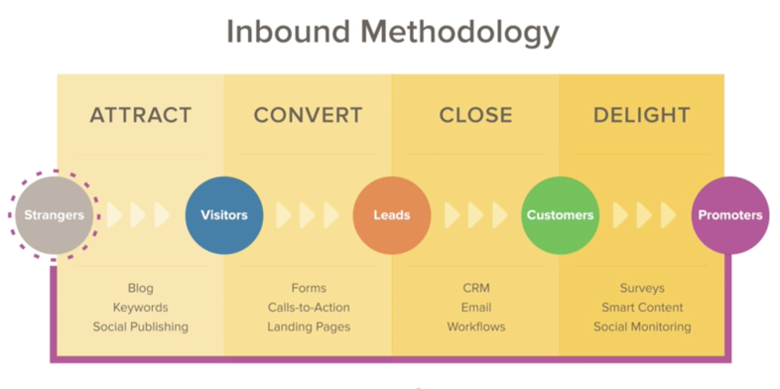
Improve results at each step of the buyer’s journey

Slide 13
Leverage customer relationships
Communicate with customers (past and present)
  Tell them what you’re doing
  Educate them
Ask them about new projects that they might have
Ask for referrals
Build application briefs (how they use market research and what it has done for them)
Develop testimonials

Slide 14
Install systems for managing and monitoring
Implement a Customer Relationship Management (CRM) system (Hubspot)
  Track companies, contacts and deals
Implement Marketing Automation (Hubspot)
  Manage and track email communication, social media, web activity
Implement a video management platform
  Own your videos especially proprietary content
  Track usage by video and person—what level of engagement do they have?

Slide 15
Big Idea
Leverage Anderson Neihbur reputation for training the industry
  In person seminars, 2 days, at hotel, $1500
Train the next generation using virtual classroom
  Big development costs
  Profit neutral (costs offset by training fees)
Build a loyal following

Slide 16

What Could Go Wrong?
Macroeconomic factors
Lose a major client
Lose key people
A strong competitor emerges
The company does not or cannot make the necessary investments
The marketing plan does not work

Slide 17
Conclusion
Market opportunity is huge
Foundation is strong
Management commitment is there
Establishing detailed plan and execution milestones is next step
There is a lot of work to do
The team is in place to make it happen

