Slide 1
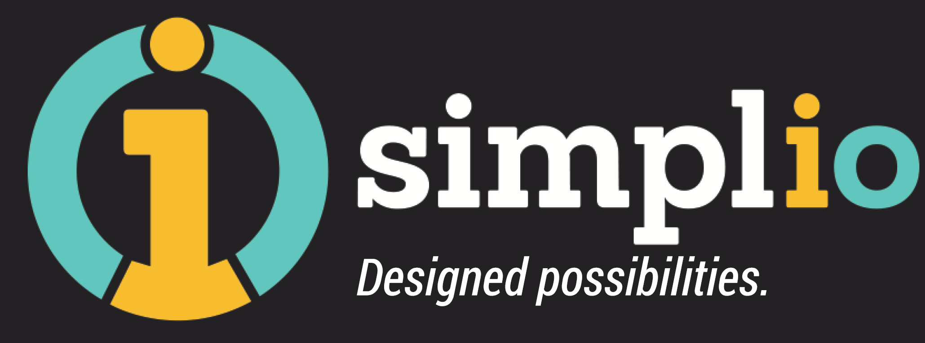
Simple, Intelligent, Beautiful
Actionable Visual Insights, Instant Business Value
Commercial in confidence
May 2017
Notes:
https://medium.muz.li/3-trends-in-landing-page-design-5cf900f2c90f
https://goworkbench.io/
http://www.fusion.com.au/#gref
http://bearddesign.co/practices/

Slide 2
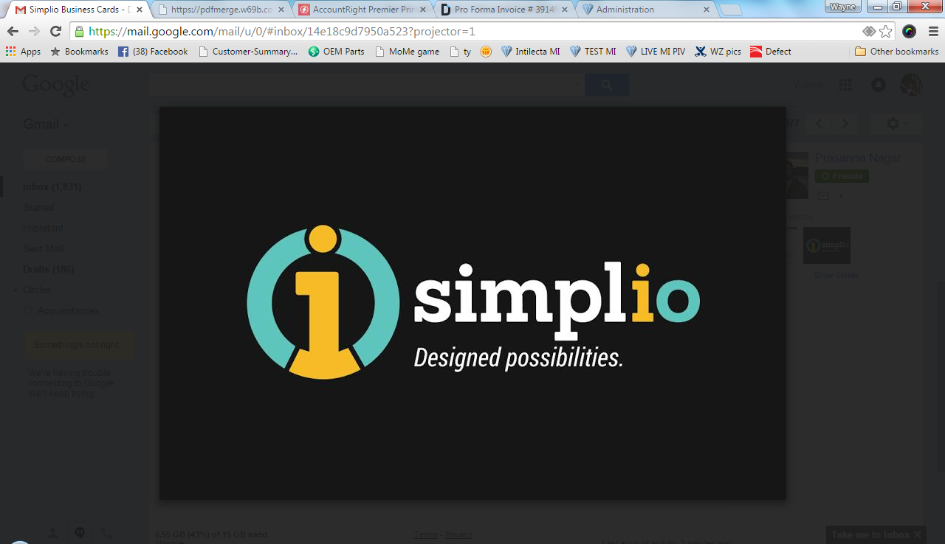

We are a data visualisation firm…
Our AI driven products and services help you consume your data through actionable visual insights
Resulting in:
Faster, smarter daily decision making
Drive impact and accelerate transformation
Increase revenues and a stronger bottom line
Notes:
We are a data visualisation products and services firm.
Our products and services help three different client markets:
Firstly, we help large companies who generally have their own data architecture and tools but need help to extract value from their own data. We do this on a consulting basis.
Our second segment is companies who have their own successful standalone digital products with their own customer footprint. These companies want to use data they have to help their customers to get value and grow. We provide white labelled solutions via our Google services APIs to make this happen.
The third segment offers our products on a distributed basis on key marketplaces. At present, we are focused on zero and salesforce.com

Slide 3




loves to solve your challenge
Does your data fuel customer experience and growth?
Advisory services
Software-as-a-Service products
Business transformation fuelled with insights from your in-house data platform
White label our platform to unlock value for your clients using your data
Use our plugins to unlock growth insights on your finance and your customer’s data
O u t c o m e s
Make better decisions …faster,
Increase user engagement
Drive revenues,
Improve bottom line, and
Accelerate transformation
Value adds to help your clients grow. Improves acquisition retention and deepen your client relationships and revenue
Improve customer experience
Minimise analytics cost via Marketplace API plug in
Improve customer experience, and
Increase user engagement
Notes:
This needs to sell JVs with integrated APIs/embedded AI services for fin techs/ – white labelled
We now live in a world with a segment of one #oneStaff #oneCustomer gone are the days of standard product, offers and services. Individual relationship pathways uncovered through data intelligence are king. The world is changing from the insight out. No longer different organisational silos stiching together standard products, offers or services.[10:19] Customer love demands we know them from the insight out ....helping the customer requires that we turn our world upside down

Slide 4





use case successes
Alternatives ….. What Simplio’s clients love to get?
What Simplio’s clients love?
Improve Business Results
Improve user & customer engagement
Double digit revenue growth- achieved 20%+ uplift at four banks
Reduce costs - Save 50-90% manual analysis
User adoption – 90% day-to-day user/adoption within weeks in four banks
Improve engagement with AI-fuelled insights that simplify roles and touchpoints across the business
Simpler + clearer value delivery to your customers
Book a demo today at https://simplio.co/ or sayhello@simplio.co

Slide 5






The why of
There are four reasons traditional data BI and customer systems underdeliver on value
NOT WHAT USER OR
CUSTOMER WANTS.
ITS CLUTTERED.
Highlights the traditional approach root cause and opportunity
My people don’t use the tools we paid for!
Head of Sales & Service
Low user adoption
DISCONNECTED.
REQUIRES COMPLEX
MANUAL ANALYSIS
Head of Product/Marketing
It does not help me. There are too much clutter to get to what matters
Lack of simple intuitive design
Data unconsumable, unactionable, unhelpful
Organisations know their data is their lifeblood, but they don’t know how to harness it efficiently
CLUTTERED / COMPLEX MANUAL ANALYSIS
Lack of automation
Lack of artificial intelligence
I have to join the dots across multiple metrics or sources in order to get the information that helps me
NOT WHAT USER AND
CUSTOMER WANTS
It does not help me learn or improve how we help customers
CEO, Head of Product & Sales
<10%
Head of Customer Experience / Ops
<10% of users can understand the reports and use all the features in the customer system
System or reporting use rarely monitored by simple performance uplift tracking and motivation
Staff spend 20 minutes a day drawing on multiple reporting sources analysing problems and what action to take. No consistency.
0%
value
20
min/day
?%
Traditional reports and CRMs are designed around the organisation – what the customer has and what we want them to do. Many miss delivering a customer centred experience.
Notes:
DIFFERENTIATOR mind map.
Unlock new opportunities through problem solving …because we understand the business (acumen)
Technology as enabler ….leading edge
Visual design …helps user to decode visual …eagereyes picture flow perception conviction knowledge action
key words : simplicity, simple, design, growth, productivity, help , customer experience, service experience,
no sales, no revenues,
Speed of in.out tool
Speed of experiementing
Input CRM agnostic
Speed of productivity change
Speed of learning and compliance uplift

Slide 6


creates the aspirin that solves your growth headache
Connect with the founders
Wayne Zwar
Joint-CEO
0402 792 824
wayne.zwar@simplio.co
https://au.linkedin.com/in/waynezwar
Prasanna Nagar
Joint-CEO
0416 054 403
Prasanna.nagar@simplio.co
https://au.linkedin.com/in/prasanna-nagar
Notes:
In a world where the data is growing exponentially and organisations and staff are overwhelmed with data,
we build intelligent data visualization to help users consume and drive action on information.
….which speeds up incremental change and growth.

Slide 7
Simple, Intelligent, Beautiful
Join the dots, change the game

