Slide 1

AX Website Brand Brief
Draft June 2017

Slide 2
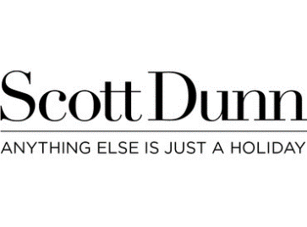

Brand Positioning
Target: UK and US Millennials (18-30) and Generation X (35-50)
‘Once in a lifetime experiences’ for affluent busy working people with little spare time but good disposable income
Or less well-off people wanting something for a special occasion
Site to position brand as Welcoming, Elegant, Quality, Aspirational, Cultured, Contemporary and ’Hip’: somewhere between:
and

Slide 3









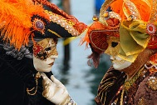



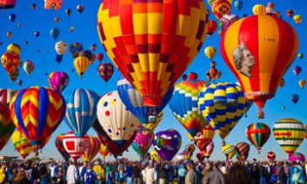
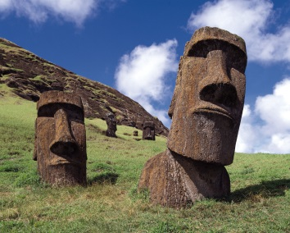

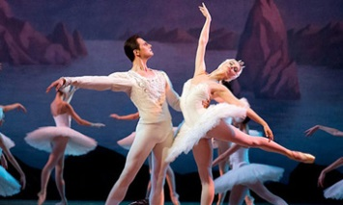

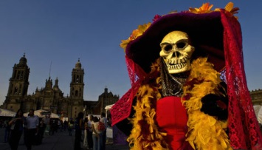
AX Rolling Images Banner
AX Outline Homepage
Follow Us:
Destinations
Experiences
Trips by Month
Topical Now
Tailored
Pioneers
Club
Client Log-In
Vlogs & Reviews
Awesome Experiences in less than 7 Days!
Last Few Places
Photo
Venice Carnival £599pp
Wonders of Wildlife
World’s Greatest Festivals
Must Do Activities
Unique Annual Events
Photo
Photo
Easter Island £2,999pp
Extraordinary & Secret Places
Unforgettable Performances
Spectacular Hiking, Climbing & Walking
Day of the Dead £3,299pp
About Us
Contacts Us
Financial Protection
Group Bookings
AX Protecting wildlife & animals,
and supporting local communities
Our Partners
Booking Conditions
Travel Insurance
Tailor-Made & Extra Nights
Newsletter
Privacy & Cookies
Visas
Booking Flights
FAQs
Terms of Use
Travel Advice
Careers with AX
Press Room
Logo 1
Logo 2
Logo 3
Logo 4

