Slide 1
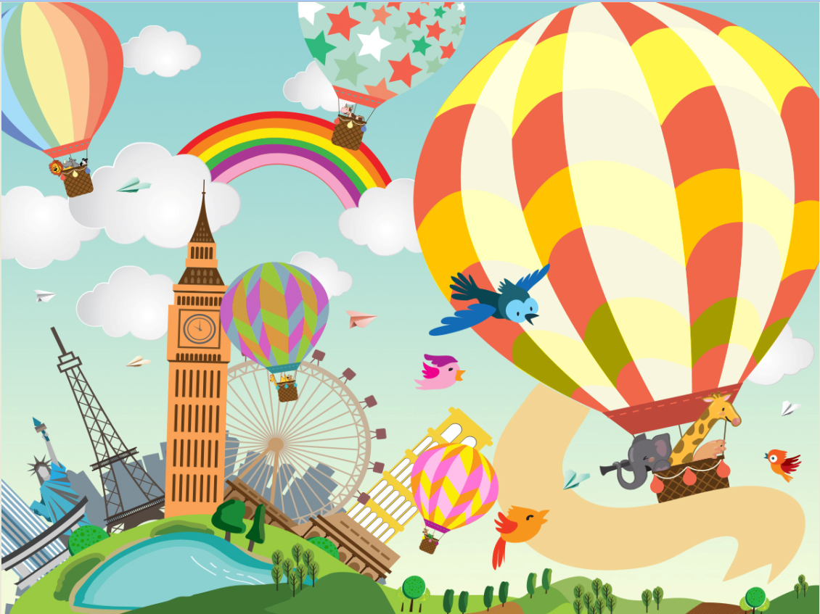

Slide 2
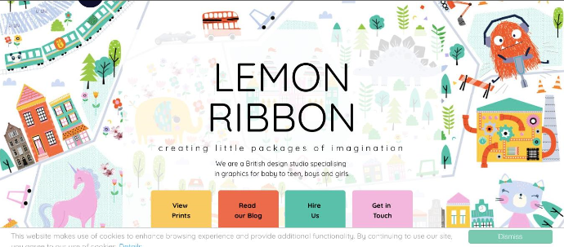
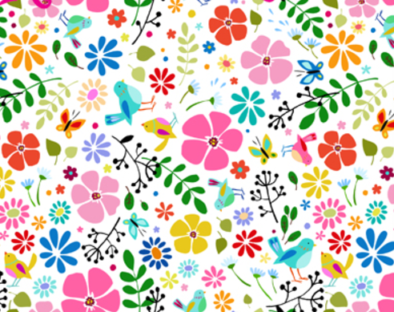
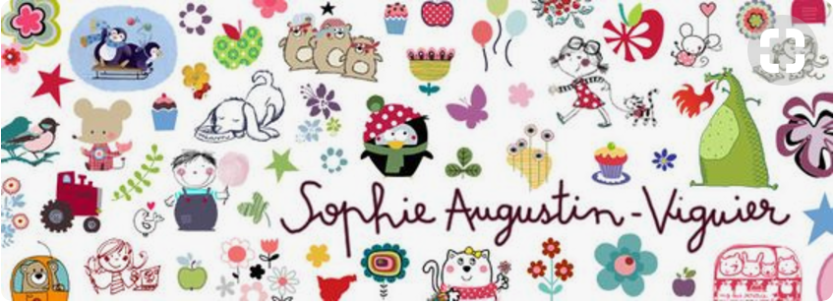
Color reference
We like this kind of color tone
Keep the color gender neutral

Slide 3
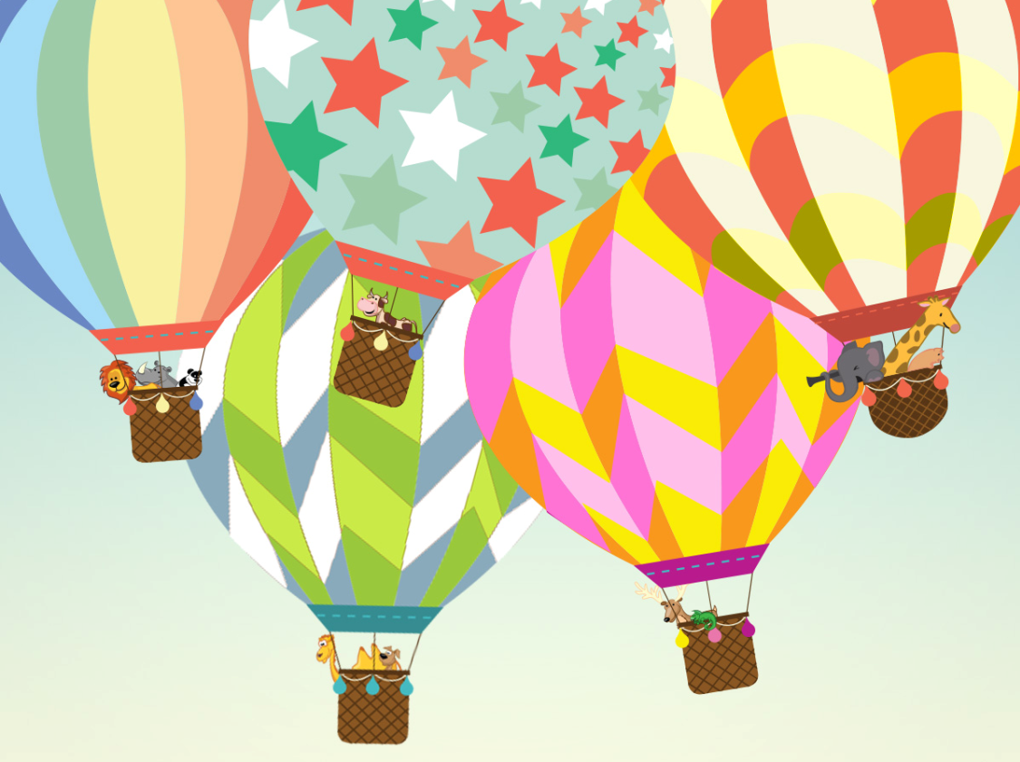
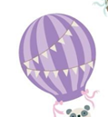

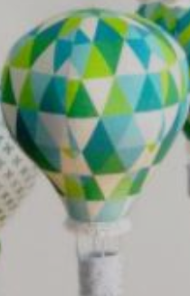
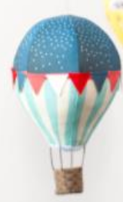
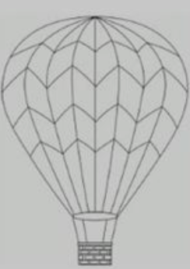
Hot Air Balloon reference
This pattern is ok, would like to change the color
This pattern is ok, would like to change the color and add the pennant on it as the reference below.
OK
The basket color should be lighter, and could add different designs for the basket as the reference below
Total : 6 different hot air balloon patterns
These three are for pattern reference, but we need it in different colors
Notes:
add other pattern as below reference

Slide 4
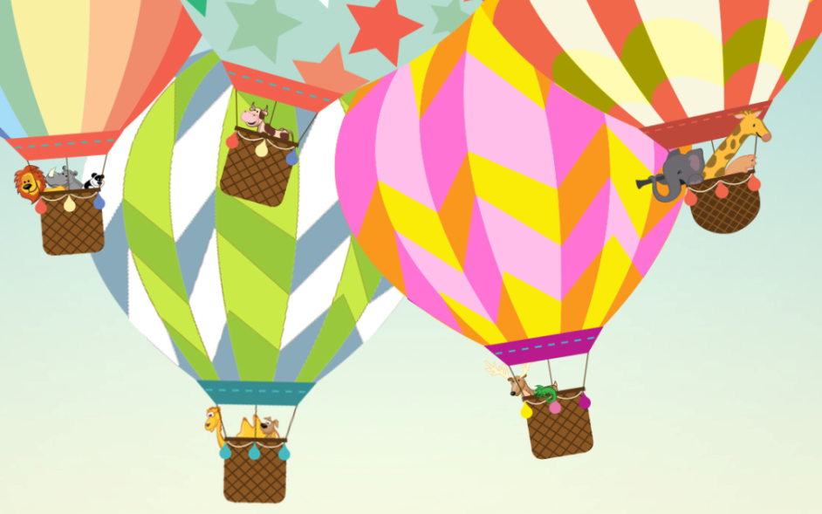
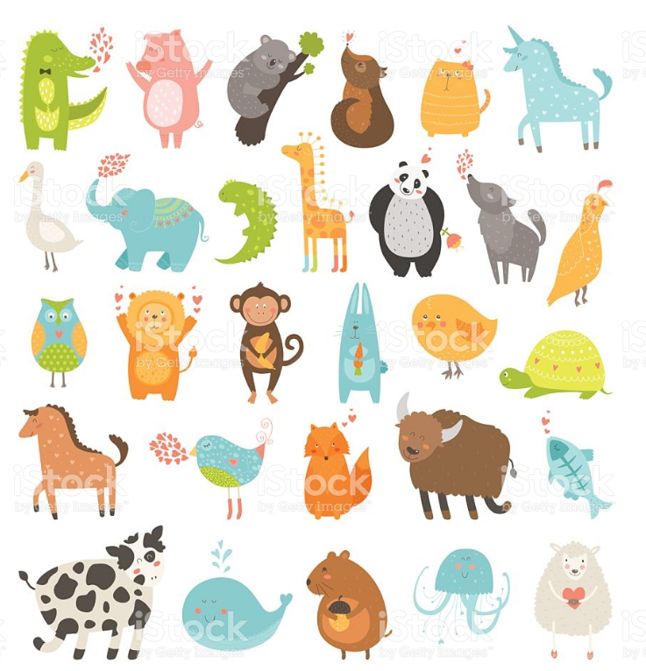
Animal reference
Need whole body of the elephant and giraffe/ color could be revised to match with the main color tone
OK
Animals we want:
Elephant
Giraffe
Squirrel
Rabbit
Bear
Raccoon
Sloth
Dog
Cat
hedgehog
The look of the animal that we like.
We want the animals to be cuter and with action(ex: photographing, reading a map)
We need the whole body of the animals.
Total : 10 different animals

Slide 5
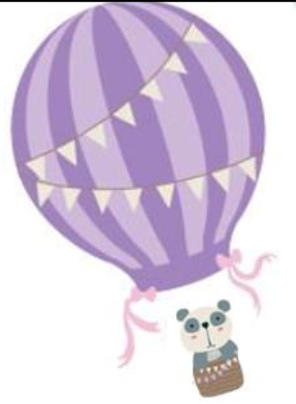
Size reference
The size of hot air balloon / animal / basket should be as this scale.
Please add strings on it. To hold the basket.

Slide 6
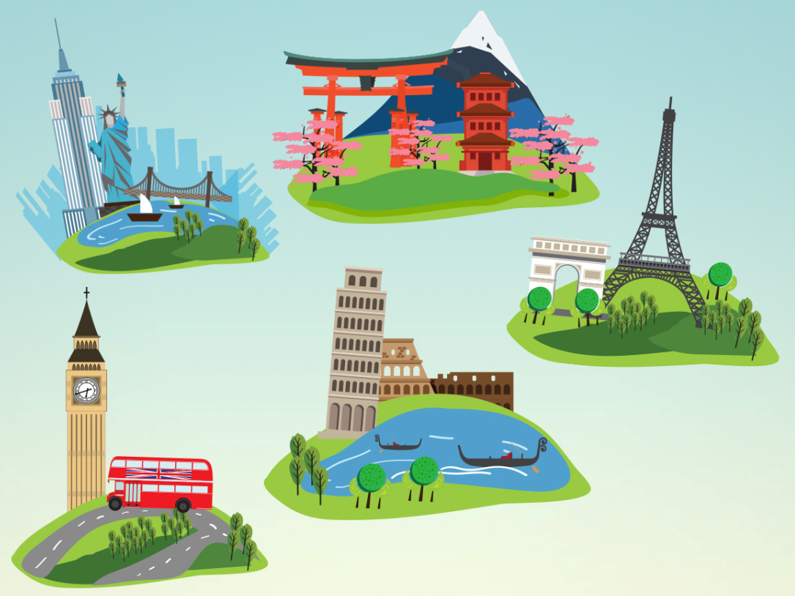
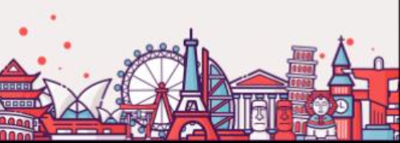
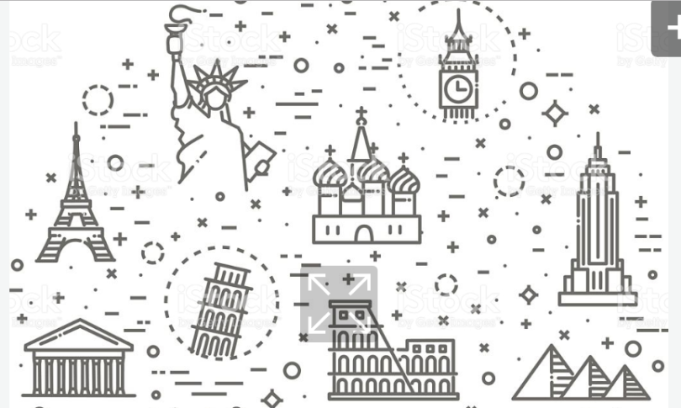
City reference
This kind of drawing style is what we like
We would like the drawings to be more simple and cuter ( The original one is too realistic)
Please keep New York / London/ Paris / Italy, and add Egypt and China (Great Wall…) in the drawings.

