Slide 1

NetSuite Demo for Refro Foods
Efficiency, Flexibility & Visibility
Notes:
Thank you We are excited
Paint a vision of what’s possible
20-30 mins slid
Interactive - more fun

Slide 2
About The Vested Group
Notes:
TVG Overview
Conceptual overview of NetSuite Solution
Then Demo

Slide 3



Meet our Team
Joel Patterson
John Mack
Cedric Carter
Jon Brower
Managing Director
Director of Support
Director of Delivery
VP of Sales
Baylor University - Bachelor in Business Administration
Arthur Andersen – Principal, Oracle Practice
Cap Gemini Ernst & Young Practice Director, Oracle Practice
Founder of Lucidity Consulting
150 clients Oracle ERP
Over 16 years of Tier 1 ERP implementation experience.
Texas A&M University
Lucidity Consulting Group – Principal Consultant, Delivery
Extensive project management experience with over 10 years working with Tier 1 systems
Led development of TVG’s NetSuite support practice, inVESTED
Ongoing business development and service design
DeVry University – Degree in Technical Management
United Parcel Service, Logistics Operations
Business Development
Strategic Transformation Group
Led re-engineering efforts at UPS
Lucidity Consulting Group, Practice Director , JD Edwards Practice
University of Texas at Dallas - Bachelor of Science, Business Administration
Grant Thornton, Director - Oracle Practice
Lucidity Consulting Group, Partner
SmartDog Services, Sales Director
15 years of ERP Experience
Notes:
Put this slide first TVG Intro - All about people
Joel – Founder and helps with biz dev, leadership and guidance
Jon – Sales – 15 years in erp industry
Cedric – Baseball umpire, 2 boys - son plays ball in College
John Mack – father of 2, new baby, Bachelor fan

Slide 4
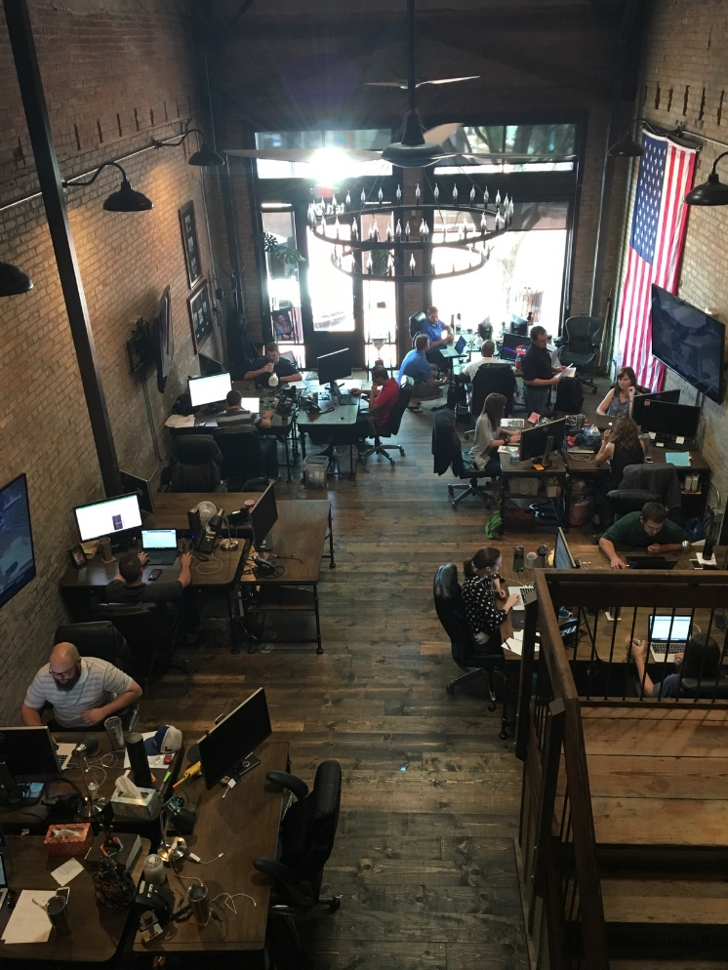
The Vested Group – Integrity, Respect, Diligence
Headquarters in Plano, TX
Extensive Manufacturing Expertise
“Tier One” ERP backgrounds
Flexible Implementation Options
Employee owned
85 Customers
25 Employees
Notes:
6 years old 5 star About 25 consultants
85 Customers Downtown Plano
tier one ERP backgrounds
Idustries – Mfg, Dist, service
Why netsuite -

Slide 5
Services
We are here for you throughout your NetSuite journey
Phase Zero
Planning and Analysis Phase
1-2 week effort to confirm Signature Processes and Project Scheduling
Prevents overwhelming users with project launch
Implementation
Adapt to the client’s culture
Slower tends to win the race
Largely dependent upon client resource availability and skill sets
inVESTED
Post Production Support
Maintenance and Enhancement
Training
Notes:
Planning to implementation to long term support
Phase zero = Ease into implementation
Planning, Signature process modeling
Implementation – Slow or fast
Support – crawl walk run
consulting, Consistency, on site or remote, 15 min increments,

Slide 6
NetSuite Solution Overview

Slide 7
















NetSuite: World’s #1 Cloud ERP
Background
Publicly traded on NYSE: “N”
4,600+ employees
$741m revenue in FY15
Performance
Used by 30,000+ organizations
Fastest growing top 10 FMS WW
Used in160+ countries
#1 Cloud ERP Suite
Notes:
First cloud ERP - Founded 1998 Acquired by Oracle
Number 1 in cloud ERP
$750m on a fast track to $1b
30,000+ customers
Small companies to large

Slide 8





























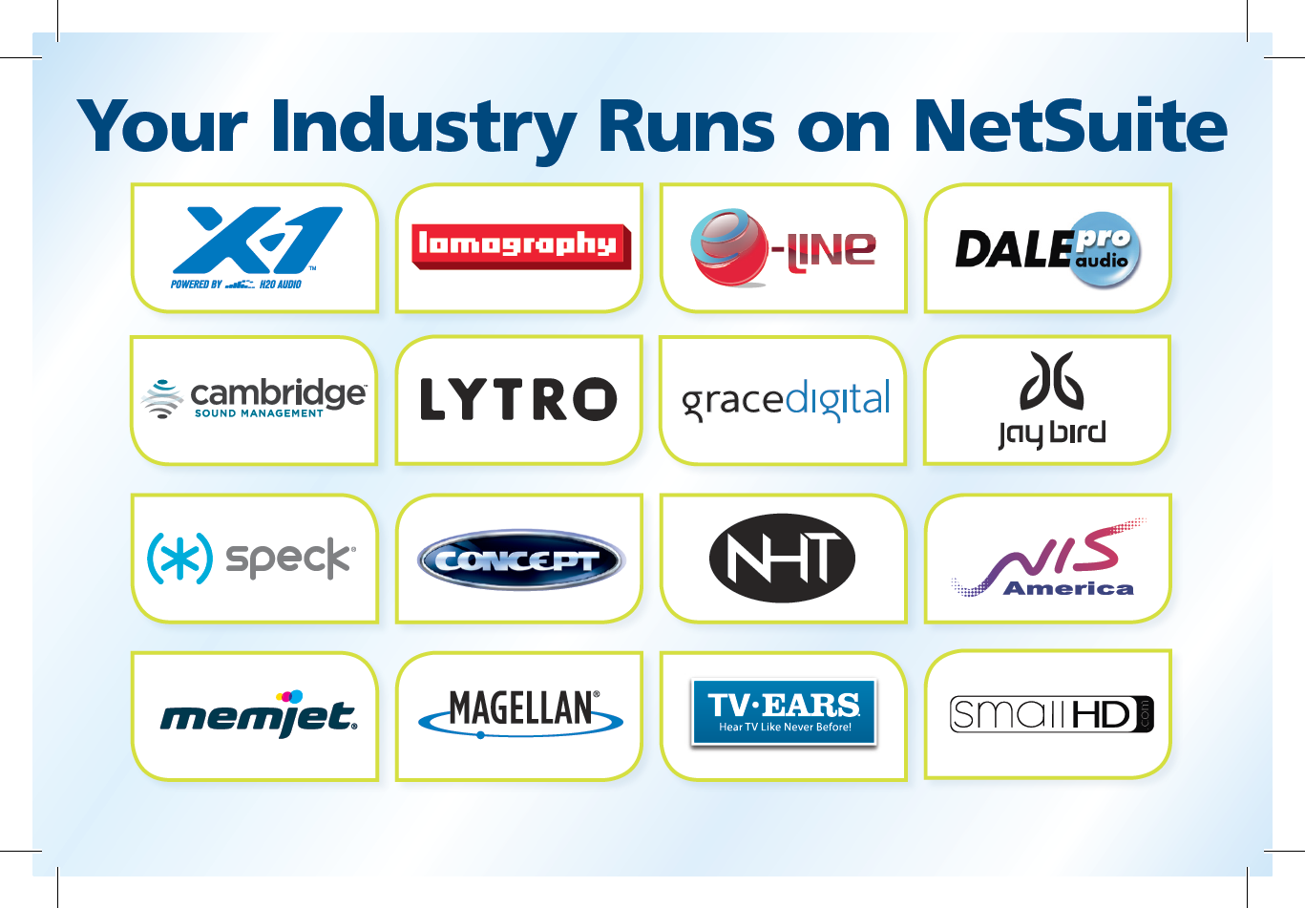















Manufacturing & Distribution Sub-Verticals
Durable Goods
Electronics
Commercial Equipment & Supplies
Industrial
Building Materials
Food & Beverage
Notes:
NetSuite is a player in Food industry
Dedicated vertical organization
Means - R&D and Investment

Slide 9
NetSuite Continues As Fastest Growing FMS
Revenue Growth for FMS
Research calculations show NetSuite is once again the fastest growing top 10 financial management system globally.
NetSuite Microsoft Sage SAP Oracle
Source: Gartner, “Market Share: All Software Markets, Worldwide, 2014” Published March 31, 2015. Chart created by NetSuite based on Gartner market share data.
Notes:
fastest growing FMS – not even close
2012 – 8 2013 – 3 2014 – 1st
Probably why Oracle bought

Slide 10

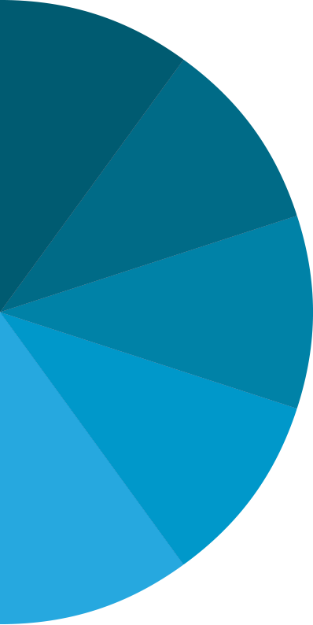


Complete Solution
SuiteCloud Platform
ERP
SuiteBundler
SuiteBuilder
E-Comm
WAREHOUSE
MANAGEMENT
PROJECT
MANAGEMENT
CORE BUSINESS
CUSTOMER MANAGEMENT
ORDER MANAGEMENT
GLOBAL FINANCIAL MANAGEMENT
BILLING MANAGEMENT
REVENUE MANAGEMENT
SuiteFlow
SuiteAnalytics
INVENTORY MANAGEMENT
RESOURCE
MANAGEMENT
TIME &
EXPENSE
MANUFACTURING
SUPPLY
CHAIN
MANAGEMENT
SuiteTalk
SuiteScript
PROJECT ACCOUNTING
Notes:
Complete Solution Fins, projects, resource mgmt, proc, time entry
Platform and ERP as a service

Slide 11
Why Today’s Businesses Choose NetSuite
Designed for Modern Business
Flexibility Built In
Business Intelligence For All
Omni-channel Commerce-Ready
It Just Works
Notes:
You will see:
Modern user interface any device any place anywhere
Extremely flexible - Customization is not a bad word
BI included - First screen is customizeable dashboard
Commerce Ready - web store, taxes, etc
30,000+ on same code bugs are rare
In on prem software imp – 40% was making software work

Slide 12









SuiteApp.com
15,000+ SuiteCloud Developers Verticalized ecosystem Build something, sell something… Search by industry Search by function
Notes:
Collection of applications with prebuilt integration
Box – store your docs
Noticed Expensify
This is just a subset

Slide 13
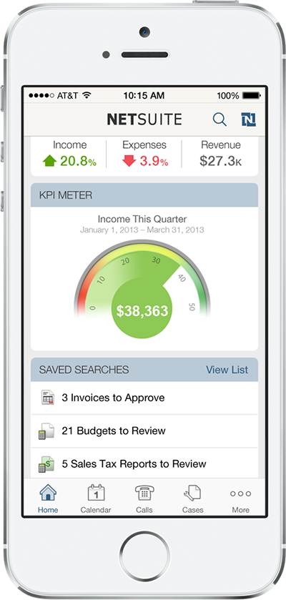
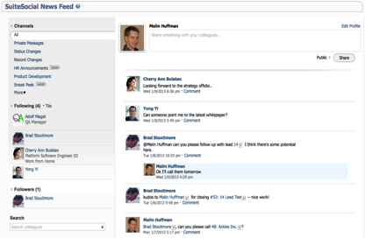
Designed for the Way You Work Today
Mobile
Social
Notes:
All this info on your phone....
Soclal – collaborate on projects, customers, etc

Slide 14
Product Demonstration

Slide 15
Thank You

Slide 16
Manufacturing Sub-Verticals
Durable Goods
Electronics
Commercial Equipment & Supplies
Industrial
Building Materials
Food & Beverage

Slide 17
Customer Success Stories
Notes:
Doc said 4 similar scoped and 1 industry
#1 in Mfg

Slide 18
Revolution Retail
Manufacturer of retail cash management solutions.
Experiencing rapid growth and increased complexity
4 month implementation
NetSuite Footprint
Financials
Manufacturing
Order Entry
Procurement
Notes:
Landed Wal Mart as a client
Bank of America – in vault = in bank

Slide 19
HiTech Assets
IT Asset Disposition
Unique industry specific requirements
6 month implementation
NetSuite Footprint
Financials
Order Management
Procurement
Inventory
Extensive custom development
Notes:
Stated objectives: systematic processes and maintain flexibility
Path and purpose - Reverse Logistics
Extensive development

Slide 20














Supported Formats
North America
Europe
Africa
Asia
Pacific
ANZ
South America
Notes:
In North America, we have NACHA, (US, Canada)
South America - Brazil
Europe – Austria, Belgium, Czech Republic, France, Germany, Hungary, Ireland, Italy, Luxembourg, Netherlands, Spain, UK
AsiaPacific, Australia and New Zealand – Japan, Singapore, HK, Au and NZ
We have a total of 58 formats.
46 standard formats for EFT
9 formats for Direct Debit
3 Positive Pay

Slide 21


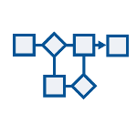





Flexibility: Easily Configured or Customized By Mere Mortals, No Version Lock
SuiteApp
Custom Forms
Custom Workflows
Web Services Integration
Personalize Dashboard
Custom Searches
Custom Reports
Custom Fields
Custom Records
Custom Code
End User
Power User
Developer
Notes:
Users - Personalize dashboard to show what they care about
Power User in each dept Point and click tools
Developers for heavy lifting inVested

Slide 22
Designed for Modern Business – Transforms Accessibility
Behind Firewall
Hard to Learn/Use
Anytime, Anywhere
Easy to Learn/Use
Maintenance
Centric
Innovation
Centric
Clunky UI
Historical Reporting
Consumer UI, Mobile
Real-time Reporting,
Forward Looking
Notes:
TALK TRACK:
Maintenance-Centric: according to leading analyst firms more than 60% of organizations run on older versions of software putting you in an endless maintenance cycle of trying to keep your old system operational.
To keep it secure, you have to enforce firewalls which hamper accessibility and international growth
Its hard to learn to use and even harder to use effectively on a day-to-day basis
The UI is clunky and not optimized for today’s new paradigms of accessibility or behavior
If you’re lucky enough to get reporting out of it at all, its only a look back into the past and adds minimal strategic value
Innovation-Centric: In sharp contrast to this world, NetSuite fosters innovation within every aspect of your organization
Access all your important business metrics from anywhere, anytime
Its easy-to-use and more importantly, easy to learn so you can ramp your new employees faster and increase productivity of your long-time employees.
Modern consumer innovations such as social collaboration are built in, along with being optimized for the latest mobile devices
A key component to driving innovation across your organization are real-time analytics that allow you to make important course corrections and project changes out into the future

Slide 23
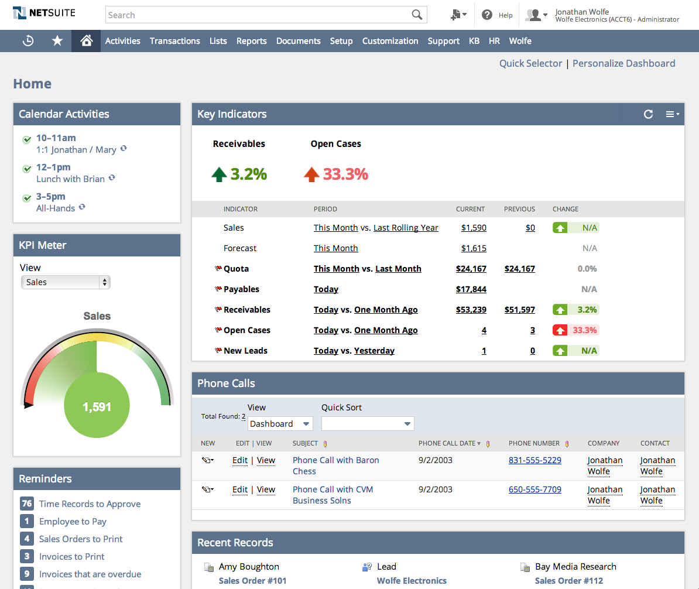
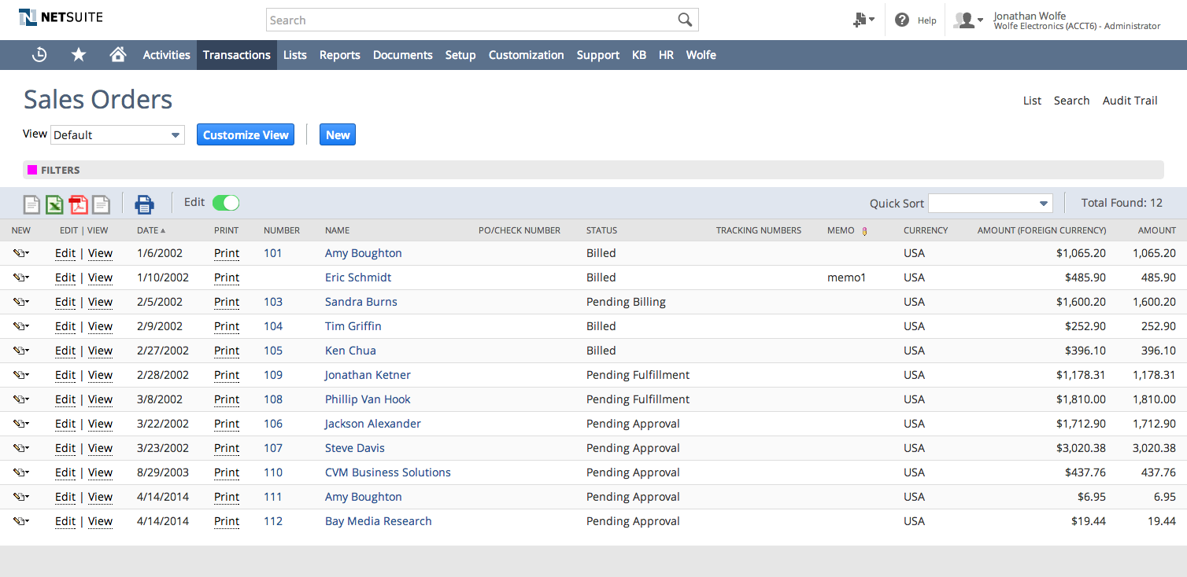
Easy to Use
Notes:
TALK TRACK:
With “The Consumerization of IT, expectations for business software have risen dramatically. Employee and customer expectations for an applications ease-of-use have forced companies to look for user friendly business applications. NetSuite’s modern browser UI bridges the gap between consumer application experience and robust business application functionality.

Slide 24
It Just Works – Proven NetSuite Benefits
40%- 70%
45%- 75%
10%-20%
Reduction in
financial close
Reduction in invoicing costs
Improvement in DSO
45% - 75%
50% - 80%
45% - 75%
Increased Order Processing efficiency
Increased in 360º Visibility
Reduction in IT Cost
Source: SL Associates and Customer Case Studies
Notes:
TALK TRACK:
Looking across the universe of NetSuite customers, you’ll see the proven benefits to business operations that can only come from a modern business system with built in flexibility, has Business Intelligence for all, that is Commerce-ready.
<sourcing notes>
20-50% - nucleus
25-75% - nucleus
DSO is from BearingPoint australia, and Peoplenet case studies
50%+ quote to cash (nucleus sofware piece) and audit prep
50%= IT costs, is from SMB

Slide 25
Methodology

Slide 26
Project Theme
1
Simple
One source of truth
Integration of key Industry Practices
Automate Your Business Processes
NetSuite provides Real Time Visibility for Your Team and Customers
2
Comprehensive
Fully Integrated Enterprise System
Everything you need today and tomorrow
Flexibility to evolve as your business changes
Product is proven and has a clear future
NetSuite is right-sized for Can-Do Tape
NetSuite is the enduring and safe choice for Can-Do Tape
3
Long Term
Lowest Risk
Streamlined IT staff to maintain
NetSuite is the LAST solution you will need

Slide 27
Enseo
Electronics manufacturer
Set top boxes for hospitality industry
Experiencing rapid growth
5 month implementation
NetSuite Footprint
CRM
Financials
Manufacturing
Order Entry
Project Management
Procurement
Demand Planning
Notes:
Complete transformation
Coming to a hotel near you = San Jose conference center Marriott
Brand standard for Marriott
Went from mfg only to installation
Went live 6/1 Transitioning to inVESTED

Slide 28
Nuo Therapeudics
Baltimore area Biomedical company
Platelet and plasma therapy system
Phased 6 month implementation
NetSuite Footprint:
Financials
Order Entry
Manufacturing
Procurement
CRM
Notes:
Highlight a customer in your industry
Current inVESTED customer

Slide 29

Project Scope
Turnkey Solution for all of Encore’s business needs
Technology
Accounting
Order Entry & Fulfillment
Scheduling
Manufacturing
WMS (Accellos)
People
Business Scenario Testing
End-to-End Training (Train the trainer)
Change Management
Process
Formal and Proven Methodology
Gate Reviews and Status Checks
Formal Signoffs

Slide 30
Project Benefits
Integrated Environment
Flexible system that is easy to maintain
Eliminate duplication and errors
Drive Consistency
Simplify Transactional Flow
Improved Efficiency
Process automation
Eliminate “work-arounds”
Improved Operating Performance
Operations Effectiveness with better, faster information
Understand and Control cost through visibility and reporting
Improved data accuracy and accessibility
Simplify!

Slide 31
Roles & Responsibilities
Project Sponsor
Overall Project Champion and vocal leader
Responsible for ensuring deliverables satisfy corporate strategy
Monitor results and performance against targets
Provide necessary facilities and services
Steering Committee
Composed of Can-Do Tape and TVG Leadership
Sets Overall Project Direction
Supports the Vision of the Project
Bi-weekly Project Status Meetings
Strategic Issue Resolution
Quality Assurance
Responsible for ensuring quality work products
Provide expertise and overall direction to the team
Monitor and support the overall engagement relationship
Implement and manage the QA Process
Project Management
Weekly project team status meetings
Status reports to the Steering Committee
Ensure scope is achieved on-time and on-budget
Mitigate risks
Change Management
Responsible for enabling transition
Assess the impact of system changes on the organization and employees
Assist Can-Do Tape in executing the communication plan
Develop and deliver training strategy
Team Leaders/SuperUsers
Execute the Project Plan
Identify risks and propose mitigation actions
Configure and test systems
Design business processes
Weekly team status meetings

Slide 32
Phase One Methodology
Project Initiation
Testing & Preparation
Deployment & Support
Solution Design
Application Configuration
Change Management
User Involvement
Program Management

Slide 33
Phase One Methodology
Project Initiation
Project Initiation
Conduct Kickoff Meeting
Finalize and Publish Project Schedule
Requirements Definition and Design
Requirements Traceability Matrix (RTM) Signoff

Slide 34
Phase One Methodology
Solution Design
Solution Design
Map and Gap Against RTM
Identify Solutions for Gaps
Custom Development
Phase Two Initiative
Business Process Change
Business Flow Recommendation

Slide 35
Phase One Methodology
Application Config
Application Configuration
System Setup
Extended Prototyping
Develop Test Scripts
Initiate Data Cleansing and Conversion Routines

Slide 36
Phase One Methodology
Testing & Prep
Testing & Preparation
Unit Testing – Individual modules/functions
Integration Testing – End-to-End Flow (Order to Cash)
User Acceptance Testing – Mock Go-Live
Full Life Cycle Simulations
End User Training

Slide 37

Phase One Methodology
Deployment & Support
Deployment & Support
Setup Production Environment
Convert Live Data
GO-LIVE!
Post Go-Live Support
Project Closeout

Slide 38
Gate Reviews & Signoffs
Phase | Acceptance Required
Project Kickoff | MSA and SOW are signed and approved
Project Initiation | Requirements Traceability Matrix is signed off as complete
Unit Testing | Unit Testing is completed and signed off as complete
Integration Testing | Integration Testing is completed and signed off as complete
UAT | User Acceptance Testing is signed off as complete
Deployment | System Acceptance Certificate is signed off as complete
Project Closeout | Project Closeout Certificate is signed off as complete

Slide 39
Organizational Change

Slide 40
Change Management
Change Curve: How People Respond to Change
There is a predictable drop-off in performance due to the implementation of new processes and systems. The response is a natural reaction to major change. Targeted performance can be achieved by proactively managing the organizational change.
Continuous Improvement
Uninformed
Optimism
Initiative Completion
Immobilization
and Denial
Informed Optimism
Anger
Acceptance
Bargaining
Hopeful Realism
Informed Pessimism
Testing
Despair

Slide 41
Guiding Principles
Take Ownership… take initiative and don’t pass the buck if you could easily resolve an issue or help a team member when it makes sense to do so. Remember the system belongs to you.
Stay Flexible… be willing to try doing things differently; anticipate and be open to change for the better. Keep smiling and maintain a positive attitude.
Apply “SPF”… whenever possible, we want to strive for simplification, purification and focus; standard functionality is the goal with no customizations and minimal bells and whistles.
Think Big Picture… think how your work affects everyone in your department as well as other departments in the company…AND globally (think systematically)
Act as a Team… teamwork is crucial; we achieve more as a team than we ever can working as individuals.
Maintain Open Communication… continuous, two way communication is crucial; constantly provide honest and useful feedback.
Identify Solutions… be proactive in looking for answers; seek out resolution of obstacles you face.

Slide 42
Project Risks
Scope creep
Delayed decision-making
Lack of Executive leadership
Conversely, Leadership Chaos
People affected by change have little input
Lack of critical skills
Retention and morale problems
Simultaneous, multiple initiatives (even within a single project)
Interruptions of day-to-day operations
Overly customizing to fit existing silos

Slide 43
Five Key Areas of User Adoption
Alignment
Communication
Training
Support
Measurement

Slide 44
Steps to Adoption
Develop Go-Live Success Criteria
Conduct User Acceptance Testing
Develop Go-Live Training Support Plan
Conduct End User Training
Develop Continuing Education Plan
Establish On-Going Performance Criteria
Review success criteria 30 days after Go-Live
Document and communicate performance expectations

