Slide 2

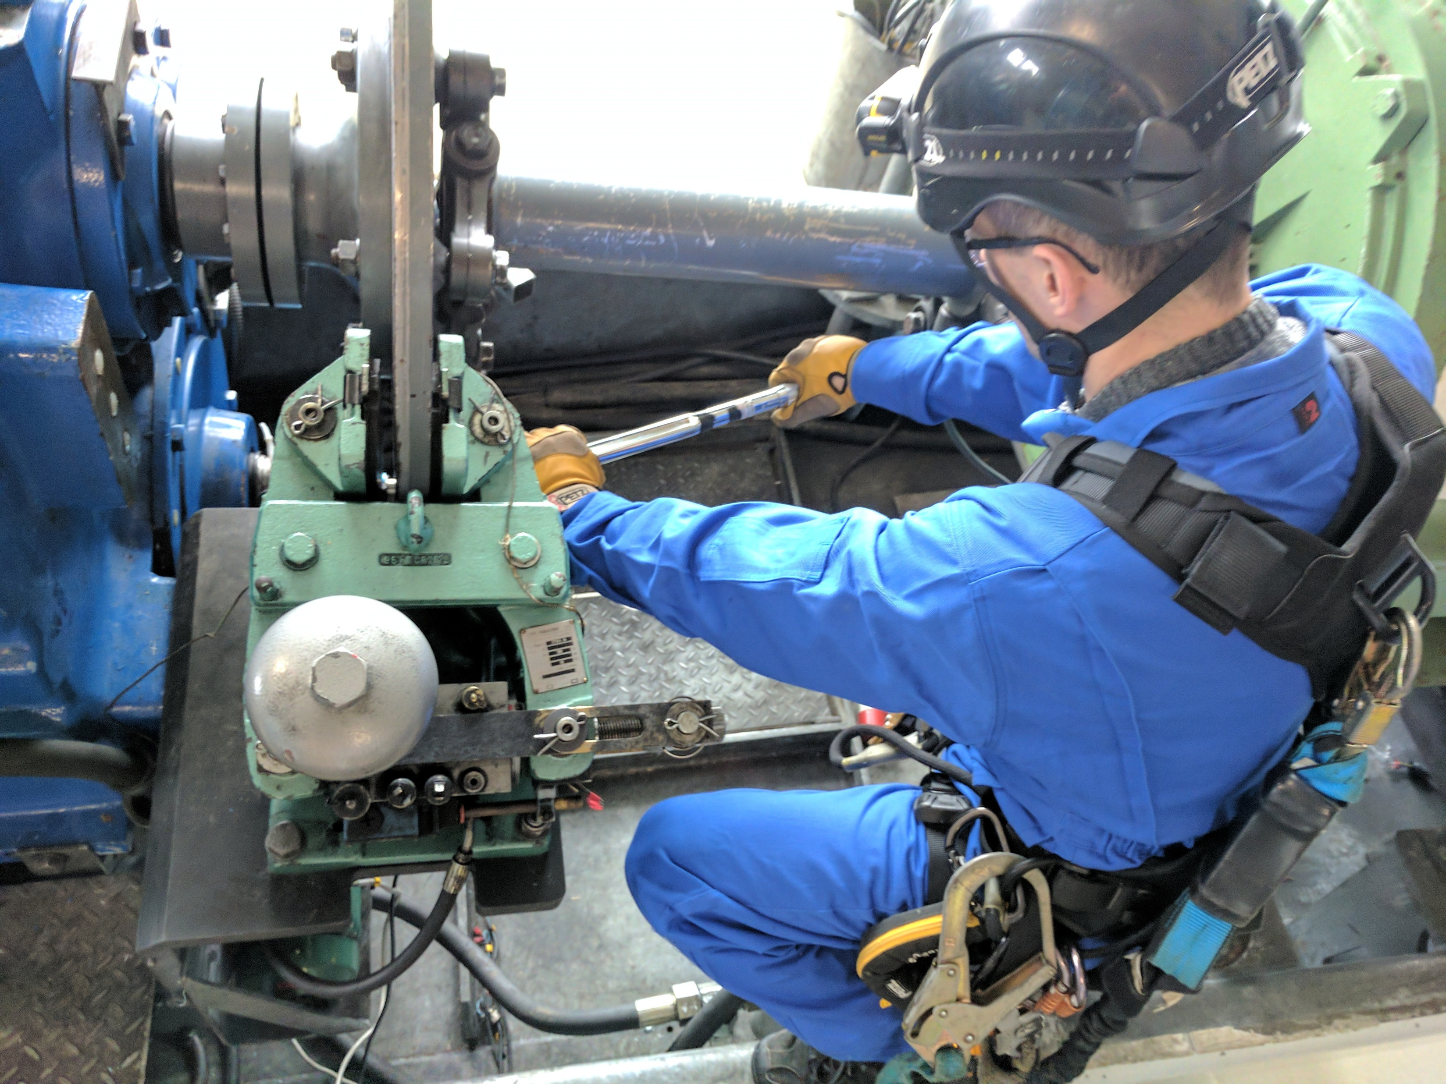
Photo to use for Blade Inspections
Photo to use for Mechanical Maintenance

