Slide 1

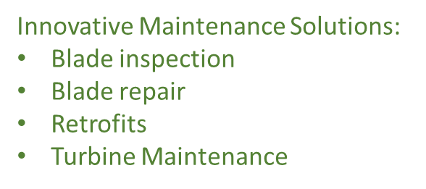
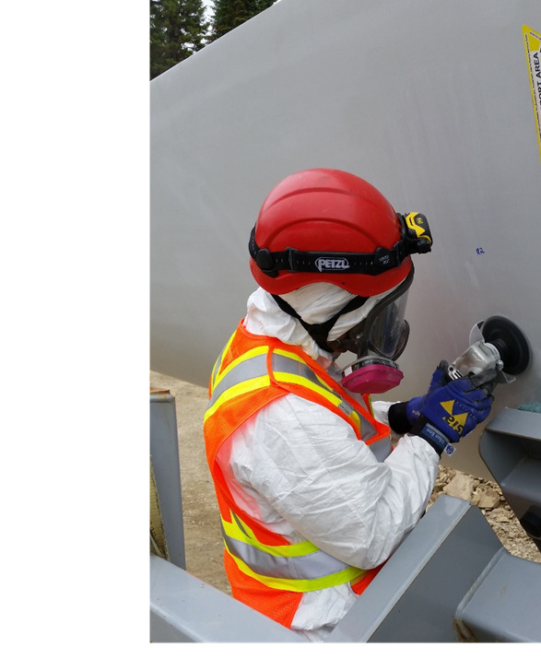
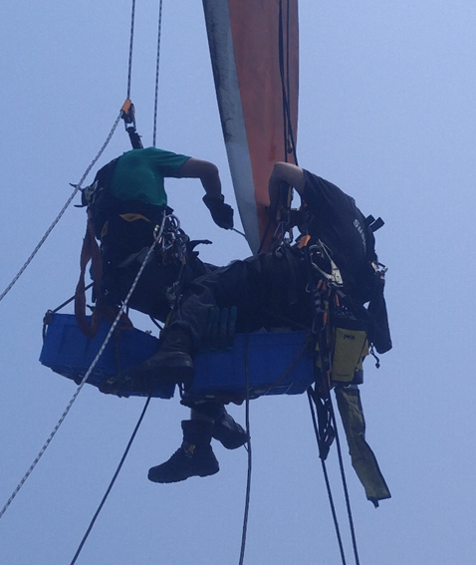
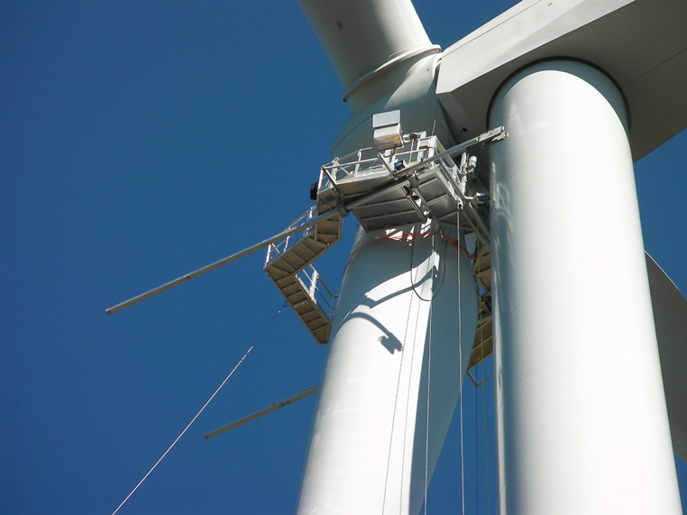
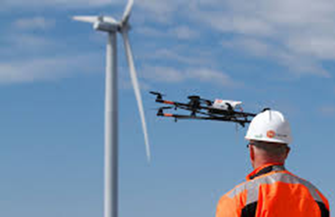
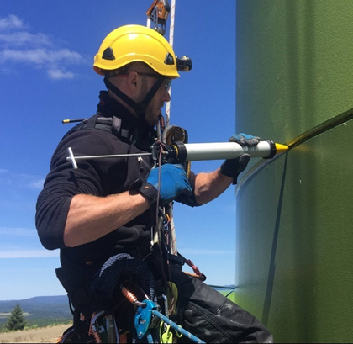
Empowering you to empower others...

Slide 2


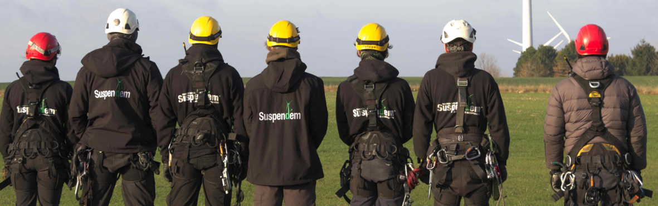
Innovative Maintenance Solutions:
Blade inspection
Blade repair
Retrofits
Turbine Maintenance

Slide 3
Innovative Maintenance Solutions:
Blade inspection
Blade repair
Retrofits
Turbine Maintenance

