Slide 1
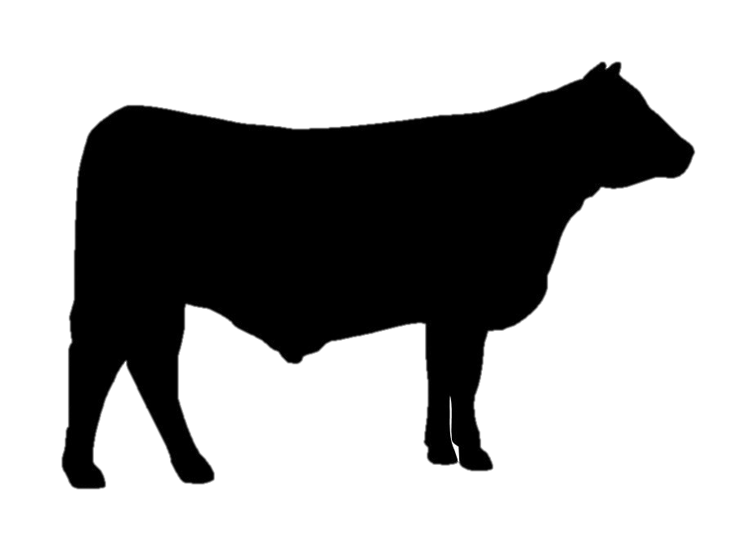
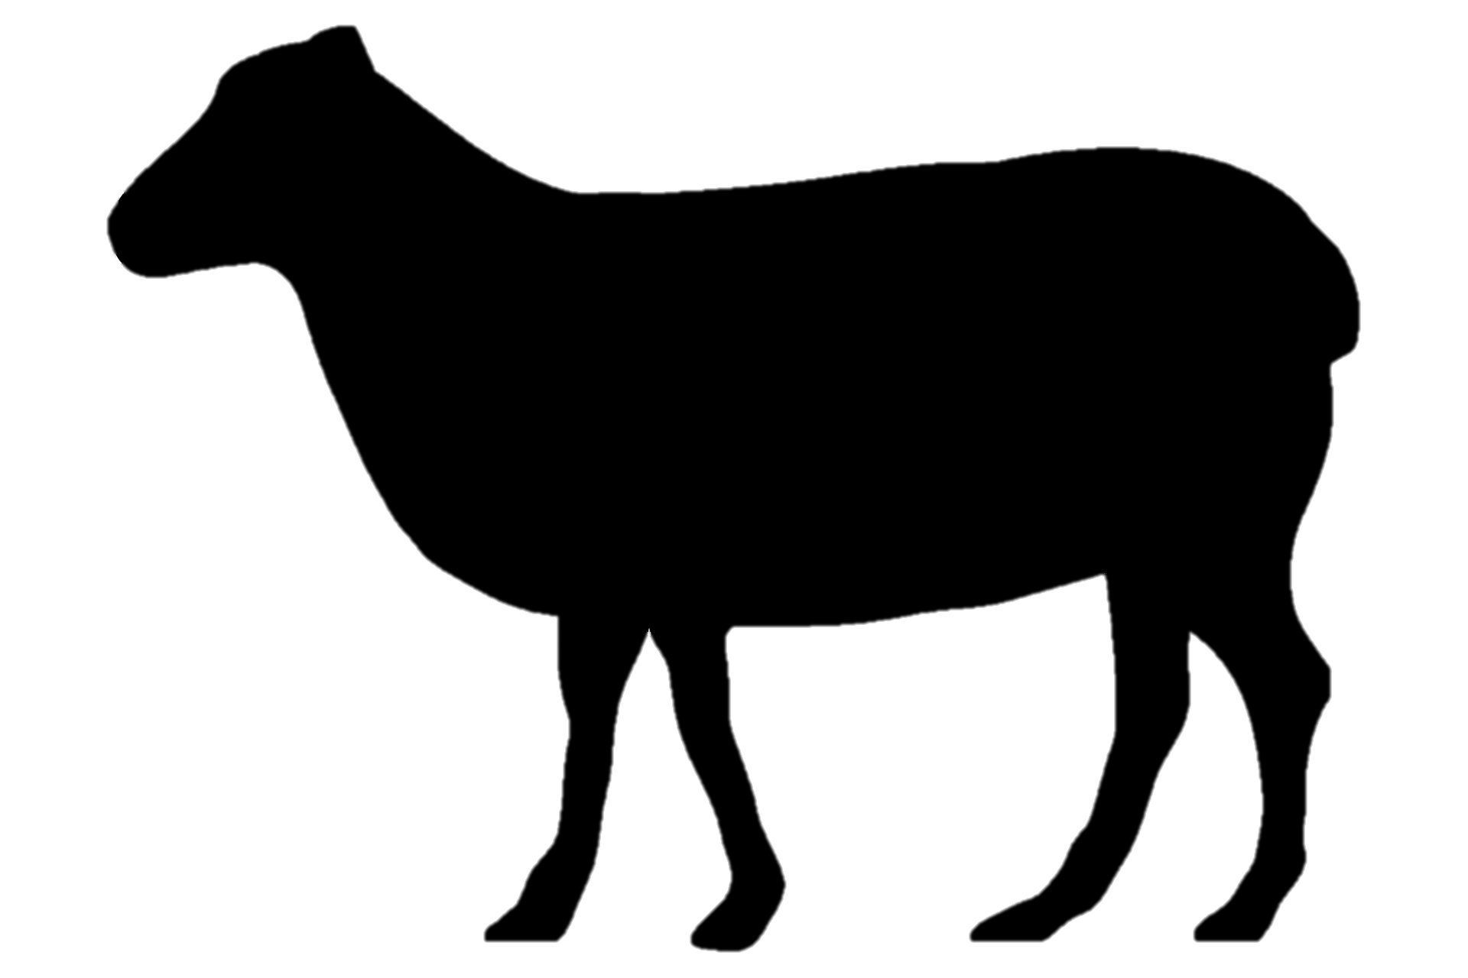

Good Life
Grass Farms

Slide 2

Good Life
Grass Farms
Good Life
Grass Farms

