Slide 1
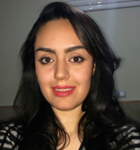
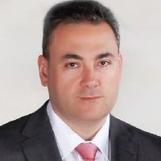
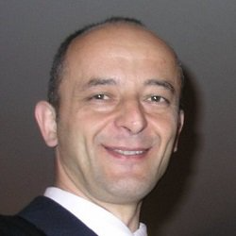
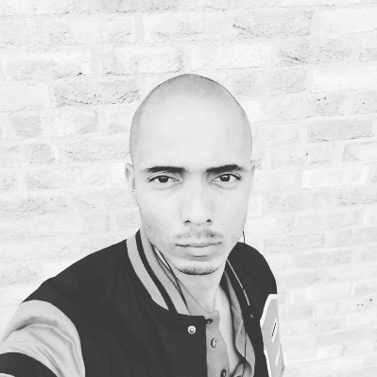
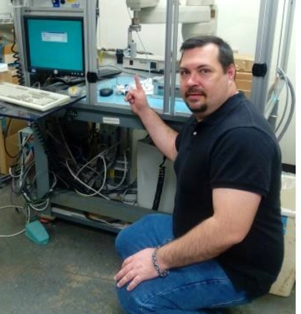
Eduardo, Engineering Manager
Spain
Petar, Academic
Serbia
Zahra, Student
Iran
Orfeuo, Startup Founder
Amsterdam
Steven, Employee
US

