Slide 1


The Hub for Engineering Innovation
June 2017

Slide 2
What is Ennomotive

Slide 3
Why ennomotive
Engineering Innovation through the Crowd
Companies’ needs
The Crowd Engineering ‘Opportunity’
Be more competitive through product and process innovation
Deliver better innovation results through better solutions
Reduce uncertainties when adopting new technologies
Increase capacity of internal engineering teams
Connect with broader talent and experience from a global and diverse engineering community
Bring innovations from other industries
Enhance internal innovation culture looking outside
Extend the supplier network with a broader perspective
© 2016 Ennomotive SL. This material may not be reproduced or distributed, in whole or in part, without prior written consent from Ennomotive

Slide 4
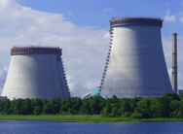
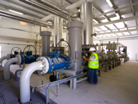
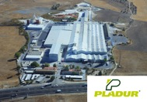
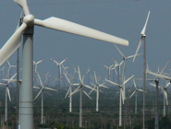
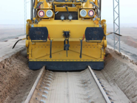
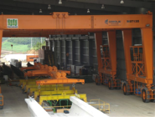
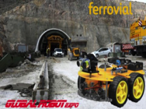
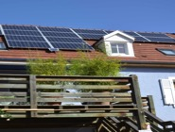

ennomotive helps companies solve engineering challenges through online contests
Water and Energy
Instrumentation
Sustainability
Logistics costs
Multinational Mining / Steel Manufacturer
Multinational Gas Infrastructure Operator
Multinational construction materials manufacturer
Multinational leading Wind Turbine manufacturer
Extreme environment
Infrastructure costs
Labor Productivity
Internet of Things (IoT)
Multinational Railways Construction company
Multinational infrastructure Construction company
Multinational Construction & Services company
Multinational leading energy solution provider
Notes:
AND what we have seen after 20 years working in Operations Consulting is that there is a gap between what the company needs and their access to such talent
AND WE ARE HERE TO SOLVE THAT

Slide 5
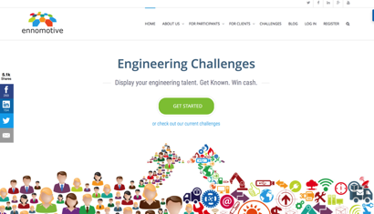
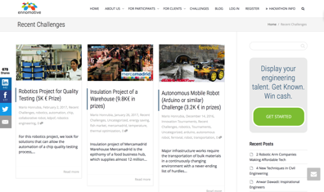
Our proprietary platform helps finding amazing viable solutions to complex challenges
Can we solve it?
What are the best solutions?
Round 1
Can we obtain the results?
Round 2
Round 3
Challenge
Unique solutions
Notes:
Revolutionary method for solving complex challenges

Slide 6
We run on-line competitions through our proprietary platform
Open or private* tournaments with a number of cycles that can be as short as one (e.g. “Tech scouting”) or multiple (progressive resolution of complex problems)
Can we solve it?
What are the best solutions?
Round 1
Can we obtain the results?
Round 2
Round 3
Challenge
Unique solutions
Optional: participants value each other
* By invitation, e.g. limited to country, university,…

Slide 7

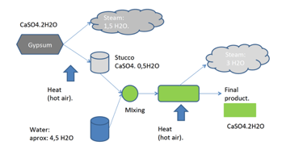
How does it work?
The challenge
How can this factory recover water from steam instead of throwing it to the air?
Plasterboard manufacturing
Notes:
Now, how does it work in practice?
The CEO of this company was wondering how he could recover water from steam and reduce the environmental impact
97 and 77 degree celsius
2,5 € / m3 water
They have been approached by big engineering companies with no succes

Slide 8



ennomotive, the 1st crowd engineering company
ennomotive helps companies turn Innovation into Tangible Results while bringing Opportunities to Engineers from all over the world
Global Multi-skilled
Engineering Community
Multi-Round
Challenge Solving Method
Proprietary Online Competitions Platform

Slide 9
Our Community

Slide 10

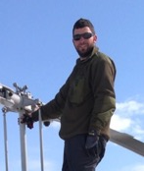
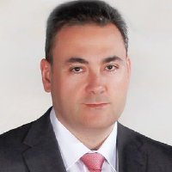
+ 5.000 engineers from +50 countries have already joined our community …
Zahra. Engineering Student
“My motivation is to connect with companies in other parts of the world, understand the problems they are facing and take the intellectual challenge”
Martin. Freelance
“This allows leverage my experience to solve new challenges, make new connections, hopefully make some money and best of all doing it from remote locations”
Eduardo. Full Time Engineer
“This is like a hobby for me, I like to get out of daily routine and enjoy finding new solutions for existing industry challenges”
Participants feedback

Slide 11
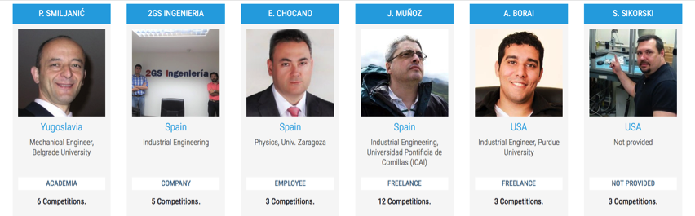
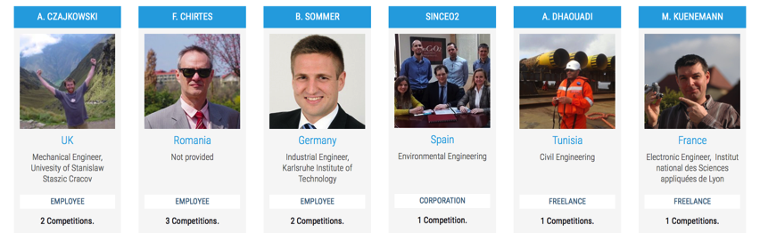
@ennomotive, the engineers are the protagonists, show their skills, solve challenges and win cash prizes and recognition

Slide 12

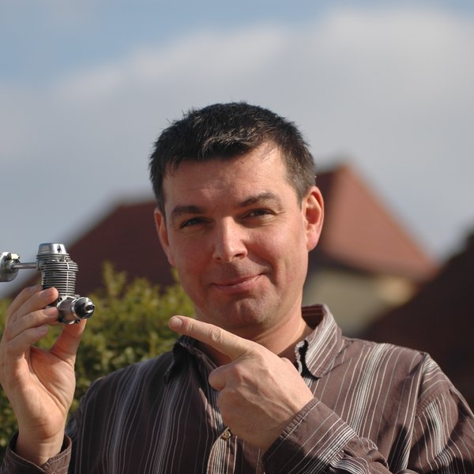
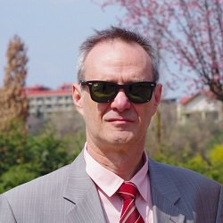

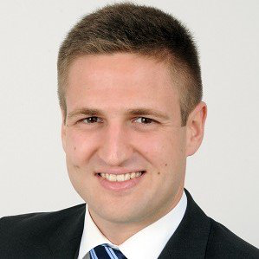
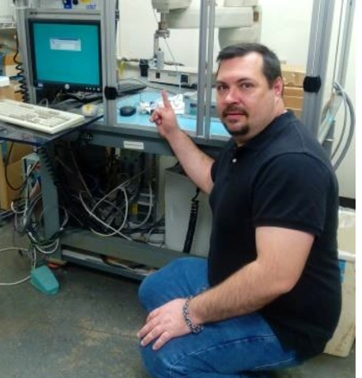

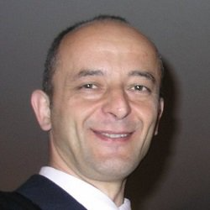

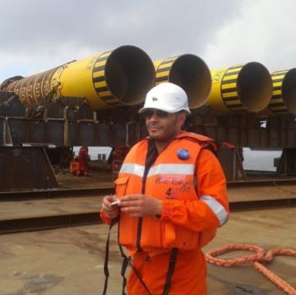
ennomotive global Engineering Community
Michel, France
Martin, Canada
Artur, UK
Fidel, Rumania
Benjamin, Germany
Steven, US
Eduardo, Spain
Petar, Serbia
Zahra. Iran
Anwar, Tunisia
Notes:
Those solutions come from our diverse and global community of engineers

Slide 13
… to solve engineering challenges with solutions coming from multiple Industries & Technologies
Top #10 skills
Product Engineering
Manufacturing Engineering
Analytics & Modeling
Energy Efficiency
Automation & Robotics
Electrical & Electronics
Systems Engineering
Construction Engineering
3D printing
Mechatronics

Slide 14
Samples Challenges

Slide 15
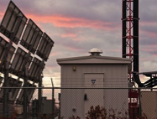
Sample challenges (I)
Sustainability
Maintenance costs
Water recovery and energy efficiency optimization in cooling towers for a steel manufacturing plant.
Sand covering and maintenance cost optimization for the high speed Medina-La Mecca railway (Haramain project)
Leading Multinational Mining / Steel Manufacturer
Multinational Railways Construction company
Infrastructure costs
Service Reliability
Flexible & Easy to transport factory solution to speed up the manufacturing service set-up and reduce cost for a pre-casted concrete parts manufacturer.
Cost-efficient BTS equipment protection system to prevent batteries thefts, maintain service reliability and reduce operational costs for a Telco service provider.
Multinational infrastructure Construction company
Telecommunications Service Provider

Slide 16
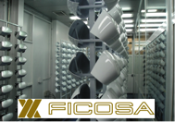
Sample challenges (II)
Internet of Things (IoT)
Sustainability
Cost-efficient and low energy consumption solution to monitor the charge status of lead batteries in Photovoltaic systems.
Water recovery and energy efficiency optimization during the process of calcination and drying for a gypsum manufacturing plant.
Multinational leading energy solution provider
Multinational construction materials manufacturer
Logistics Costs
Labor Productivity
Reduction of ship transportation costs through the optimization of the volume in wind-turbines blades stacking for a manufacturer
Productivity improvement of an intensive parts loading process through Robotics / Automation for a leading manufacturer of rear view systems.
Multinational leading Wind Turbine manufacturer
Multinational Tier 1 Automotive Supplier

Slide 17
Solutions

Slide 18
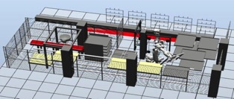

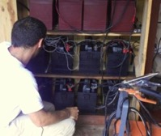
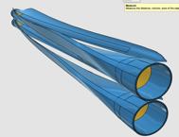
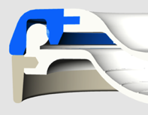
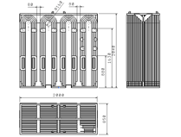
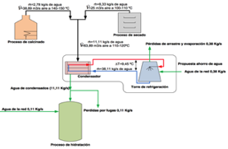
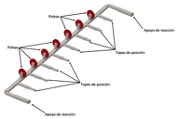
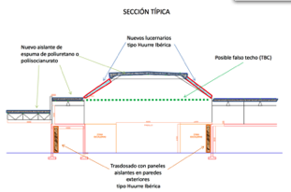
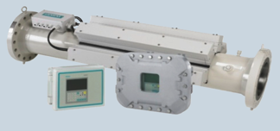
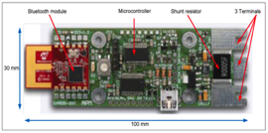
Tangible & Viable solutions

Slide 19











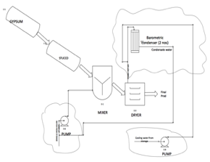
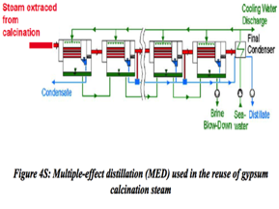

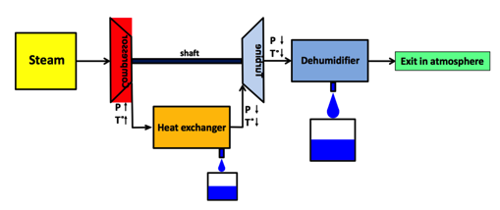
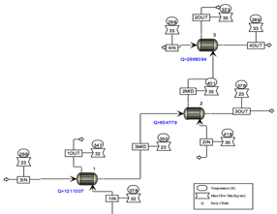
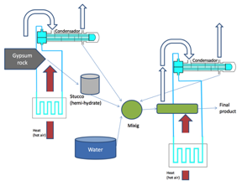
From +12 participating countries, 6 alternatives reached the semi-finals!
Notes:
After 6 weeks we were able to find 6 different viable technologies to solve the challenge
Aspen model coming from geothermal use in Nordic countries. Air cooling exchangers
Steam turbines for energy generation used typically used in thermosolar plants
Barometric condenser from sugar manuf. Industry and others
Water condenser + air heat exchangers (aerotermos)
Cooling towers used in steel manufacturing and refinado aceite
Multiple-effect distillation, to produced distilled water. interesting when you have a lot of cool water from the sea or a lake. Used a experimental setup

Slide 20
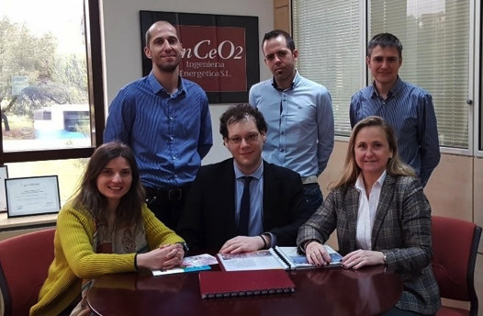
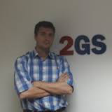

As a result, 235K€ /year of water can be earned with a 3,5 years payback
The winners
2nd finalist
15.000 € Prize
1.000 € Prize
Notes:
We awarded the winner with a prize as well as the second best soltion
Investmemt 800K€ so 235K€ each year – 3,5 years payback – 100.000 – 125.000 M3

Slide 21
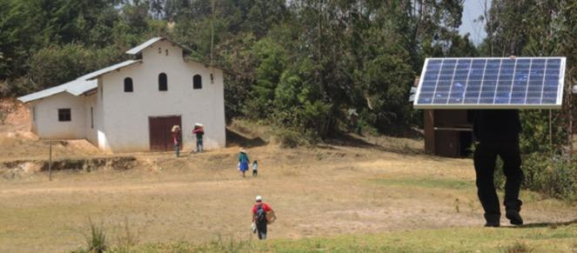


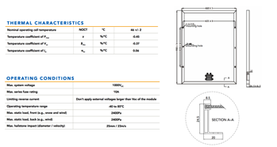
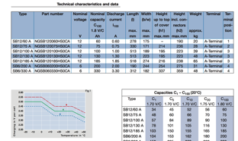
IoT - Photovoltaic systems batteries challenge
The challenge
Monitor charge
status of photovoltaic
system battery
Accurate
Minimum cost
Low consumption
Reliable
Notes:
Bateria de plomo, 40% carga mínima, alto coste del sistema

Slide 22
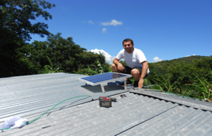

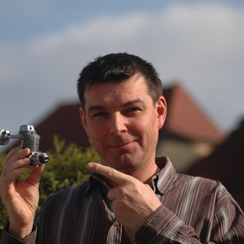

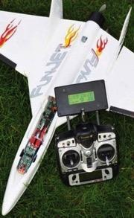
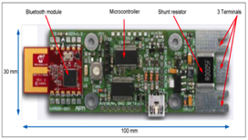


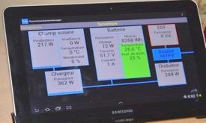


Result: Monitoring System Below 20€!
Participants
Android software
< 50 components
Robust, low cost
APP for tablet

Slide 23
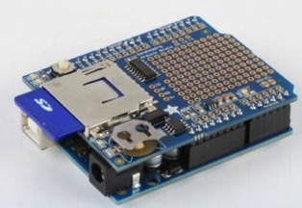
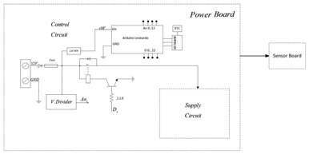



Other pictures
© 2016 Ennomotive SL. This material may not be reproduced or distributed, in whole or in part, without prior written consent from Ennomotive

Slide 24

Sustainability - Water Recovery in Gypsum Plasterboard Manufacturing
The challenge
How to recover water
from steam efficiently
Notes:
97 and 77 degree celsius
2,5 € / m3 water
They have aproach

Slide 25







Results: 235K€ /year of water can be saved
Participants

Slide 26




Optimization of “lost wax” manufacturing
© 2016 Ennomotive SL. This material may not be reproduced or distributed, in whole or in part, without prior written consent from Ennomotive

Slide 27






Results: Reduce manufacturing lead time from months to days, eliminate molding costs!
Participants
© 2016 Ennomotive SL. This material may not be reproduced or distributed, in whole or in part, without prior written consent from Ennomotive

Slide 28


Case 3: Complex process automation challenge (robotics)
Can we automate the manual process of holding mirror covers on a rack?
Criteria
Replace manual operations as much as possible
Feasible placement of covers on rack pins
Target payback
© 2016 Ennomotive SL. This material may not be reproduced or distributed, in whole or in part, without prior written consent from Ennomotive

Slide 29



Case 3: Complex process automation challenge (robotics) (cont.)
Challenge participants
Germany
Canada
Denmark
Egypt
Spain
Estonia
Philippines
France
India
Kenya
Rumania
Serbia
Tunisia
Turkey
UK
USA
Solutions
Results – 2 feasible technical solutions
- Kuka and ABB robots
- Artificial vision
- Payback 4-5 years
© 2016 Ennomotive SL. This material may not be reproduced or distributed, in whole or in part, without prior written consent from Ennomotive

Slide 30

















El Crowd Engineering, una forma distinta …
DESAFIO + RECOMPENSA
How to minimize CO2 in cogeneration plants?
ABOUT THE COMPANY
VG Electricity (name is disguised for anonymity) is a multinational utilities company which core business is the production and distribution of electricity.
In most of the plants our client is using different types of cogeneration with gas turbines CHP (Combined Heat and Power).
CHALLENGE DESCRIPCION
VC Electricity has a target to reduce 20 % its emissions of CO2 and known technologies are not efficient enough and cost attractive.…
Type of fuel: Natural gas
3 engines:
Electricity: 44% performance and a 3.3 MWt/unit
Exhaust conditions: 1.5 MWt/unit at 410 C
Volume of water: 1.6 MWt at 72 m3/h at 95C and return at 75C
Consumption:
Steam: 4.4 MWt, Hot water: 2.6 MWt
Current performance: 0,67
EVALUATION CRITERIA
1. Technical Feasibility
For each of the proposed solutions/technologies you should bring real cases where the technology…
2. Economic Feasibility
Business Case supporting the profitability …
INTELLECTUAL PROPERTY
Not applicable
AWARDS
The 3 best submissions will be awarded with a 15K, 10K and 5 K USD cash prize.
In addition, all 3 finalists will be invited to present in front of the board of the company their solutions.

Slide 31
Companies

Slide 32







Our experience with +20 companies
Notes:
We have experience in Automotive, Construction, Commodities and Energy

Slide 33



Are you up to our challenge?
Discover how we turn Innovation into Tangible Results
Visit us at www.ennomotive.com

