Slide 1
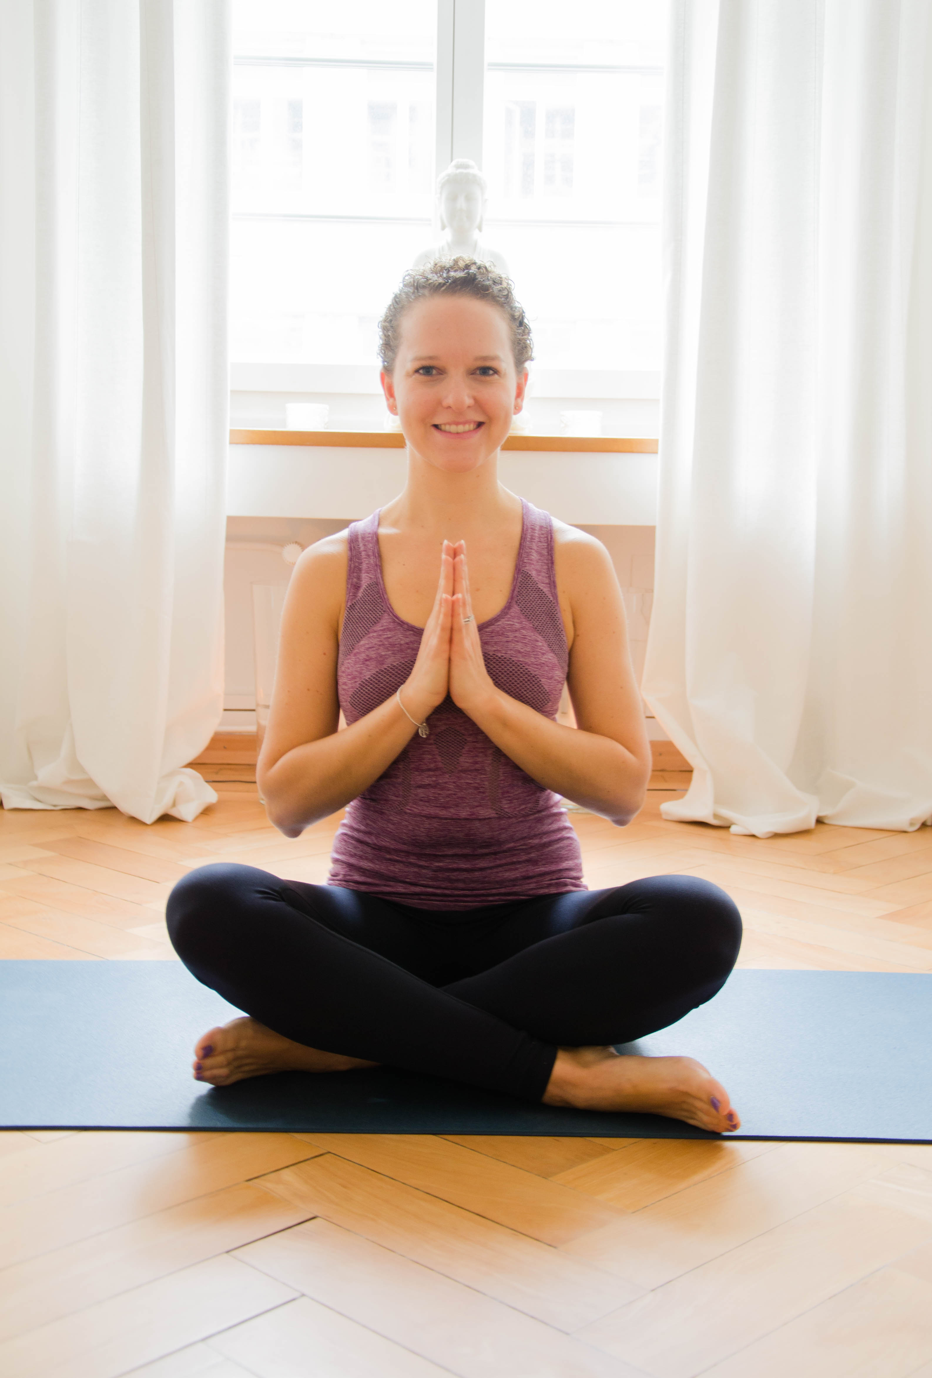

Private Yoga Classes
**********************
Bring a friend for free this summer!
Going to a new yoga class can be a little intimidating. Where do I put my mat? Does it matter I can’t even touch my toes? What language will they speak?
I get it. I’ve been there.
So instead, how about trying private yoga classes? We can practice at the best time for your schedule. And make it even more fun by doing it with your friend.
This summer if you book a private class with me you can now do just that, and bring a friend along for free!
Offer period: July to September 2017
Location: Let’s discuss! I have options to use studio spaces or we can do it at yours’ or your friend’s home.
60 minutes – 120fr (60fr each!)
75 minutes – 150fr (75fr each!)
90 minutes – 180fr (90fr each!)
Get in touch to book your session!
www.lavender.yoga
0789 442 605
zoe_lavender@hotmail.com

Slide 2
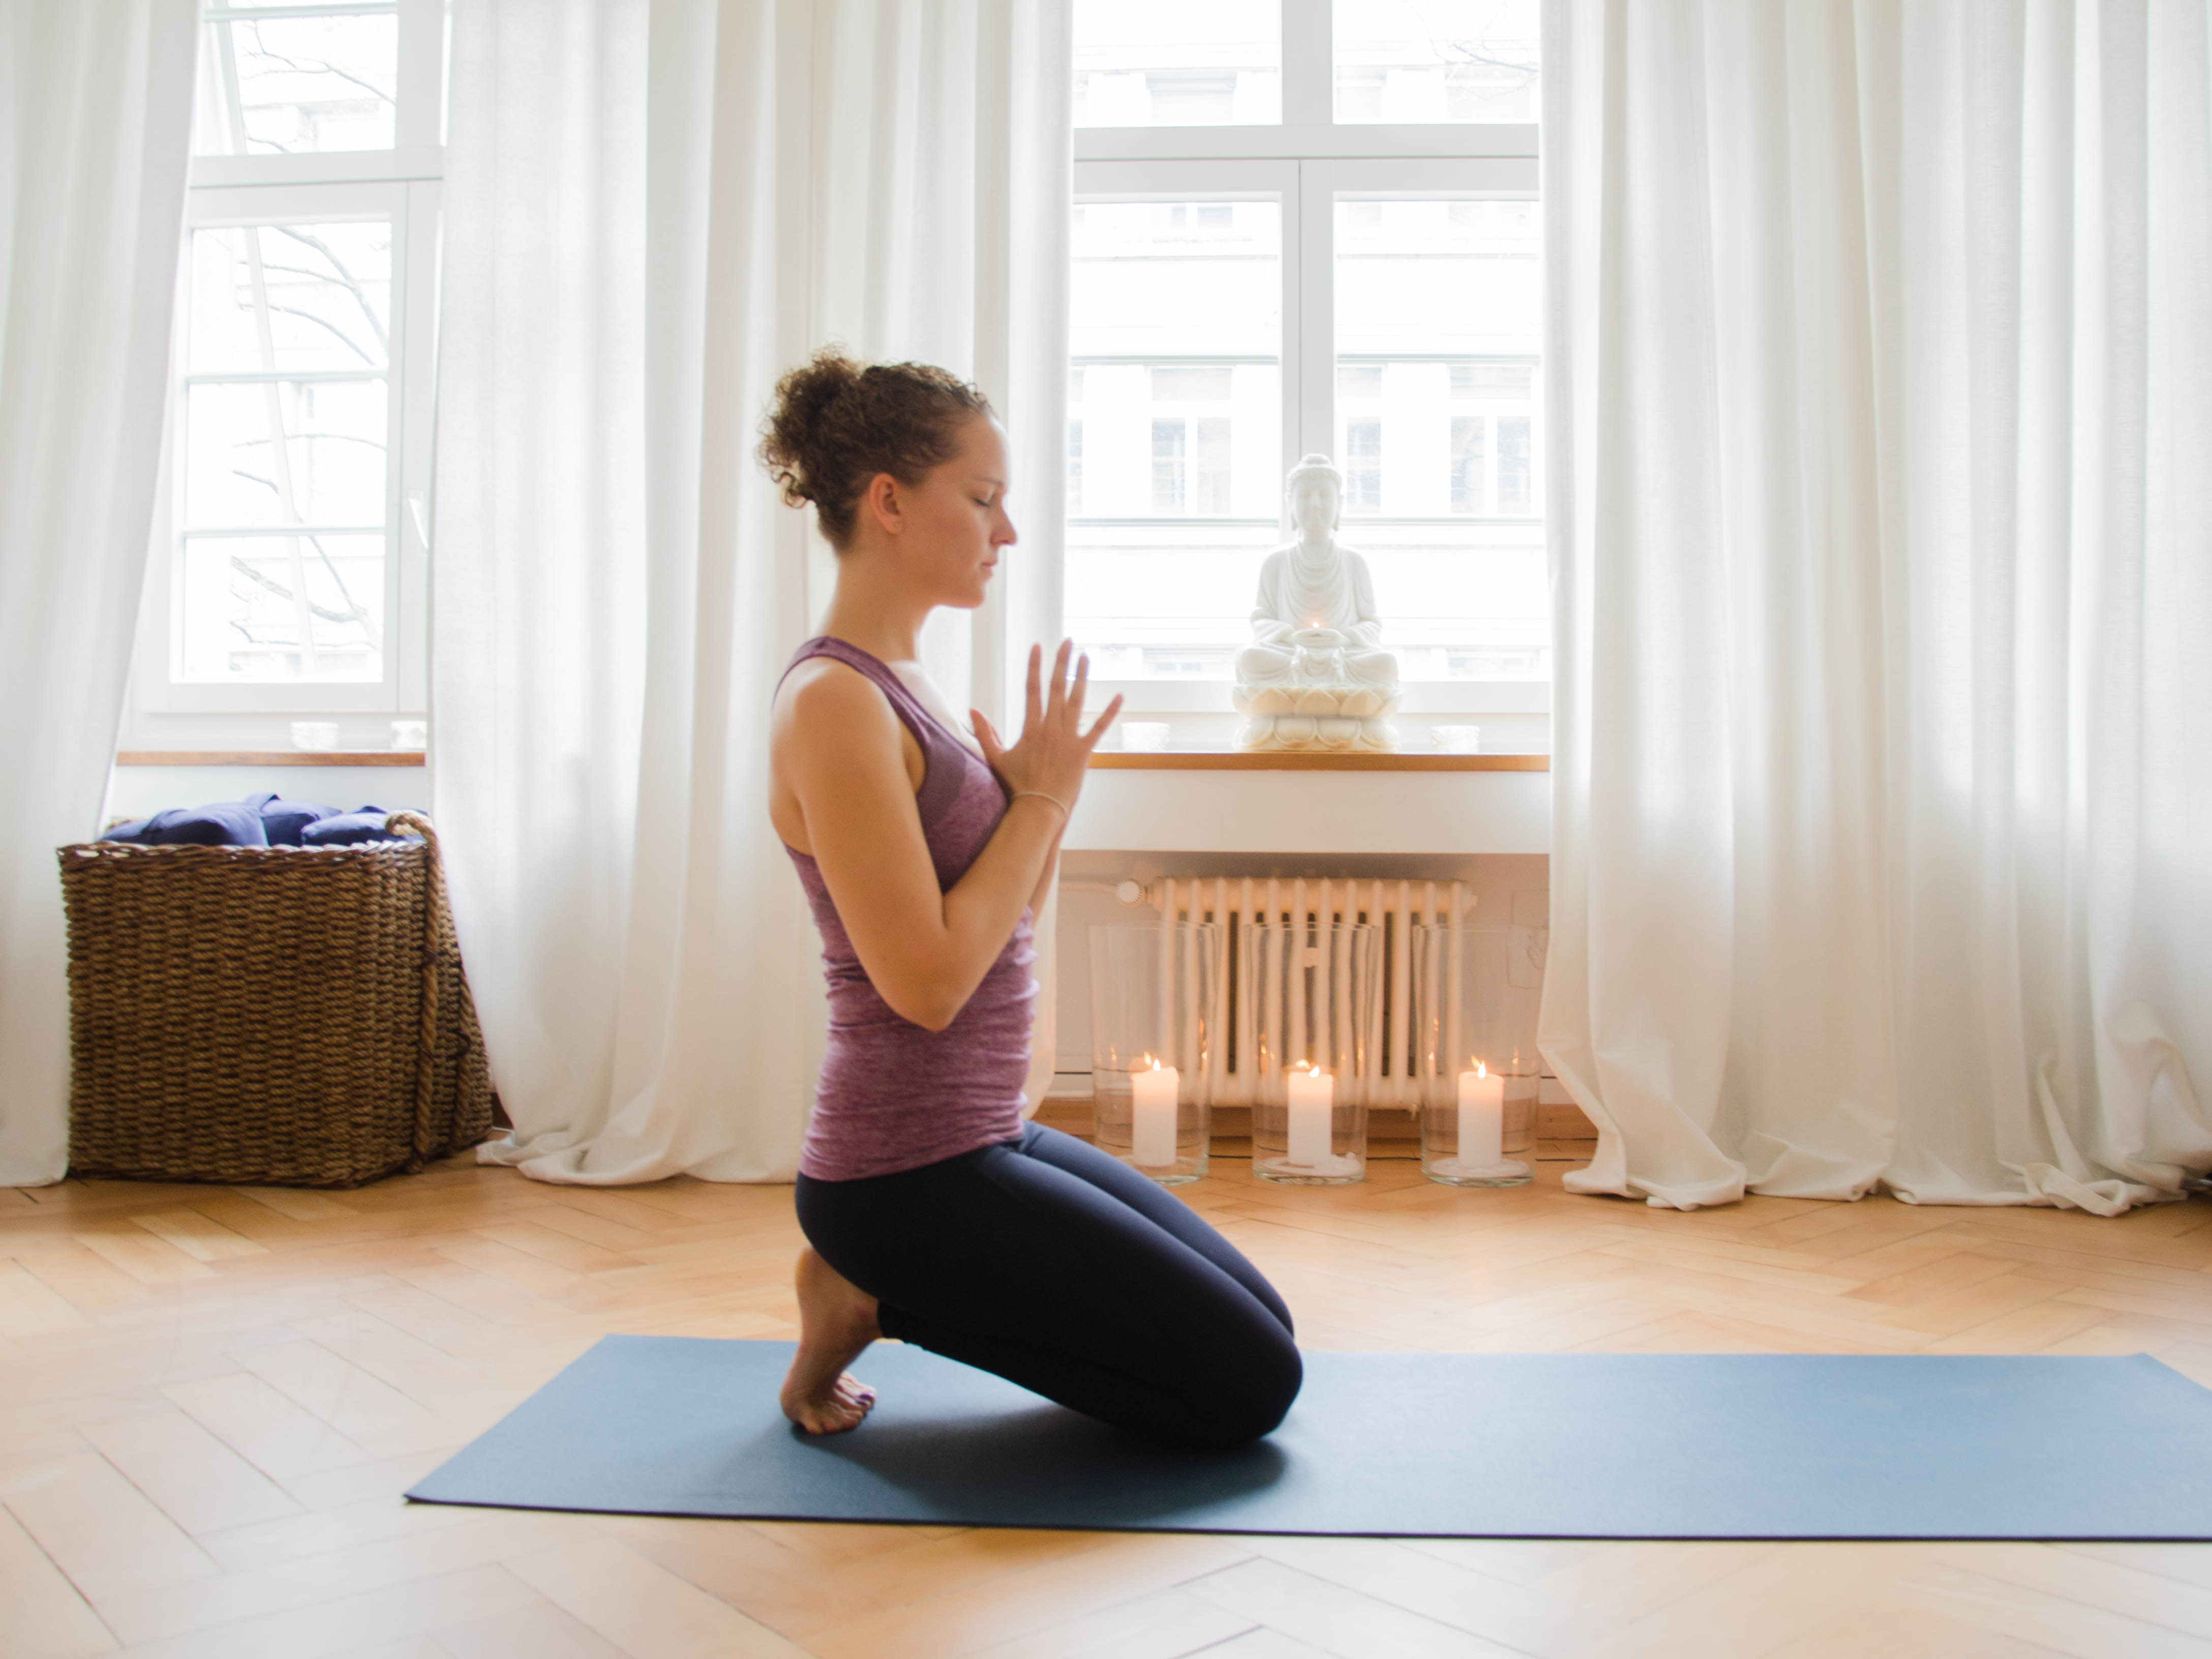
Private Yoga Classes
**********************
4 classes for the price of 3
Would you like to develop a home yoga practice? Do you have a particular yoga pose or series of poses you’d like to work on? Or perhaps you’d just like an opportunity to ask questions and dive deeper into your yoga practice?
Private classes are the perfect way to do this! And this summer Lavender Yoga is offering a private class package to help you really make the most of your yoga practice.
During July to September 2017, if you book 3 private yoga classes you will get the 4th for free!
60 minute package: 360fr (save 120fr)
75 minute package: 450fr (save 150fr)
90 minute package: 540fr (save 180fr)
Offer period: July to September 2017
Location: Let’s discuss! I have options to use studio spaces or we can do it at yours’ or your friend’s home.
Get in touch to book your sessions!
www.lavender.yoga
0789 442 605
zoe_lavender@hotmail.com

