Slide 1


Mission
Our Team
Selz Contracting takes a Lifetime Relationship approach to solving all our client’s construction contracting needs.
We believe in leveraging our knowledge with our network to deliver optimal value for our client’s properties.
Our team of Experts work hard to ensure that you receive the highest quality craftsmanship and customer service.
Headquartered in DFW, Selz Contracting regularly does business with the area’s insurance companies, real estate agencies, and property managers. Our extensive relationships with these companies are built on rapid response times and a top quality customer experience.
Selz Contracting carries an “A+” rating with the BBB.
Green Energy Consultants - Our Green energy consultants find you tax incentives and quantify the added value to your property from implementing green energy.
Building Code Experts - We ALWAYS follow the most recent building codes!
Designers, Architects, and Decorators - Our design professionals help you bring your dream home to life!
Engineers, Public Adjusters and Appraisers – Assist in the claims process to make sure no money is left on the table.
Who Does Our Team Serve?
Property Managers Real Estate Agents & Brokers, Insurance Agents,
Mortgage Loan Officers and Dealers Home Owners, Business Owners
How Do YOU Benefit?
Our construction Professionals work closely with property owners to optimize the property value.
We service both residential and commercial properties for all Interior or Exterior Construction, Remodeling, or Restoration

Slide 2

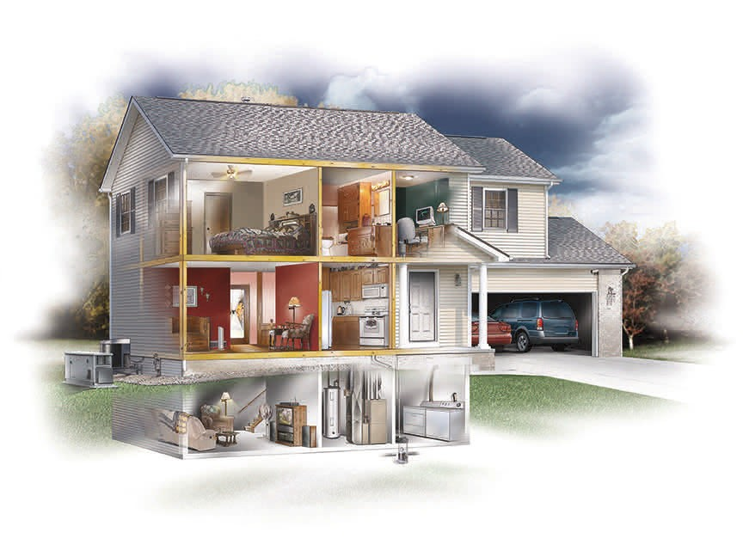
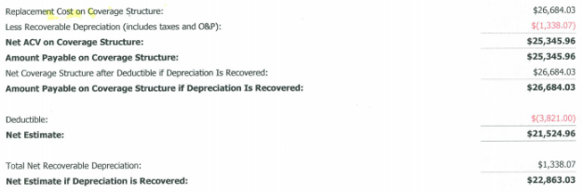
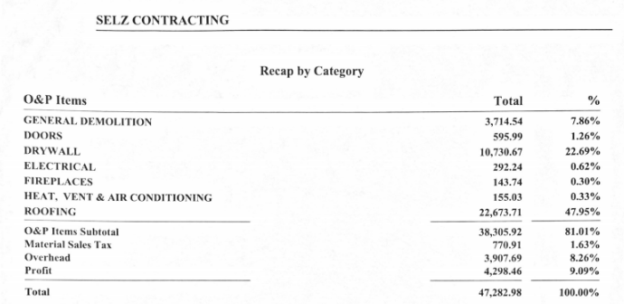
Post-Storm Check-List
Before and After Consultation
Roof, Vents & Skylights
Framing and Insulation
Siding
A/C Unit and Gutters
Vinyl Window Stripping, Screens & Shutters
Drywall, Texture, Paint
Trees & Debris
Flooring
Garage Doors, Carports & Fences
Doors
Porch & Patio
Coverings
Roofing | Siding/Gutters | Windows | Drywall/Painting
Fences | Consulting | Metal Buildings | Retaining Walls
Remodels | Renovations | Floors | Restoration
Concrete Staining | Outdoor Living/Kitchen | Framing/Demo | Custom Glass
Brick/Masonry/Tile | Stucco | Insulation/Radiant Barrier | Garage Doors

Slide 3
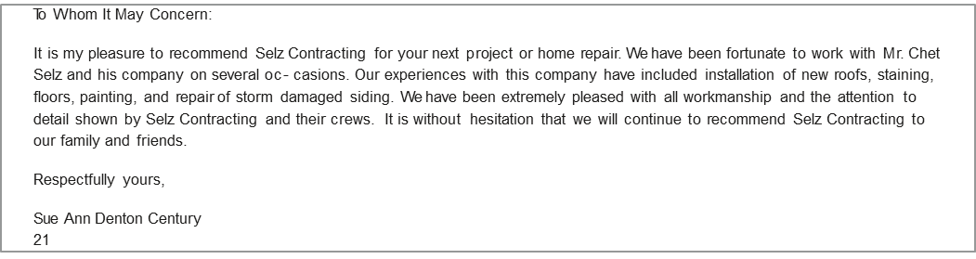
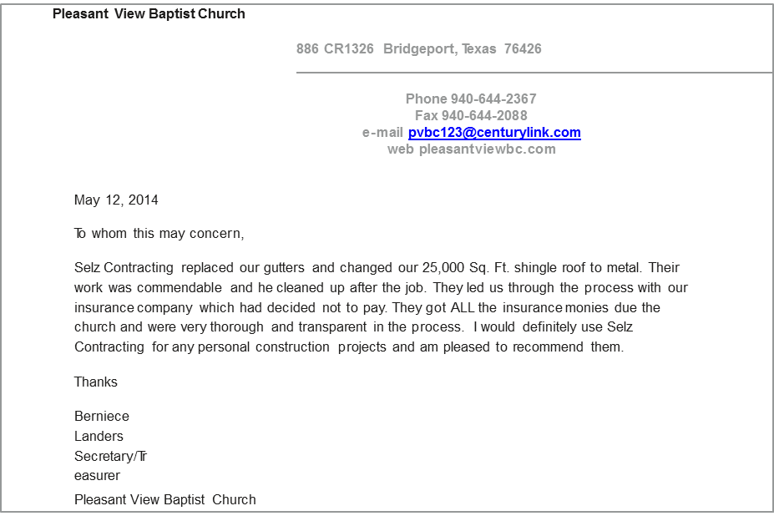
Insured and Bonded
“A Happy Customer is our Goal”
Hi Chet
I want to take a moment to let you know how impressed I am with the hail-damage roof repair job you did at my house in Frisco.
Everything from planning to execution was seamless. No hassle to the family; we barely felt the crew was there; and finished a high quality job in just two days, wow!! A++.
Most notably the honesty and integrity this whole job was conducted in; one cannot find these qualities in this industry anymore these days.
You're definitely on the top of my list now for any future jobs. I'll highly recommend you to all my friends.
Regards, George

Slide 4
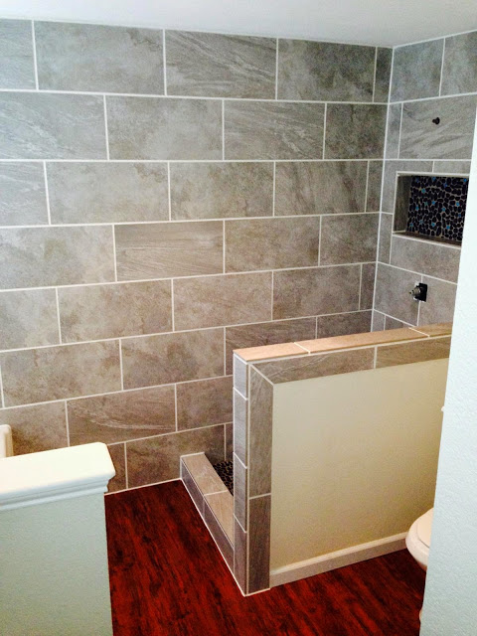
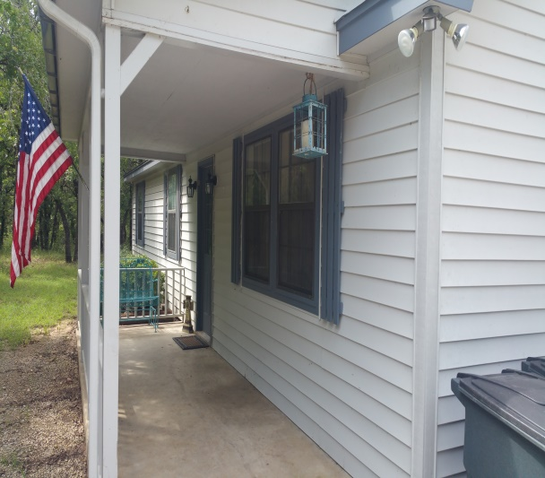
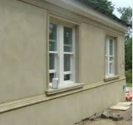
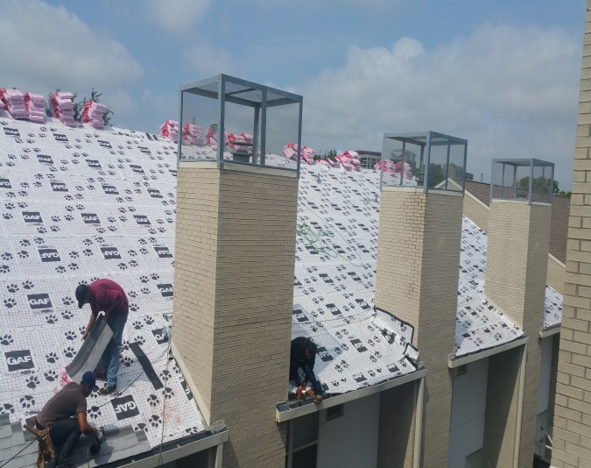
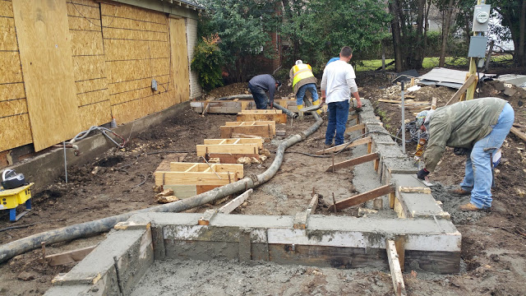
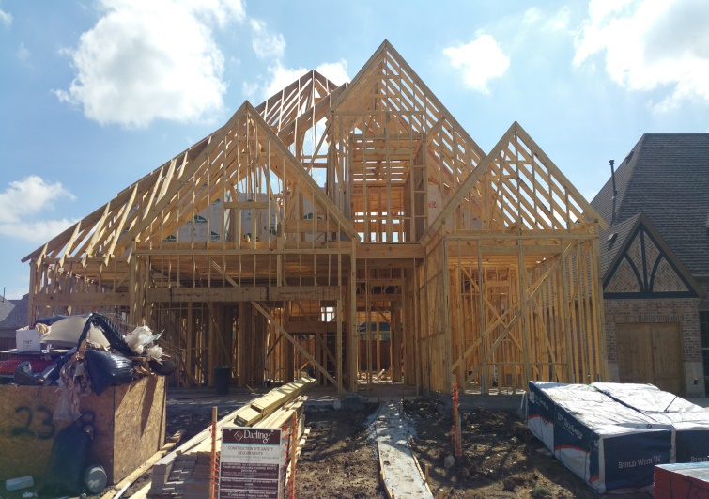
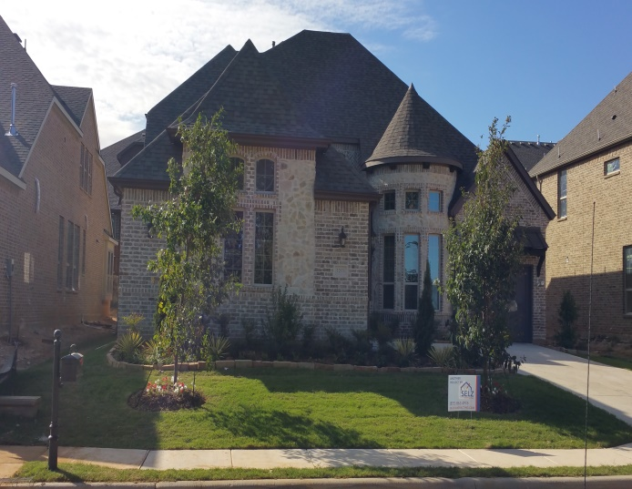
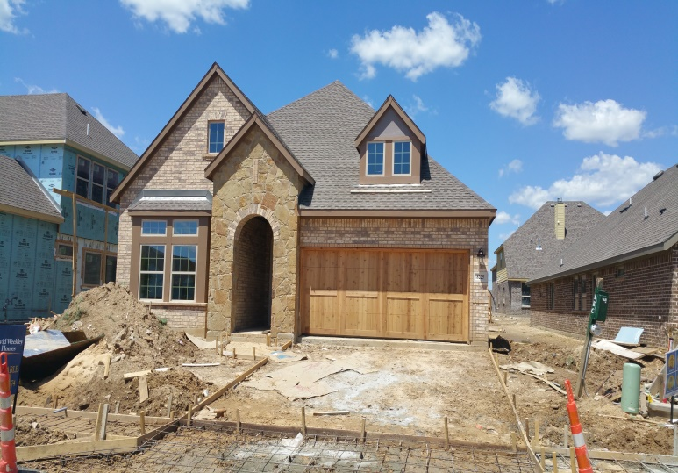
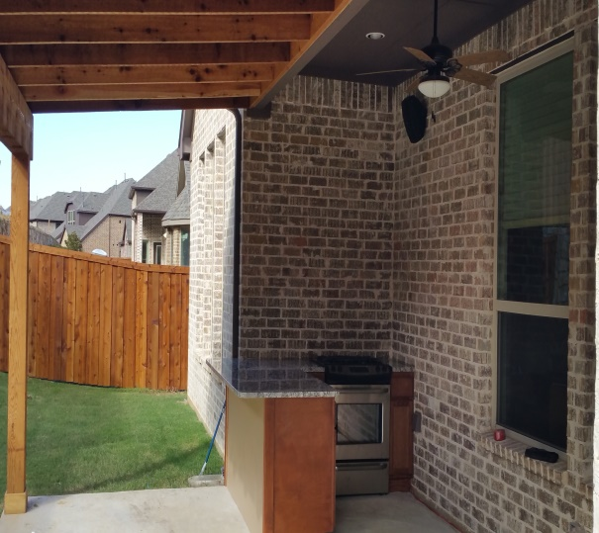
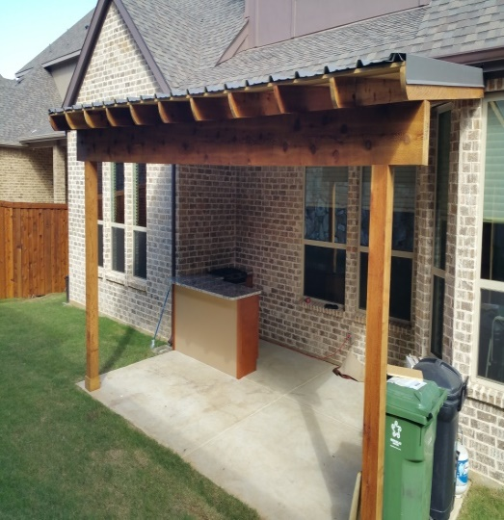
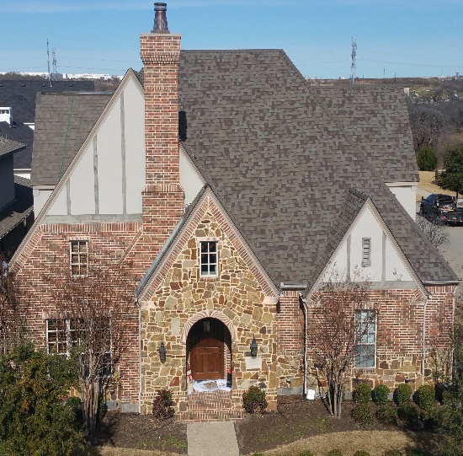
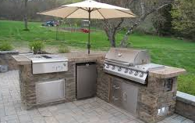
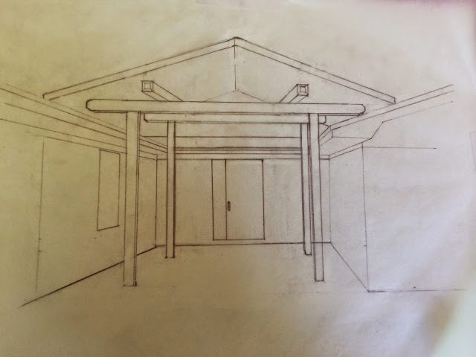
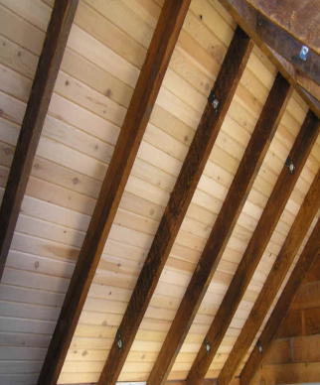
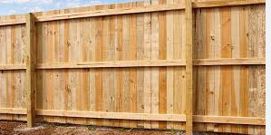
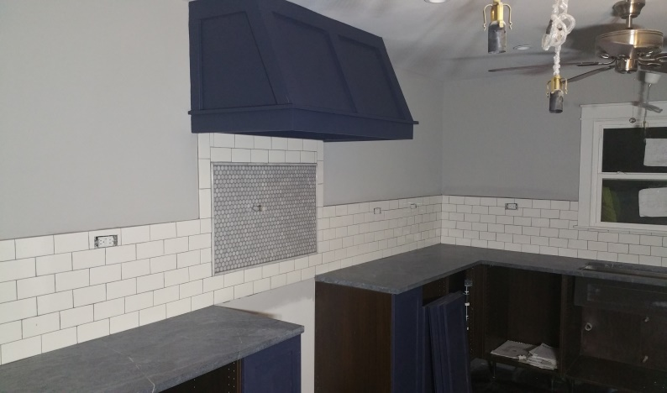
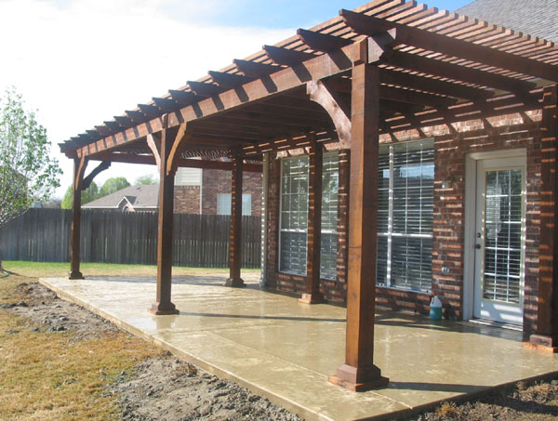
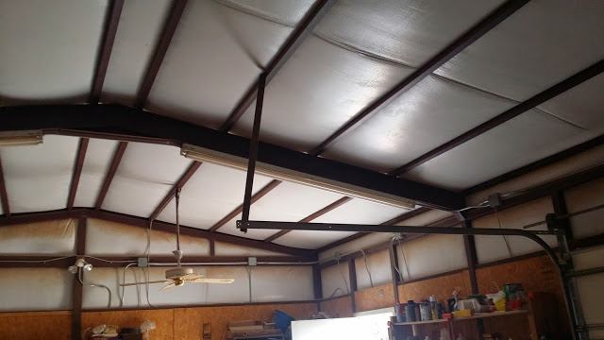
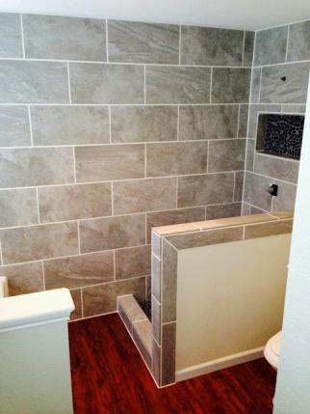
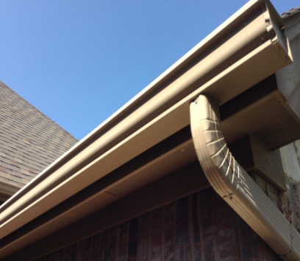
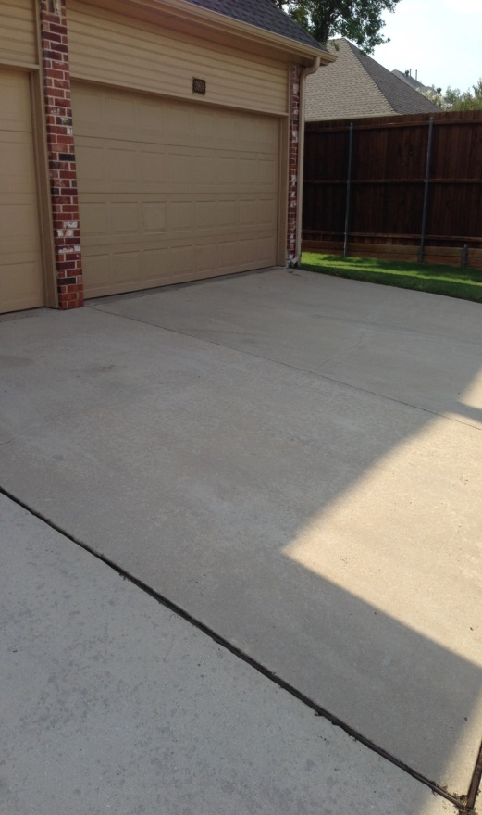
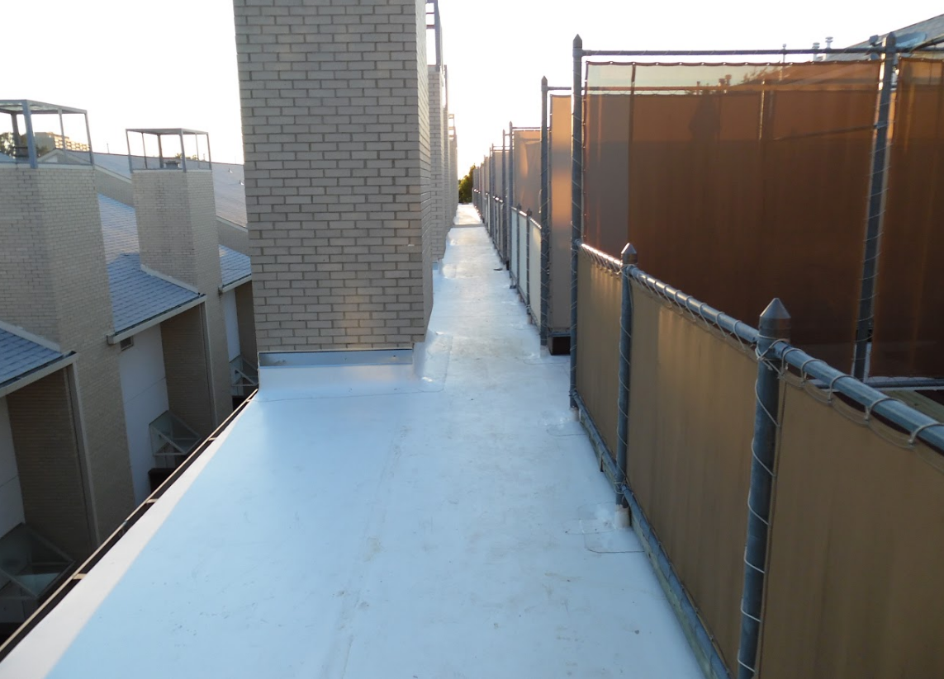
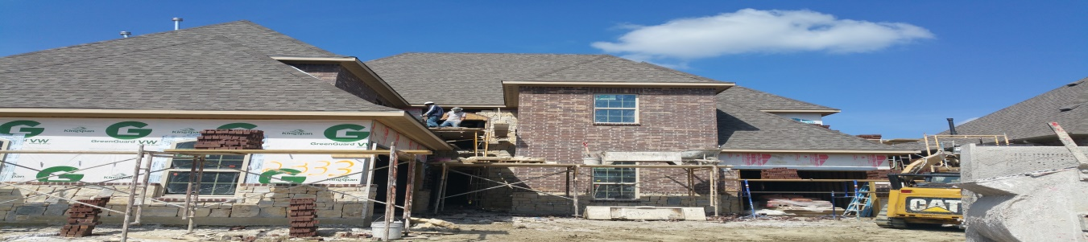
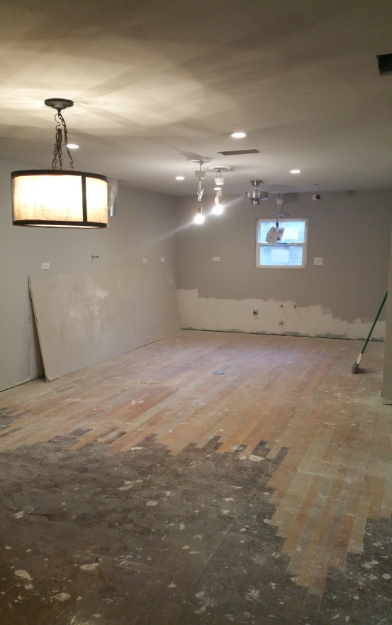
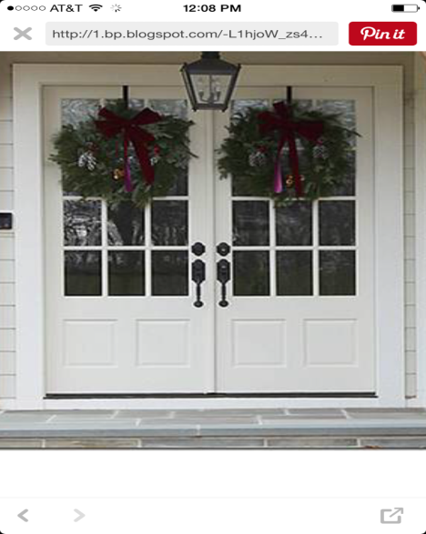
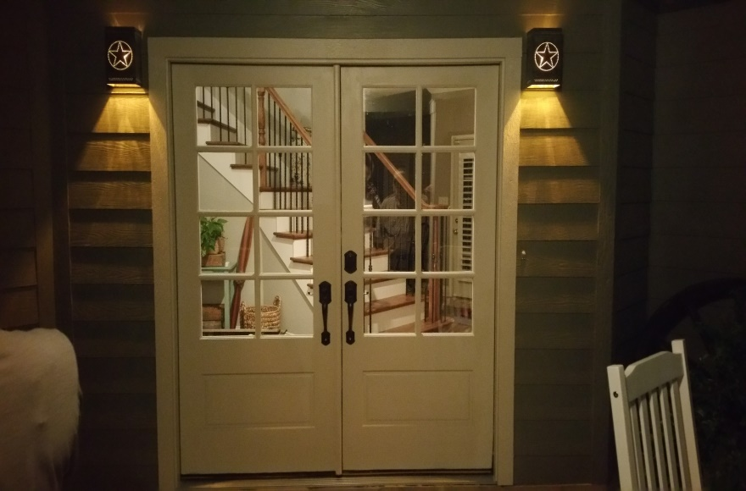
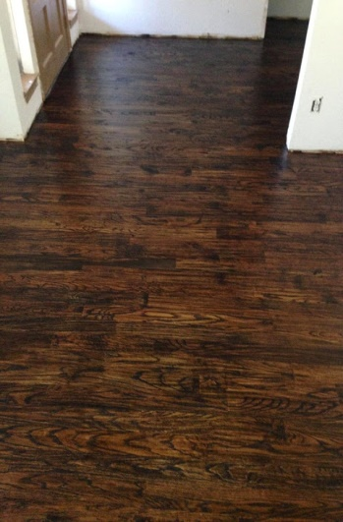
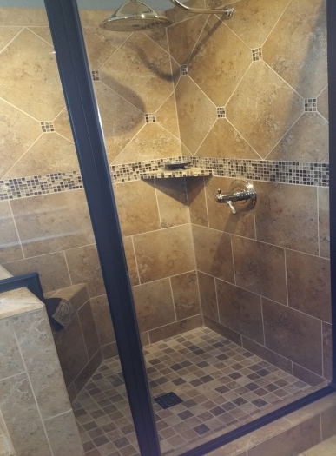

Slide 5
A STEP-BY-STEP GUIDE TO SUCCESSFUL HOME REPAIR
THE INSPECTION PROCESS
Step 1: Inspection
A Construction Consultants will inspect your property for signs of damage.
We use the same inspection and estimating software aa most insurance providers. An Inspection from Selz Contracting includes site visits and photographs by a friendly and knowledgeable Construction Consultant.
The site visit and photographs are documented and included in the Findings Report.
Step 2: Findings Report and Letter of Intent
The Construction Consultant will notify you of his findings.
After the initial inspection, our Construction Consultant will notify you of any damage discovered and give you a personalized Findings Report .
If extensive damage is discovered during the inspection, a Letter of Intent along with a n Insurance Claim should promptly be filed.
The Letter of Intent binds the Customer and Selz Contracting to an agreement allowing Selz Contracting to further Inspect, Estimate and Setup for the project.
The Letter of Intent includes consideration of $1,750 which will be credited towards the final payment for the restoration project.
Note: As a homeowner, you have a contractual duty to your insurance company to inspect and take care of your property in order to mitigate unnecessary damages. Once you are aware of damage to your home, Texas insurance policies only allow you 365 days to file a claim or you forfeit your right to obtain payment from the insurance company.
PRE CONSTRUCTION
Step 3: File an Insurance Claim
If our Construction Consultant notifies you that your home is damaged, file an insurance claim and schedule an adjuster inspection appointment.
If your property has extensive damage, contact your insurance company and schedule an adjuster inspection appointment. If you do not know the number for your insurance company, our Construction Consultant will assist you. Carefully document your claim number, the time of your adjuster appointment, and get your adjuster’s name and phone number.
Caution: Be wary of contractors who attempt to persuade you by writing cheap “bids”or “estimates”on an insurance job.
Bids and estimates from a contractor are not required unless insurance is NOT paying for the damage. Insurance companies will pay you the amount invoiced by the contractor (not to exceed the adjuster’s damage price written in the inspection summary unless there is reasonable cause to supplement.)
Also, avoid contractors who offer to save or reduce your deductible —saving or reducing deductibles for a customer is illegal under Texas law!
Step 4: Schedule a Construction Date and Sign your Contract
Once the insurance assesses the damage and agrees to pay the claim, schedule a date for construction and sign your contract
Once the insurance company agrees to pay the claim, we will work diligently to schedule the construction on a day that is convenient for you. If the insurance does not agree to pay for the claim, we will give you a cash price repair estimate.
After a construction date is set, our Construction Consultant will review your personalized contract and construction details.
ACCREDITED BUSINESS
®
A+ RATED

Slide 6
PAYMENT INFORMATION
CONSTRUCTION DAY AND FINAL PAYMENT
Step 5: Initial Payment
Collect the initial check from your insurance company and make your down payment
Step 6: Construction Day
Sit back and relax!
After the insurance company agrees to pay for the claim, they will send you the first check, which is only a portion of the full cost. This check, like all checks from insurance, must be paid to Selz Contracting before construction on your home begins
Keeping this check and not repairing your home will:
Forfeit your right to obtaining full payment from your insurance
Violate your contract
Make your insurance useless
Possibly cause your mortgage company to initiate foreclosure
Once we have received the first payment, construction will begin on the scheduled date. Your Construction Consultant will be available to answer any questions or discuss any concerns you may have.
Once the roof is finished workers will perform clean up and your Construction Consultant will perform a final inspection and collect the deductible immediately upon your approval.
We take all the proper safety measures to ensure that your home and property are protected and respected throughout construction, and we take pride in pleasing our customers and restoring homes to like-newcondition (or better). We are fully prepared for any situation and glad to have your business.
Insurance companies use three important terms during the claims payment process:
Actual cost value (ACV)
Replacement cost value (RCV)
Deductible
Step 7: Final Invoice and Final Insurance Payment
After construction is completed and approved, we will send you a final invoice. Your insurance carrier should send you a check for the same final amount. Once we have received final payment, your No Questions Asked Warranty begins!
-Replacement Cost Value (RCV) is the full value of replacing your damage property, regardless of the property’s age. For example, a 20-year roof that costs $20,000 but is 10 years old will simply have a replacement cost value of $20,000.
Actual Cost Value (ACV) is the full value of your home or the damaged property minus the age depreciation. For example, a 20-year roof that costs $20,000 but is 10 years old will have an ACV of $10,000 ($20,000 -$10,000 = $10,000).
POST CONSTRUCTION
-The Deductible is your share of the damage amount you are required, by law, to pay out of pocket to the contractor in order to have your property restored. The deductible is usually 1% of the insured value of your home (a $100,000 home will have a deductible of $1,000) but this depends on the area and the policy. Remember, avoid contractors that attempt to pay or “absorb” your deductible. Such an act is illegal for both the homeowner and the contractor!
Step 8: Keep in Touch!
Congratulations! At this point, you are the proud owner of a completely restored property! Although our construction job is complete, we like to stay in touch with faithful customers. If you have any, questions or concerns, do not hesitate to call us. We are here for you!
Your payment from the insurance company will depend on the type of policy you own. Most homeowners have a policy that pays the replacement cost value, or the full cost of restoring the property to like-new conditions. Your first check will be the actual cost value (full value of the damaged property depreciated for age) minus your lawfully required deductible.
Your Construction Consultant will provide you with a brief satisfaction survey. Complete this survey and return it to your Consultant to receive referral rewards (see consultant for details). If you would like to rate your experience with us, we invite you to review Selz Contracting on any major review site (Angie’s List, Yelp, Google, Facebook, etc.)
We would love to hear from you!

