Slide 1


Flattened, with back side de-emphasized graphically… as below
The forward portion would be out menu of points on the time line for them to dive into commentary and projects done in each point???

Slide 2
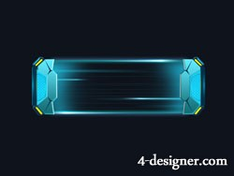



Button features… for the button portions of the infinity graphic…
Responsive animated buttons glow bright when activated, dull blue when inactive
http://btools.weebly.com/page-of-buttons.html

