Slide 1
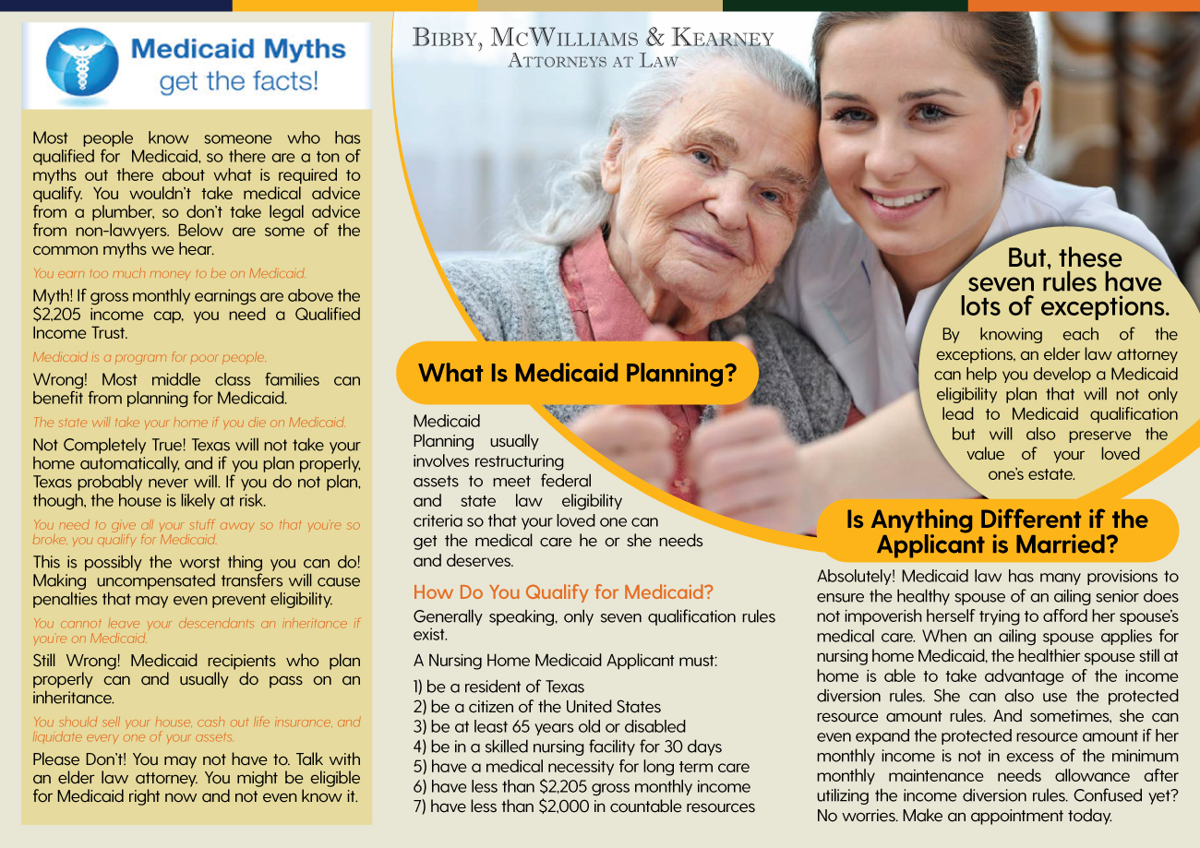
Can the white background on this image match the beige color below?
Make font stand out, either bold or a darker color. Cannot read it as it is.
Rotate the copy and headings, so that where “What is Medicaid Planning” section is where “But, these seven rules …” currently is, and so forth

Slide 2
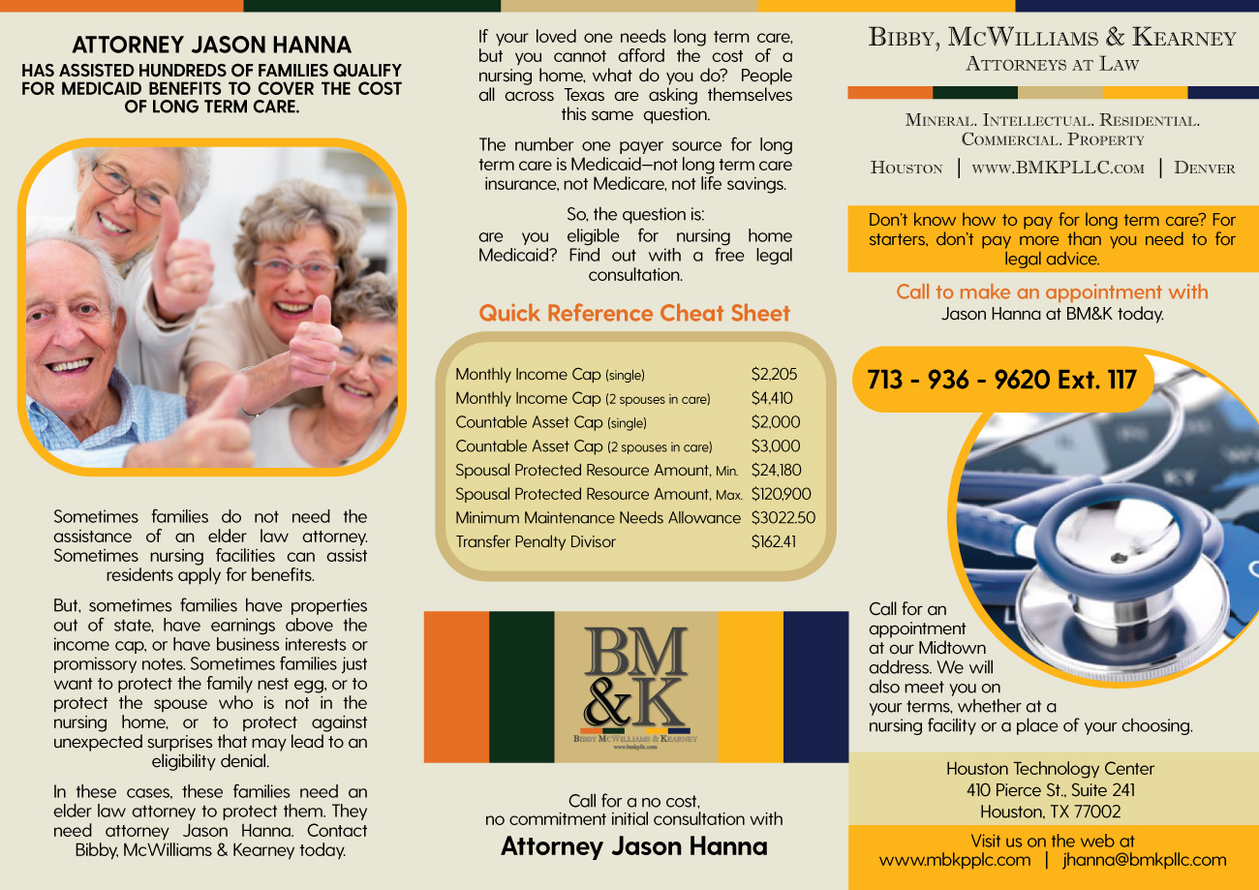

Remove word “Attorney”
Left justify all these paragraphs too
Correct to: “$3,022.50”
Left justify these paragraphs
Add photo to the left, balance size, position, etc. with BM&K logo on the right
Remove color banner
Remove word “Attorney”
Correct to: “www.BMKPLLC.com”

